Slide 1
Smart Collectorate
Taking a District Magistrate's office from paper files to an AI-enabled workflow, and getting people to use it
Pulse Rajan · Applied AI Engineer assessment · Creditfix Group · November 2026
Notes:
Open with the one-line promise: every application gets a number, reaches the right desk on day one, and the DM sees every delay on one screen.

Slide 2
The problem: district backlogs are growing
1 crore+
157 → 15
82.1%
2.16 lakh
grievances on CPGRAMS in the last five years
days to dispose, central ministries, 2014 → 2025
closed within the 21-day target in 2025, so about 1 in 5 is late
pending with States/UTs (June 2026), up ~26% since Dec 2025
In a typical district office (our working assumptions, measured in discovery)
~4,000 grievances and applications a month, ~30 days to dispose, 1 in 3 citizens come back only to ask for status
Paper files and registers, follow-ups on phone and WhatsApp, no single owner per step, no live view for the DM
Sources: DARPG CPGRAMS monthly reports (PIB, 2026); Lok Sabha replies as reported by ThePrint and All India Radio News (2025–26); data.gov.in.
Notes:
The top row is real, published government data. With tracking and monitoring, central ministries went from 157 days to 15. But one in five is still late, and state-level pending grew by a quarter in six months. The bottom box is our assumption for one district; discovery replaces it with the office's own numbers, which become the pilot baseline.

Slide 3


A. Discovery: map the workflow with its people
Citizen
applies
Inward
register
DM / ADM
marks
Department
section
Field
verification
Report and
disposal
Citizen
informed
Hand-written, no tracking number
File waits in a tray
Reports by phone / WhatsApp
Often never told
Who we talk to (25–30 interviews)
Assumptions we check, and how
DM, ADM, SDMs: which three numbers do you want every Monday?
Clerks and inward desk: walk me through one file
Field staff: how do reports reach you and go back?
Citizens at the gate: how many visits did this take?
Mostly paper, mostly Hindi → count one month of the register
~10 categories cover 70% → hand-tag 300 past cases
Data stays in India → confirm with NIC
CPGRAMS / IGRS stays the system of record → check API access
2–3 weeks · trace 50 real files with dates at every hand-off · rank steps by delay × volume
Notes:
Red steps are where delays usually happen in a Collectorate. Tracing 50 real files proves or disproves this. The top three steps by delay times volume become the pilot targets. Every assumption has a cheap check in the first three weeks.

Slide 4
B. Seven use cases, and where AI is really needed
# | Use case | Why it matters | AI or rules? | Phase
1 | Grievance intake and smart routing | Right department on day one; reads Hindi/English free text | AI | Pilot
2 | QR code tracking on every file | No lost files; anyone can see who holds a file now | Rules | Pilot
3 | SLA reminders and escalation | Files stop waiting in trays unnoticed | Rules | Pilot
4 | Live dashboard for the DM | Backlog and overdue cases by department, today | Rules | Pilot
5 | WhatsApp helpline (Hindi / English) | File and check status without visiting | AI | Rollout
6 | Weekly review-meeting reports | Minutes instead of two days of compiling | Rules + AI | Rollout
7 | AI assistant for officers | Summarise files, draft replies, find past orders | AI | Scale
Our rule: AI only where the input is messy language. Tracking, deadlines, alerts and dashboards are plain rules: cheaper, predictable, auditable. AI suggests; a person decides.
Notes:
Picked by citizen pain times volume times speed to go live. In the pilot only number 1 uses AI; numbers 2 to 4 are plain software and deliver most early value. That keeps the pilot low-risk.

Slide 5






Architecture, and one grievance start to finish
Channels
Backend and workflow
AI layer
Integrations
Web portal and kiosk
WhatsApp helpline
SMS / phone (IVR)
Counter entry by clerk
Field staff mobile app
Case lifecycle and routing
SLA timers and escalation
SMS / WhatsApp notifications
LLM: classify, summarise, draft
Bhashini: translation, speech
Masking, confidence check, logs
CPGRAMS / IGRS
e-Office
DigiLocker
Data
Dashboards
PostgreSQL · document storage · tamper-proof audit log
DM · officer · clerk
1. Citizen files
2. Gets a number
3. AI suggests
4. Officer acts
5. Reminders
6. Closed
Any channel, Hindi or English
Tracking ID by SMS
Unsure? A clerk confirms
Sees summary and deadline
At 50% and 90%, then ADM
Citizen told and rates it
Notes:
Several ways in, one system. The core is a standard web backend and PostgreSQL. The AI layer sits to one side behind guardrails, so it can be switched off and the office still works. Hosted in India on NIC or a MeitY-empanelled cloud. The bottom row is the citizen's journey; step 3 is the only AI step, with a human check when the AI is unsure.

Slide 6
C. Roadmap: zero to district-wide in 12 months
Discovery
Pilot
Rollout
Scale
Support
Weeks 1–3
Weeks 4–14
Months 4–6
Months 7–12
Ongoing
Workflow map, baseline
Use cases signed off
2 departments, 1 tehsil
Use cases 1–4 live
4 weeks parallel with paper
Whole district
WhatsApp helpline
Weekly reports
Officer AI assistant
Field app, integrations
Helpdesk and fixes
Monthly AI review
Team: Lead, AI engineer, UX researcher
Team: Lead, 2 devs, AI engineer, QA, trainer
Team: Pilot team + 1 dev, 2 trainers
Team: 2 devs, AI engineer, QA, DevOps
Team: Support engineer, helpdesk
~8 person-weeks
~45 person-weeks
~70 person-weeks
~80 person-weeks
~1.5 people
Go / no-go at week 14: we scale only if the pilot targets are met. Office side: one nodal officer (~20% time) and a champion clerk per department.
Notes:
The pilot is deliberately small: two high-volume departments such as Revenue and Food and Civil Supplies, in one tehsil. Paper continues in parallel for four weeks. Effort figures are rough estimates to show scale, not a quote.

Slide 7
What a successful pilot looks like
−40%
−30%
≥ 85%
average time to dispose of a case
backlog older than 30 days
AI routing accuracy (confirmed by officers)
≥ 80%
≥ 4 / 5
0
of officers using it every week
citizen rating of the service
lost files in pilot departments
All measured against the discovery baseline, for the same departments, after 10 weeks live.
Notes:
Every metric comes from the system's own data, except citizen rating, which is a one-question SMS. Officer adoption matters as much as speed.

Slide 8



D. Risks, and how we control them
Citizen data
AI mistakes
System and vendor
Staff adoption
DPDP Act 2023: collect only what is needed
Hosted in India (NIC / approved cloud)
Encrypted, role-based OTP login, full audit log
Aadhaar and phone masked before any AI call
AI suggests, an officer decides
Under 70% confidence → a person checks
Fixed department list; AI cannot invent one
Accuracy and bias reviewed monthly
AI down → routing falls back to the clerk
Daily backups; works on slow connections
CERT-In empanelled security audit
Open source; data exportable any time
Hindi first, fewer steps than the register
A champion clerk in each department
30-min desk-side training; paper kept 4 weeks
DM reviews from the dashboard in meetings
Notes:
The most important control is the human check: the AI never closes or rejects a case. On adoption, the last point matters most: staff keep the system updated when the DM reviews from it.

Slide 9

E. The pitch, the objections, and the price
In ten weeks, in two departments, every application gets a tracking number and reaches the right desk on day one, and you see every delayed file on one screen. Your staff still decide. Data stays in India. If delays don't fall by a third, you don't pay for the next phase.
“We already have a system.” We fill gaps around CPGRAMS and e-Office, and feed data back.
“It is not secure.” India hosting, OTP login, audit log, security audit.
“Staff won't use it.” Hindi, fewer steps, champions; usage tracked weekly.
Pilot · 10–12 weeks
Rollout · Module by module
Support · Yearly
₹5–8 lakh
₹20–30 lakh
15–20% / yr
Fixed fee, 2 departments; next phase only if targets are met
Whole district, bought through GeM
Of build cost: hosting, helpdesk, AI monitoring, training
Indicative figures, firmed up after discovery. Discovery can be free, to earn trust.
Notes:
Say the pitch word for word: it names the problem, promises something measurable, addresses control and safety, and removes the risk. Each objection is answered by agreeing first, then something concrete. Government is a careful buyer, so the first step is small and the risk sits with us.

Slide 10
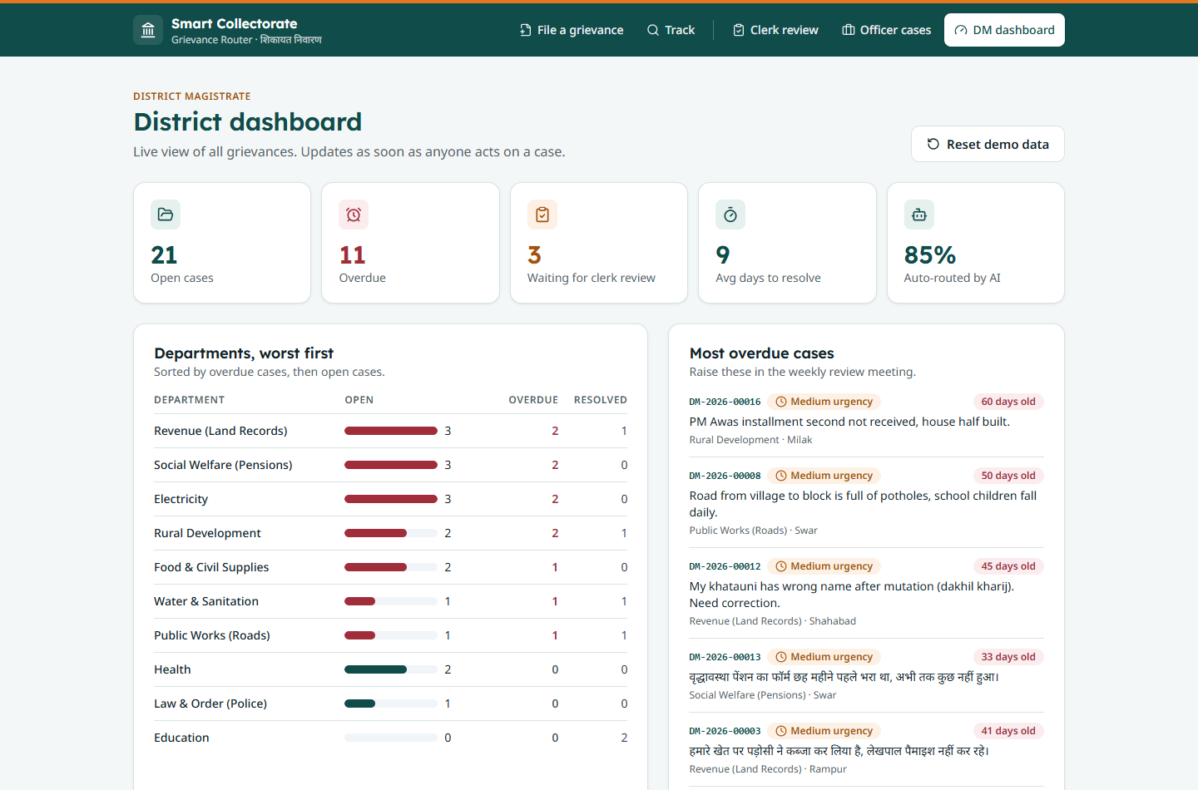
F. Working proof: AI grievance router, live
Complaint in Hindi, English or a mix; phone and Aadhaar masked before the AI sees it
AI suggests department, urgency and a summary, with a confidence score
Under 70% confidence → clerk review queue; every decision logged
Tracking ID, deadline clock, DM dashboard of overdue cases
20 test cases: Claude Sonnet 100% correct, keyword backup 90%, 0 wrongly routed
Live: smart-collectorate-grievance-router.vercel.app
Code: github.com/easycodewithme/Assignemnt-Automation
Next steps: 1. Approve a 3-week discovery (no cost) 2. Name a nodal officer and two pilot departments 3. Agree targets and the go / no-go date
Notes:
Show the live demo: one Hindi complaint, one English, and one vague one landing in the review queue. That proves the human check works. Then end with the small, concrete ask. Thank you, questions welcome.

