Slide 1
OpenGL Programming Guide
Chap 10, Geometry Shader
Yifei Huang

Slide 2

A Complete OpenGL Pipelines
OpenGL 4.3
Vertex Data
Vertex Shader
Primitive Setup
Clipping
Rasterization
Fragment Shader
Blending
Tessellation Control Shader
Tessellation Evaluation Shader
Geometry Shader
Pixel Data
Texture Store
Notes:
我们这边介绍的是 OpenGL 4.X pipeline。 以前用的固定管线，而现在用的是dynamic tessellation
4.3 对4.1 之后有了一些新的功能，但是在shading 的步骤上是相同的。
几何着色器 （Geometry shader）允许在光栅化之前对每个几何图元做进一步操作，比如创建新的图元。
在 setup 之前我们处理的都是顶点数据，setup 阶段会把定点与几何图元之间组织起来，准备下一步剪切。
剪切就是吧 在view point 之外的定点处理掉。 Clipping。OpenGL 自动完成。
光栅化就是生成片元，也就是像素，定点之间的像素是通过插值完成的。
最后会有一个blending 和 zcull 的处理（判断是否可见。有没有被挡住）。

Slide 3
Behavior of geometry shader
Vertex Shader
Primitive Setup
Clipping
Rasterization
For each vertex shader, it will receive one vertex each
Tessellation Shader
Geometry Shader
Geometry shader can :
discard a primitive,
update the primitive,
generate new primitives
(with different primitive types)
For each geometry shader program,
it will receive a complete primitives,
Which a collection of vertices (array format)

Slide 4
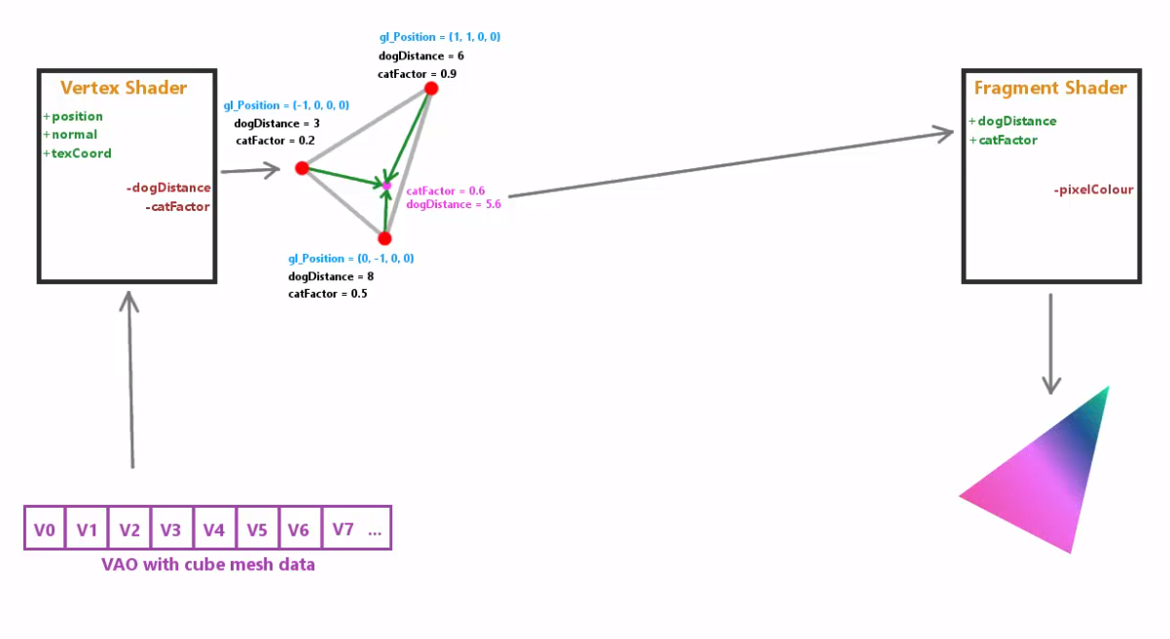
OpenGL PipeLine without geometry shader

Slide 5
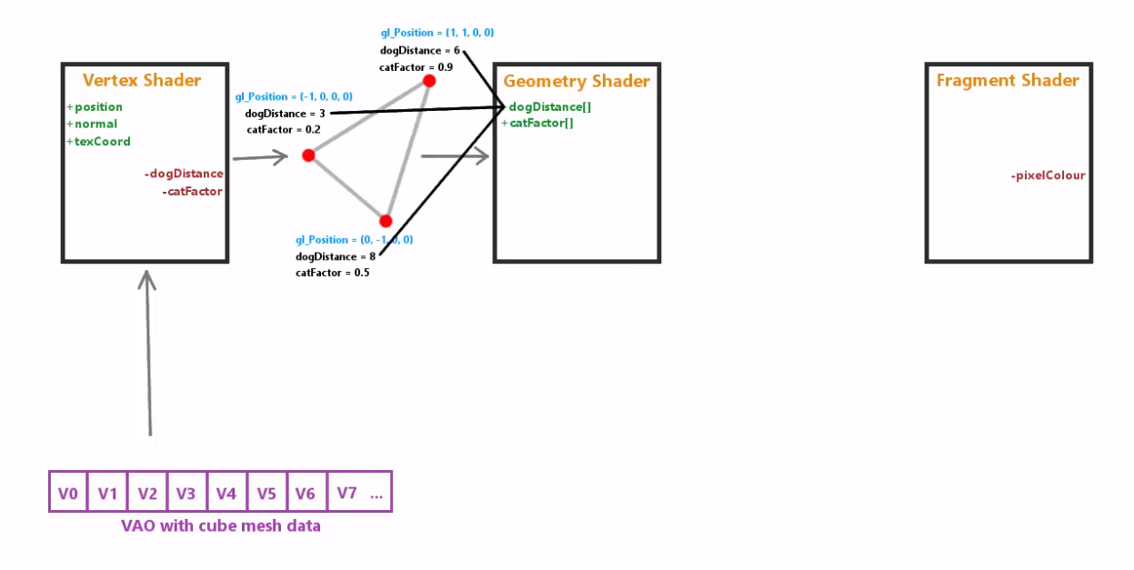
Geometry shader:
Processing a primitive, not only one vertex

Slide 6
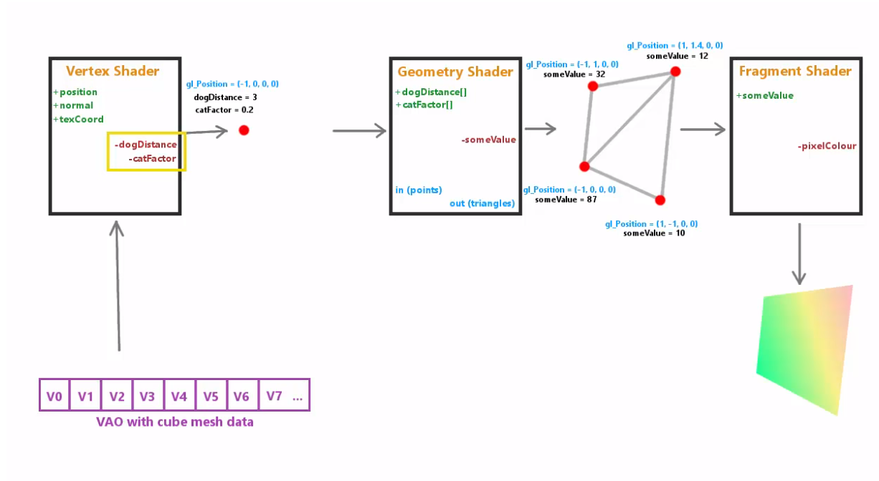
A geometry shader can:
Update the primitive attribute
Change primitive types
Discard primitive
Add new primitive
But only one type primitive output

Slide 7
Life of a geometry shader
Create Program
glCreateProgram()
Shaders need to be compiled and linked to form an executable shader program
OpenGL provides the compiler and linker
A program must contain
vertex and fragment shaders
Geometry shader and other shaders are optional
Create Shader
glCreateShader()
These steps need to be repeated for each type of shader in the shader program
Load Shader Source
glShaderSource()
Compile Shader
glCompileShader()
Attach Shader to Program
glAttachShader()
Link Program
glLinkProgram()
GL_GEOMETRY_SHADER
Use Program
glUseProgram()
Notes:
Shaders need to be compiled in order to be used in your program. As compared to C programs, the compiler and linker are implemented in the OpenGL driver, and accessible through function calls from within your program. The diagram illustrates the steps required to compile and link each type of shader into your shader program. A program can contain either a vertex shader (which replaces the fixed-function vertex processing), a fragment shader (which replaces the fragment coloring stages), or both. If a shader isn’t present for a particular stage, the fixed-function part of the pipeline is used in its place.
Just a with regular programs, a syntax error from the compilation stage, or a missing symbol from the linker stage could prevent the successful generation of an executable program. There are routines for verifying the results of the compilation and link stages of the compilation process, but are not shown here. Instead, we’ve provided a routine that makes this process much simpler, as demonstrated on the next slide.

Slide 8
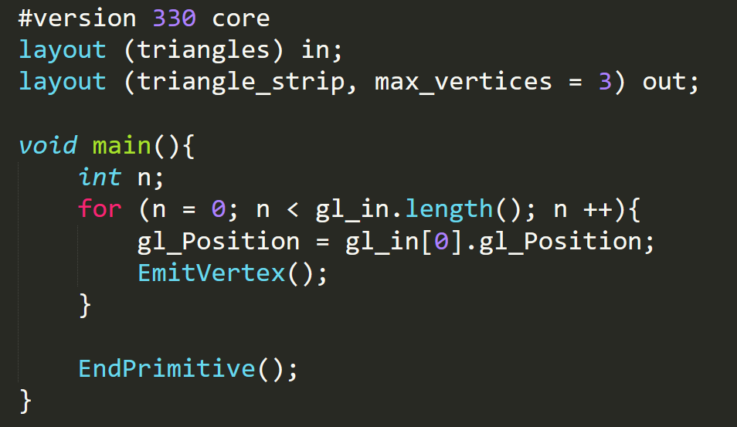
Example: Input
in gl_PerVertex{
vec4 gl_Position;
float gl_PointSize;
float gl_ClipDistance[];
gloat gl_CullDistance[];
} gl_in[];
input primitives:
Triangles, each geometry will handle a triangle, e.g., 3 vertices
gl_in.length() ==3

Slide 9
Input Primitive for a geometry shader
Points:
GL_POINTS, GL_PATCHES
Lines:
GL_LINES, GL_LINE_STRIP, GL_LINE_LOOP, GL_PATCHES
Triangles:
GL_TRIANGLES, GL_TRIANGLE_STRIP, GL_TRIANGLE_FAN, GL_TRIANGLE_PATCHS
Lines adjacency:
GL_LINES_ADJACENCY, GL_LINE_STRIP_ADJACENCY
Triangles adjacency:
GL_TRIANGLES_ADJANCENCY, GL_TRIANGLE_STRIP_ADJANCENCY

Slide 10


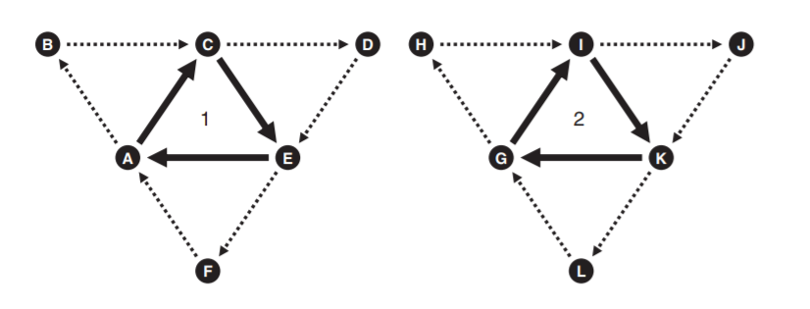
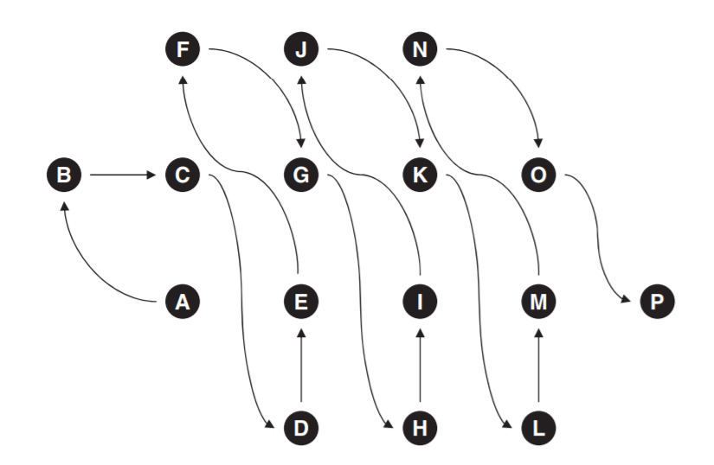
Lines_adjacency, triangles_adjacency
Lines_adjacency, line_strip_adjancency
triangles_strip_adjacency
triangles_adjacency

Slide 11
Output
Output:
Triangle_strip (triangles)
What will be emitted?
Emit a vertex
by calling EmitVertex()
What’s in the vertex?
gl_Position
think about vertex shader
What primitive will be output?
3 vertices make a triangle
Why use triangle_strip, not triangles?
Regard a triangle as a special triangle_strip.
GS support output type as:
Points, line_strip, triangle_strip
No line, no triangle
What if I emit only 2 vertices?
This primitive will be discarded.
End current primitive
Notes:
What will geometry shader do?
Nothing, just pass through vertices position

Slide 12
Vertex shader output ➔ geometry shader input
gl_in
Input Block from vertex shader
Mapped by block name, e.g., VS_GS_INTERFACE here
gl_PrimitiveIDIn, gl_InvocationID
Equivalent to gl_PrimitiveID in vertex shader
out VS_GS_INTERFACE{
out vec4 position;
out vec3 normal;
out vec4 color;
out vec2 tex_coord[4];
}
in VS_GS_INTERFACE{
in vec4 position;
in vec3 normal;
in vec4 color;
in vec2 tex_coord[4];
}
in gl_PerVertex{
vec4 gl_Position;
float gl_PointSize;
float gl_ClipDistance[];
gloat gl_CullDistance[];
} gl_in[];

Slide 13
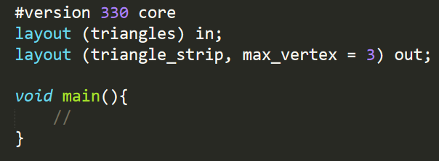
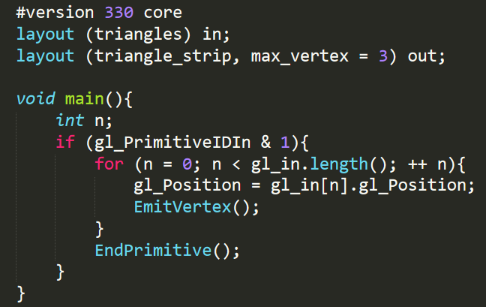
A geometry shader can:
Discard all
Filter half triangles

Slide 14
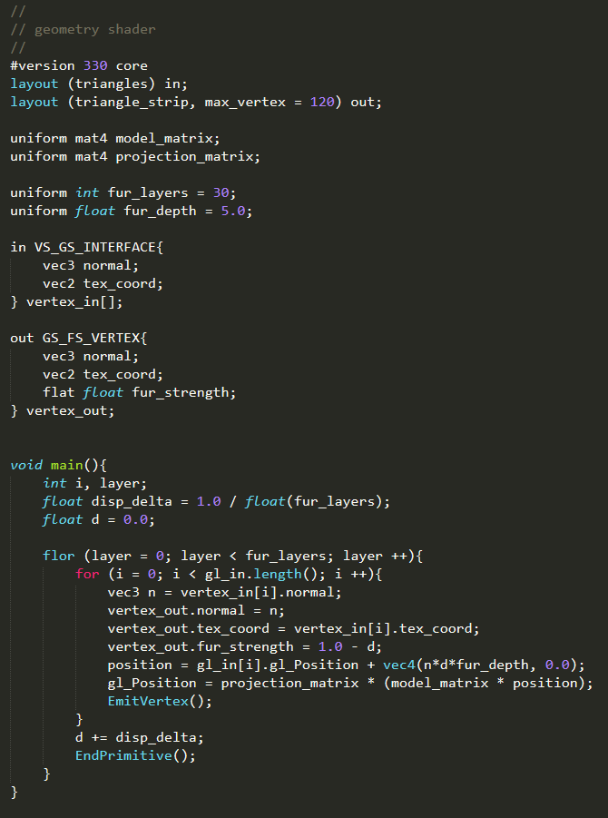
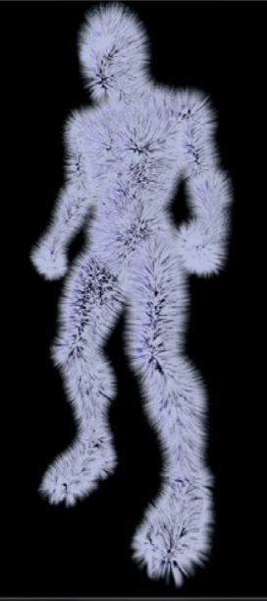
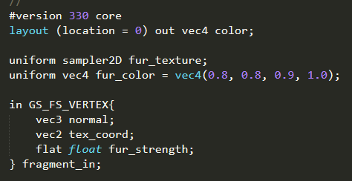
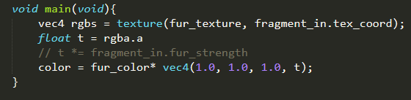
GS
…
FS

Slide 15
Multiple output stream
Geometry Shader
Primitive Setup
Clipping
Rasterization
Stream = 0

Slide 16
Multiple output stream
Geometry Shader
Primitive Setup
Clipping
Rasterization
Stream = 0
layout (stream = 0) out;
out vec4 foo;
out vec4 bar;
layout (stream =1) out;
out vec4 proton;
flat out float electron;
in vec2 elephant;
layout (stream = 2) out;
out vec4 baz;
Stream = 1
Stream = 2
…

Slide 17
Multiple output stream
Geometry Shader
Primitive Setup
Clipping
Rasterization
Stream = 0
layout (stream = 0) out stream0{
vec4 foo;
vec4 bar;
};
layout (stream =1) out stream1{
out vec4 proton;
flat out float electron;
};
in vec2 elephant;
layout (stream = 2) out stream2{
out vec4 baz;
}
Stream = 1
Stream = 2
…

Slide 18
Multiple output stream
Geometry Shader
Primitive Setup
Clipping
Rasterization
Stream = 0
EmitStreamVertex(0)
or
EmitVertex()
layout (stream = 0) out stream0{
vec4 foo;
vec4 bar;
};
layout (stream =1) out stream1{
out vec4 proton;
flat out float electron;
};
in vec2 elephant;
layout (stream = 2) out stream2{
out vec4 baz;
}
Stream = 1
EmitStreamVertex(1)
Stream = 2
EmitStreamVertex(2)
…

Slide 19
Multiple output stream
Geometry Shader
Primitive Setup
Clipping
Rasterization
Stream = 0
EmitStreamVertex(0)
or
EmitVertex()
layout (stream = 0) out stream0{
vec4 foo;
vec4 bar;
};
layout (stream =1) out stream1{
out vec4 proton;
flat out float electron;
};
in vec2 elephant;
layout (stream = 2) out stream2{
out vec4 baz;
}
Static const char* vars[] = {
“foo”, “bar”,
“gl_NextBuffer”,
“proton”,
“electron”,
“gl_NextBuffer”,
“baz”
};
glTransformFeedbackVaryings(
program, sizeof(vars) / sizeof(vars[0]),
varyings, GL_INTERLEAVED_ATTRIBS);
glLinkProgram(program);
Stream = 1
EmitStreamVertex(1)
Stream = 2
EmitStreamVertex(2)
…

Slide 20
Multiple output stream
Geometry Shader
Primitive Setup
Clipping
Rasterization
Stream = 0
How to retrieve primitive in the transform feedback buffer?
Query first
GL_PRIMITIVES_GENERATED
GL_TRANSFORM_FEEDBACK_PRIMITIVE_WRITTEN
The query function
void glBeginQueryIndexed(Glenum target, Gluint index, Gluint id);
void glEndQueryIndexed(Glenum target, Gluint index);
glCreateQueries()
glGetQueryObjectiuiv()
Stream = 1
Stream = 2
…
Notes:
GL_PRIMITIVES_GENERATED 用来查询所有生成的，无论是否被写入 feedback
GL_TRANSFORM_FEEDBACK_PRIMITIVE_WRITTEN 只能用于已经启用了 transform feedback 的场合

Slide 21
What the transform feedback can do
Void glDrawTransformFeedback(Glenum mode, Gluint id);
Void glDrawTransformFeedbackStream(Glenum mode, Gluint id, Gluint stream);
Void glDrawTransformFeedbackInstanced(Glenum mode, Gluint id, Glsizei instancount);
Void glDrawTransformFeedbackStreamInstanced(Glenum mode, Gluint id, Gluint stream, Glsizei instancecount);

Slide 22
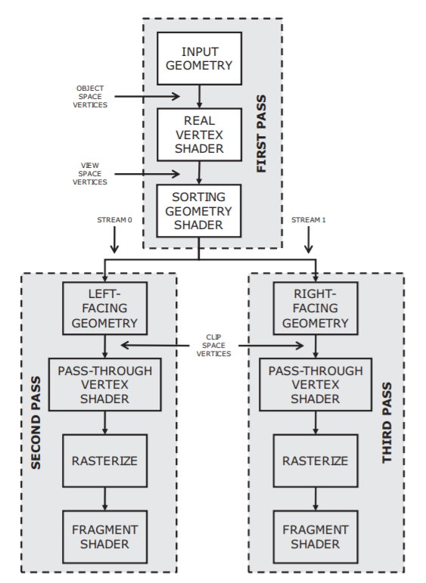
Example
Draw an object, with different facial orientation

Slide 23
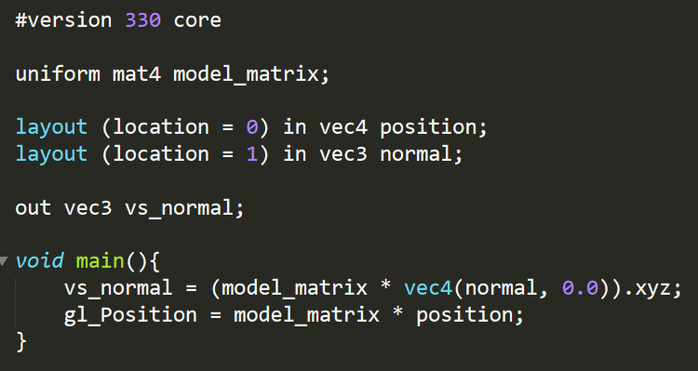

Slide 24
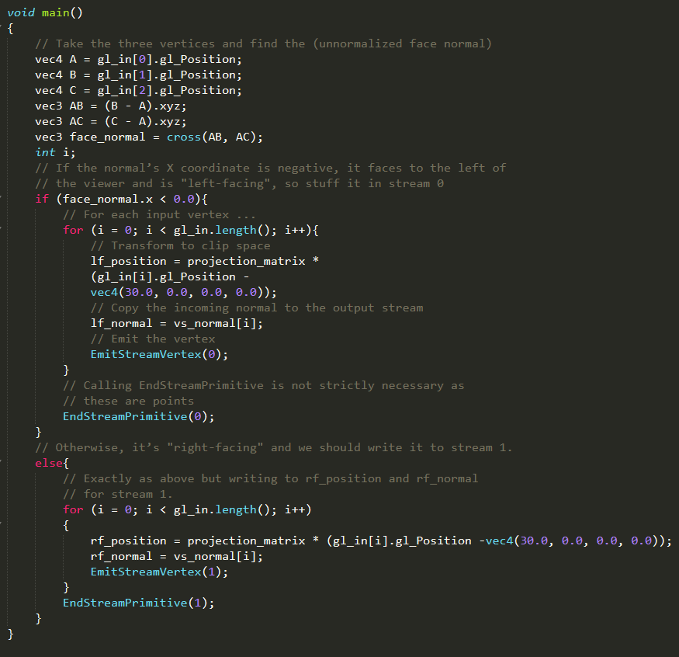
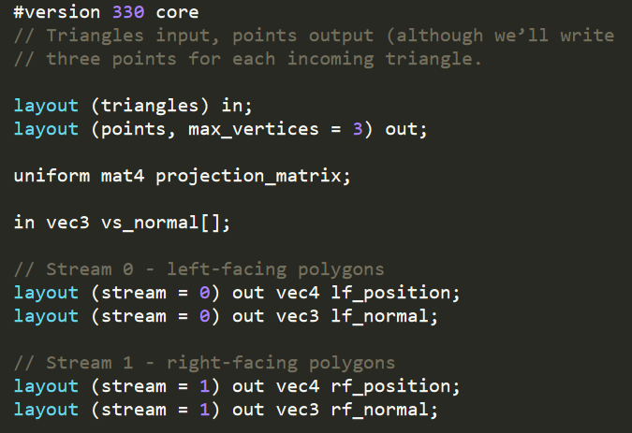
Stream 0
Stream 1

Slide 25
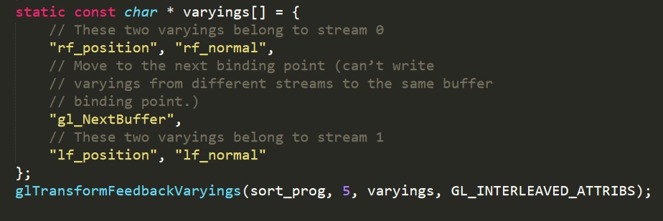
Config transform feedback

Slide 26
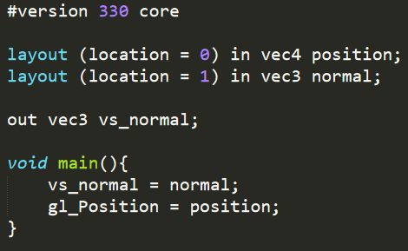

Slide 27
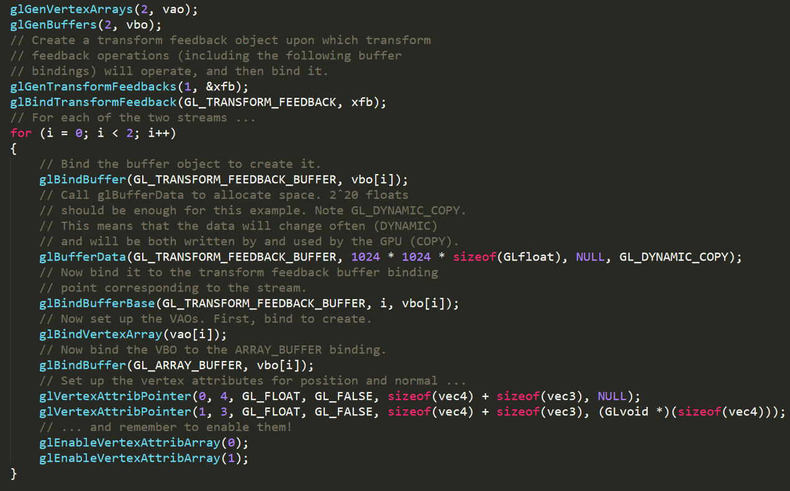

Slide 28
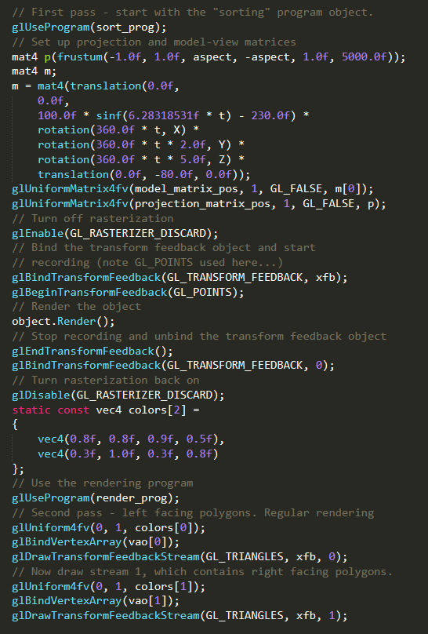
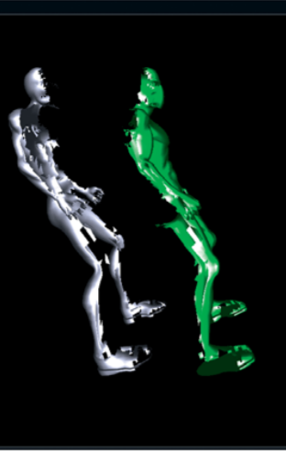

Slide 29
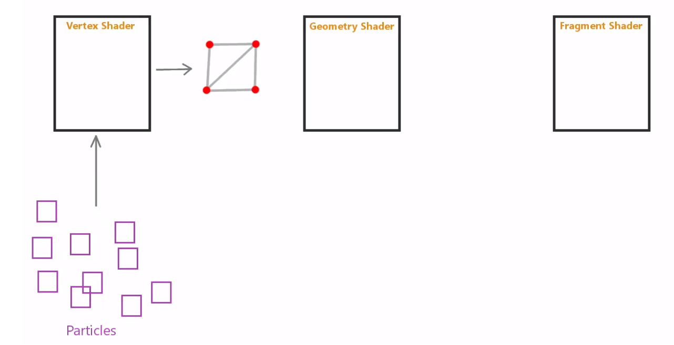
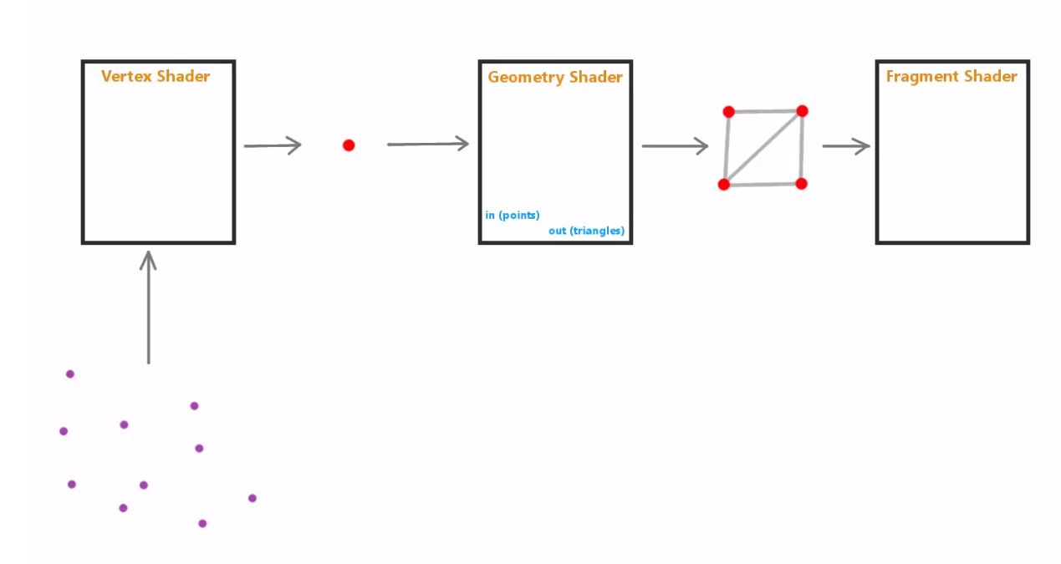
Application: particles
Triangle vertex ➔ VS ➔ triangles ➔ GS ➔ triangles ➔ FS ➔
Point vertex ➔ VS ➔points ➔ GS ➔ triangles ➔ FS ➔
Point_sprit ??

Slide 30
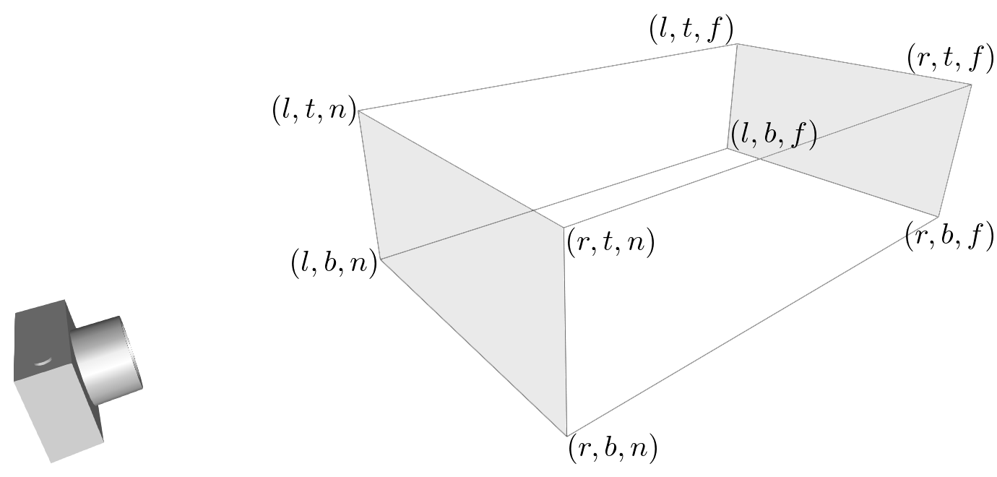
Multi ViewPort
Gl_ViewportIndex
Purpose:
Index of the viewport, tell shader which viewport parameters to use
APIs:
Set viewport ranges:
Void glViewportIndexedf(Gluint viewport_index, Glfloat right_upper_x, Glfloat left_upper_y, Glfloat w, Glfloat h);
Void glVIewportIndexedv(Gluint viewport_index, const Glfloat* v);
Set viewport depth:
Void glDepthRangeIndexed(Gluint viewport_index, Glclampd near, Glclampd far);
Set multi viewport parameters:
Void glViewportArrayv(Gluint first, Glsizei count, const Glfloat *v)
Void glDepthRangeArrayv(Gluint first, Glsizei count, const Gldouble *v)
Gl_Layer

Slide 31
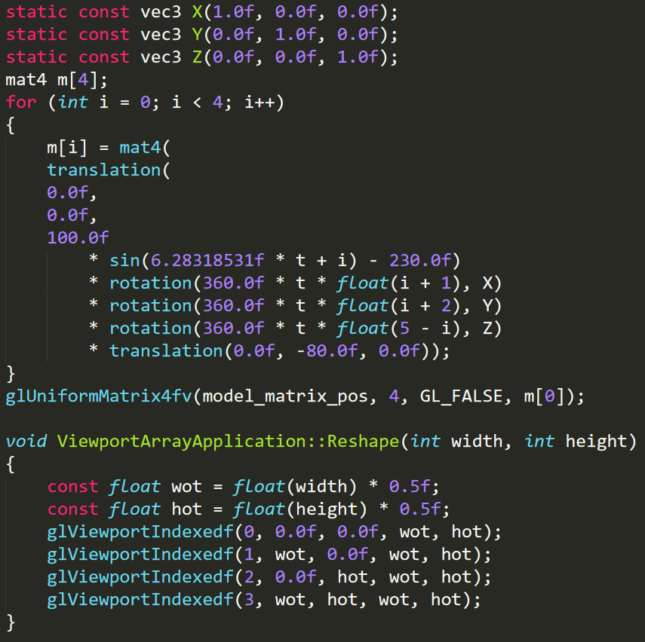
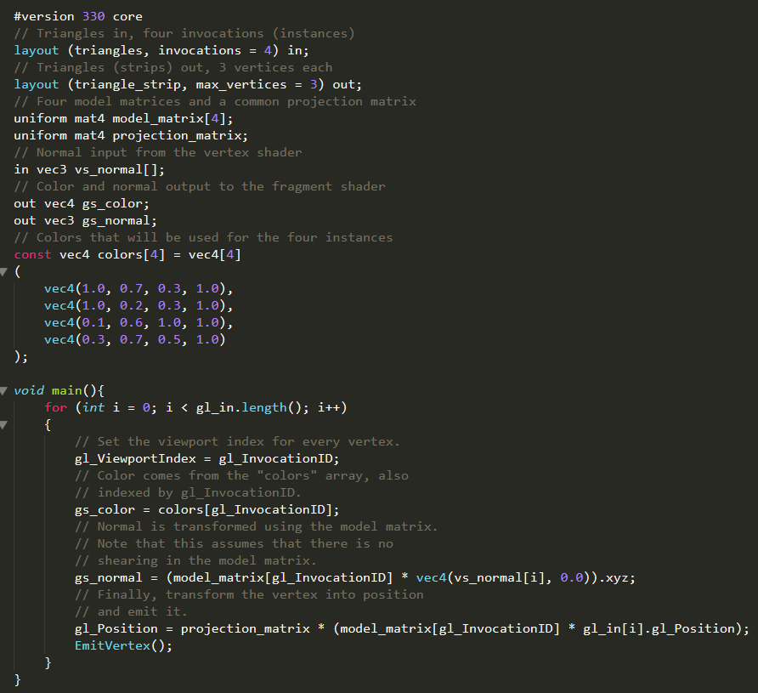
Example

Slide 32
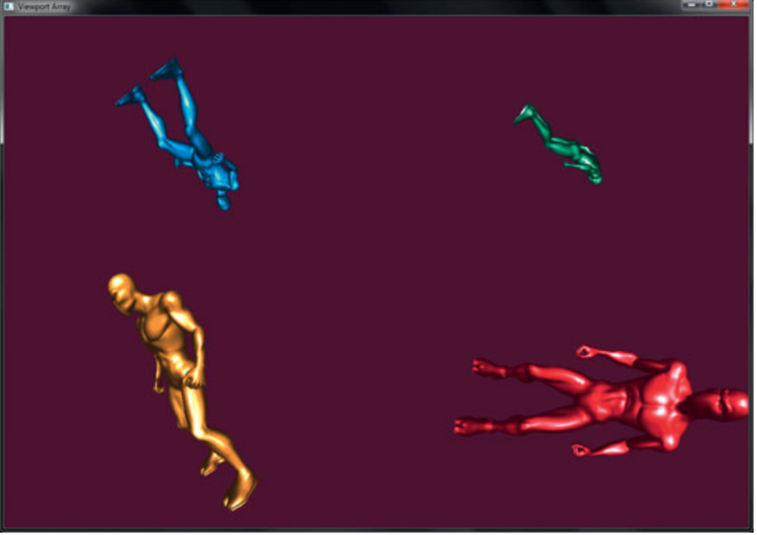
Multi viewport example

Slide 33
Ref:
OpenGL.Programming.Guide.8th.Edition.Mar.2013
https://www.youtube.com/watch?v=C8FK9Xn1gUM

Slide 34
Appendix:

Slide 35
