Slide 1
Django and Model
Yifei Huang
2015-11-07

Slide 2

Previously
T
Django
V
M
C-R-U-D

Slide 3


Today
T
Django
V
M
C-R-U-D

Slide 4
Run SQL in python
See file 01_mysql.py
import MySQLdb
db = MySQLdb.connect(user = 'root', db='books', host='localhost')
cursor = db.cursor()
execute= 'select * from customers order by name;'
cursor.execute(execute)
names = cursor.fetchall()
print names
names = cursor.fetchall()
print names
db.close()

Slide 5
But…
Pythonic
多掌握一门SQL这样的语言是好事，
但是我就想一个人安安静静写python代码

Slide 6







But…
SELECT name from customers
WHERE ROWNUM <= 3;
Compatibility
SELECT name
from customers FETCH
FIRST 3 ROWS ONLY;
SELECT
TOP 3 name
FROM customers;
SQL select
SELECT name from customers LIMIT 3;

Slide 7
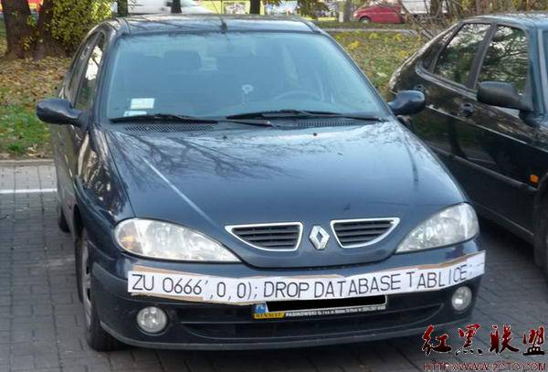


But…
Security
name = 'yifei'
query = 'select * from customers where name =\' ' + name + ' \'; ''
name = 'yifei \'; drop table customers; # '
query = 'select * from customers where name =\' ' + name + '\'; '

Slide 8

Django Model will help
CREATE DATABASE dbname;
CREATE TABLE tbname;.
INSERT TINTO … VALUES (…);
SELECT * FROM tbname WHERE …;
SELECT *, *, FROM tb1, tb2 WHERE
… and … or …;
Django
Model
UPDATE tbname SET …
WHERE …;
ALTER tbname [MODIFY | ADD | DROP ] …;
DELETE FROM tbname WHERE …
DROP TABLE tablename;
DROP DATABASE databasename;

Slide 9
Let’s do coding now
A customer relation management sys:
Create a new customer
Read a customer by name
Update a customer
Delete a customer

Slide 10




Save password
Try:
grant all to tom for books.* identified by ‘abc’;
grant all to tom2 for books.* identified by ‘abc’;
use mysql;
passwd=‘abc’
salt= ‘%$we=#@(-+=k…………’
passwd2 = md5(passwd+salt)

Slide 11
Relation and ForeignKey
Product id | Name | Size
200 | tshirt | S
201 | tshirt | M
202 | shoes | L
Order id | Customer id | Product id | Quantity
100 | 1 | 200 | 15
101 | 1 | 202 | 33
102 | 3 | 200 | 23
Customer id | name | city
1 | Tom | San Jose
2 | Yifei | Shanghai
3 | Jerry | Beijing

Slide 12
Homework
支持推荐功能
向该客户推荐订购了同样产品的其他客户订购的其他产品
Fix bug
当 数据库里面没有customer数据的时候，点击删除会出错。
请修复这个bug，改为输出一下warning 信息
掌握如何在django的setting.py里将数据库从SQLite改为MySQL

Slide 13
Q & A

