Slide 1
Group 1 | Group 2 | Group 3 | Group 4 | Group 5
Xuefeng Chen | Jiajun Chen | Yongxin Tan | Yan Wei | Ji Dong
Dehuang Wu | Xiaowen Tong | Yanghui Xiao | Huihuang Li | Tingting Jiang
Lianpeng Sang | Jinghua Huang | Yifei Huang | Jian Wang | Xiao sun
Zhaojie Li | Xuguang Shen | Lijuan Wang | Yijiang Huang | Sen Cao
Jianbiao Liao |  | Yijiang Zhang | Yuli Zhang
GROUP | project
Group 1 | “Battle ship” game
Group 2 | Personal task and case management system
Group 3 | Regression bench mark system
Group 4 | Server task management system
Group 5 | Cosim feature tag system

Slide 2
Group 1 “Battle Ship” python game
项目成员：
Xuefeng Chen, Lianpeng Sang, Zhaojie Li, Jianbiao Liao

Slide 3
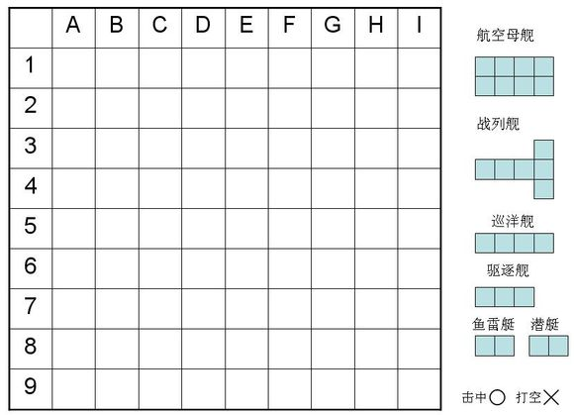
项目内容：设计以下一款游戏
游戏规则：
甲方在上图中放置6艘军舰。规定乙方炮击次数上限
乙方炮击上图坐标，在规定次数内击沉所有军舰为胜。否则判负
*军舰被击沉的条件是该键所有方格都被击中*

Slide 4
工作流程
组长提出一个项目
开会研究产品需求，设计流程，用户界面；
按设计，代码，验证分工项目各阶段任务
开会共同制定各任务完成时间和负责人
开始项目

Slide 5
分工明细
Xuefeng Chen:
提出项目，组织会议，测试产品
Lianpeng Sang:
设计产品功能流程，完成伪代码
Zhaojie Li
编写甲方程序
Jianbiao Liao
编写乙方程序

Slide 6
Group 2 A Personal Task and Case Management System in Python
PySIG group II

Slide 7
Features
Basically a database system in Python
A unified personal management system by gathering tasks, cases and changelists together
Case1
Keyword1
Task
Case2
Keyword2
.
.
.
Changelist /
CCR
Files#
Keywordn

Slide 8
Features
Input personal tasks with priorities and importance
STAR or Projects
Status update
Case Collections
Case classifications with key word searching
Link important cases with tasks
Changelist log Append
GUI

Slide 9
Group 3: regression benchmark system project

Slide 10
PySIG project
HSPICE, FineSim
Output
QR system
DB
(SQLite)
Excel,
plot
web
GUI
(PyQT)

Slide 11
Group 4 Python Project
Server Task Manger
Huihuang Li, Yuli Zhang, Jian Wang, Yijiang Huang, Yan Wei
20150128

Slide 12
User
Password
Server
Disk
OK
Cancel

Slide 13
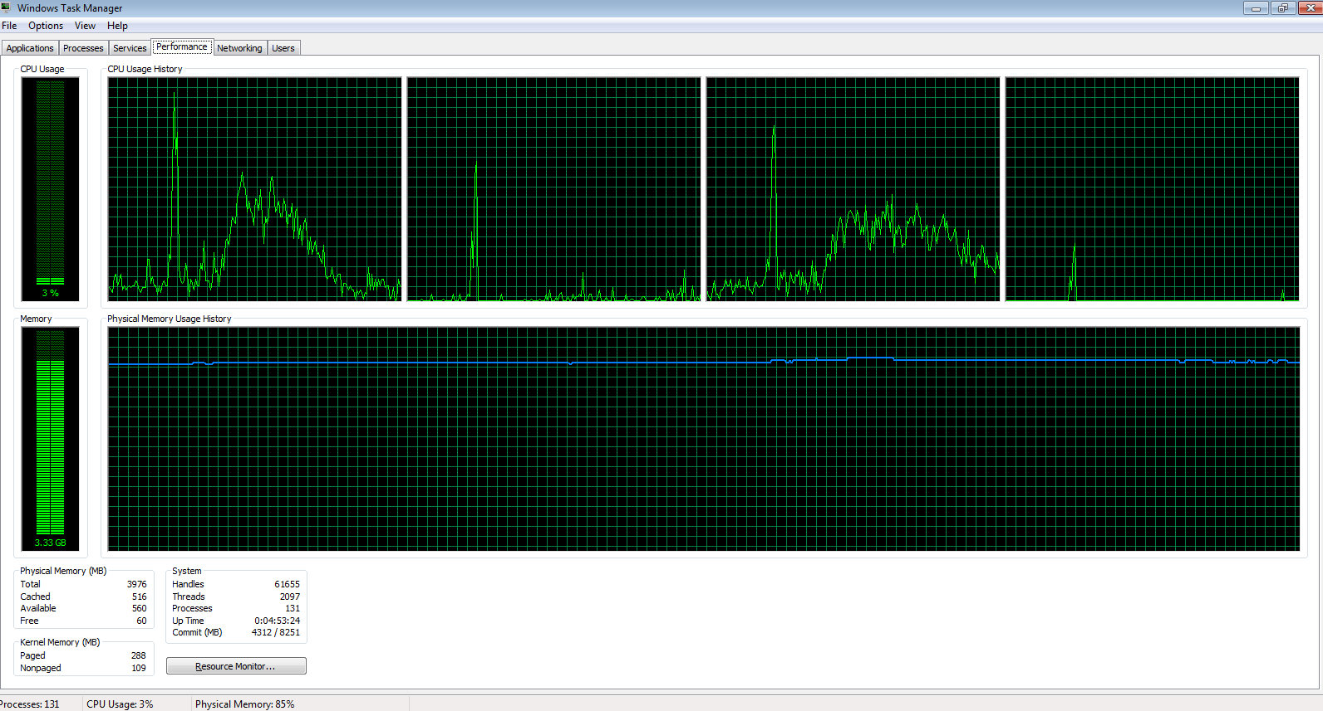

Slide 14
Server loading checking
Whose process on the server , loading?
Disk email

Slide 15
Group 5 Generating Cosim Feature Tag
Phase II
Ji Dong
1/28/2015

Slide 16
Project Initiation
About Sith-Tag
Feature tag of Cosim DKI (i.e. DKI_spice_top, DKI_bus_format ..)
Easy of use in classify features
Improve functional coverage
Sith-Tag Usage
Case dir/sith.run:
set sith(feature,xa) {DKI_thru_net DKI_spice_top DKI_bus_format DKI_rmap DKI_cell_partitioning DKI_port_map DKI_wildcard}
List for All Tags
/u/raptmgr/integration/main/nightly_client/unit_common/sith/tags

Slide 17
Project Initiation
Sith-Tag Generating
/u/raptmgr/integration/main/nightly_client/unit_common/sith/tag_dki.tcl
Current Limitation
Limited feature coverage (based on Cosim config file only)
Deliverable Scope
Sith-tag gathering script in Python
Based on Cosim config file and ams.cmd

