Slide 1
Python Introduction and Variable
HSPICE PySIG 1st Meeting
Yifei Huang
2014-11-05

Slide 2
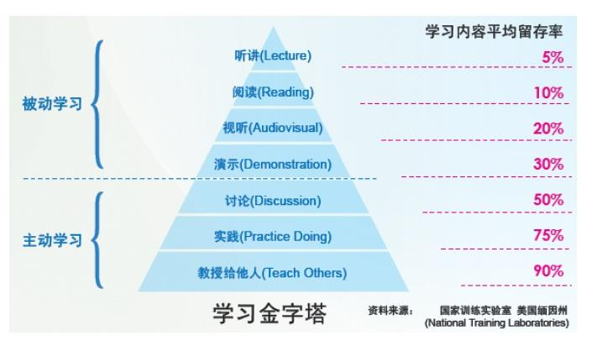
PySIG Proposal
Best practice from IG
Bi-weekly presentation and discussion
Group study
Everybody can be a learner and a teacher
Code study and exercise

Slide 3
Group 1 | Group 2 | Group 3 | Group 4
Xuefeng Chen | Jiajun Chen | Yongxin Tan | Yan Wei
Dehuang Wu | Xiaowen Tong | Yanghui Xiao | Huihuang Li
Lianpeng Sang | Jinghua Huang | Yifei Huang | Jian Wang
Zhaojie Li | Ji Dong | Lijuan Wang | Yijiang Huang
Jianbiao Liao | Xuguang Shen | Yijiang Zhang | Yuli Zhang
Yan Luo | Tingting Jiang | Xiao sun | Xiaonan Shi

Slide 4
Group responsibility
Slides prepare and present on the bi-weekly meeting
Book meeting room and sent invitation
Book lunch, reimbursement application on GEMS
QA
Final project

Slide 5
PySIG schedule
Chap 00➔chap 05
Kick off, introduction
Chap 06➔chap 14
String, Input, output
Chap 15➔chap 22
File and function
Chap 23➔chap 30
If and Boole
Chap 31➔chap 36
Loop and switch
Chap 37➔chap 41
List and Dict
Chap 42➔chap 45
Class
Chap 46➔chap 49
Project structure and testing
Chap 50➔chap 52
Python for web
Code study
Project

Slide 6
Why Python?
http://www.imooc.com/video/3370

Slide 7
Python Materials
TearnPythonTheHardWay
ThinkPythonLikeAComputerScientist
http://www.liaoxuefeng.com/wiki/001374738125095c955c1e6d8bb493182103fac9270762a000
https://www.python.org/
http://stackoverflow.com/

Slide 8
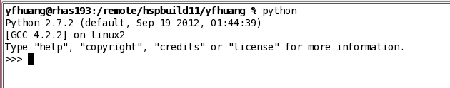
0. Install Python on Your Computer
Linux/Windows/OSX
Interactive mode
> python
>>>
command mode
> python thescript.py
binary mode
#!/usr/bin/env python
chmod a+x thescript.py

Slide 9
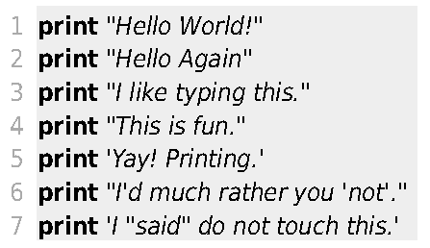
1. ‘Hello World!”
Interactive mode
python
Run script file
python ex01.py
.py is necessary for multi file import (like include) and run

Slide 10
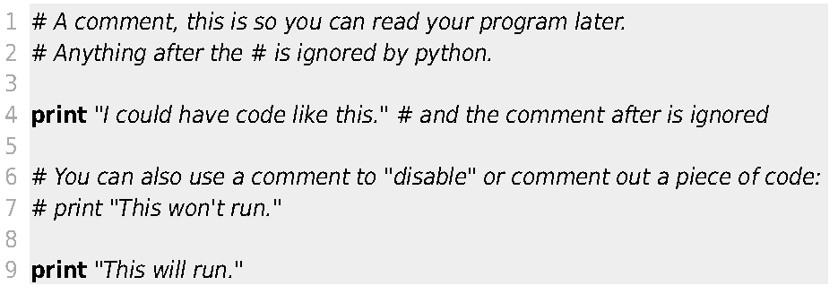
2. Comments

Slide 11
2. Another Comments
””” this is another comments that can cross line
Cross line
Cross line2
The end of comments ”””

Slide 12
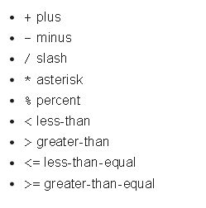
3. Numbers and math

Slide 13
3. Numbers and math
Try for string:
a=”Tom”+”Jerry”
print a

Slide 14
3. Numbers and math
Not only for numbers, but also for string
print “test”*3

Slide 15
3. Numbers and math
What does ** mean?
print 4**3

Slide 16
3. Numbers and math
print 9/5
print 9%5
If I want to get 1.8, try
print 9.0/5
print 9/5.0

Slide 17
3. Numbers and math
No ++, no -- for python
But you can use += , -=
A++
A+=1

Slide 18
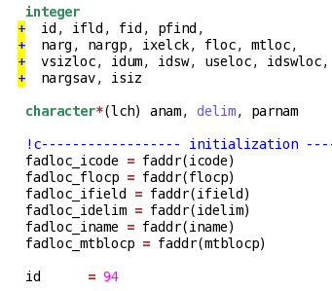
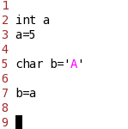
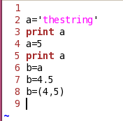
4. Variable and Names
FROTRAN
static
C++
static
Python
dynamic

Slide 19
4. Variable and Names
What’s the range for an int number?
a=1234567891011121314151617181920
print a
(Auto switch to int Long)
Int/float
Boole
String
list
tuple
dict/set
Class

Slide 20
4. Variable and Names
True/False and/or/not
print True and False
print True or False
print not True
If a>0:
print “a>0”
elif a<0:
print “a<0”
else:
print “a=0”
Int/float
Boole
String
list
tuple
dict/set
Class

Slide 21
4. Variable and Names
name=‘A’
name=“A”
name=“my name is ‘Lucy’ ”
name=‘my name is “Lucy” ’
name=“my name is \”Lucy\” ”
name=“my name is:\n Lucy”
name=“my name is:”+“ Lucy”
name=”””
My name is Lucy
I am 12
I love python
”””
Int/float
Boole
String
list
tuple
dict/set
Class

Slide 22
4. Variable and Names
Like a vector<> in C++
But more flexible
A=list()
A=[1,2,3,”name”, 3.14]
B=[A, 4.5]
A.pop()
A.append(9)
print a[0]
print a[-1]
print a[0:2]
Int/float
Boole
String
list
tuple
dict/set
Class

Slide 23
4. Variable and Names
Like a list, but immutable
Safe.
A=(3, 3.14)
Int/float
Boole
String
list
tuple
dict/set
Class

Slide 24
4. Variable and Names
dict:
Like the map in C++
Key➔value pairs group
A={‘name’:’Tom’, ‘age’:16}
set:
Like the set in C++
A=set()
A.add(5)
A.remove(5)
Int/float
Boole
String
list
tuple
dict/set
Class

Slide 25
4. Variable and Names
Int/float
Boole
String
list
tuple
dict/set
Class
A special one:
None
type(a)

Slide 26
4. Variable and Names
a, b=1, 2
a, b=b, a
a=b=1
for i in range(10):
pass
for key, value in thedict.items():
pass
You Will Like It ☺

Slide 27
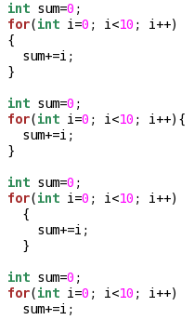

Python Format
Python is short and elegant
Uniform format and coding style
Hard to use copy/paste
Python is case sensitive

Slide 28

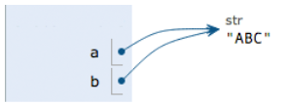
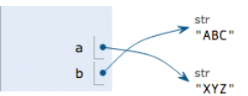

Mutable VS Immutable
Int/float/string/tuple VS list/dict
a=“ABC”
b=a
print a
print b
a=“XYZ”
print a
print b
a=“XYZ”
print a[0]
a[0]=‘k’
‘XYZ’
a[0]=‘k’

Slide 29
Mutable VS Immutable
Int/float/string/tuple VS list/dict
A=list()
B=A
print A
print B
A.append(2)
A.append(3)
A.remove(3)
print A
print B
A=[5,6,7]
print A
print B

Slide 30
Need help?
> help()

Slide 31
Next
1. LPTHW ex06->ex14
2. Introduction for string module?

Slide 32
Q&A

