Slide 1
Boole, Loop and Recursion
HSPICE PySIG 4th Meeting
2014-12-17

Slide 2
PySIG schedule
Chap 00➔chap 05
Kick off, introduction
Chap 06➔chap 14
String, Input, output
Chap 15➔chap 22
File and function
Chap 23➔chap 36
If, Boole, Loop 12/17
Chap 37➔chap 41
List and Dict Set 12/31
Chap 42➔chap 45
Class 01/14
Chap 46➔chap 49
Project structure and testing
re module
01/28
GUI
02/11
Code study
03/11
Chap 50➔chap 52
Python for web 03/25
Final project
05/25

Slide 3
Group 1 | Group 2 | Group 3 | Group 4 | Group 5
Xuefeng Chen | Jiajun Chen | Yongxin Tan | Yan Wei | Ji Dong
Dehuang Wu | Xiaowen Tong | Yanghui Xiao | Huihuang Li | Tingting Jiang
Lianpeng Sang | Jinghua Huang | Yifei Huang | Jian Wang | Xiao sun
Zhaojie Li | Yan Luo | Lijuan Wang | Yijiang Huang | Sen Cao
Jianbiao Liao | Xuguang Shen | Yijiang Zhang | Yuli Zhang

Slide 4
Boole
True or False?
this is the question.

Slide 5
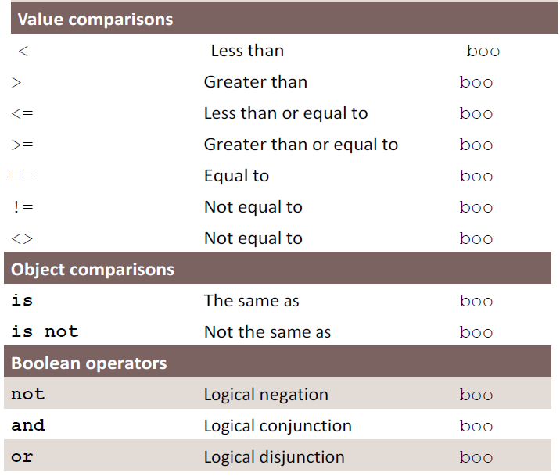

Slide 6
Not equal
A,B,C=1,2,3
A<B<C → A<B and B<C
A<C>B → A<C and C>B
A==B
A != B →A<>B

Slide 7
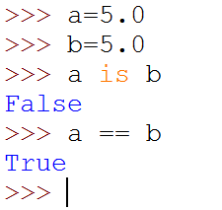
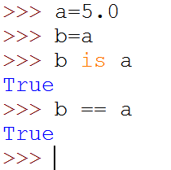
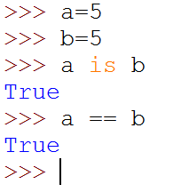
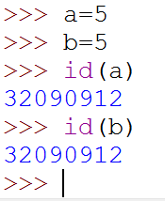
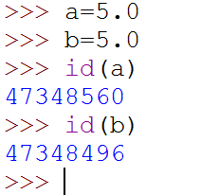
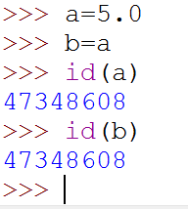
is ==, is not !=
a
a
5.0
a
5
5.0
b
b
b
5.0

Slide 8
and, or
A=3
B=5
C=0
In C
In python
A && B
>>> 1
B&&A
>>> 1
A||B
>>> 1
C||B
>>> 1
A and B
>>> 5
B and A
>>> 3
A or B
>>> 3
C or B
>>> 5

Slide 9
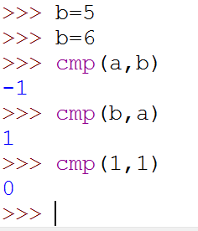
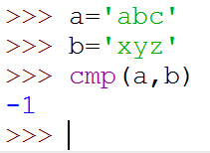
cmp()
Help on built-in function cmp in module __builtin__:
cmp(...)
cmp(x, y) -> integer
Return negative if x<y, zero if x==y, positive if x>y.
(END)

Slide 10
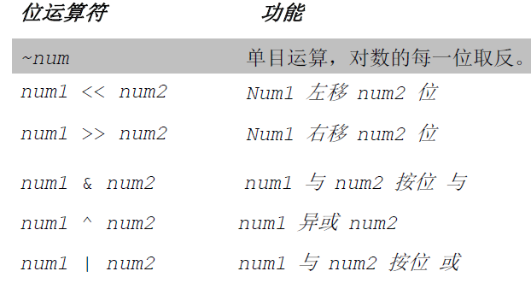
Bit operation

Slide 11
Conditional expression
If X<Y is true, Z=X
else, Z=Y
Z = X<Y ? X:Y
Z = X if X<Y else Y

Slide 12
Python can avoid “DANGLING ELSE”
C
Python
If (a>1)
if (a>2)
printf “a>2”;
else
printf “a<=1”
If (a>1)
{
if (a>2)
printf “a>2”;
else
printf “a<=1”;
}
If a>1:
if a>2:
print “a>2”
else:
print “a<=1”
If a>1:
if a>2:
print “a>2”
else:
print “a<=1”

Slide 13
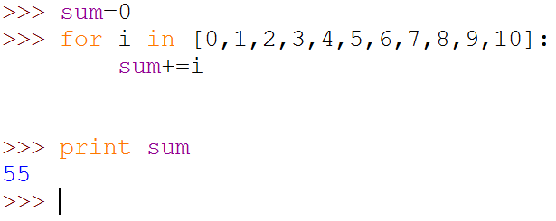
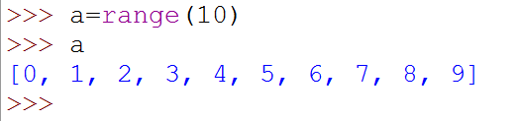
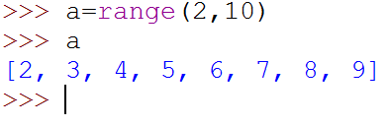
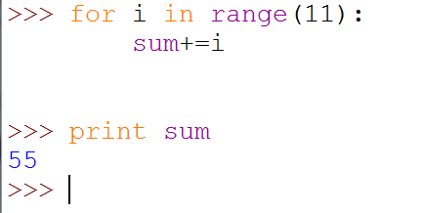
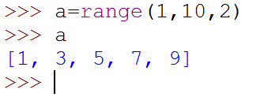
Loop

Slide 14
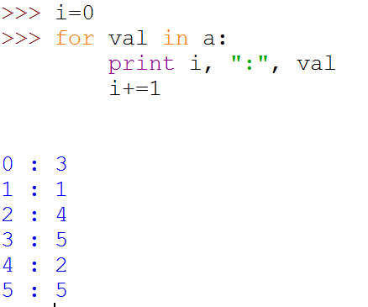
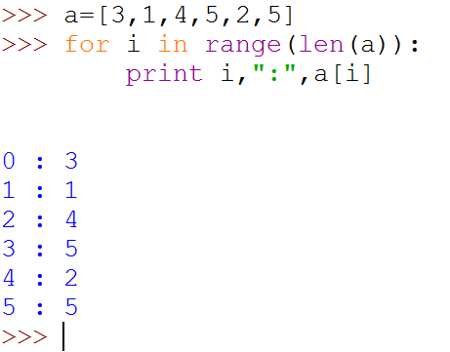
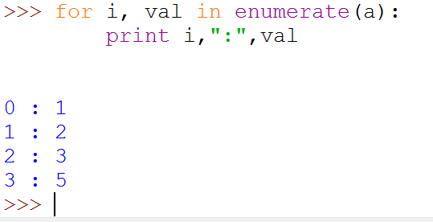
Loop with the index and list

Slide 15
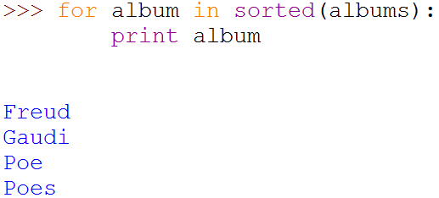
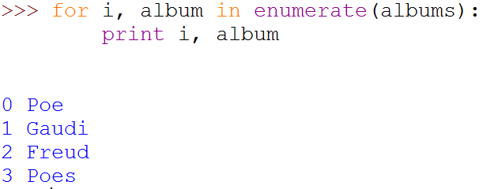
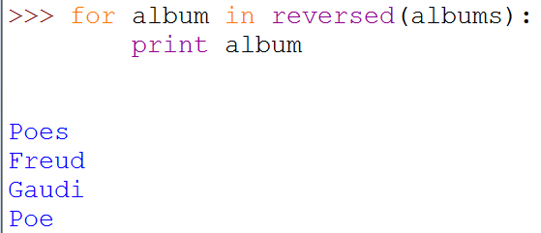
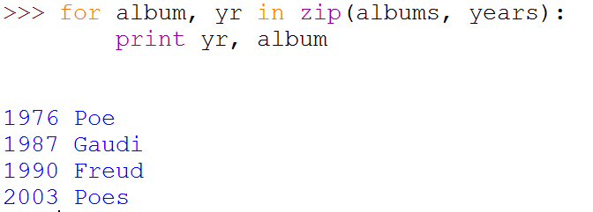
enumerate/sorted/reversed

Slide 16
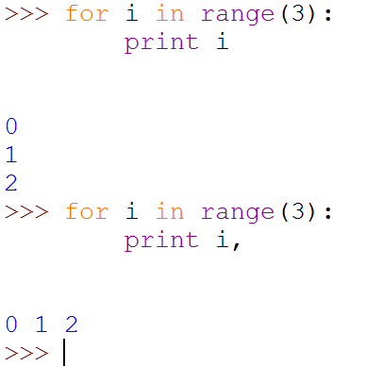
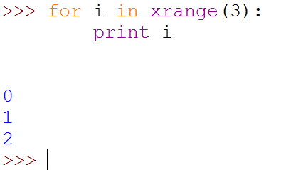
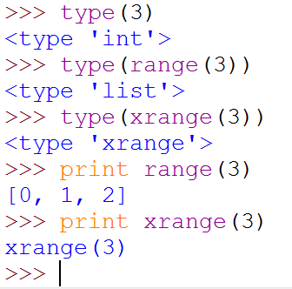
range(x) VS xrange(x)
xrange() is much efficent
Only will be used within the for range

Slide 17
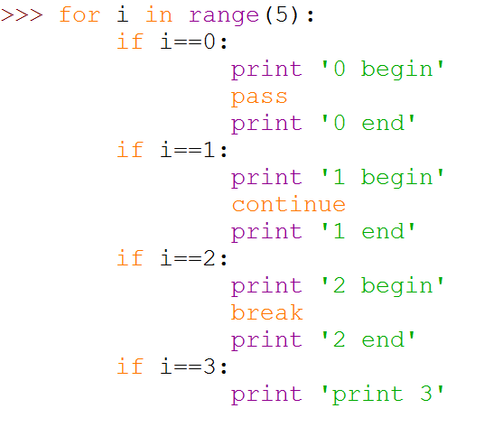
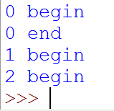
pass/continue/break

Slide 18
YIELD
Get Fibonacci list

Slide 19
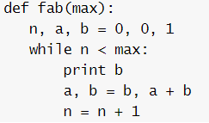
fab()
1

Slide 20
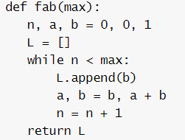
fab()
2

Slide 21
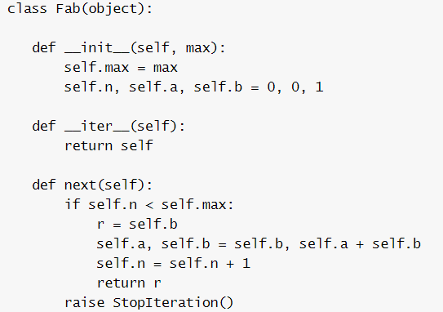
fab()
3

Slide 22
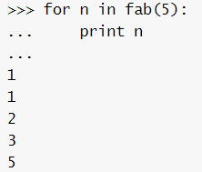
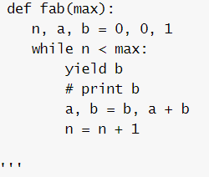
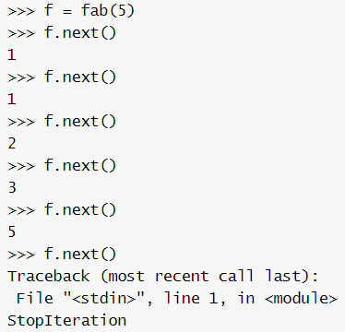
fab()
4

Slide 23
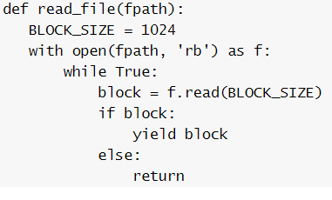
read large file
5

Slide 24

List comprehension
[exp for iter_val in iterable]

Slide 25
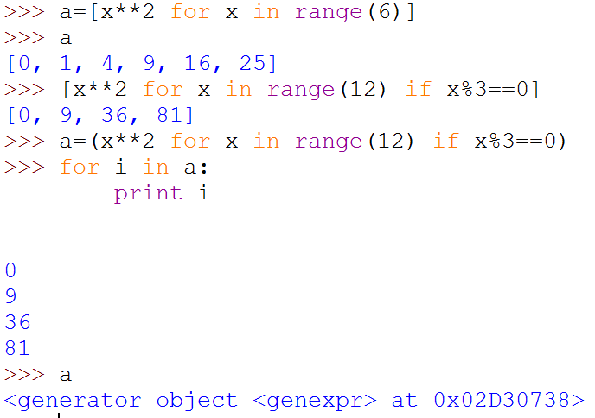
List comprehension VS generator
[expr for iter_val in iterable if cond_expr]
(expr for iter_val in iterable if cond_expr)

Slide 26
Why not use recursion?
fab(0)=0
fab(1)=1
fab(n)=fab(n-1)+fab(n-2)

Slide 27
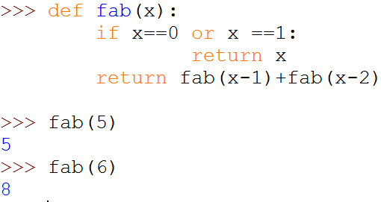
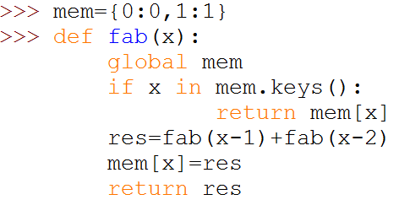



Be careful when using recursion

Slide 28
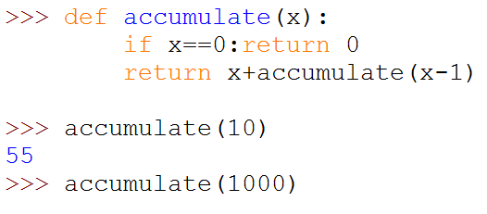
Be careful when using recursion
No end recursion optimize for python
RuntimeError: maximum recursion depth exceeded
import sys
sys.setrecursionlimit(10000)

Slide 29
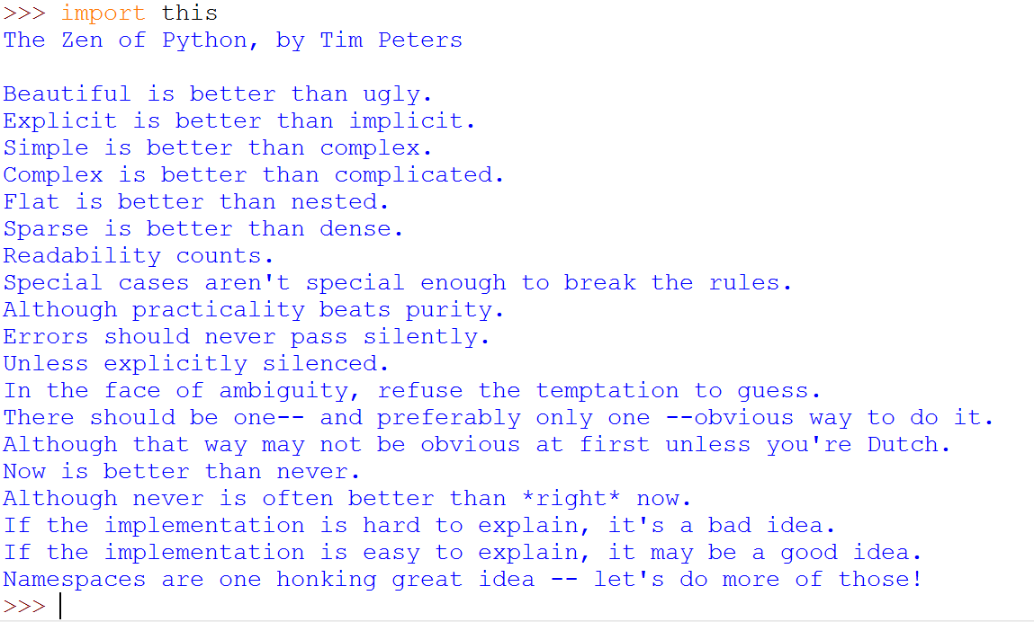
Be Pythonic
蛇宗三字经 翻译：元创
美胜丑
明胜暗
简胜复
复胜杂
浅胜深
疏胜密
辞达意
不逾矩
弃至清
无阴差
有阳错
拒疑数
求完一
虽不至
向往之
敏于行
戒莽撞
差难言
好易说
每师出
多有名

Slide 30
Next
LPTHW ex37->ex41
List and dict (set)

Slide 31
Q&A

