Slide 1
Regular Expression
Python SIG 5th

Slide 2
1. Expression
Syntax format | Explaination | Example | Matched | Matched …
expr |  | abc123 | abc123
expr1|expr2 | expr1 or expr2 | abc|123 | 123 | abc
. | Any char (except \n) | a.b | acb | A b
^ | Begin of str Begin of line | ^abc | xyabc abcded dabc | abcdefg
$ | End of str End of line | abc$ | thisabc abcdef xyz

Slide 3
2. Repeat
Syntax format | Explaination | Example | Matched | Matched …
* | repeat 0 or more | a[b]*c | ac | abbc
+ | Repeat 1 or more | a[b]+c | abc | abbc
? | Repeat 0 or 1 | a(b)?c | abc | ac
{N} | Repeat N times | [0-9]{3} | 123 | 000
{M,N} | Repeat M to N times | [0-9]{2,4} | 12 | 1234

Slide 4
3. Range
Syntax format | Explanation | Example | Matched | Matched …
[…] | Any char in the range | [12] | 1 | 2
[M-N] | Any char in M to N | [2-5] | 2 | 3
[^…] | Not in the range | [^123]a | 4a | 5a
(…) | Sub set pattern for match
(*|?|+|{})? | Match * ? + or {} self | .(*)?[a-z] | 4*a

Slide 5
4. Special char
Syntax format | Explanation | Example | Matched | Matched …
\d | Any digital number, Equals to [0-9] | data\d.txt | data1.txt | data2.txt
\w | Any digital or letter Equals to [a-zA-Z0-9] | [a-zA-Z_]\w+
\s | Any space, Equals to [\n\t\r\v\f]
\b | Words boundary | \bThe\b | This The n
\nn | Match previous saved sub set
\c | Original char | \. \\ \*
\A | The matched string begin
\Z | The matched string end

Slide 6
Examples
f.o
..
.end
^From
/bin/tcsh$
^hello world$
.*\$$

Slide 7
Examples 2
the
\bthe
\bthe\b
\Bthe
\Bthe\B

Slide 8
Examples 3
b[aeiu]t
[cr][23][dp][o2]

Slide 9
Examples 4
z.[0-9]
[r-u][env-y][us]
[^aeiou]
[^\t\n]
["-a]

Slide 10
Examples 5
[dn]ot?
0?[1-9]
[0-9]{15,16}
</?[^>]+>
[KQRBNP][a-h][1-8]-[a-h][1-8]

Slide 11
Examples 6
\w+-\d+
[A-Za-z]\w*
\d{3}-\d{3}-\d{4}
\w+@\w+\.com

Slide 12
Examples 7
\d+(\.\d*)?
(Mr?s?\. )?[A-Z][a-z]* [ A-Za-z-]+

Slide 13
RE Module in Python
More powerful, more general, perl style regular expression
Multi-thread share of one compiled re object
Grouped/called by name support
import re

Slide 14
RE functions
compile(pattern,flags=0)
对正则表达式模式pattern 进行编译，flags 是可选标志符，并返回一个regex 对象
Compiler the pattern, return an regex object
match(pattern,string, flags=0)
尝试用正则表达式模式pattern 匹配字符串string, flags 是可选标志符，如果匹配成功，则返回一个匹配对象，否则返回None
Try to
search(pattern,string, flags=0)
在字符串string 中查找正则表达式模式pattern 的第一次出现，flags 是可选标志符，如果匹配成功，则返回一个匹配对象；否则返回None

Slide 15
findall(pattern,string[,flags])
在字符串string 中查找正则表达式模式pattern 的所有 (非重复)出现；返回一个匹配对象的列表
finditer(pattern,string[, flags])
和findall()相同，但返回的不是列表而是迭代器；对 于每个匹配，该迭代器返回一个匹配对象

Slide 16
split(pattern,string, max=0)
根据正则表达式pattern 中的分隔符把字符string 分割为一个列表，返回成功匹配的列表，最多分割max 次(默认是分割所有匹配的地方)。
sub(pattern, repl, string, max=0)
把字符串string 中所有匹配正则表达式pattern 的地方替换成字符串repl,如果max 的值没有给出，则对所有匹配的地方进行替换(另外，请参考subn(),它还会返回一个表示替换次数的数值)。

Slide 17
group(num=0)
返回全部匹配对象(或指定编号是num 的子组)
groups()
返回一个包含全部匹配的子组的元组(如果没有成功匹配，就返回一个空元组)

Slide 18
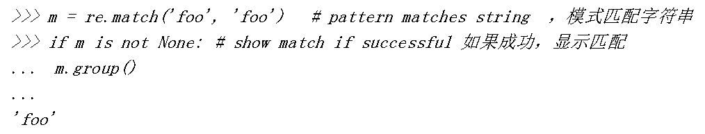
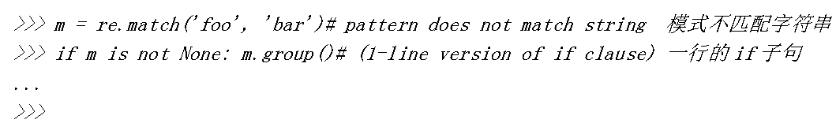
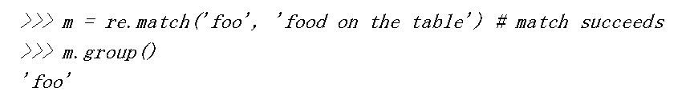
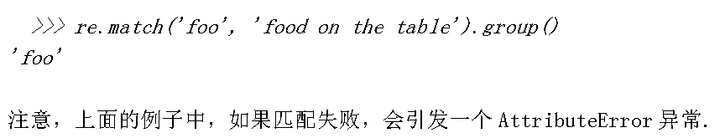
match

Slide 19
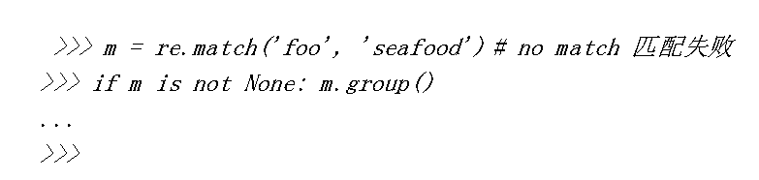
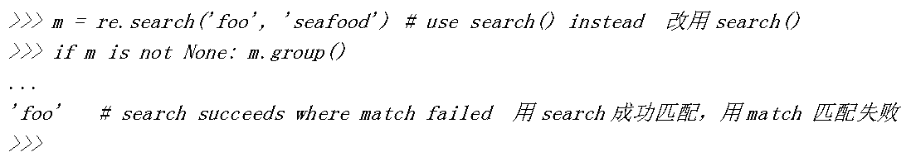

Slide 20
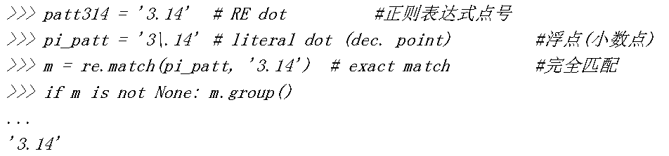
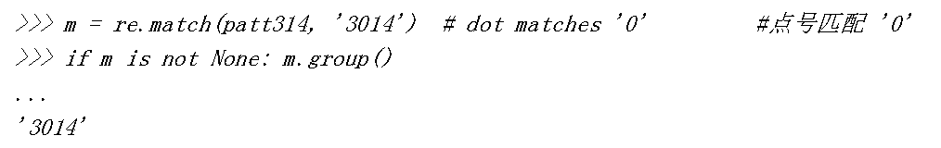
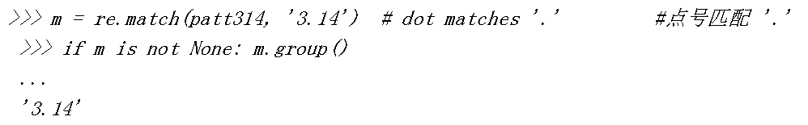

Slide 21
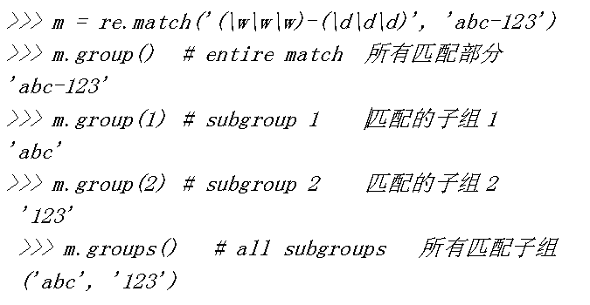

Slide 22
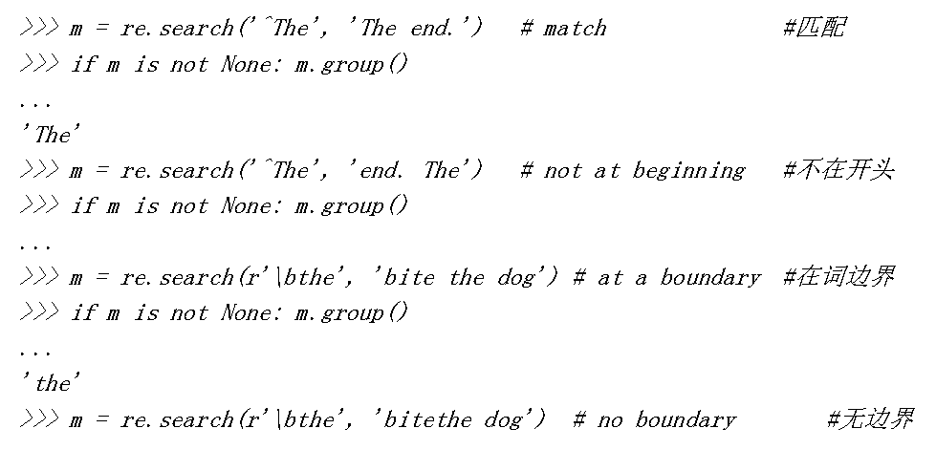
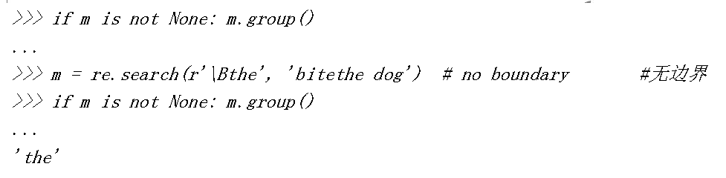

Slide 23
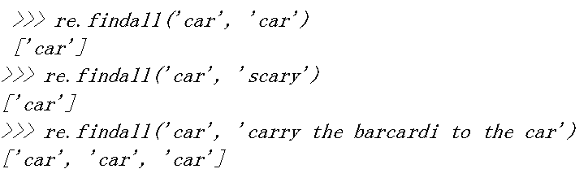
findall()

Slide 24
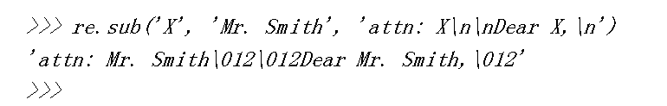
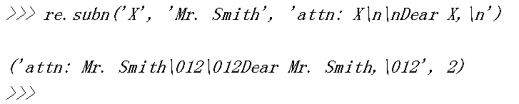
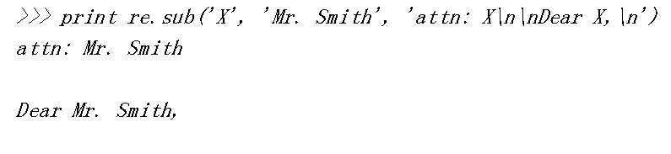
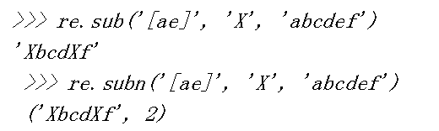
Sub() subn()

Slide 25

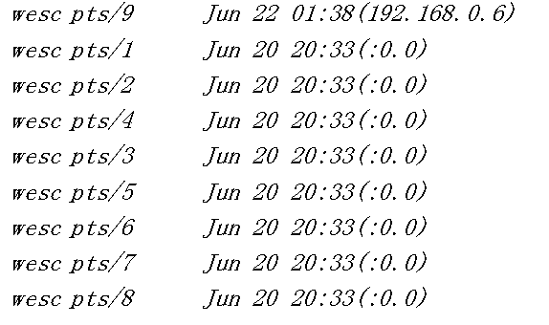
Split()
string.split()
re.split()

Slide 27
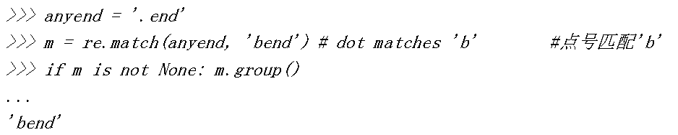
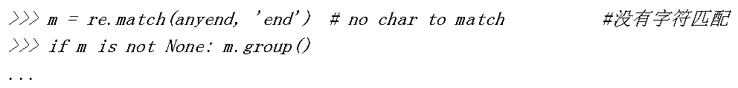
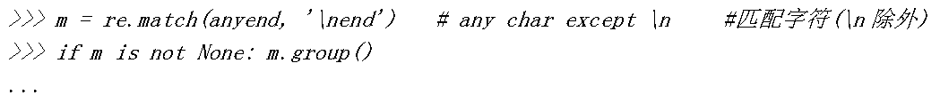
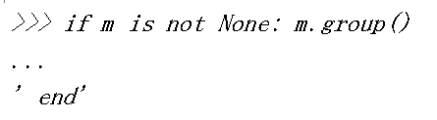

Slide 28
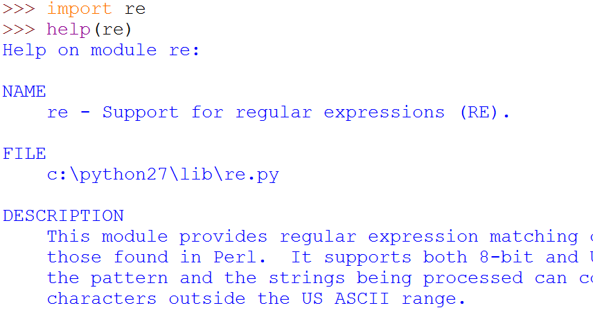
Learn more?

Slide 29
Thank you!

