Slide 1
Python and its buddies
Sun Xiao
04/15/2015

Slide 2

What you should do ?
Just listen and talk about !
Be happy and relax ~

Slide 3
Agenda
Python + swig
Python + lex & yacc
Python + OpenGL
Python + (in) Django
Python + serial
Python + USB

Slide 4
Agenda
Python + swig
Python + lex & yacc
Python + OpenGL
Python + (in) Django
Python + serial
Python + USB
.

Slide 5

Swig
Swig -> Open Graphics Library
SWIG is a software development tool that connects programs written in C and C++ with a variety of high-level (script…) programming languages.
C/C++….
TCL, Ruby, Python….

Slide 6
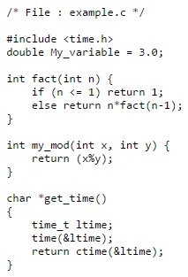
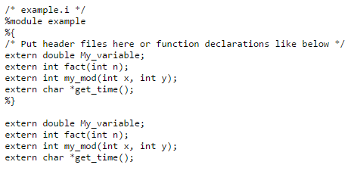
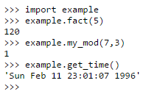

Python + Swig
Interface file

Slide 7
Agenda
Python + swig
Python + lex & yacc
Python + OpenGL
Python + (in) Django
Python + serial
Python + USB
.

Slide 8
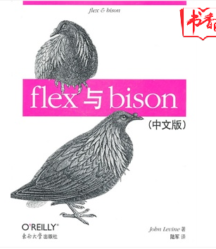
Lex & Yacc
Lex -> lexical compiler (flex).
Yacc ->Yet Another Compiler Compiler (bison).
30 – 50 RMB.

Slide 9
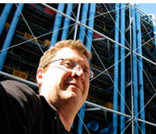
Python + Lex & Yacc
PLY -> PLY is Lex/YACC implement of python.
Website: http://www.dabeaz.com/ply/
Author : David Beazley
tokens = ( 'NAME','NUMBER', 'PLUS','MINUS','TIMES','DIVIDE','EQUALS', 'LPAREN','RPAREN', )
…………………………………
precedence = ( ('left','PLUS','MINUS'), ('left','TIMES','DIVIDE'), ('right','UMINUS'), )
…………………………..

Slide 10
Agenda
Python + swig
Python + lex & yacc
Python + OpenGL
Python + (in) Django
Python + serial
Python + USB
.

Slide 11
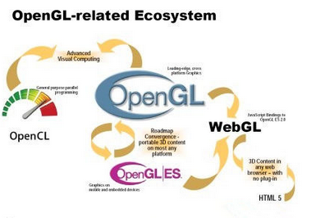
OpenGL
OpenGL -> Open Graphics Library
cross-language, multi-platform application programming interface (API) for rendering 2D and 3D vector graphics.

Slide 12

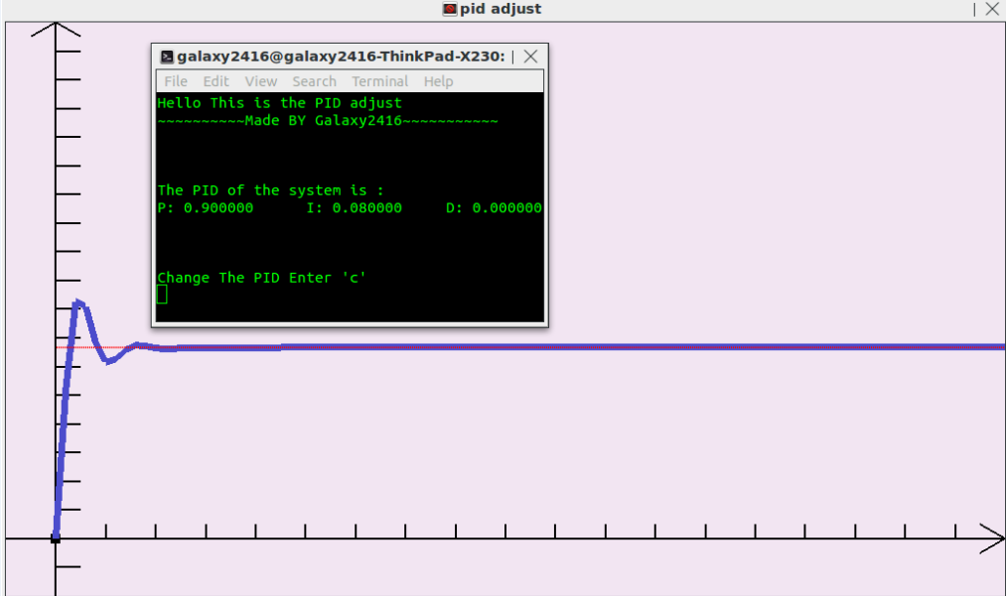
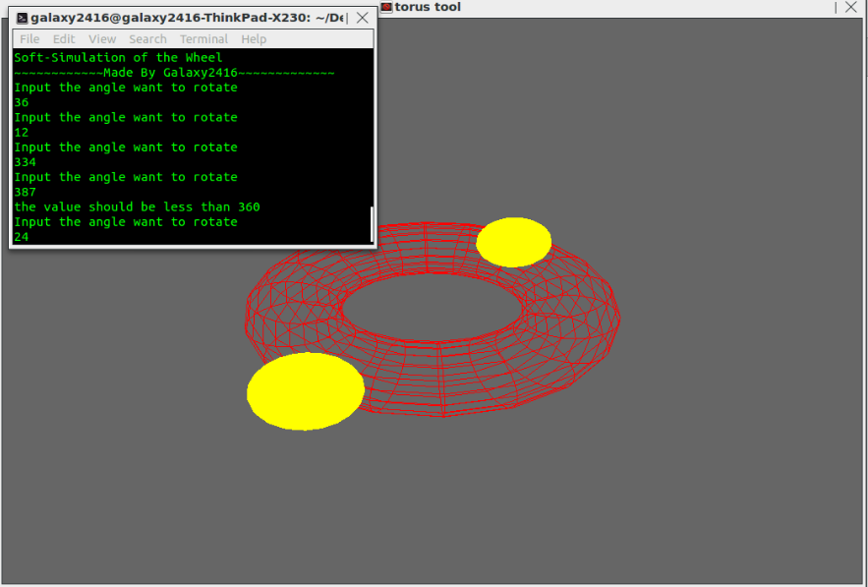
OpenGL

Slide 13
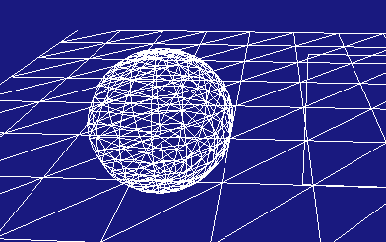
OpenGL + Python
PyOpenGL -> http://pyopengl.sourceforge.net/
……….
def mouseButton( button, mode, x, y ):
if button == GLUT_RIGHT_BUTTON:
camera.mouselocation = [x,y]
def ReSizeGLScene(Width, Height):
glViewport(0, 0, Width, Height)
glMatrixMode(GL_PROJECTION)
glLoadIdentity()
gluPerspective(45.0, float(Width)/float(Height), 0.1, 100.0)
glMatrixMode(GL_MODELVIEW)
def main():
……..

Slide 14
Agenda
Python + swig
Python + lex & yacc
Python + OpenGL
Python + (in) Django
Python + serial
Python + USB
.

Slide 15

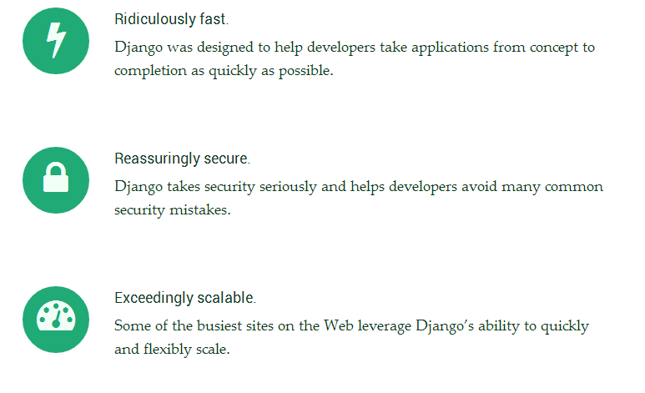
Django
https://www.djangoproject.com/
Django is a high-level Python Web framework that encourages rapid development and clean, pragmatic design. It’s free and open source.

Slide 16
Agenda
Python + swig
Python + lex & yacc
Python + OpenGL
Python + (in) Django
Python + Serial
Python + USB
.

Slide 17

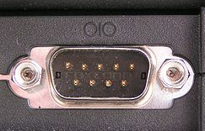
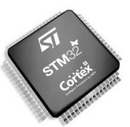
COM or UART ?
In computing, a serial port is a serial communication physical interface through which information transfers in or out one bit at a time (in contrast to a parallel port). Throughout most of the history of personal computers, data was transferred through serial ports to devices such as modems, terminals and various peripherals.

Slide 18

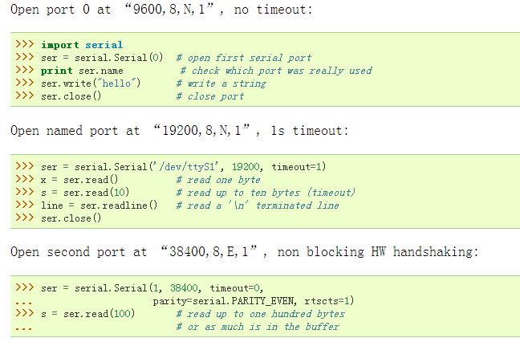
Python + serial
Website : http://pyserial.sourceforge.net/

Slide 19
Agenda
Python + swig
Python + lex & yacc
Python + OpenGL
Python + (in) Django
Python + serial
Python + USB
.

Slide 20

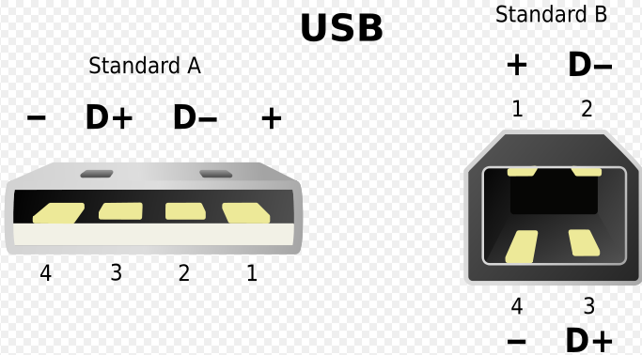
USB
Universal Serial Bus (USB) is an industry standard developed in the mid-1990s that defines the cables, connectors and communications protocols used in a bus for connection, communication, and power supply between computers and electronic devices..

Slide 21


Python + USB
PyUSB - Easy USB access on Python
Website : http://walac.github.io/pyusb/
# find our device
dev = usb.core.find(idVendor=0xfffe, idProduct=0x0001)
....................
# set the active configuration.
dev.set_configuration()
# get an endpoint instance
cfg = dev.get_active_configuration()
intf = cfg[(0,0)]
ep = usb.util.find_descriptor(
intf,
# match the first OUT endpoint
custom_match = \
lambda e: \
....................
# write the data
ep.write('test')
40 – 60 RMB

Slide 22








Շնորհակալություն
רב תודות
감사합니다
Obrigado
Armenian
Hebrew
Korean
Portuguese
Danke
Arabic
German
Traditional Chinese
Russian
Simplified Chinese
Gracias
Japanese
Hindi
Spanish
Thai
Merci
Grazie
French
Italian
Tamil

