Slide 1
Django Model Introduction
--using MySQL as an example
Yifei Huang
2015-10-23

Slide 2
Agenda
Prepare work
Why we need a database for our web site?
How to handle a database (MySQL) ?
Practice

Slide 3
1. Prepare work
Supposed that you have installed the work environment:
Python
Django
MySQL or WAMPServer
Ipython
Notepad / sublime

Slide 4
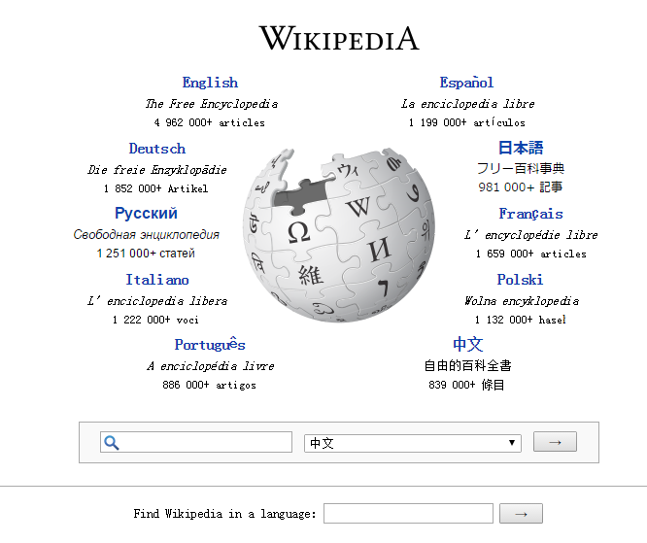
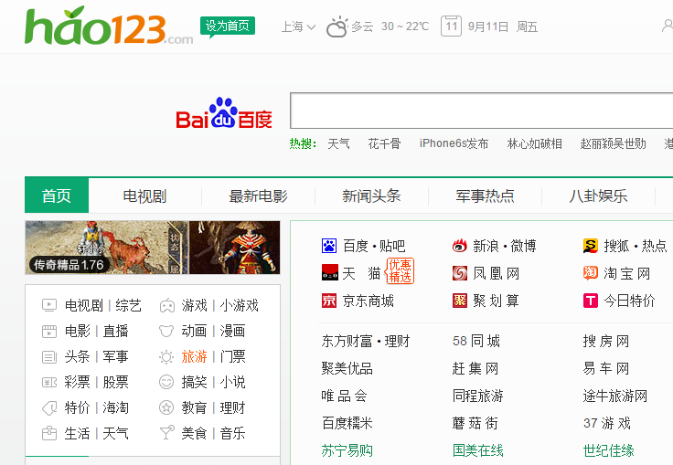
2.Why we need a database for our web site?
STATIC
DYNAMIC

Slide 5
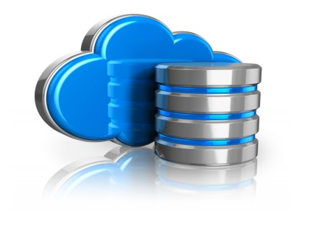
MVT
Template
Django
View
Model

Slide 6


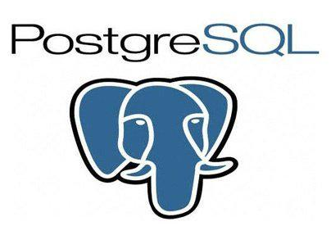

3. How to handle a database (MySQL) ?

Slide 7

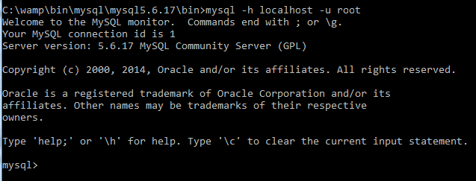
3. How to handle a database

Slide 8
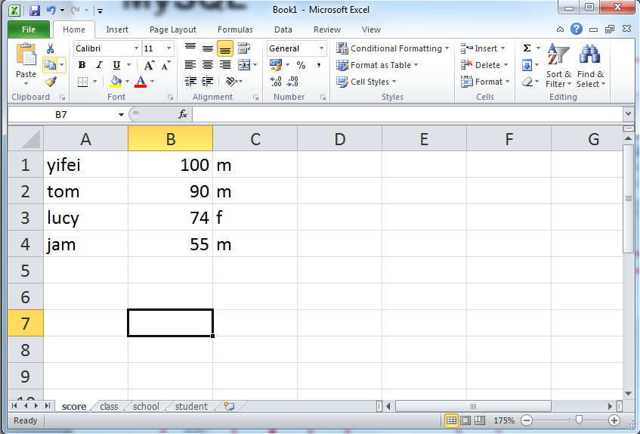
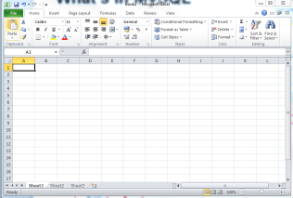
SQL
database
Column
(property)
Row
(data)
table1
table2

Slide 9



MySQL CRUD
Create
Read
MySQL
Update
Delete

Slide 10

Summary
T
Django
V
M
C-R-U-D

Slide 11

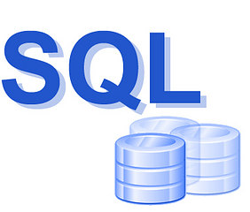
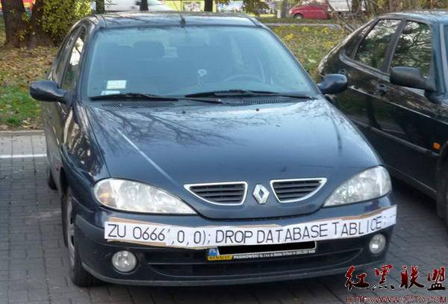
SQL injection

Slide 12

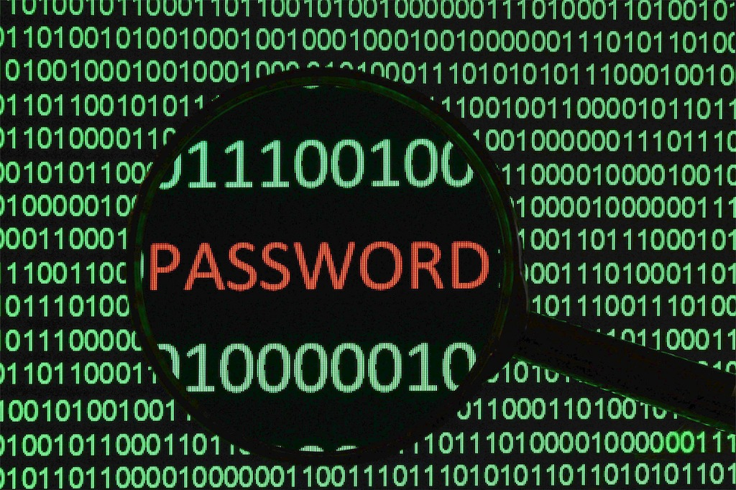


Save password

