Slide 1
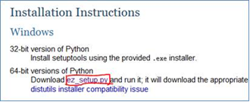
10. Preparation for testing
How to install 4 packages (pip, distribute, virtualenv and nose) in the Windows (Practice 46)?
1) Open http://pypi.python.org/pypi/setuptools#windows
2) Click “ez_setup.py”
3) Save “ez_setup.py”to your Python local disks
4)Run ez_setup.py under doc OS

Slide 2
10. Preparation for testing
How to install 4 packages (pip, distribute, virtualenv and nose) in the Windows (Practice 46)?
5) Download software package to local disk and uncompression.
pip – http://pypi.python.org/pypi/pip
distribute – http://pypi.python.org/pypi/distribute
nose – http://pypi.python.org/pypi/nose/
virtualenv – http://pypi.python.org/pypi/virtualenv

Slide 3
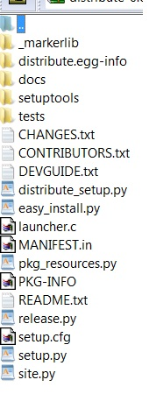
10. Preparation for testing
How to install 4 packages (pip, distribute, virtualenv and nose) in the Windows (Practice 46)?
6) Enter package location
One example for distribute 0.6.35
7) Run the below commands:
setup.py build
setup.py install

