Slide 1
Gauss-Markov Model
蒋智超
2025年 秋
Notes:
最小二乘估计不需要任何假设
但是要研究最小二乘的估计量有什么性质，需要一定的模型假设。
问题一：最小二乘估计的均值方差是什么，为什么要用最小二乘估计而不是其他的估计 optimality of OLS
问题二：最小二乘估计有什么统计性质，如何做统计推断，即从有限样本得到的beta hat 去估计总体中的beta，有什么样的不确定性
第一个问题 用gauss markov model
第二个用Normal linear model

Slide 2

Regression model
Describe the systematic fashion of the tendency of $Y$ to vary with $x$.
Describe how the points (realization of the random variable $Y$) are scattered around the curve of the statistical relation $f\left(x_{i}\right)$
Typical forms
$E\left(Y_{i}\right)=f(x_{i})$
$Y_{i} =f\left(x_{i}\right)+ε_{i}$

Slide 3

Linear model
One type of regression model where $f(x)$ is a linear function
Key assumption: The response will change by the same amount for each unit of change in the regressor.
Simple linear regression:
$$Y_{i} =a+bx_{i}+ε_{i}$$
Multiple linear regression:
$$Y_{i} =α+β_{1}x_{i1}+β_{2}x_{i2}+…+β_{p}x_{ip}+ε_{i}$$
$$Y=Xβ+ε$$

Slide 4
Two important models
Different assumptions on the error term
Gauss-Markov model
Unbiasedness and optimality of OLS
Inadequate for exact statistical inference
Normal linear model
Additional distributional assumption
Enables statistical inference

Slide 5
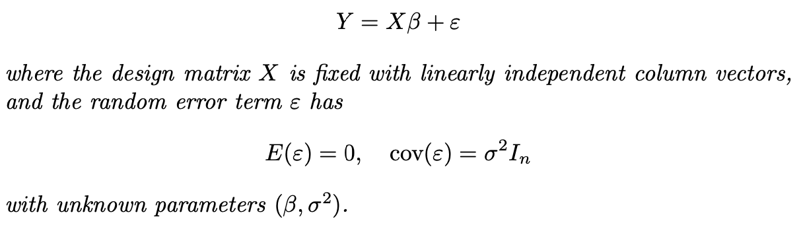
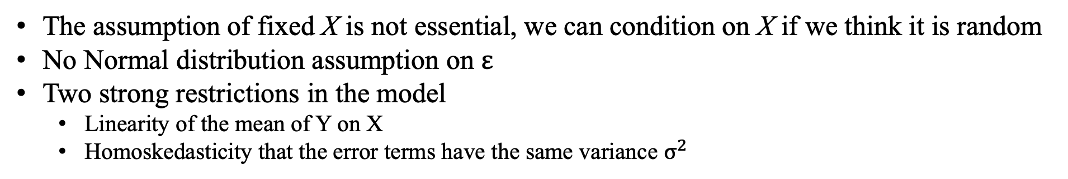
Gauss-Markov model
Gauss Markov model
The assumption of fixed X is not essential, we can condition on X if we think it is random
No Normal distribution assumption on $ε$
Two strong restrictions in the model
Linearity of the mean of Y on X
Homoskedasticity that the error terms have the same variance $σ^{2}$
Notes:
当有了stochastic assumptions 才能讨论期望 方差 分布等等
统计中一般假设X fixed 计量经济中 假设X 随机， 理论是等价的 fixed X = conditional on X
E(Y)=Xbeta cov(Y)= sigma^2 I_n
Why E(epsilon) = 0? Y =alpha + betaX + \epsilon = (\alpha+c) +betaX + (\epsilon-c) identifiability issus
Yi and Yj are independent, violation: cluster
Transformation of Y

Slide 6


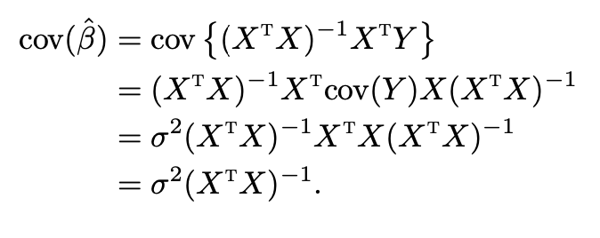
OLS properties under the Gauss-Markov model
Mean:
Variance:
Proof

Slide 7
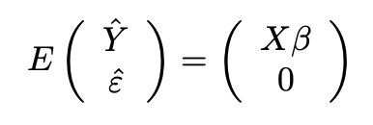
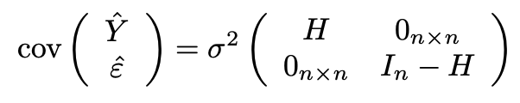
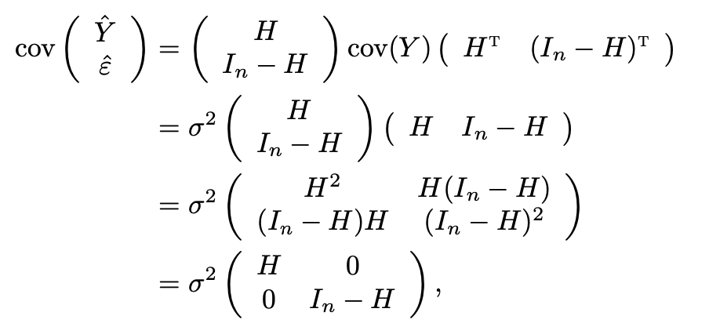
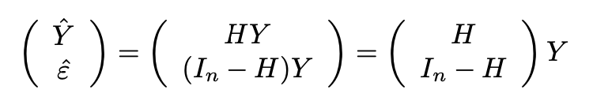
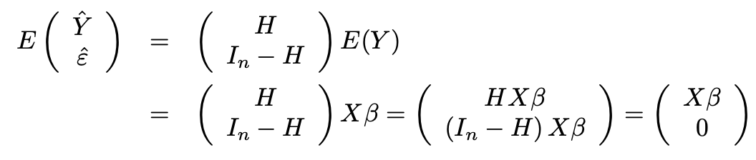
OLS properties under the Gauss-Markov model
Theorem 1
Proof
Notes:
Two statements：
1. Y hat and epsilon hat are orthogonal algebraic, relationship between two vectors
2. Y hat and epsilon hat are uncorrelated stochastic relationship between two random vectors

Slide 8
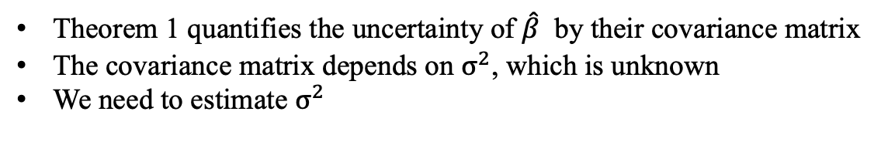
OLS properties under the Gauss-Markov model
Theorem 1 quantifies the uncertainty of $\hat{β}$ by their covariance matrix
The covariance matrix depends on $σ^{2}$, which is unknown
We need to estimate $σ^{2}$

Slide 9

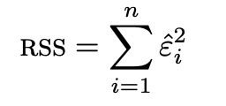
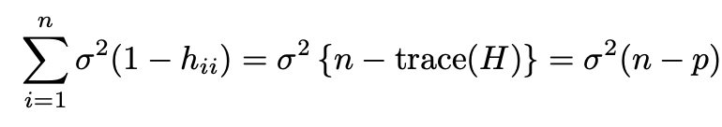
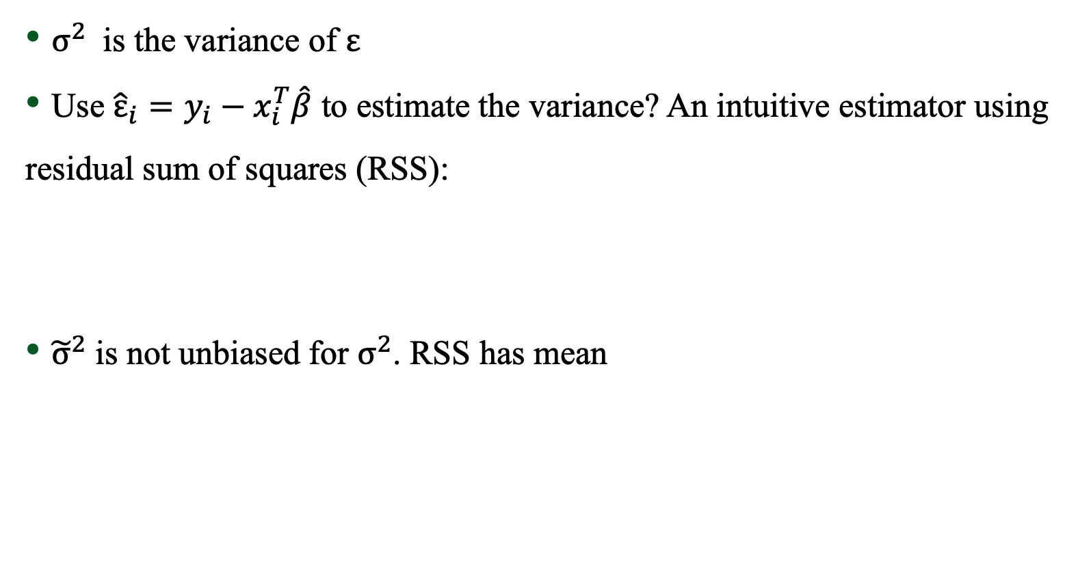
Variance estimation
$σ^{2}$ is the variance of $ε$
Use ${\hat{ε}}_{i}=y_{i}−x_{i}^{T}\hat{β}$ to estimate the variance? An intuitive estimator using residual sum of squares (RSS):
${\tilde{σ}}^{2}$ is not unbiased for $σ^{2}$. RSS has mean

Slide 10
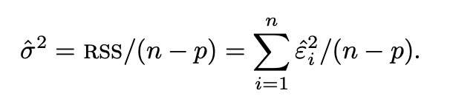
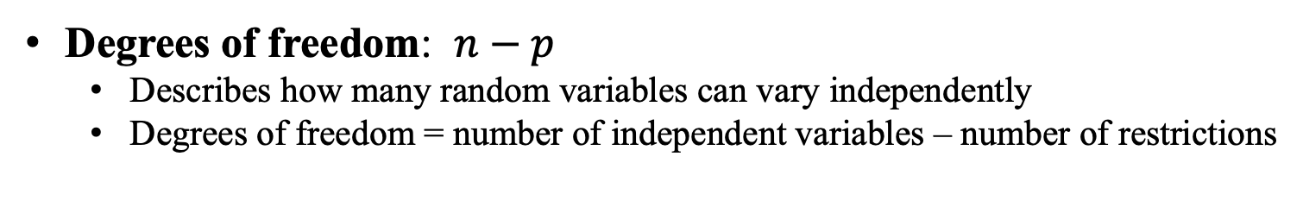
Variance estimation
Unbiased variance estimator
Degrees of freedom: $n−p$
Describes how many random variables can vary independently
Degrees of freedom = number of independent variables – number of restrictions
Notes:
Sample variance

Slide 11

Revisit the sample variance formula
$X_{1},…,X_{n}$ are i.i.d. with mean $μ$ and variance $σ^{2}$
Sample variance $S^{2}=\frac{1}{n−1}∑{\left(X_{i}−\overline{X}\right)}^{2}$
$E\left(S^{2}\right)=σ^{2}$
A regression perspective
Gauss-Markov model: $X_{i}=μ+ε_{i}$, $E\left(ε_{i}\right)=0$
OLS estimate: $\hat{μ}=\overline{X}$
$\text{RSS}=\left(n−1\right)S^{2}$

Slide 12

Revisit the pooled sample variance formula
$X_{1},…,X_{n}$ are i.i.d. with mean $μ_{1}$ and variance $σ^{2}$, $Y_{1},…,Y_{m}$ are i.i.d. with mean $μ_{2}$ and variance $σ^{2}$
pooled variance $S_{pool}^{2}=\frac{1}{n+m−2}\{∑{\left(X_{i}−\overline{X}\right)}^{2}+∑{\left(Y_{j}−\overline{Y}\right)}^{2}$}
$E\left(S_{pool}^{2}\right)=σ^{2}$
A regression perspective
Gauss-Markov model: $X_{i}=μ_{1}+ε_{i}, Y_{j}=μ_{2}+ε_{j},$ $E\left(ε_{i}\right)=0$ for $i=1,…,n+m$
OLS estimate: ${\hat{μ}}_{1}=\overline{X},{\hat{μ}}_{2}=\overline{Y}$
$\text{RSS}=\left(n+m−2\right)S_{pool}^{2}$

Slide 13

Revisit the SSW (Sum of Squares Within)
$X_{1j},…,X_{n_{j}j}$ $j=1,…,b$ are i.i.d. with mean $μ_{j}$ and variance $σ^{2}$
SSW $= ∑{∑\left(X_{ij}−{\overline{X}}_{⋅j}\right)}^{2}$
Degrees of freedom$=$
A regression perspective
Gauss-Markov model: $X_{ij}=μ_{j}+ε_{ij}, E\left(ε_{ij}\right)=0$
OLS estimate: ${\hat{μ}}_{j}={\overline{X}}_{⋅j}$
$\text{RSS}=$

Slide 14

Gauss-Markov theorem
Why should we focus on the OLS estimator?
Why not use other functions of “misfits”?
Is it optimal in some sense?
Gauss-Markov theorem
$\hat{β}$ has the smallest covariance matrix among all linear unbiased estimators
Named after Carl Friedrich Gauss and Andrew Markov
The corresponding model is called Gauss-Markov model
Notes:
Smallest cov means most efficient

Slide 15
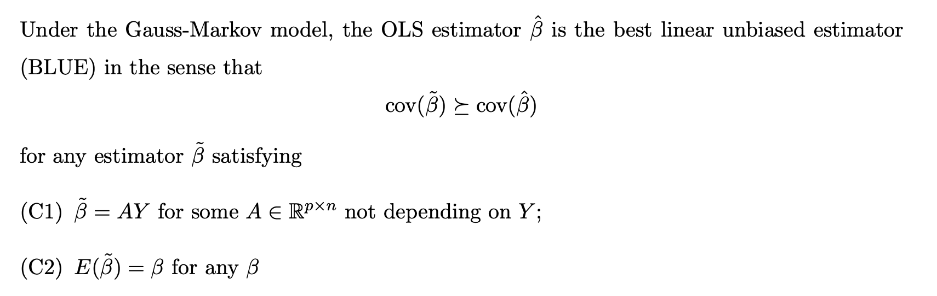
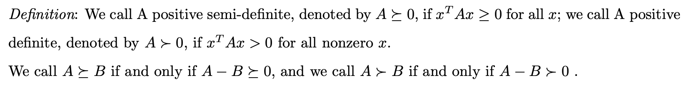
Gauss-Markov theorem

Slide 16
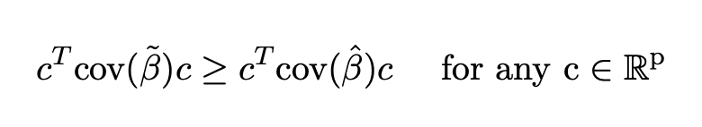

Gauss-Markov theorem
Condition (C1)
Linear transformation of $Y$
$A$ can be nonlinear function of $X$
Condition (C2) : $\tilde{β}$ is an unbiased estimator of $β$
Implication:
OLS estimator has smaller variance than other estimators for all coordinates
Notes:
The class of linear estimator is quite large because A can be any nonlinear function of X, and the only requirement is that the estimator is linear in Y.
In many modern applications with many covariates, some biased estimators can perform better than unbiased estimators if they have smaller variance.

Slide 17
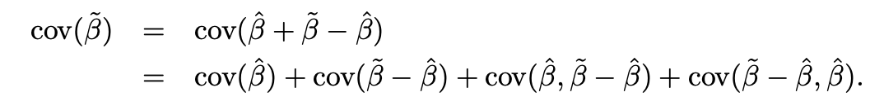
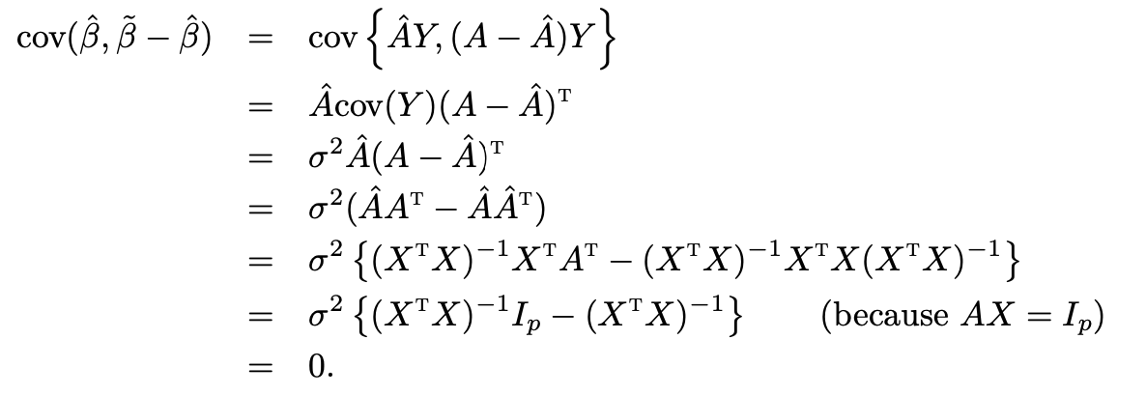


Gauss-Markov theorem: proof
$\hat{β}$ is a linear unbiased estimator
Decomposition

Slide 18


Other linear unbiased estimators
Linear unbiased estimators only need to satisfy $AX=I_{p}$
$np−p^{2}$ free parameters to choose
Infinitely many linear unbiased estimators
A class of linear unbiased estimators: weighted least squares estimator
Notes:
Less efficient than OLS under Gauss Markov model

Slide 19

多选题
1分
If the Gauss-Markov model holds except for homoskedasticity, what changes?
A
OLS becomes biased
B
OLS still unbiased but not efficient
C
OLS still unbiased and efficient
D
OLS cannot be computed
提交

Slide 20
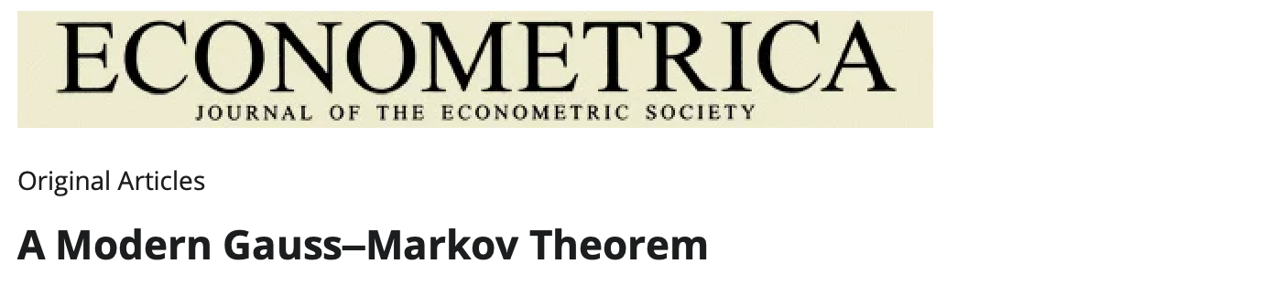
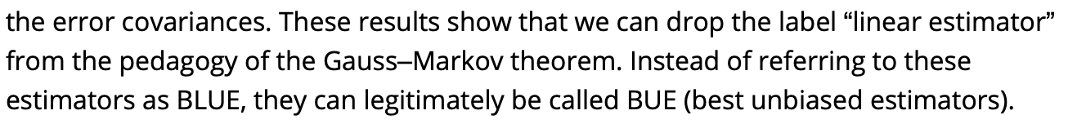
A modern Gauss-Markov Theorem?
Critics argue that Hansen's results are either equivalent to the classical theorem (with linearity reintroduced indirectly) or introduce extra, unnecessary assumptions.

