Slide 1
Lasso
蒋智超
2025年 秋

Slide 2
Motivation
Ridge regression works well for prediction, but it is difficult to interpret many small but non-zero coefficients
Tibshirani (1996) proposed to use the lasso, the acronym for the Least Absolute Shrinkage and Selection Operator
Simultaneously estimate parameters and select important variables in the linear regression
By changing the penalty in the ridge regression, the lasso automatically estimates some
parameter as zero, dropping them out of the model and thus selecting the remaining variables
as important predictors
Notes:
Ridge regression 主流是做预测，效果不错，但不一定能帮你选到真模型。如果p>n，它并不能告诉你哪些参数X=0，它可以帮你缩小某些beta的估计，只能把它变得很小。但是lasso 可以帮你选择哪些是正确的X。

Slide 3
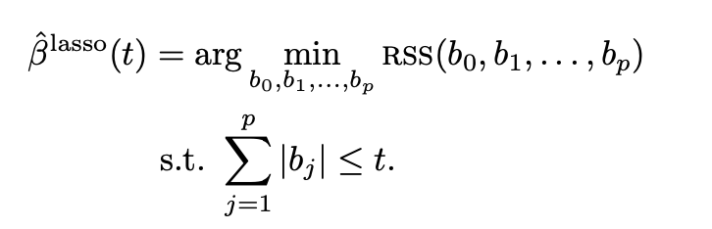
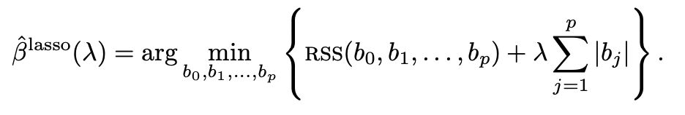
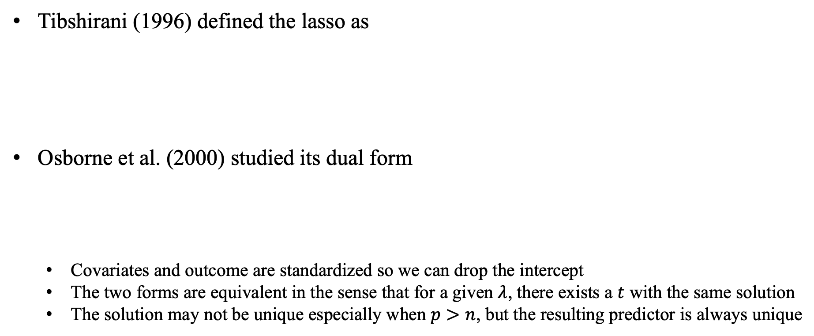
Definition
Tibshirani (1996) defined the lasso as
Osborne et al. (2000) studied its dual form
Covariates and outcome are standardized so we can drop the intercept
The two forms are equivalent in the sense that for a given $λ$, there exists a $t$ with the same solution
The solution may not be unique especially when $p>n$, but the resulting predictor is always unique
Notes:
和Ridge regression的区别是b的平方变成了b的绝对值。它的缺点是绝对值不可导，需要用一些凸优化的方法去求解；它的解是不唯一的，p>n的时候lasso不一定有唯一解，但是他们对应的值是一样的。
带有惩罚项的回归都是有偏的。

Slide 4
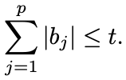

A geometric perspective of the lasso
The OLS minimizes
With the penalty, the OLS coefficient may not satisfy
The lasso can give sparse solutions due to the non-smooth penalty term
Notes:
为什么lasso改了这个惩罚项就这么有名？和Ridge有什么区别？

Slide 5
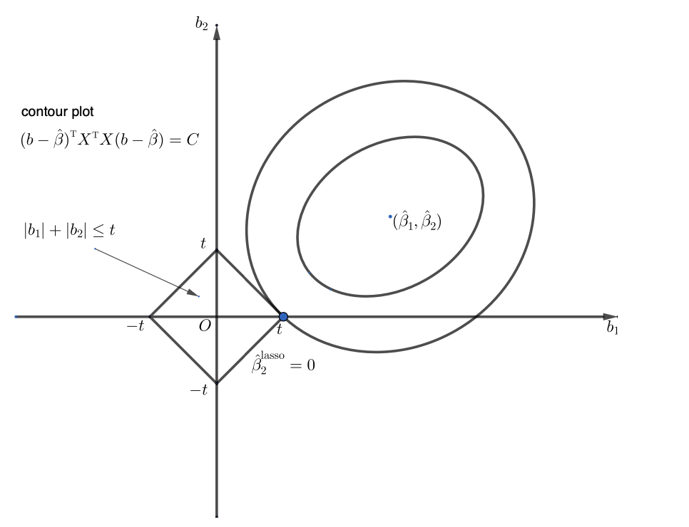
A geometric perspective of the lasso
Notes:
这个切点很有可能是切在端点处的，端点就意味着有一个参数=0，lasso相比Ridge更能说明，某些参数是不需要选择的。

Slide 6
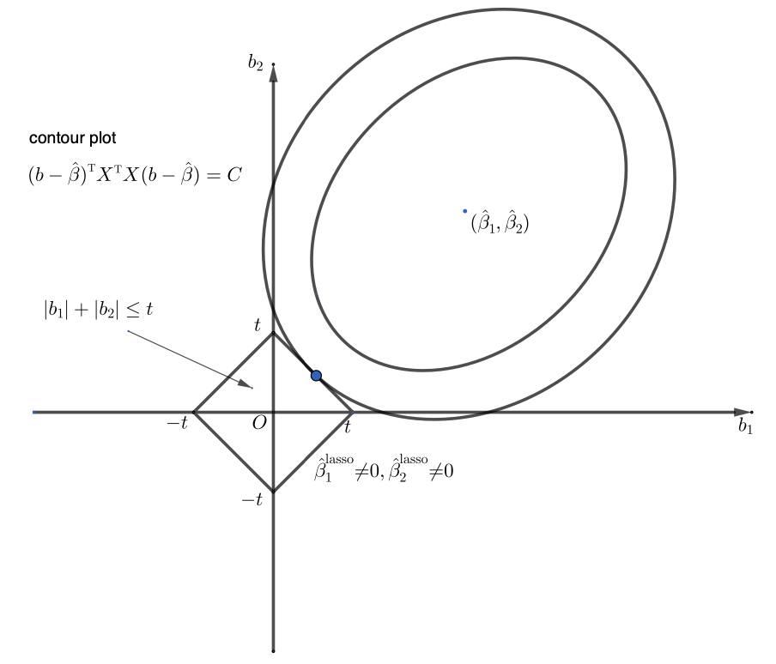
A geometric perspective of the lasso

Slide 7
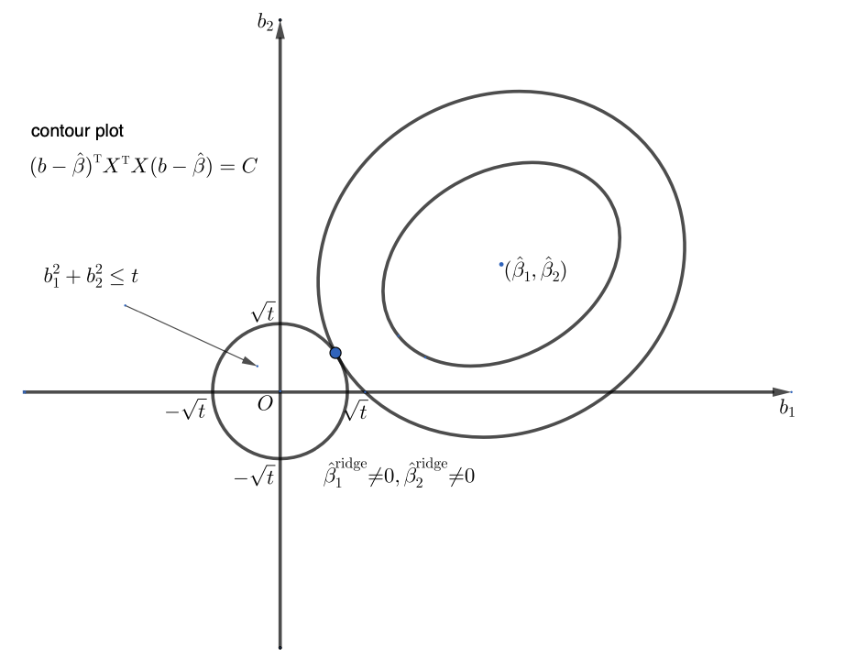
A geometric perspective of the ridge regression

Slide 8

Computing the lasso
Key challenge: $|b_{j}|$ is not differentiable
Optimization via coordinate descent

Slide 9
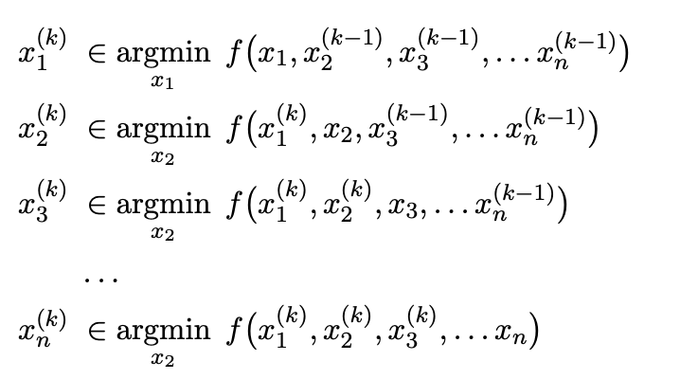
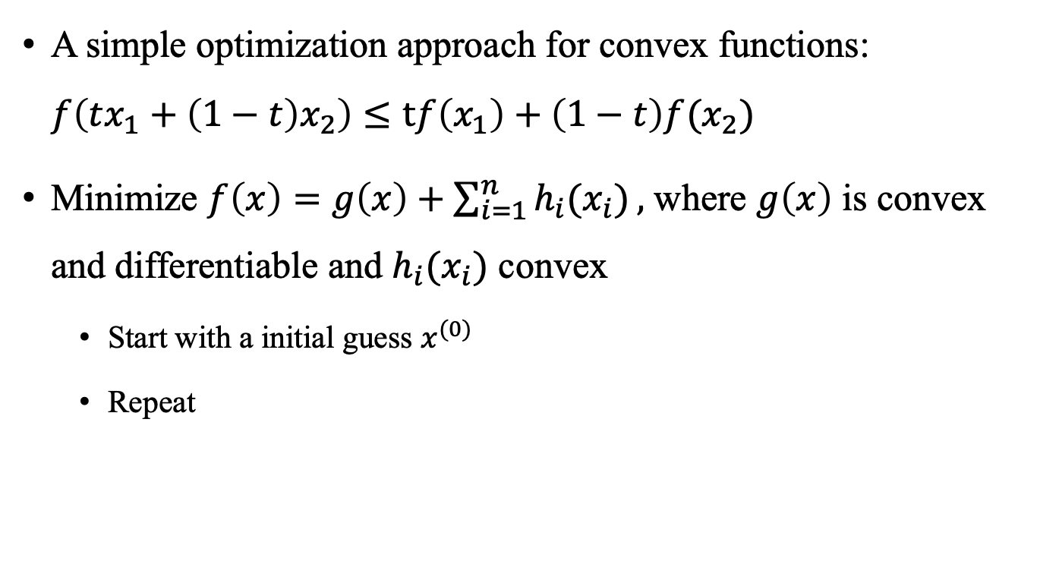
Coordinate descent
A simple optimization approach for convex functions: $f\left(tx_{1}+\left(1−t\right)x_{2}\right)≤\operatorname{tf}\left(x_{1}\right)+\left(1−t\right)f(x_{2})$
Minimize $f\left(x\right)=g\left(x\right)+\sum_{i=1}^{n}{h_{i}(x_{i})},$ where $g\left(x\right)$ is convex and differentiable and $h_{i}(x_{i})$ convex
Start with a initial guess $x^{(0)}$
Repeat
Notes:
Order of cycle through coordinates is arbitrary

Slide 10
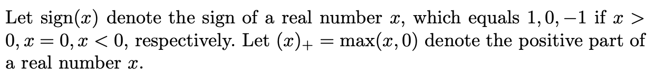
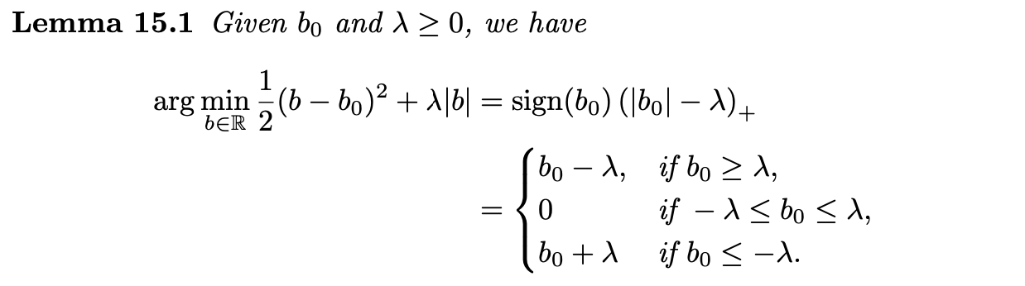

Computing the lasso via coordinate descent
Denote
Notes:
The glmnet package in R uses the coordinate descent algorithm

Slide 11
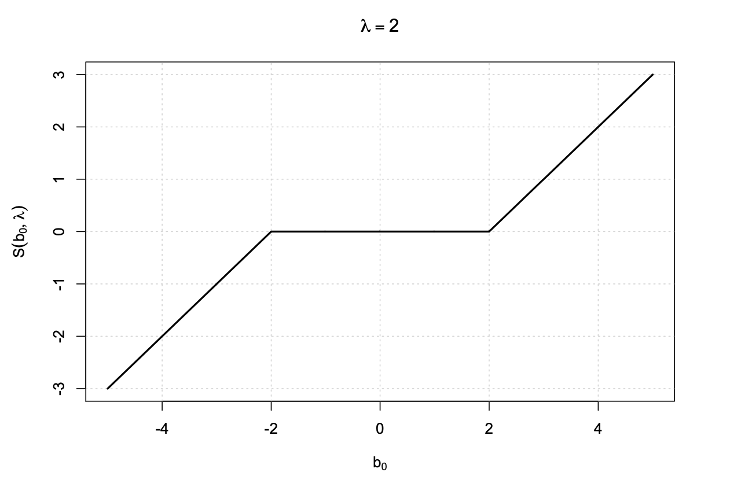
Soft thresholding

Slide 12
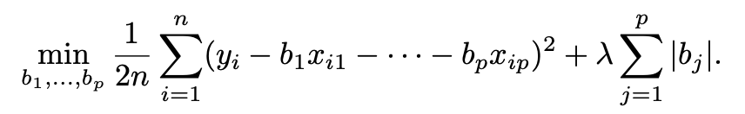
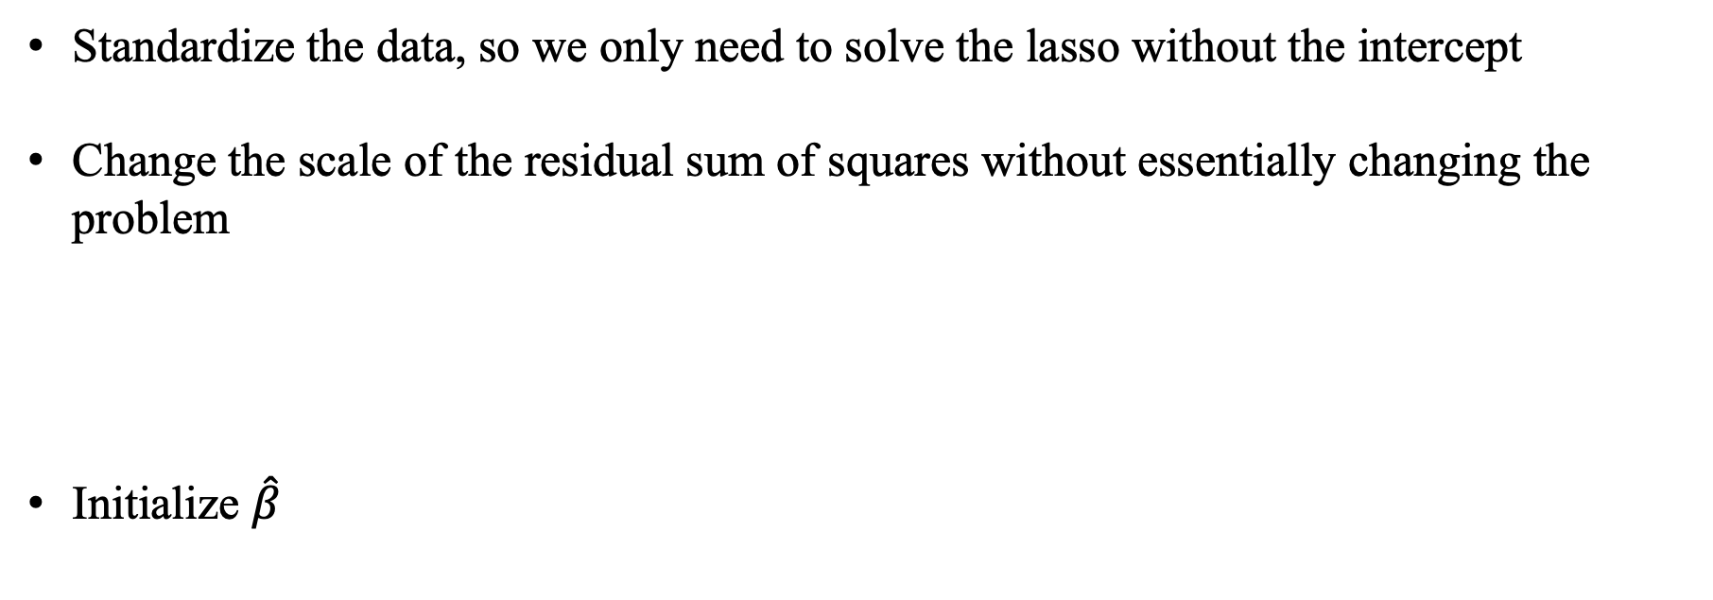
Coordinate descent for the lasso
Standardize the data, so we only need to solve the lasso without the intercept
Change the scale of the residual sum of squares without essentially changing the problem
Initialize $\hat{β}$

Slide 13
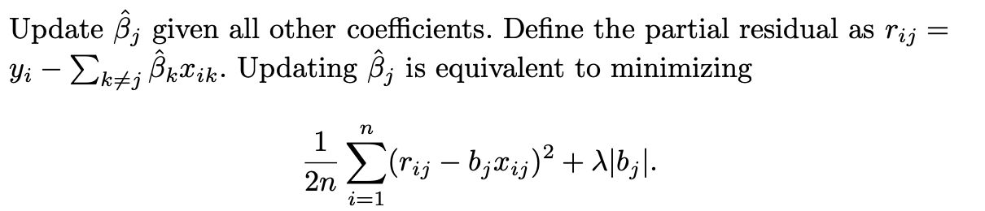
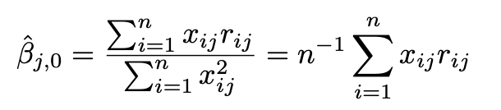
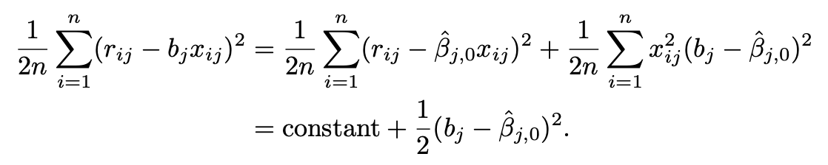

Coordinate descent for the lasso
Define
Iterate until convergence

Slide 14
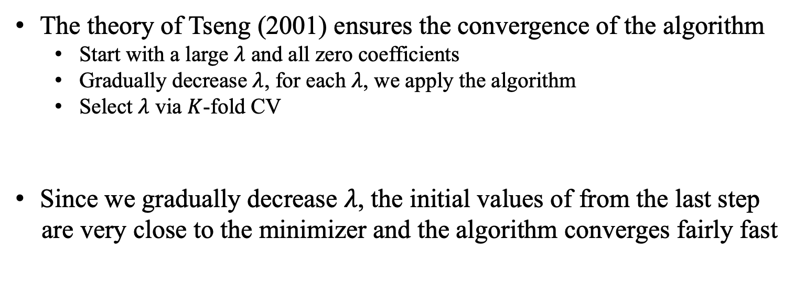
Coordinate descent for the lasso
The theory of Tseng (2001) ensures the convergence of the algorithm
Start with a large $λ$ and all zero coefficients
Gradually decrease $λ$, for each $λ$, we apply the algorithm
Select $λ$ via $K$-fold CV
Since we gradually decrease $λ$, the initial values of from the last step
are very close to the minimizer and the algorithm converges fairly fast

Slide 15
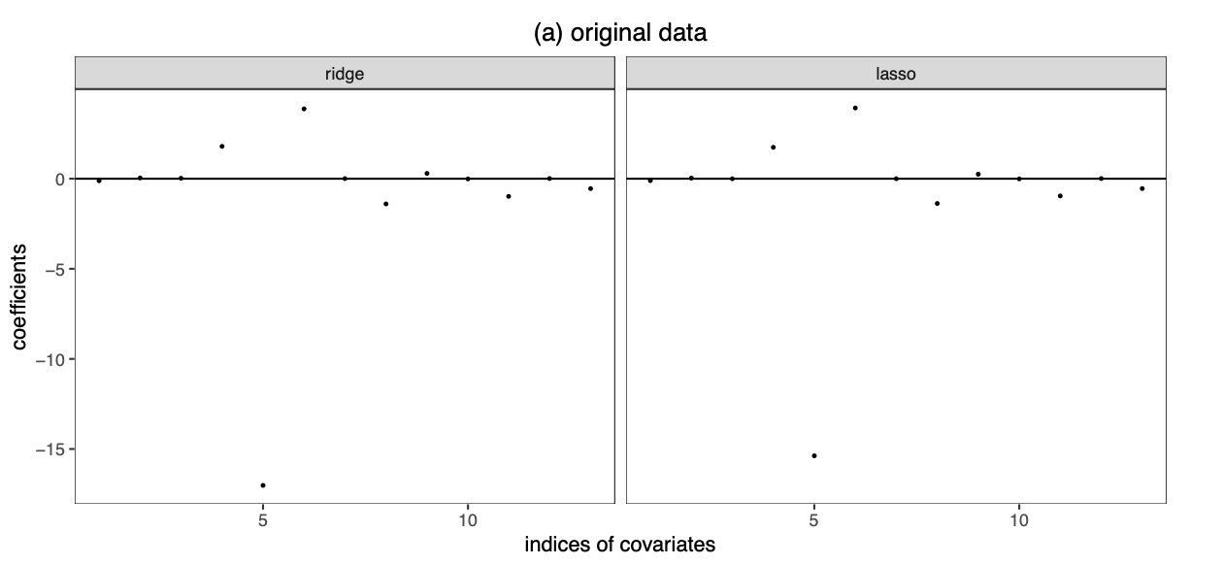

Boston housing data analysis

Slide 16
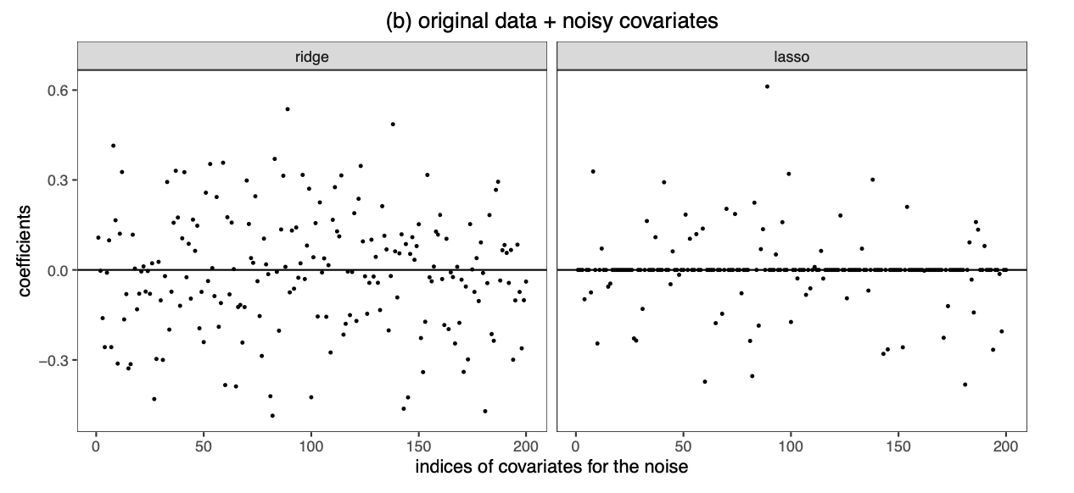

Boston housing data analysis
Notes:
加入了两百个噪声（随机生成数据），可以看到Ridge很多都是接近0，没有选择参数。但是lasso很多都是0，选择了参数。

Slide 17
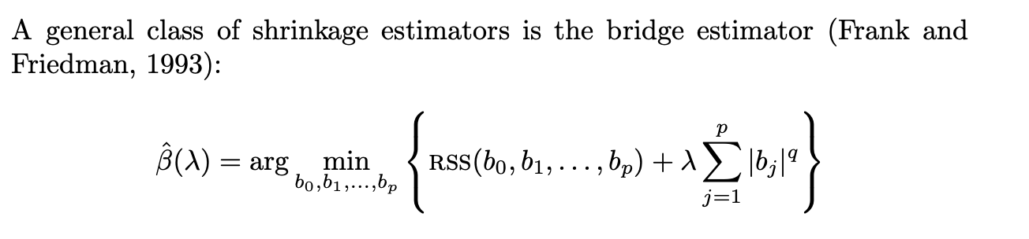
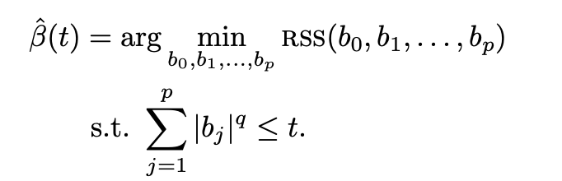
Other shrinkage estimator
Dual form

Slide 18
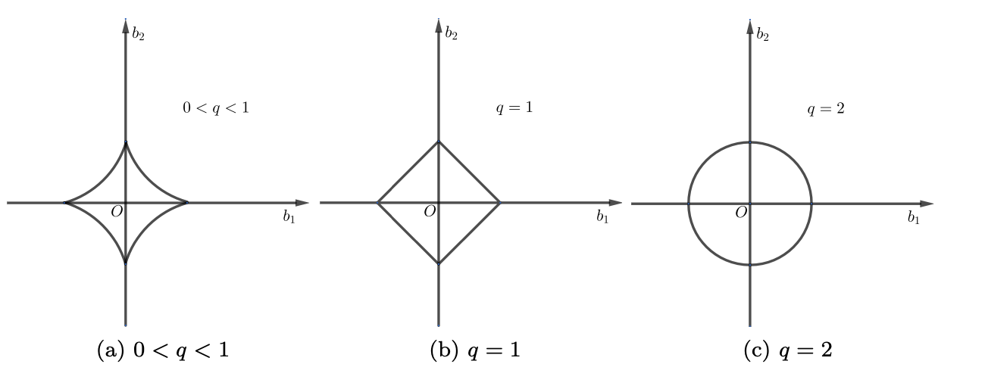
Other shrinkage estimator

Slide 19
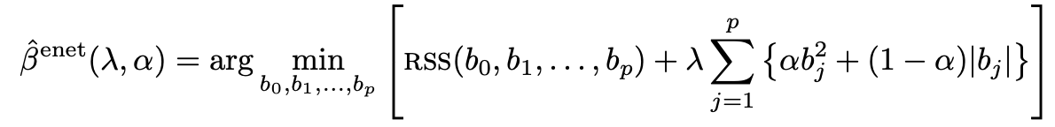
Other shrinkage estimator
Zou and Hastie (2005) proposed the elastic net, which combines the penalties of the
lasso and ridge
Because the constraint is not smooth, it encourages sparse solution as the lasso
Due to the ridge penalty, it can deal with collinearity of the covariates better than
the lasso
Implemented in glmnet package

Slide 20
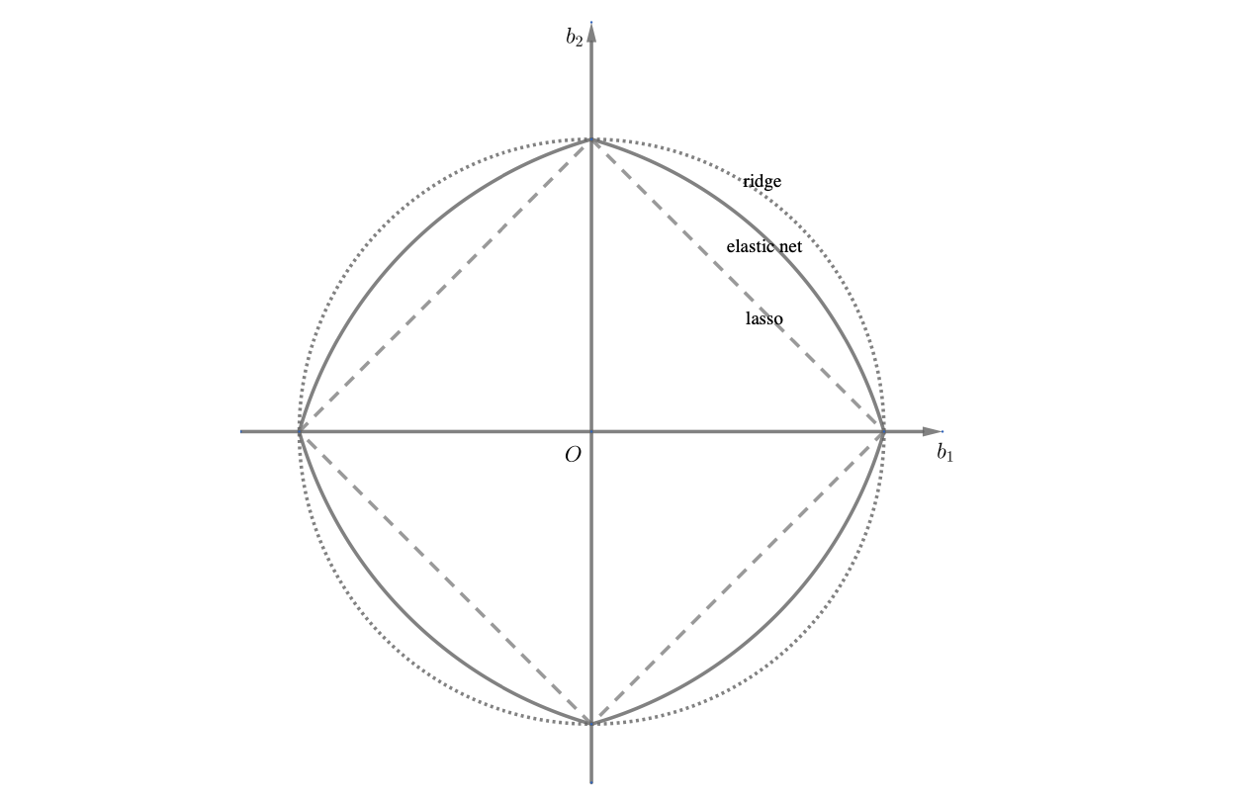
Other shrinkage estimator

