Slide 1
Transformation
蒋智超
2025年 秋

Slide 2
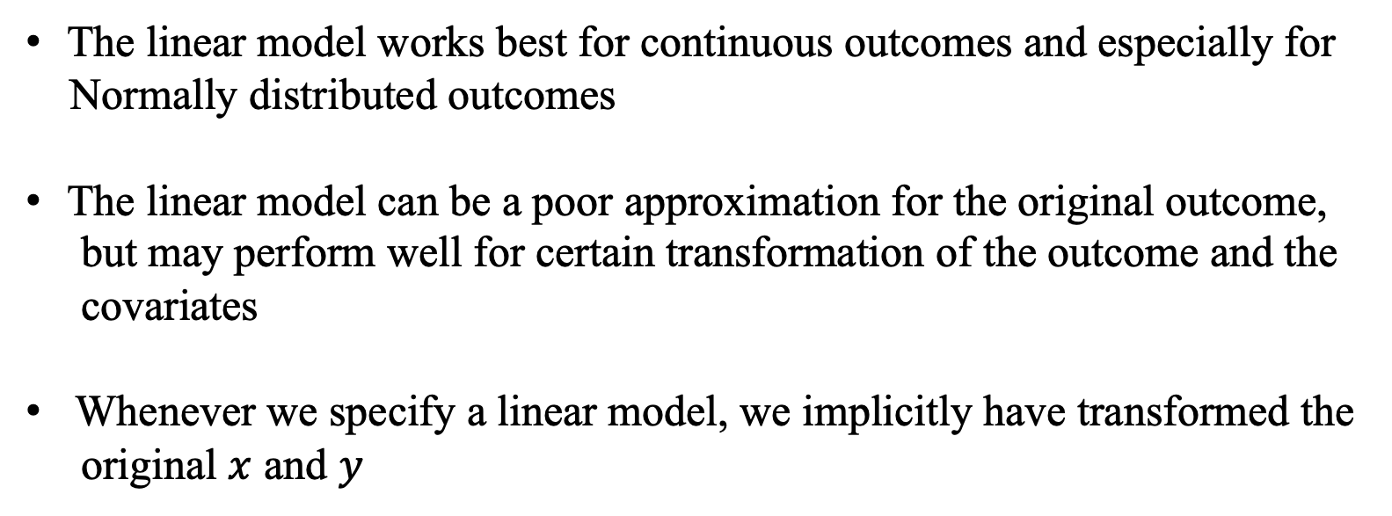
Transformation
The linear model works best for continuous outcomes and especially for
Normally distributed outcomes
The linear model can be a poor approximation for the original outcome,
but may perform well for certain transformation of the outcome and the
covariates
Whenever we specify a linear model, we implicitly have transformed the
original $x$ and $y$
Notes:
Carroll and Ruppert (1988) is a textbook on this topic
虽然我们有EHW，但是模型还是在估计量接近正态分布的时候效果最好，所以要做transformation

Slide 3

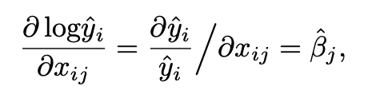
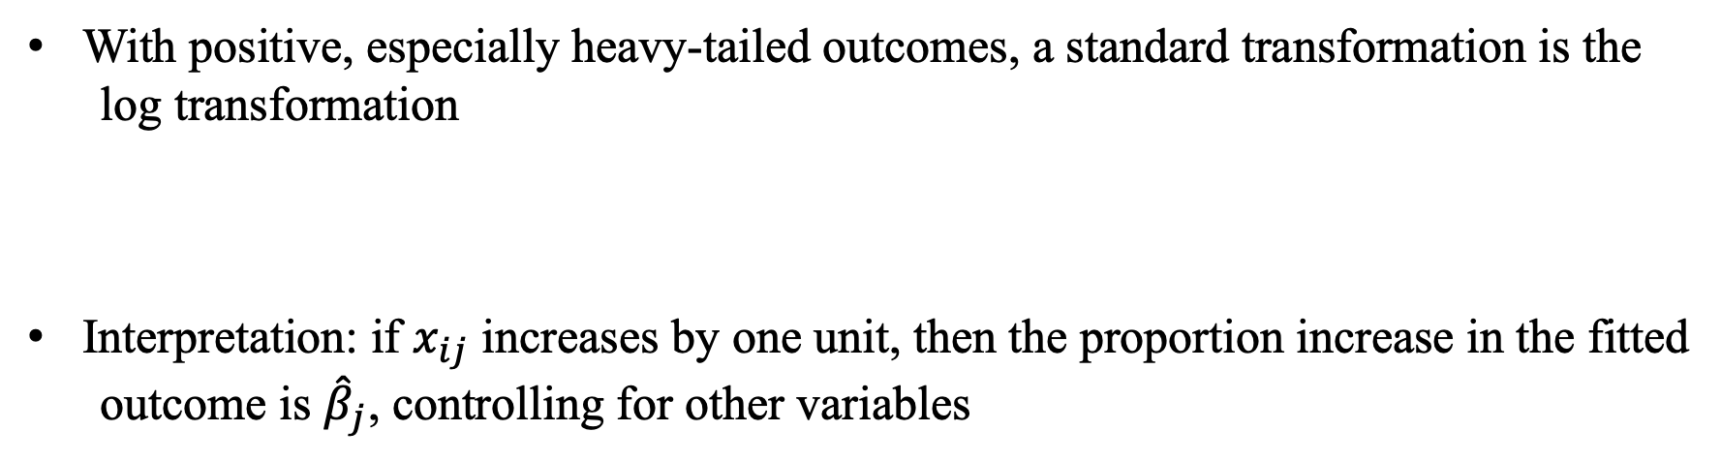
Log transformation of the outcome
With positive, especially heavy-tailed outcomes, a standard transformation is the
log transformation
Interpretation: if $x_{ij}$ increases by one unit, then the proportion increase in the fitted
outcome is ${\hat{β}}_{j}$, controlling for other variables
Notes:
In economics, βˆj is the semi-elasticity of y on xj in the model with log transformation on the outcome.

Slide 4


多选题
1分
If we regression $\log{Y}$ on a binary variable $Z$, which of the following statements about the coefficient of $Z$ is correct?
A
$β$ represents $\log{E(Y∣Z=1)}−\log{E(Y∣Z=0)}$
B
$β$ represents $\log{\{E\left(Y ∣ Z=1\right)−E\left(Y ∣ Z=0\right)\}}$
C
$β$ represents $E\left(\log{Y} ∣ Z=1\right)−E(\log{Y}∣Z=0)$
D
$β$ represents $\frac{E\left(Y ∣ Z=1\right)−E(Y∣Z=0)}{E(Y∣Z=1)}$
提交

Slide 5
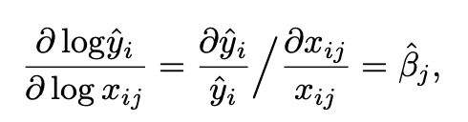

Log transformation
Sometimes, we may apply the log transformation on both the outcome and a certain covariate
Interpretation: if $x_{ij}$ increases by 1%, then the fitted outcome will increase by ${\hat{β}}_{j}$%, controlling for other variables
Notes:
In economics, βˆj is the xj-elasticity of y in the model with log transformation on both the outcome and xj.

Slide 6
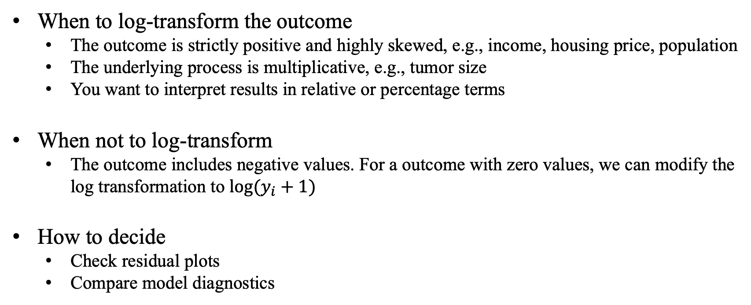
Remark
When to log-transform the outcome
The outcome is strictly positive and highly skewed, e.g., income, housing price, population
The underlying process is multiplicative, e.g., tumor size
You want to interpret results in relative or percentage terms
When not to log-transform
The outcome includes negative values. For a outcome with zero values, we can modify the log transformation to $log⁡(y_{i}+1)$
How to decide
Check residual plots
Compare model diagnostics

Slide 7
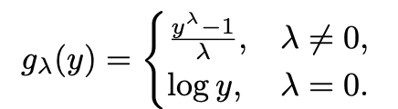
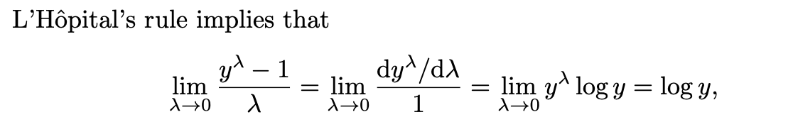

Box-Cox transformation
Box-Cox transformation unifies the log transformation and the power transformation
$g_{λ}(y)$ is continuous at $λ=0$
Can we choose $λ$ based on data?

Slide 8
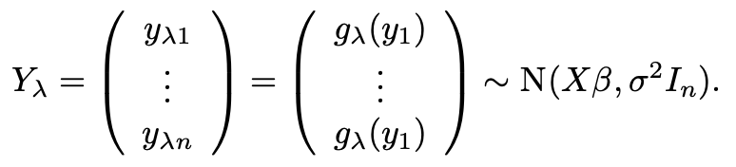
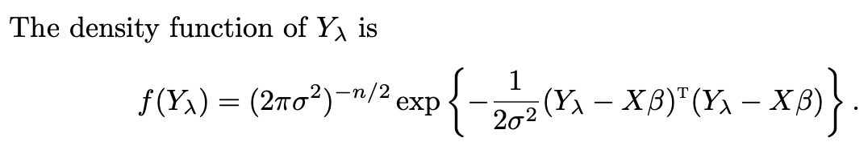


Estimating $λ$
Box and Cox (1964) proposed a strategy based on the maximum likelihood under
the Normal linear model
$$n$$

Slide 9
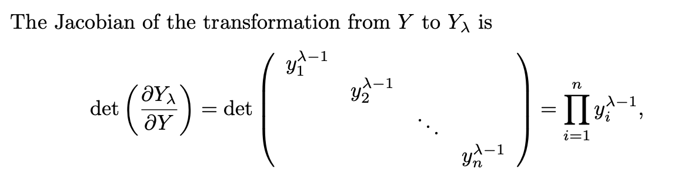
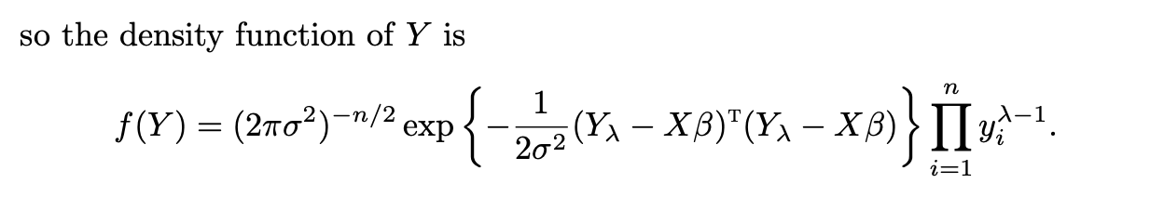
Estimating $λ$
We can treat this as the likelihood function, defined as $L(β,σ^{2},λ)$

Slide 10


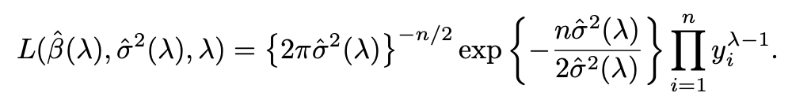
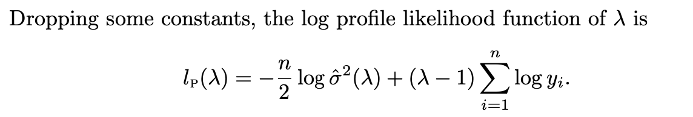
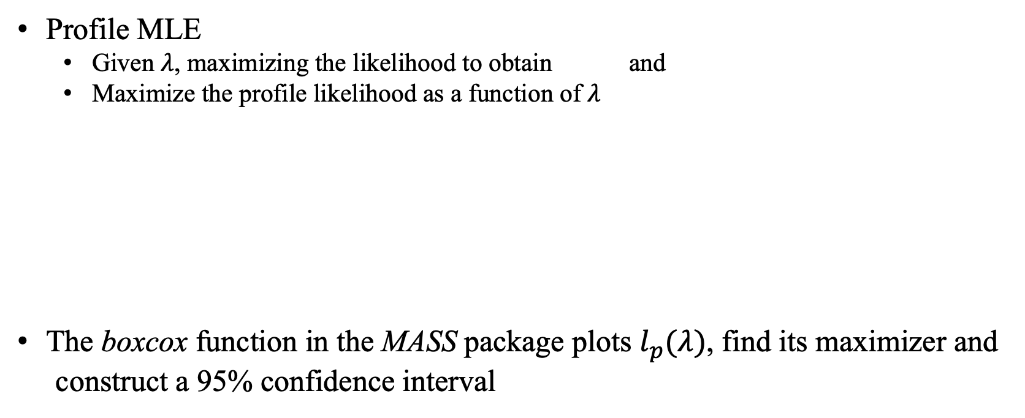
Estimating $λ$
Profile MLE
Given $λ$, maximizing the likelihood to obtain and
Maximize the profile likelihood as a function of $λ$
The boxcox function in the MASS package plots $l_{p}(λ)$, find its maximizer and
construct a 95% confidence interval

Slide 11
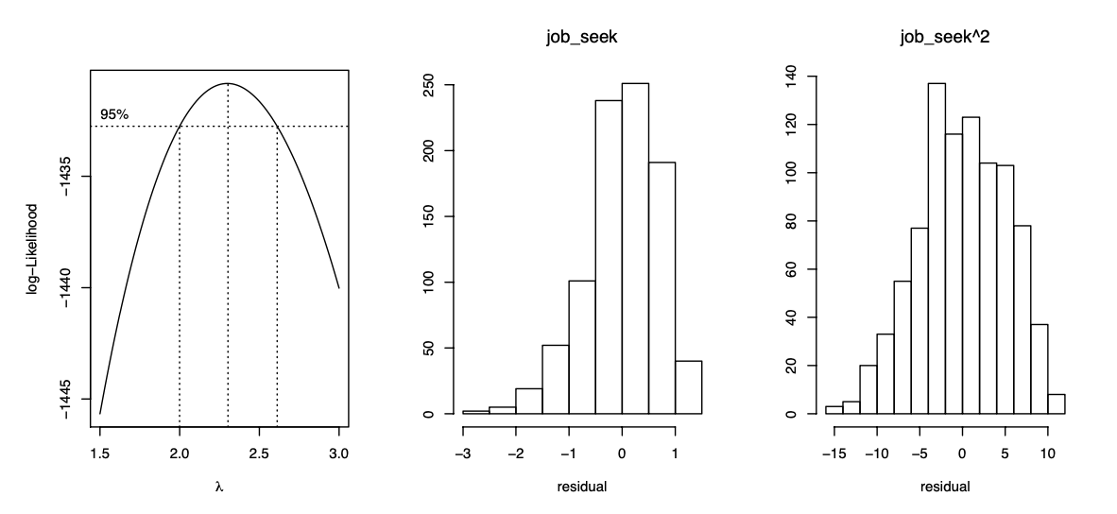
Jobs data analysis

Slide 12



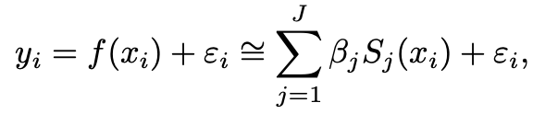
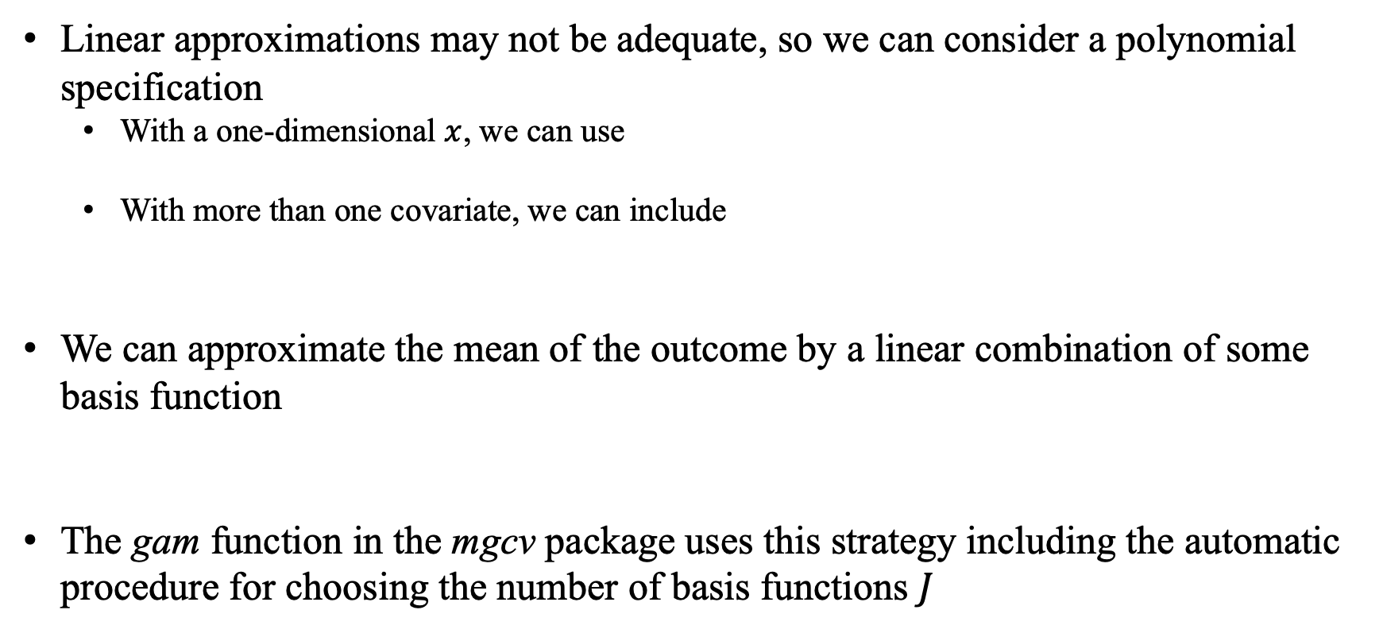
Transformation of the covariates
Linear approximations may not be adequate, so we can consider a polynomial specification
With a one-dimensional $x$, we can use
With more than one covariate, we can include
We can approximate the mean of the outcome by a linear combination of some basis function
The gam function in the mgcv package uses this strategy including the automatic procedure for choosing the number of basis functions $J$
Notes:
In economics, it is almost the default choice to include the quadratic term of working experience in the log wage equation.

Slide 13
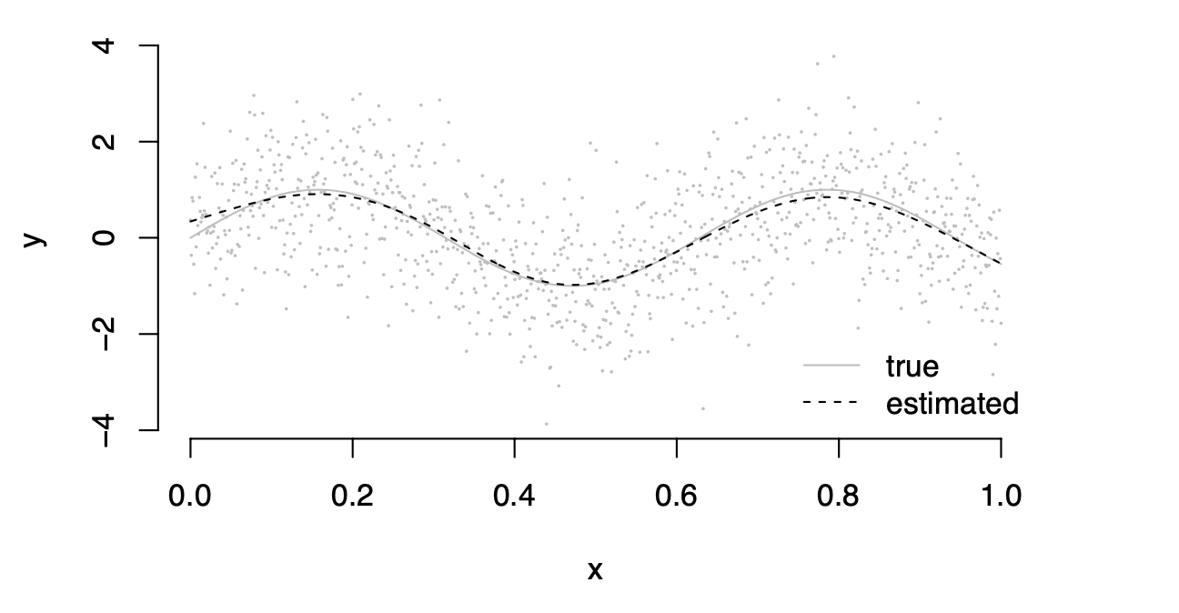
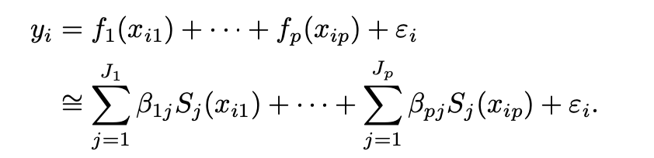
Example
True function is a sine function
The generalized additive model is an extension to the multivariate case

Slide 14
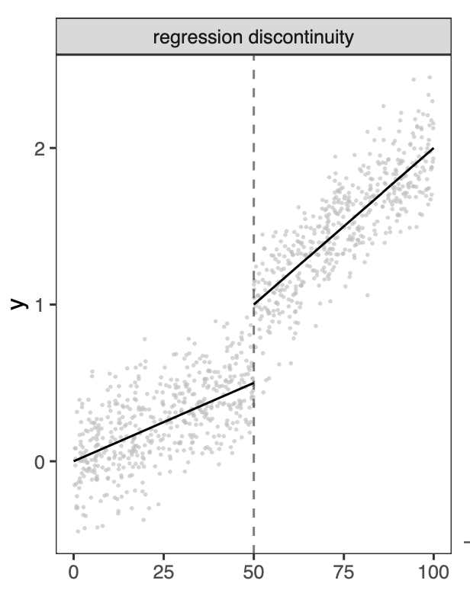
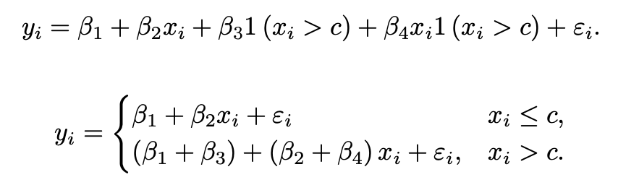

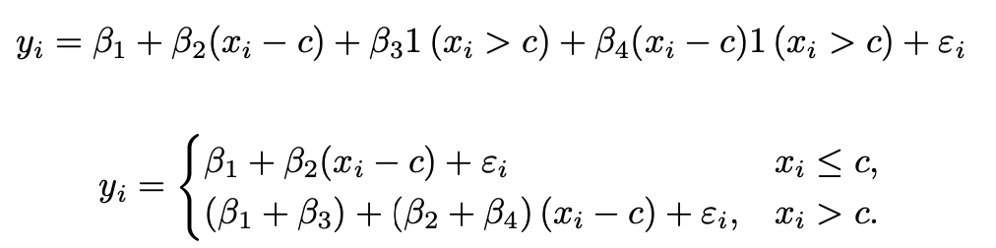

Regression discontinuity
If we center the covariates at $c$

Slide 15
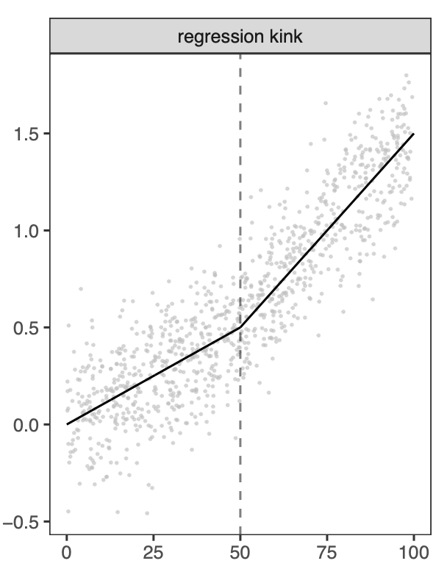
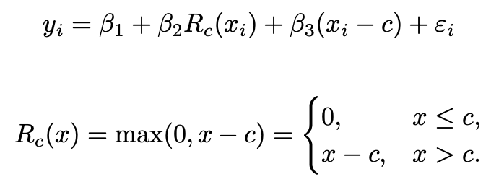
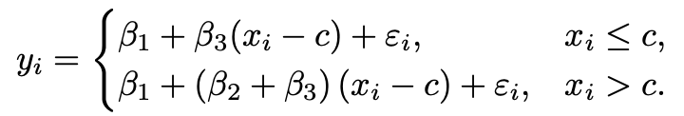
Regression kink
Notes:
more discussions in Angrist and Pischke (2008) and Card et al. (2015).

