Slide 1

Completely Randomized Experiments and FRT
Zhichao Jiang
Sun Yat-sen University
Spring 2026
1 / 19

Slide 2
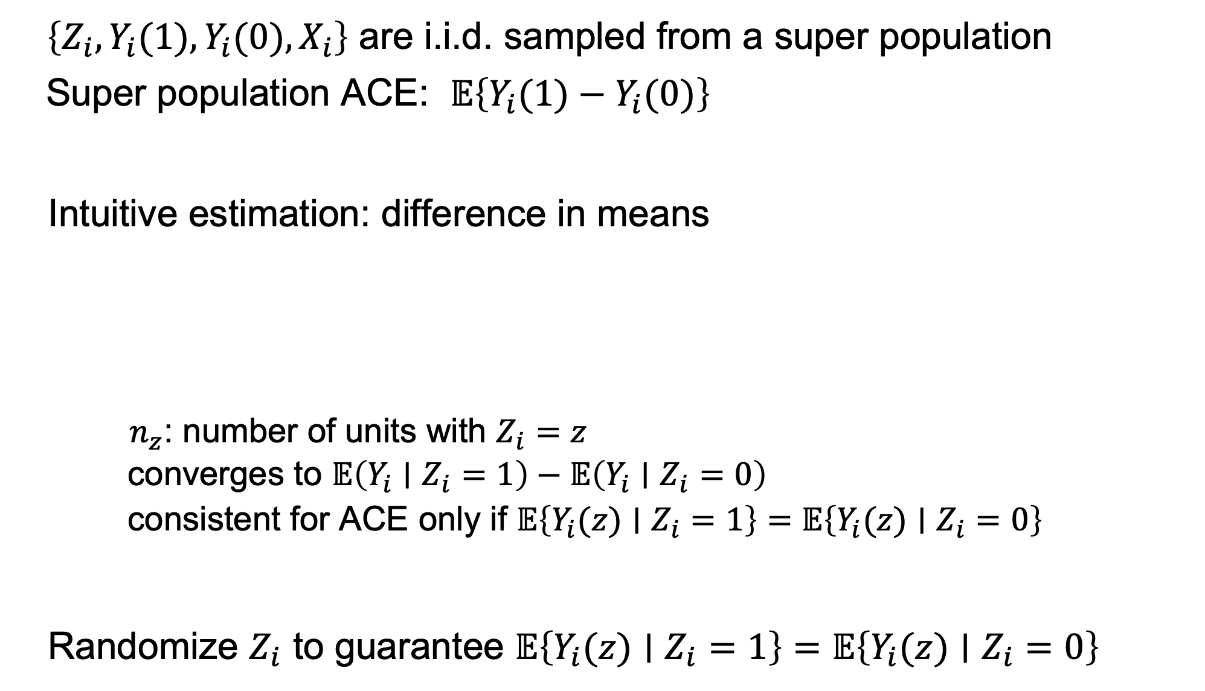
Randomized experiments: super population framework
$\left\{Z_{i},Y_{i}(1),Y_{i}(0),X_{i}\right\}$ are i.i.d. sampled from a super population Super population ACE: $𝔼\left\{Y_{i}(1)−Y_{i}(0)\right\}$
Intuitive estimation: difference in means
$n_{z}$: number of units with $Z_{i}=z$
converges to $𝔼\left(Y_{i}∣Z_{i}=1\right)−𝔼\left(Y_{i}∣Z_{i}=0\right)$
consistent for ACE only if $𝔼\left\{Y_{i}(z)∣Z_{i}=1\right\}=𝔼\left\{Y_{i}(z)∣Z_{i}=0\right\}$
Randomize $Z_{i}$ to guarantee $𝔼\left\{Y_{i}(z)∣Z_{i}=1\right\}=𝔼\left\{Y_{i}(z)∣Z_{i}=0\right\}$
2 / 19

Slide 3
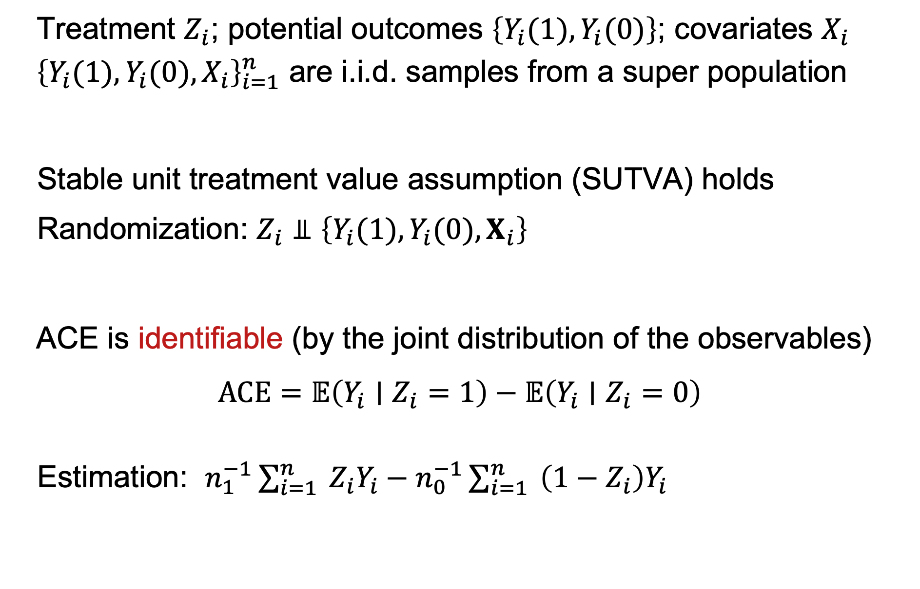
Randomized experiments: super population framework
Treatment $Z_{i}$; potential outcomes $\left\{Y_{i}(1),Y_{i}(0)\right\}$; covariates $X_{i}$ ${\left\{Y_{i}(1),Y_{i}(0),X_{i}\right\}}_{i=1}^{n}$ are i.i.d. samples from a super population
Stable unit treatment value assumption (SUTVA) holds Randomization: $Z_{i}⫫\left\{Y_{i}(1),Y_{i}(0),X_{i}\right\}$
ACE is identifiable (by the joint distribution of the observables)
$ACE=𝔼\left(Y_{i}∣Z_{i}=1\right)−𝔼\left(Y_{i}∣Z_{i}=0\right)$
Estimation: $n_{1}^{−1}\sum_{i=1}^{n}{ }Z_{i}Y_{i}−n_{0}^{−1}\sum_{i=1}^{n}{ }\left(1−Z_{i}\right)Y_{i}$
3 / 19

Slide 4
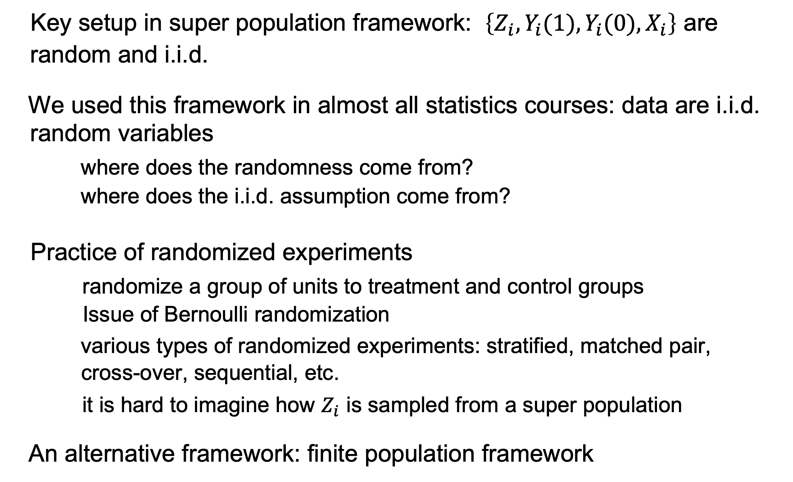
Difficulties under super population framework
Key setup in super population framework: $\left\{Z_{i},Y_{i}(1),Y_{i}(0),X_{i}\right\}$ are random and i.i.d.
We used this framework in almost all statistics courses: data are i.i.d. random variables
where does the randomness come from?
where does the i.i.d. assumption come from?
Practice of randomized experiments
randomize a group of units to treatment and control groups
Issue of Bernoulli randomization
various types of randomized experiments: stratified, matched pair, cross-over, sequential, etc.
it is hard to imagine how $Z_{i}$ is sampled from a super population
An alternative framework: finite population framework
4 / 19

Slide 5

An example of finite population framework from survey sampling
A population with $N$ units
$Y_{i}$: wage of unit $i$
Quantity of interest: average wage $\overset{‾}{Y}=\frac{1}{N}∑_{i=1}^{N} Y_{i}$
$N$ is very large $⇝$ we sample $n$ units from the population: $S_{i}=1$ if
sampled $⇝pr\left(S_{i}=1\right)=n/N$
$$cov\left(S_{i},S_{j}\right)=𝔼\left(S_{i}S_{j}\right)−𝔼\left(S_{i}\right)𝔼\left(S_{j}\right)=\frac{n(n−1)}{N(N−1)}−\frac{n^{2}}{N^{2}}=−\frac{n(N−n)}{N^{2}(N−1)}$$
Estimator $\overset{ˆ}{Y}=\frac{1}{n}\sum_{i=1}^{N}{ }S_{i}Y_{i}$
5 / 19

Slide 6
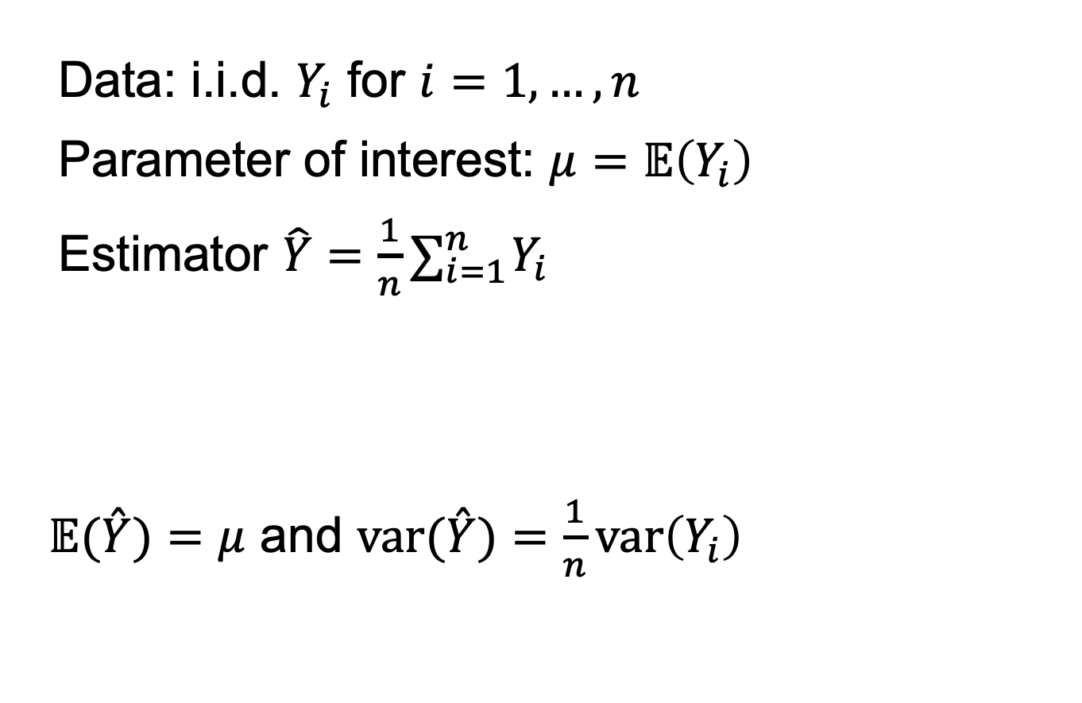
Super population inference for the example
Data: i.i.d. $Y_{i}$ for $i=1,…,n$
Parameter of interest: $μ=𝔼\left(Y_{i}\right)$
Estimator $\hat{Y}=\frac{1}{n}∑_{i=1}^{n} Y_{i}$
$𝔼(\overset{ˆ}{Y})=μ$ and $var(\overset{ˆ}{Y})=\frac{1}{n}var\left(Y_{i}\right)$
6 / 19

Slide 7
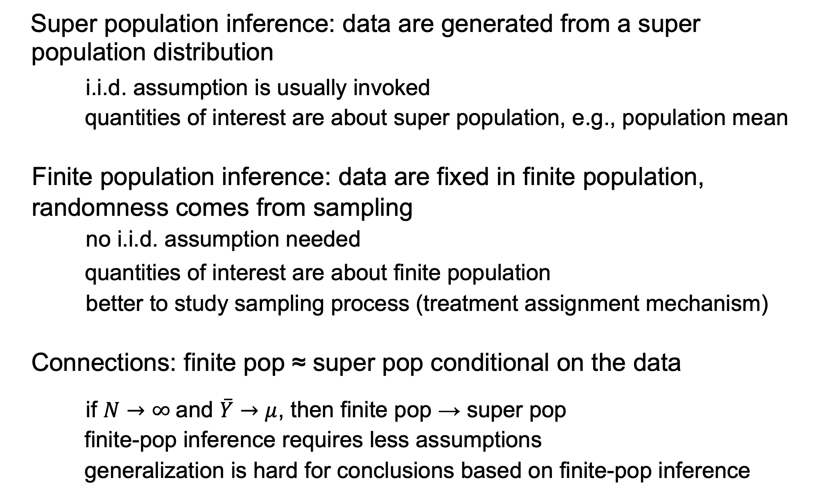
Finite population vs. super population
Super population inference: data are generated from a super population distribution
i.i.d. assumption is usually invoked
quantities of interest are about super population, e.g., population mean
Finite population inference: data are fixed in finite population,
randomness comes from sampling
no i.i.d. assumption needed
quantities of interest are about finite population
better to study sampling process (treatment assignment mechanism)
Connections: finite pop ≈ super pop conditional on the data
if $N→∞$ and $\overset{‾}{Y}→μ$, then finite pop → super pop
finite-pop inference requires less assumptions
generalization is hard for conclusions based on finite-pop inference
7 / 19

Slide 8
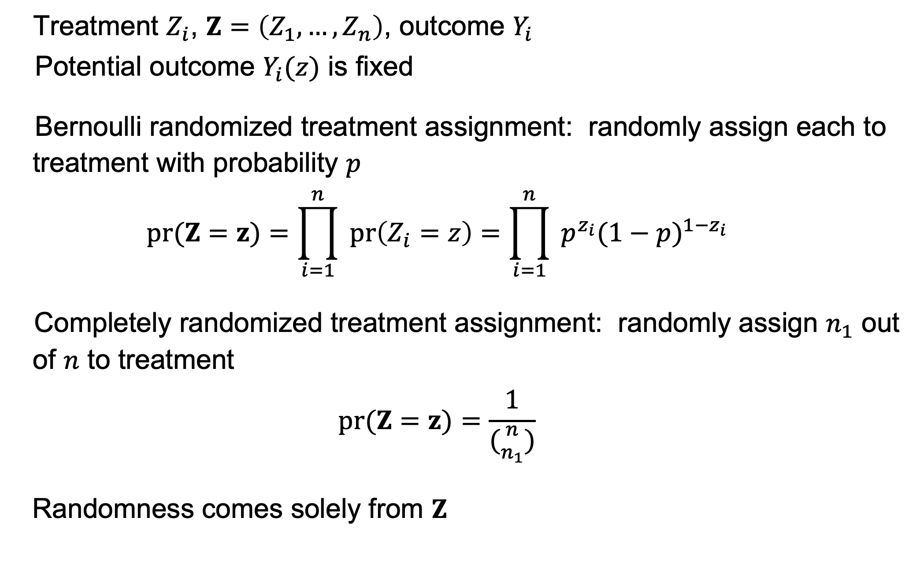
Randomization-based inference
Treatment $Z_{i}$, $Z=\left(Z_{1},…,Z_{n}\right)$, outcome $Y_{i}$
Potential outcome $Y_{i}(z)$ is fixed
Bernoulli randomized treatment assignment: randomly assign each to treatment with probability $p$
$$pr(Z=z)=\prod_{i=1}^{n}{ }pr\left(Z_{i}=z\right)=\prod_{i=1}^{n}{ }p^{z_{i}}(1−p)^{1−z_{i}}$$
Completely randomized treatment assignment: randomly assign $n_{1}$ out of $n$ to treatment
$$pr(Z=z)=\frac{1}{({n \atop n_{1}})}$$
Randomness comes solely from $Z$
8 / 19

Slide 9
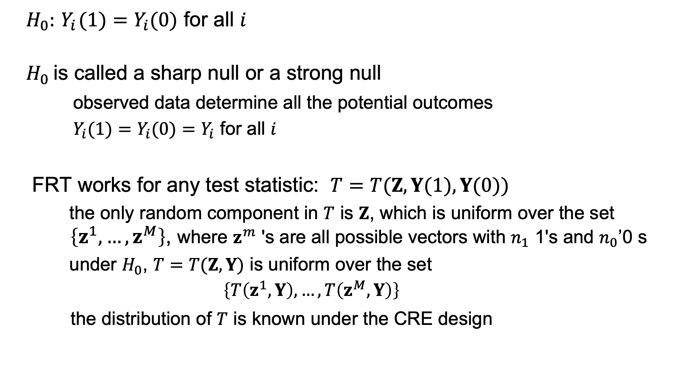
Fisher randomization test (Fisher, 1935)
$H_{0}:{ Y}_{i}(1)=Y_{i}(0)$ for all $i$
$H_{0}$ is called a sharp null or a strong null
observed data determine all the potential outcomes
$Y_{i}(1)=Y_{i}(0)=Y_{i}$ for all $i$
FRT works for any test statistic: $T=T(Z,Y(1),Y(0))$
the only random component in $T$ is $Z$, which is uniform over the set $\left\{z^{1},…,z^{M}\right\}$, where $z^{m}$ 's are all possible vectors with $n_{1}$ 1's and $n_{0}$ 0’s
under $H_{0}$, $T=T(Z,Y)$ is uniform over the set
$$\left\{T\left(z^{1},Y\right),…,T\left(z^{M},Y\right)\right\}$$
the distribution of $T$ is known under the CRE design
9 / 19

Slide 10

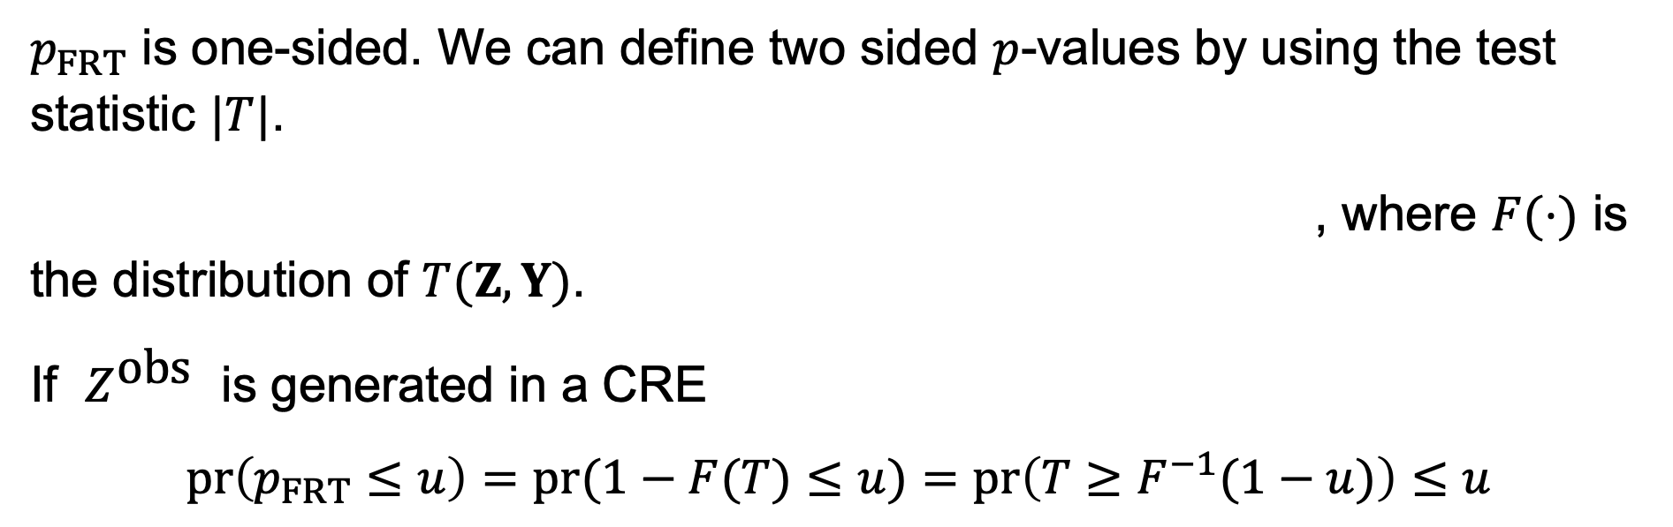
Fisher randomization test (Fisher, 1935)
If larger values are more extreme for $T$, we can use the tail probability to measure the extremeness with respect to its randomization distribution
which is called the $p$-value by Fisher.
$p_{FRT}$ is one-sided. We can define two sided $p$-values by using the test statistic $|T|$.
, where $F(⋅)$ is the distribution of $T(Z,Y)$.
If $Z^{\text{obs}}$ is generated in a CRE
$pr\left(p_{FRT}≤u\right)=pr(1−F(T)≤u)=pr\left(T≥F^{−1}(1−u)\right)≤u$
10 / 19

Slide 11
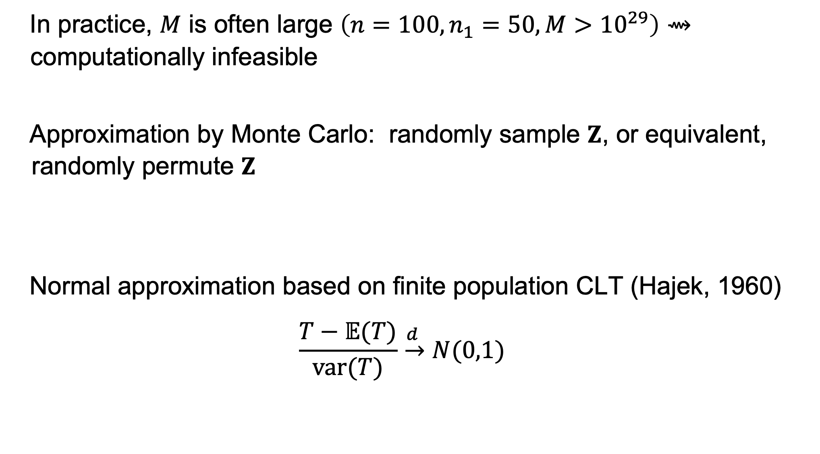

Approximation for the $p$-value
In practice, $M$ is often large $\left(n=100,n_{1}=50,M>{10}^{29}\right)⇝$ computationally infeasible
Approximation by Monte Carlo: randomly sample $Z$, or equivalent, randomly permute $Z$
Normal approximation based on finite population CLT (Hajek, 1960)
$$\frac{T−𝔼(T)}{var(T)}\overset{d }{→}N(0,1)$$
11 / 19

Slide 12

Example: difference in means
$T=n_{1}^{−1}∑_{i=1}^{n} Z_{i}Y_{i}−n_{0}^{−1}∑_{i=1}^{n} \left(1−Z_{i}\right)Y_{i}$
We use CLT to approximate the distribution of under $T$ the sharp null
12 / 19

Slide 13
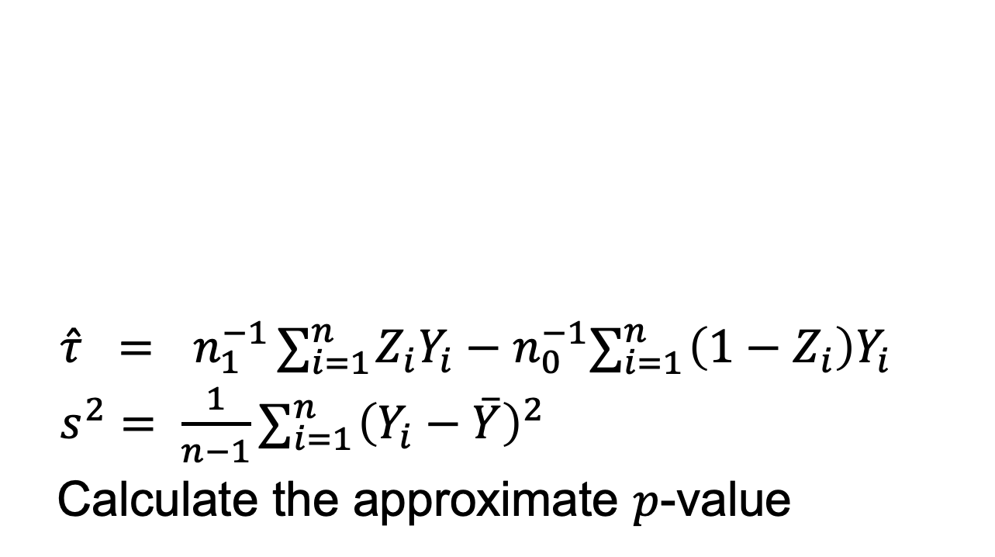

Normal approximation
$$\frac{\overset{ˆ}{τ}}{\sqrt{\frac{n}{n_{1}n_{0}}s^{2}}}→N(0,1)$$
$\overset{ˆ}{τ} ={ n}_{1}^{−1}∑_{i=1}^{n} Z_{i}Y_{i}−n_{0}^{−1}∑_{i=1}^{n} \left(1−Z_{i}\right)Y_{i}$
$s^{2}= \frac{1}{n−1}∑_{i=1}^{n} {\left(Y_{i}−\overset{‾}{Y}\right)}^{2}$
Calculate the approximate $p$-value
13 / 19

Slide 14
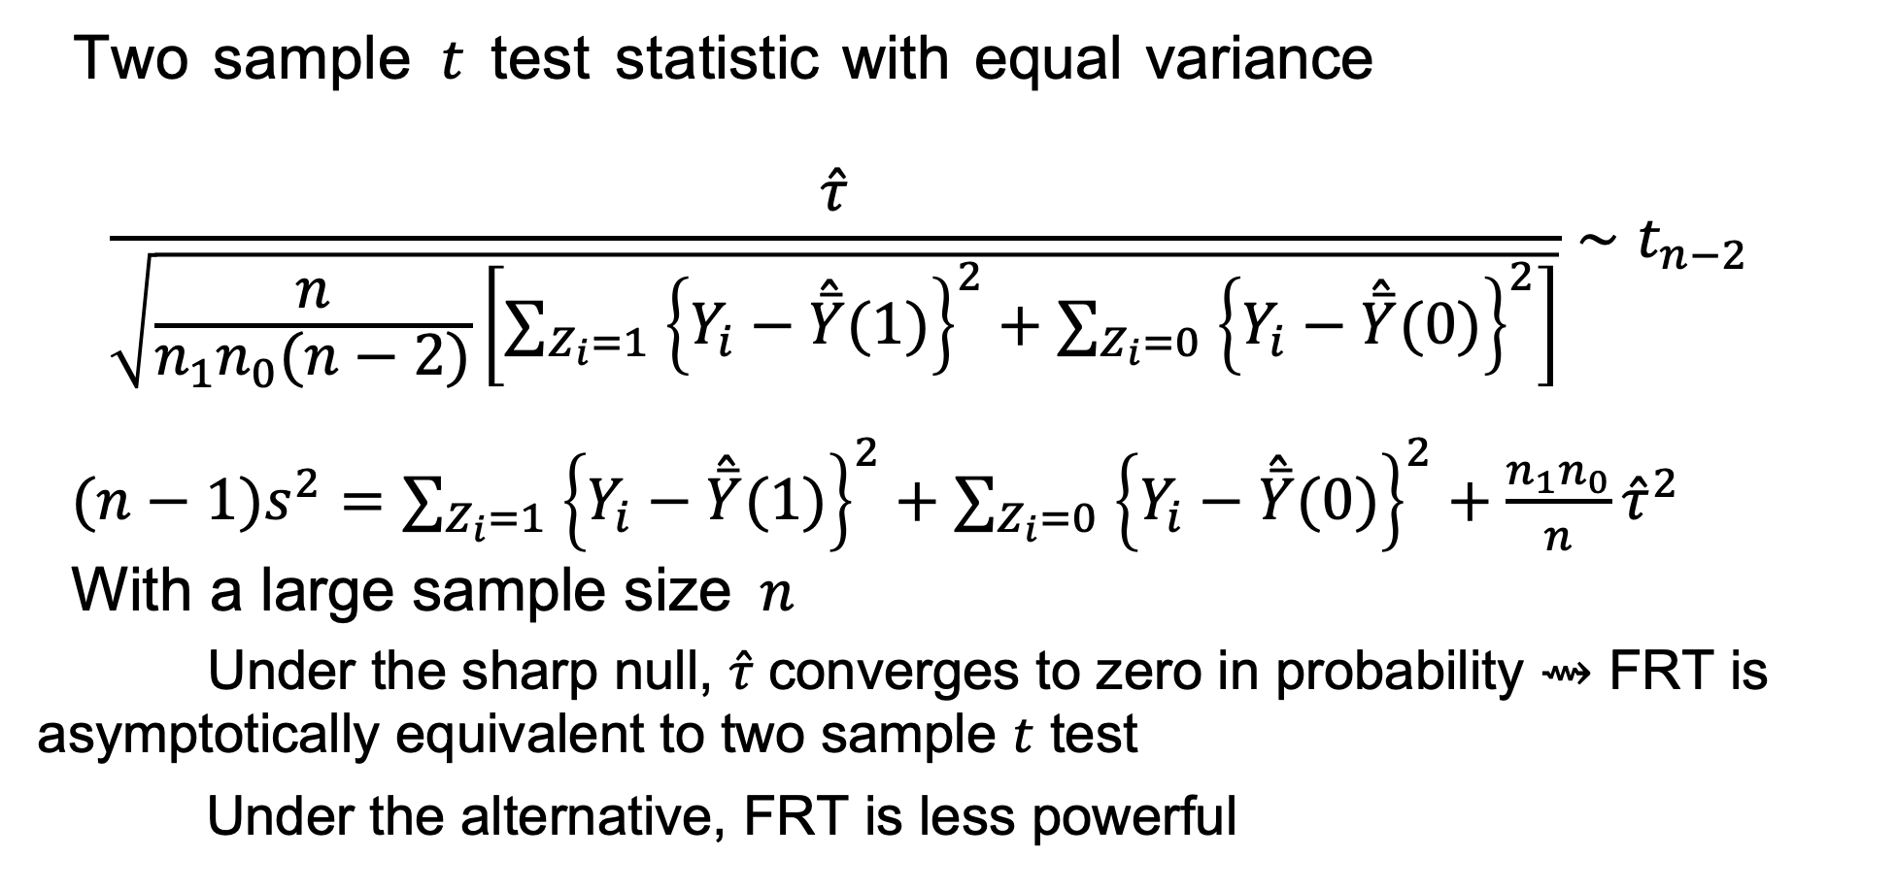
FRT vs. two sample test
Two sample $t$ test statistic with equal variance
$$\begin{matrix}\frac{\overset{ˆ}{τ}}{\sqrt{\frac{n}{n_{1}n_{0}(n−2)}\left[∑_{Z_{i}=1} {\left\{Y_{i}−\overset{ˆ}{\overset{‾}{Y}}(1)\right\}}^{2}+∑_{Z_{i}=0} {\left\{Y_{i}−\overset{ˆ}{\overset{‾}{Y}}(0)\right\}}^{2}\right]}}∼t_{n−2} \\ \end{matrix}$$
$(n−1)s^{2}=∑_{Z_{i}=1} {\left\{Y_{i}−\overset{ˆ}{\overset{‾}{Y}}(1)\right\}}^{2}+∑_{Z_{i}=0} {\left\{Y_{i}−\overset{ˆ}{\overset{‾}{Y}}(0)\right\}}^{2}+\frac{n_{1}n_{0}}{n}{\overset{ˆ}{τ}}^{2}$
With a large sample size $n$
Under the sharp null, $\overset{ˆ}{τ}$ converges to zero in probability ⇝ FRT is asymptotically equivalent to two sample $t$ test
Under the alternative, FRT is less powerful
14 / 19

Slide 15
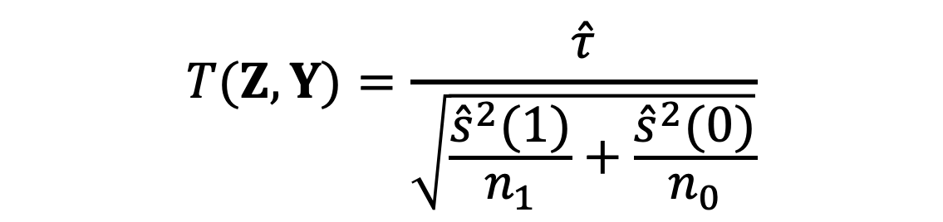
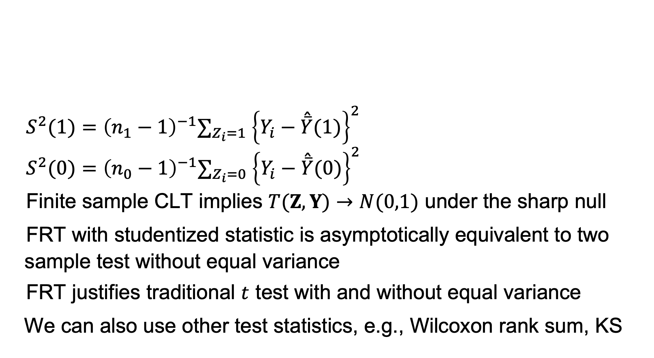
Test statistic: studentized statistic
$S^{2}(1)={\left(n_{1}−1\right)}^{−1}∑_{Z_{i}=1} {\left\{Y_{i}−\overset{ˆ}{\overset{‾}{Y}}(1)\right\}}^{2}$
$S^{2}(0)={\left(n_{0}−1\right)}^{−1}∑_{Z_{i}=0} {\left\{Y_{i}−\overset{ˆ}{\overset{‾}{Y}}(0)\right\}}^{2}$
Finite sample CLT implies $T(Z,Y)→N(0,1)$ under the sharp null
FRT with studentized statistic is asymptotically equivalent to two sample test without equal variance
FRT justifies traditional $t$ test with and without equal variance
We can also use other test statistics, e.g., Wilcoxon rank sum, KS
$$T(Z,Y)=\frac{\overset{ˆ}{τ}}{\sqrt{\frac{{\overset{ˆ}{s}}^{2}(1)}{n_{1}}+\frac{{\overset{ˆ}{s}}^{2}(0)}{n_{0}}}}$$
15 / 19

Slide 16
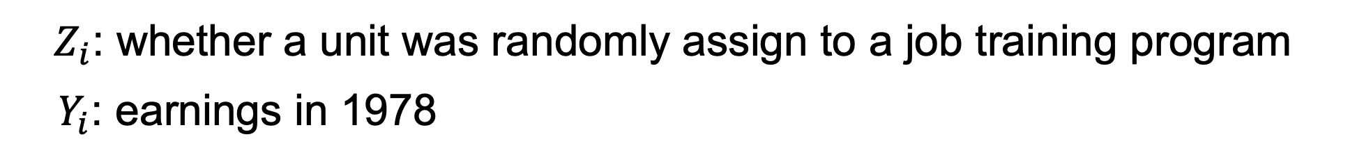
Application: Lalonde experimental data
$Z_{i}$: whether a unit was randomly assign to a job training program
$Y_{i}$: earnings in 1978
16 / 19

Slide 17
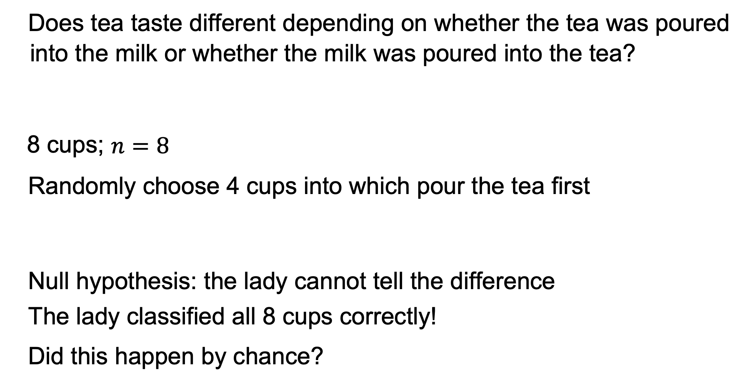
Lady Tasting Tea (Fisher 1935 . The Design of Experiments)
Does tea taste different depending on whether the tea was poured into the milk or whether the milk was poured into the tea?
8 cups; $n=8$
Randomly choose 4 cups into which pour the tea ﬁrst
Null hypothesis: the lady cannot tell the difference
The lady classified all 8 cups correctly!
Did this happen by chance?
17 / 19

Slide 18
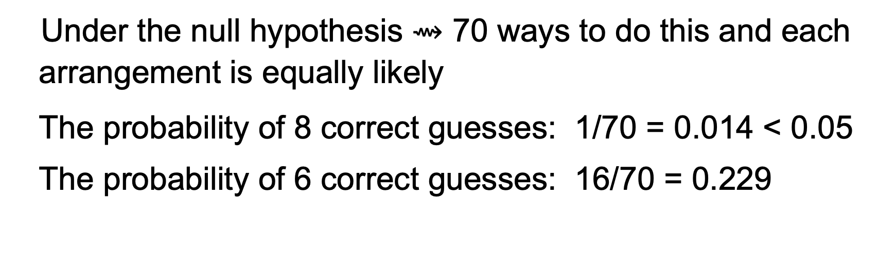
Permutation test
cups guess |  | actual | scenarios . . .
1 | M | M | T | T
2 | T | T | T | T
3 | T | T | T | T
4 | M | M | T | M
5 | M | M | M | M
6 | T | T | M | M
7 | T | T | M | T
8 | M | M | M | M
correctly | guessed | 8 | 4 | 6
Under the null hypothesis $⇝$ 70 ways to do this and each arrangement is equally likely
The probability of 8 correct guesses: 1/70 = 0.014 < 0.05
The probability of 6 correct guesses: 16/70 = 0.229
18 / 19

Slide 19



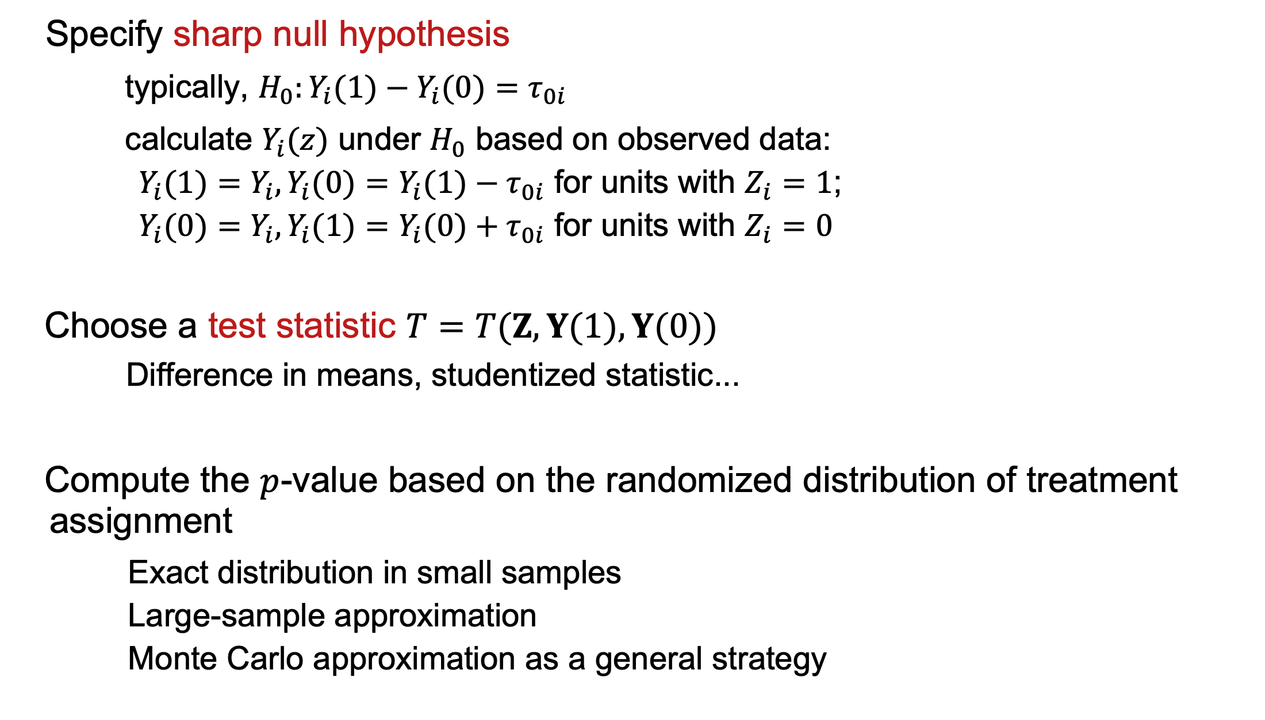
General procedure for FRT
1
Specify sharp null hypothesis
typically, $H_{0}:Y_{i}(1)−Y_{i}(0)=τ_{0i}$
calculate $Y_{i}(z)$ under $H_{0}$ based on observed data:
$Y_{i}(1)=Y_{i},Y_{i}(0)=Y_{i}(1)−τ_{0i}$ for units with $Z_{i}=1$;
$Y_{i}(0)=Y_{i},Y_{i}(1)=Y_{i}(0)+τ_{0i}$ for units with $Z_{i}=0$
Choose a test statistic $T=T(Z,Y(1),Y(0))$
Difference in means, studentized statistic...
Compute the $p$-value based on the randomized distribution of treatment assignment
Exact distribution in small samples
Large-sample approximation
Monte Carlo approximation as a general strategy
15 / 29

