Slide 1

Neymanian Repeated Sampling Inference in Completely Randomized Experiments
Zhichao Jiang
Sun Yat-sen University
Spring 2026
1 / 12

Slide 2
Finite population setup
FRT focuses on individual treatment effect
Neymanian inference considers average causal effect (Neyman, 1923, 1990)
17 / 29

Slide 3
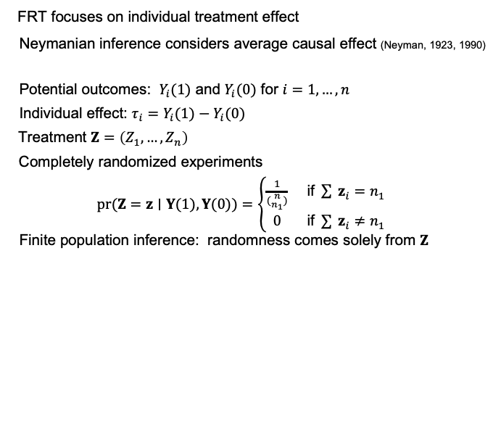
Finite population setup
FRT focuses on individual treatment effect
Neymanian inference considers average causal effect (Neyman, 1923, 1990)
Potential outcomes: $Y_{i}(1)$ and $Y_{i}(0)$ for $i=1,…,n$
Individual effect: $τ_{i}=Y_{i}(1)−Y_{i}(0)$
Treatment $Z=\left(Z_{1},…,Z_{n}\right)$
Completely randomized experiments
$pr(Z=z∣Y(1),Y(0))=\left\{\begin{matrix}\frac{1}{({n \atop n_{1}})} & \text{if} \sum{ }z_{i}=n_{1} \\ 0 & \text{if} \sum{ }z_{i}≠n_{1}\end{matrix}\right.$
Finite population inference: randomness comes solely from $Z$
17 / 29

Slide 4

Finite population quantities
Finite population means
$\overset{‾}{Y}(1)=\frac{1}{n}\sum_{i=1}^{n}{ }Y_{i}(1), \overset{‾}{Y}(0)=\frac{1}{n}\sum_{i=1}^{n}{ }Y_{i}(0)$
Quantity of interest: $τ=\frac{1}{n}\sum_{i=1}^{n}{ }τ_{i}=\overset{‾}{Y}(1)−\overset{‾}{Y}(0)$
3 / 12

Slide 5
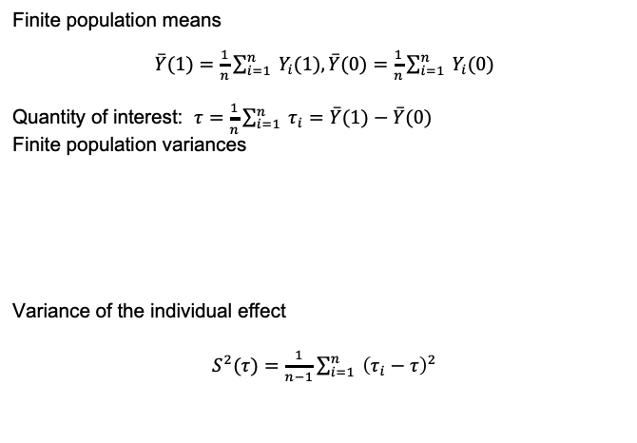
Finite population quantities
Finite population means
$\overset{‾}{Y}(1)=\frac{1}{n}\sum_{i=1}^{n}{ }Y_{i}(1), \overset{‾}{Y}(0)=\frac{1}{n}\sum_{i=1}^{n}{ }Y_{i}(0)$
Quantity of interest: $τ=\frac{1}{n}\sum_{i=1}^{n}{ }τ_{i}=\overset{‾}{Y}(1)−\overset{‾}{Y}(0)$
Finite population variances
Variance of the individual effect
$S^{2}(τ)=\frac{1}{n−1}\sum_{i=1}^{n}{ }{\left(τ_{i}−τ\right)}^{2}$
3 / 12

Slide 6
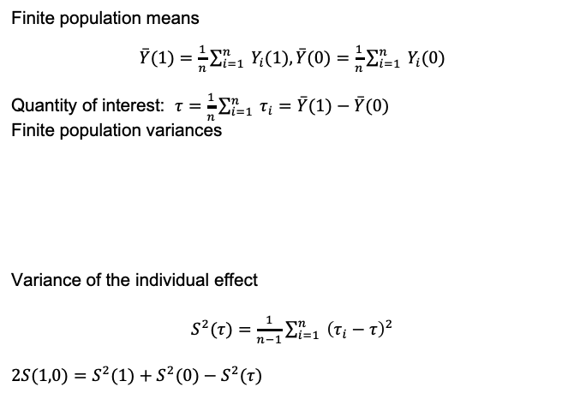
Finite population quantities
Finite population means
$\overset{‾}{Y}(1)=\frac{1}{n}\sum_{i=1}^{n}{ }Y_{i}(1), \overset{‾}{Y}(0)=\frac{1}{n}\sum_{i=1}^{n}{ }Y_{i}(0)$
Quantity of interest: $τ=\frac{1}{n}\sum_{i=1}^{n}{ }τ_{i}=\overset{‾}{Y}(1)−\overset{‾}{Y}(0)$
Finite population variances
Variance of the individual effect
$S^{2}(τ)=\frac{1}{n−1}\sum_{i=1}^{n}{ }{\left(τ_{i}−τ\right)}^{2}$
$$2S(1,0)=S^{2}(1)+S^{2}(0)−S^{2}(τ)$$
3 / 12

Slide 7

Estimators
Sample means
$\hat{Y}(1)=\frac{1}{n_{1}}\sum_{i=1}^{n}{ }Z_{i}Y_{i}, \hat{Y}(0)=\frac{1}{n_{0}}\sum_{i=1}^{n}{ }\left(1−Z_{i}\right)Y_{i}$
Sample variances
${\hat{S}}^{2}(1)=\frac{1}{n_{1}−1}\sum_{i=1}^{n}{ }Z_{i}{\left\{Y_{i}−\hat{Y}(1)\right\}}^{2}, {\hat{S}}^{2}(0)=\frac{1}{n_{0}−1}\sum_{i=1}^{n}{ }\left(1−Z_{i}\right){\left\{Y_{i}−\hat{Y}(0)\right\}}^{2}$
4 / 12

Slide 8
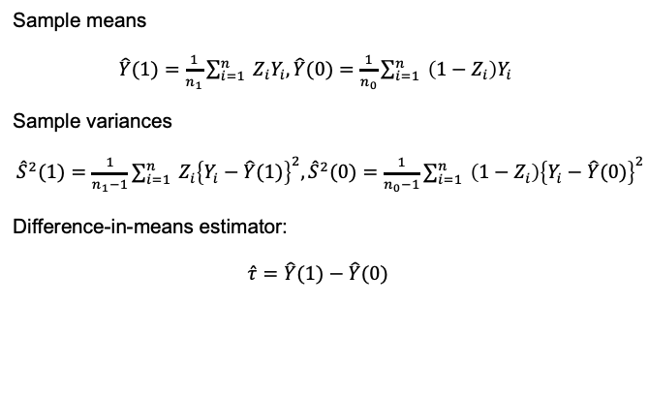
Estimators
Sample means
$\hat{Y}(1)=\frac{1}{n_{1}}\sum_{i=1}^{n}{ }Z_{i}Y_{i}, \hat{Y}(0)=\frac{1}{n_{0}}\sum_{i=1}^{n}{ }\left(1−Z_{i}\right)Y_{i}$
Sample variances
${\hat{S}}^{2}(1)=\frac{1}{n_{1}−1}\sum_{i=1}^{n}{ }Z_{i}{\left\{Y_{i}−\hat{Y}(1)\right\}}^{2}, {\hat{S}}^{2}(0)=\frac{1}{n_{0}−1}\sum_{i=1}^{n}{ }\left(1−Z_{i}\right){\left\{Y_{i}−\hat{Y}(0)\right\}}^{2}$
Difference-in-means estimator:
$$\hat{τ}=\hat{Y}(1)−\hat{Y}(0)$$
4 / 12

Slide 9
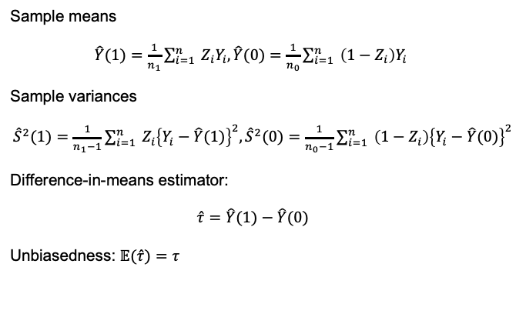
Estimators
Sample means
$\hat{Y}(1)=\frac{1}{n_{1}}\sum_{i=1}^{n}{ }Z_{i}Y_{i}, \hat{Y}(0)=\frac{1}{n_{0}}\sum_{i=1}^{n}{ }\left(1−Z_{i}\right)Y_{i}$
Sample variances
${\hat{S}}^{2}(1)=\frac{1}{n_{1}−1}\sum_{i=1}^{n}{ }Z_{i}{\left\{Y_{i}−\hat{Y}(1)\right\}}^{2}, {\hat{S}}^{2}(0)=\frac{1}{n_{0}−1}\sum_{i=1}^{n}{ }\left(1−Z_{i}\right){\left\{Y_{i}−\hat{Y}(0)\right\}}^{2}$
Difference-in-means estimator:
$$\hat{τ}=\hat{Y}(1)−\hat{Y}(0)$$
Unbiasedness: $𝔼(\hat{τ})=τ$
4 / 12

Slide 10
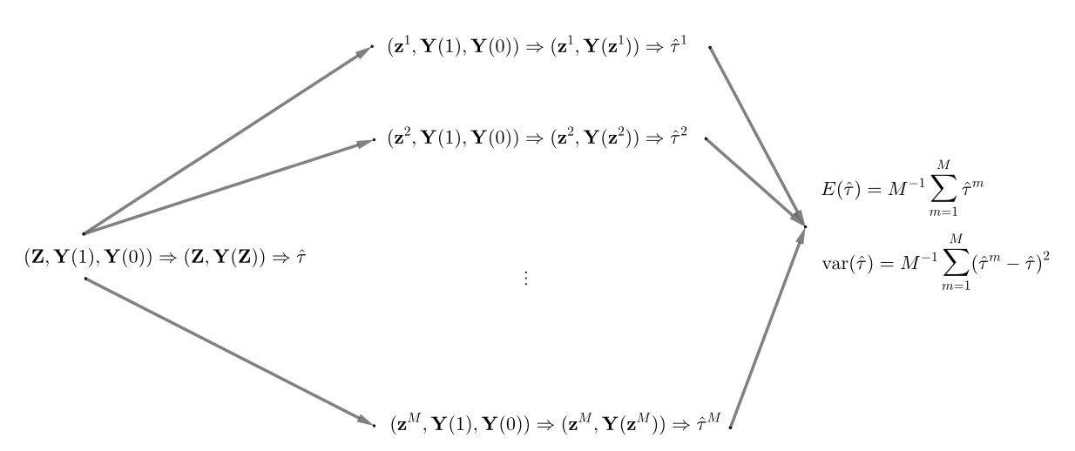
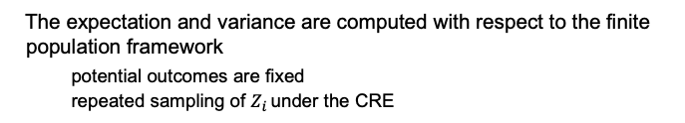
Repeated sampling inference
The expectation and variance are computed with respect to the finite population framework
potential outcomes are ﬁxed
repeated sampling of $Z_{i}$ under the CRE
5 / 12

Slide 11

Variance
$var(\hat{τ})=var\{\hat{Y}(1)\}+var\{\hat{Y}(0)\}−2cov\{\hat{Y}(1),\hat{Y}(0)\}$
$var(\hat{τ})=\frac{S^{2}(1)}{n_{1}}+\frac{S^{2}(0)}{n_{0}}−\frac{S^{2}(τ)}{n}$
5 / 12

Slide 12

Variance
$var(\hat{τ})=var\{\hat{Y}(1)\}+var\{\hat{Y}(0)\}−2cov\{\hat{Y}(1),\hat{Y}(0)\}$
$var(\hat{τ})=\frac{S^{2}(1)}{n_{1}}+\frac{S^{2}(0)}{n_{0}}−\frac{S^{2}(τ)}{n}$
Variance estimator
5 / 12

Slide 13

Variance
$var(\hat{τ})=var\{\hat{Y}(1)\}+var\{\hat{Y}(0)\}−2cov\{\hat{Y}(1),\hat{Y}(0)\}$
$var(\hat{τ})=\frac{S^{2}(1)}{n_{1}}+\frac{S^{2}(0)}{n_{0}}−\frac{S^{2}(τ)}{n}$
Variance estimator
A conservative 95% confidence interval based on normal approximation
$(\hat{τ}−1.96\sqrt{\hat{var}(\hat{τ})},\hat{τ}+1.96\sqrt{\hat{var}(\hat{τ})})$
5 / 12

Slide 14
Regression analysis of CRE
Can we run a linear regression to obtain the ACE estimator
7 / 12

Slide 15

Regression analysis of CRE
Can we run a linear regression to obtain the ACE estimator
OLS: $(\overset{ˆ}{α},\overset{ˆ}{β})={argmin}_{a,b}\sum_{i=1}{ }{\left(Y_{i}−a−bZ_{i}\right)}^{2}$
$\overset{ˆ}{β}=\overset{ˆ}{τ}$
but the OLS variance estimator from lm function in R is
7 / 12

Slide 16
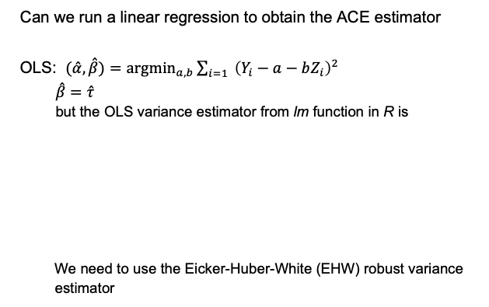
Regression analysis of CRE
Can we run a linear regression to obtain the ACE estimator
OLS: $(\overset{ˆ}{α},\overset{ˆ}{β})={argmin}_{a,b}\sum_{i=1}{ }{\left(Y_{i}−a−bZ_{i}\right)}^{2}$
$\overset{ˆ}{β}=\overset{ˆ}{τ}$
but the OLS variance estimator from lm function in R is
We need to use the Eicker-Huber-White (EHW) robust variance estimator
7 / 12

Slide 17

Heteroskedasticity Robust Variance Estimator
Eicker-Huber-White robust variance estimator:
where $X_{i}={\left(1,Z_{i}\right)}^{⊤}$ and $X={\left(X_{1},…,X_{n}\right)}^{⊤}$
8 / 12

Slide 18
Heteroskedasticity Robust Variance Estimator
Eicker-Huber-White robust variance estimator:
where $X_{i}={\left(1,Z_{i}\right)}^{⊤}$ and $X={\left(X_{1},…,X_{n}\right)}^{⊤}$
8 / 12

Slide 19

Heteroskedasticity Robust Variance Estimator
Eicker-Huber-White robust variance estimator:
where $X_{i}={\left(1,Z_{i}\right)}^{⊤}$ and $X={\left(X_{1},…,X_{n}\right)}^{⊤}$
HC2 variant of the EHW variance estimator is identical to $\overset{ˆ}{V}$ R code $lm(Y∼Z)$ and hccm(model, type='hc2')
8 / 12

Slide 20





Reducing Transphobia (Brookman and Kalla, 2016, Science)
Can perspective-taking $−$ “imagining the world from another's perspective” $−$ reduce transphobia?
Treatment group ($n_{1}=912$): canvasser asking people to think about a time when they were judged unfairly and were guided to translate that experience to a transgender individual's experience
Control group ($n_{0}=913$): canvasser asking people to recycle
Outcome variable: feeling thermometer towards transgender people (0 - 100)
¹ baseline
² 3 day
³ 3 week
⁴ 6 week
⁵ 3 month
9 / 12

Slide 21
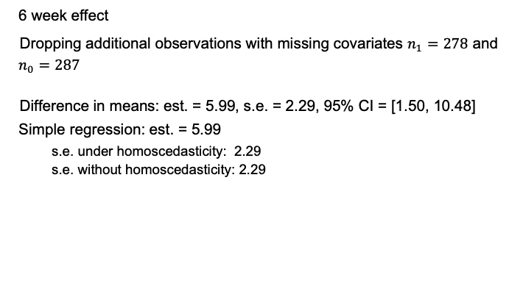
Durable Effects
6 week effect
Dropping additional observations with missing covariates $n_{1}=278$ and $n_{0}=287$
Difference in means: est. = 5.99, s.e. = 2.29, 95% CI = [1.50, 10.48]
Simple regression: est. = 5.99
s.e. under homoscedasticity: 2.29
s.e. without homoscedasticity: 2.29
10 / 12

Slide 22
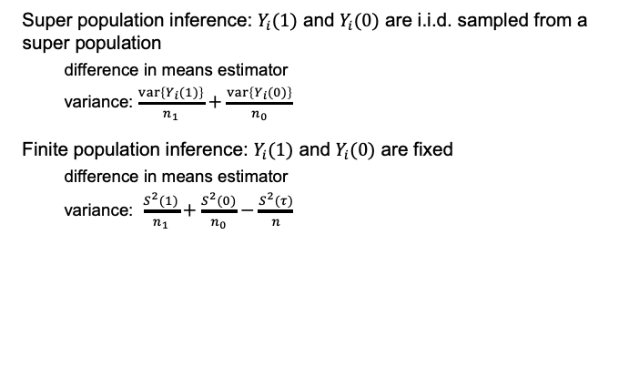
Finite population inference vs. super population inference
Super population inference: $Y_{i}(1)$ and $Y_{i}(0)$ are i.i.d. sampled from a super population
difference in means estimator
variance: $\frac{var\left\{Y_{i}(1)\right\}}{n_{1}}+\frac{var\left\{Y_{i}(0)\right\}}{n_{0}}$
Finite population inference: $Y_{i}(1)$ and $Y_{i}(0)$ are fixed
difference in means estimator
variance: $\frac{S^{2}(1)}{n_{1}}+\frac{S^{2}(0)}{n_{0}}−\frac{S^{2}(τ)}{n}$
11 / 12

Slide 23
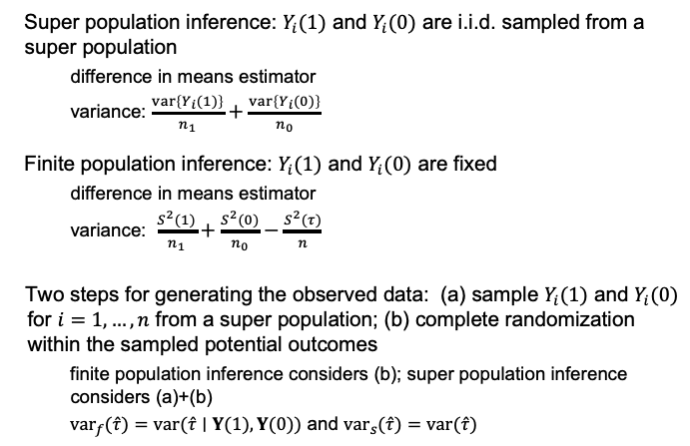
Finite population inference vs. super population inference
Super population inference: $Y_{i}(1)$ and $Y_{i}(0)$ are i.i.d. sampled from a super population
difference in means estimator
variance: $\frac{var\left\{Y_{i}(1)\right\}}{n_{1}}+\frac{var\left\{Y_{i}(0)\right\}}{n_{0}}$
Finite population inference: $Y_{i}(1)$ and $Y_{i}(0)$ are fixed
difference in means estimator
variance: $\frac{S^{2}(1)}{n_{1}}+\frac{S^{2}(0)}{n_{0}}−\frac{S^{2}(τ)}{n}$
Two steps for generating the observed data: (a) sample $Y_{i}(1)$ and $Y_{i}(0)$ for $i=1,…,n$ from a super population; (b) complete randomization within the sampled potential outcomes
finite population inference considers (b); super population inference considers (a)+(b)
${var}_{f}(\hat{τ})=var(\hat{τ}∣Y(1),Y(0))$ and ${var}_{s}(\hat{τ})=var(\hat{τ})$
11 / 12

Slide 24





Summary: Fisher vs. Neyman
Like Fisher, Neyman proposed randomization-based inference
Unlike Fisher,
estimands are average causal effects
heterogenous treatment efects are allowed
asymptotic approximation is required for inference
conservative variance estimator
CLT may fail with heavy-tailed outcome
Reading: Imbens and Rubin, Chapter 6
1
2
3
4
5
12 / 12

