Slide 1

Introduction
Zhichao Jiang
Sun Yat-sen University
Spring 2026
1 / 15

Slide 2
Causal inference and statistics
Causality is central to human knowledge
2 / 15

Slide 3
Causal inference and statistics
Causality is central to human knowledge
Statisticians have focused on inference until recently
foundation of experimental analysis (R. Fisher and J. Neyman)
causal inference in observational studies (J. Robins, D. Rubin et al.)
2 / 15

Slide 4
Causal inference and statistics
Causality is central to human knowledge
Statisticians have focused on inference until recently
foundation of experimental analysis (R. Fisher and J. Neyman)
causal inference in observational studies (J. Robins, D. Rubin et al.)
Causal revolution over the last 40 years
influences from scientiﬁc disciplines (medical and social sciences) Holland (1986) “Statistics and causal inference”
2 / 15

Slide 5
Why causal inference is important?
Health: evaluation of drugs and treatments by clinical trials
Politics: evaluation of policies
Money: evaluation of business strategies by A/B testing
Love: evaluation of matching algorithms at online dating sites
3 / 15

Slide 6
Why causal inference is important?
Health: evaluation of drugs and treatments by clinical trials
Politics: evaluation of policies
Money: evaluation of business strategies by A/B testing
Love: evaluation of matching algorithms at online dating sites
Causal inference asks “What if” questions?
what would happen to the stones if the patient received treatment A instead of B?
what would happen to unemployment if government increased minimum wages?
what would your life been like if you went to a different University?
3 / 15

Slide 7
Why causal inference is important?
Health: evaluation of drugs and treatments by clinical trials
Politics: evaluation of policies
Money: evaluation of business strategies by A/B testing
Love: evaluation of matching algorithms at online dating sites
Causal inference asks “What if” questions?
what would happen to the stones if the patient received treatment A instead of B?
what would happen to unemployment if government increased minimum wages?
what would your life been like if you went to a different University?
Causal inference is essential for making decisions and taking action
3 / 15

Slide 8
Causal inference and statistics
Classic statistics is about association rather than causation
two sample test, Chi-squared test, linear regression...
4 / 15

Slide 9
Causal inference and statistics
Classic statistics is about association rather than causation
two sample test, Chi-squared test, linear regression...
Traditional view in statistics: correlation does not imply causation
4 / 15

Slide 10
Causal inference and statistics
Classic statistics is about association rather than causation
two sample test, Chi-squared test, linear regression...
Traditional view in statistics: correlation does not imply causation
Results from statistical methods necessitate careful interpretation
4 / 15

Slide 11
Simpson's paradox
 | small stones | large stones
 | success fail | success fail
Treatment A | 81 6 | 192 71
Treatment B | 234 36 | 55 25
Treatment A: open surgical procedures
Treatment B: a minimally-invasive procedure
5 / 15

Slide 12

单选题
1分
 | small stones | large stones
 | success fail | success fail
Treatment A | 81 6 | 192 71
Treatment B | 234 36 | 55 25
Which treatment is more effective?
A
A
B
B
C
Not sure
提交

Slide 13
Simpson's paradox
 | small stones | large stones
 | success fail | success fail
Treatment A | 81 6 | 192 71
Treatment B | 234 36 | 55 25
Treatment A: open surgical procedures
Treatment B: a minimally-invasive procedure
Success rate for small stones:
Success rate for large stones:
5 / 15

Slide 14
Simpson's paradox
 | small stones | large stones
 | success fail | success fail
Treatment A | 81 6 | 192 71
Treatment B | 234 36 | 55 25
Treatment A: open surgical procedures
Treatment B: a minimally-invasive procedure
Success rate for small stones: 93% (81/87) > 87% (234/270)
Success rate for large stones: 73% (192/263) > 69% (55/80)
5 / 15

Slide 15
Simpson's paradox
 | small stones | large stones
 | success fail | success fail
Treatment A | 81 6 | 192 71
Treatment B | 234 36 | 55 25
Treatment A: open surgical procedures
Treatment B: a minimally-invasive procedure
Success rate for small stones: 93% (81/87) > 87% (234/270)
Success rate for large stones: 73% (192/263) > 69% (55/80)
Overall success rate:
5 / 15

Slide 16
Simpson's paradox
 | small stones | large stones
 | success fail | success fail
Treatment A | 81 6 | 192 71
Treatment B | 234 36 | 55 25
Treatment A: open surgical procedures
Treatment B: a minimally-invasive procedure
Success rate for small stones: 93% (81/87) > 87% (234/270)
Success rate for large stones: 73% (192/263) > 69% (55/80)
Overall success rate: 78% (273/350) < 83% (289/350)
5 / 15

Slide 17
Berkeley admission data
Aggregated data: large positive diference between males and females
6 / 15

Slide 18
Berkeley admission data
Aggregated data: large positive diference between males and females
Stratifying on departments
insigniﬁcant differences
signiﬁcant negative difference in department A
6 / 15

Slide 19
Causation versus association
Association: non-directional, based on passive observation of data
Causation: directional, based on active intervention of data
7 / 15

Slide 20
Causation versus association
Association: non-directional, based on passive observation of data
Causation: directional, based on active intervention of data
Possible reasons for association between A and B
A causes B
B causes A
A and B are caused by C
7 / 15

Slide 21
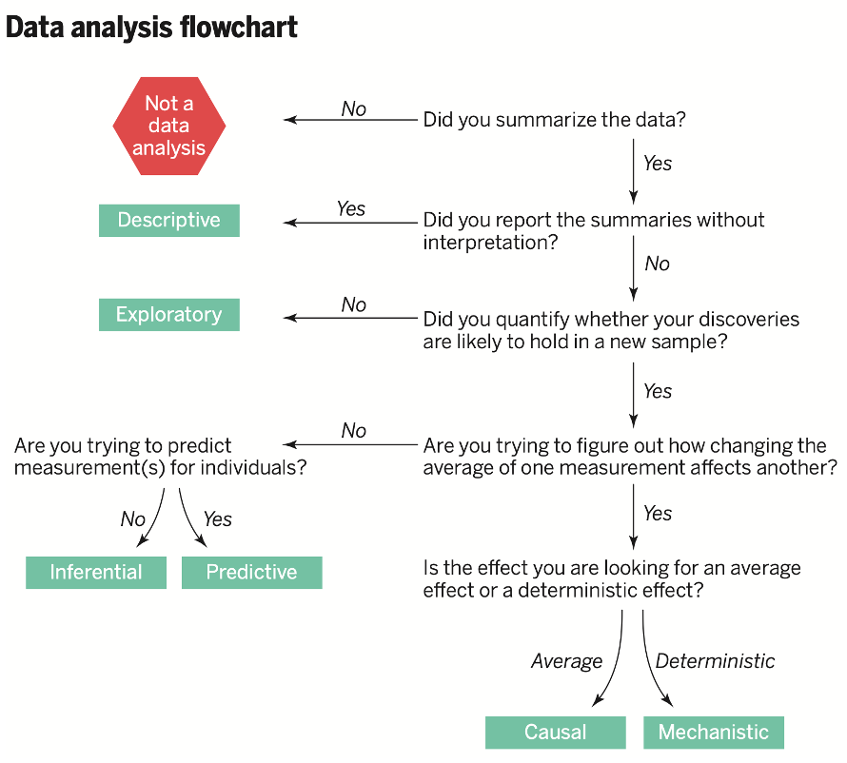

Slide 22
Questions to answer in this course
Can we learn causal relationship from data?
8 / 15

Slide 23
Questions to answer in this course
Can we learn causal relationship from data?
How should we learn causal relationship from data?
8 / 15

Slide 24
Course description
A statistics course
introduction of statistical methods
implementation using R
Focus on causal relationship
infer causal relationship rather than association from observed data both statistical theory and practice of causal inference
Content
causal frameworks
methodological tools
real examples from public health, political science, economics, education, and other disciplines
9 / 15

Slide 25
Topics
Randomized experiments
Observational studies without latent confounders
Instrumental variable
Special topics
difference in differences
causal mechanisms
longitudinal causal inference
10 / 15

Slide 26
Course requirements
Problem sets and class participation (40%)
biweekly problem sets
you can collaborate with other students but must write your own
answer
submit through Rain Classroom
Final exam (60%)
12 / 15

Slide 27
Rules
Course staffs
Instructor: questions about course materials
TA: questions about assignments
Check Rain Classroom for
slides, R codes
course assignments
reading materials
13 / 15

Slide 28
Suggested references
Ding, Peng (2024) A First Course in Causal Inference
https://arxiv.org/pdf/2305.18793
Imbens, Guido W. and Rubin, Donald B. (2015) Causal Inference in Statistics, Social, and Biomedical Sciences: An Introduction.
Cambridge University Press.
Hernán, Miguel and Robins, James. (2020) Causal Inference: What If. Boca Raton: Chapman & Hall/CRC.
Angrist, Joshua D. and Pischke, JÖrn-Steffen. (2015) Mostly Harmless Econometrics: An Empiricist’s Companion. Princeton University Press.
Cunningham, Scott. (2026) Causal Inference: The Mixtape. Yale University Press.
14 / 15

Slide 29
Brief review of pre-requisites
Statistical inference
Frequentist perspective: repeated sampling
MLE, moment estimation, conﬁdence interval, testing
Conditional expectation
Unbiasedness, consistency, basic LLN and CLT
Linear model
More details later
15 / 15

Slide 30
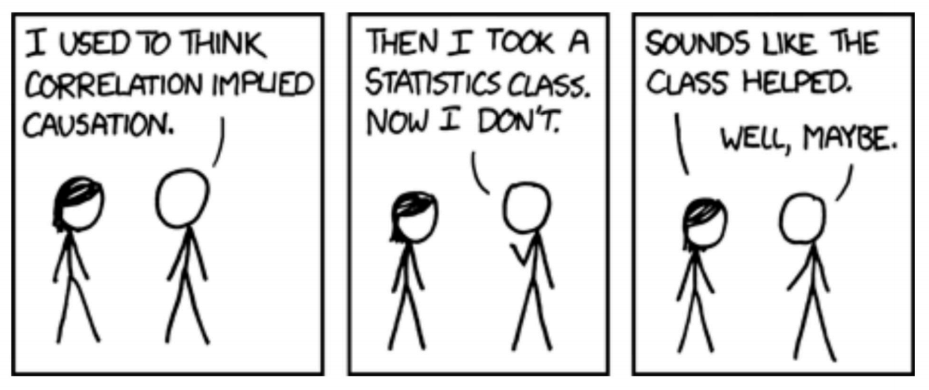
15 / 15

