Slide 1
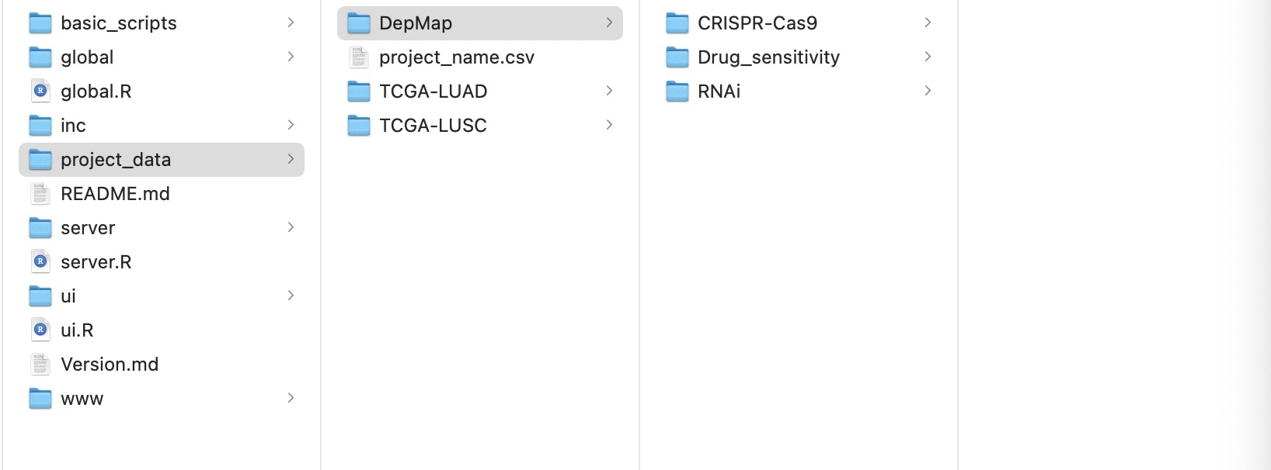
df_survival.csv
ccle.csv
df_gene.csv
df_gene_scale.csv
df_snv_class.csv
df_cnv.csv
df_cnv_scale.csv
df_rppa.csv
df_rppa_scale.csv
df_proteomic.csv
df_proteomic_scale.csv

