Slide 1

RCENR: A Reinforced and Contrastive Heterogeneous Network Reasoning Model for Explainable News Recommendation
Hao Jiang
Communication University of China

Slide 2
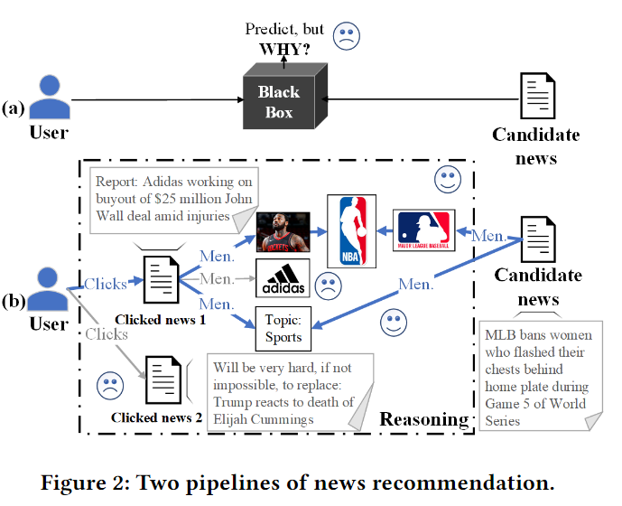
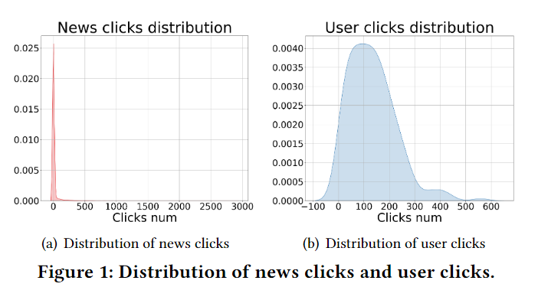
challenges
personalized news recommendations
- Feature-based - Deep learning-based - Graph-based
Sparse and Weak Interaction Data
Poor Interpretability

Slide 3
challenges
personalized news recommendations
- Knowledge Reasoning Recommendation
use knowledge graph (KG) information to improve data sparsity and model interpretability
Slow Convergence Speed
Complex Pre-processing Steps
treat the reasoning process as a Markov Decision Process (MDP) and optimize it using reinforcement-based strategies.

Slide 4
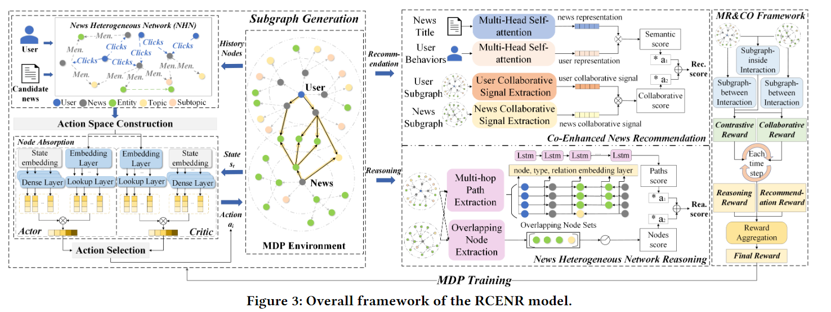
RCENR
RCENR Framework

Slide 5
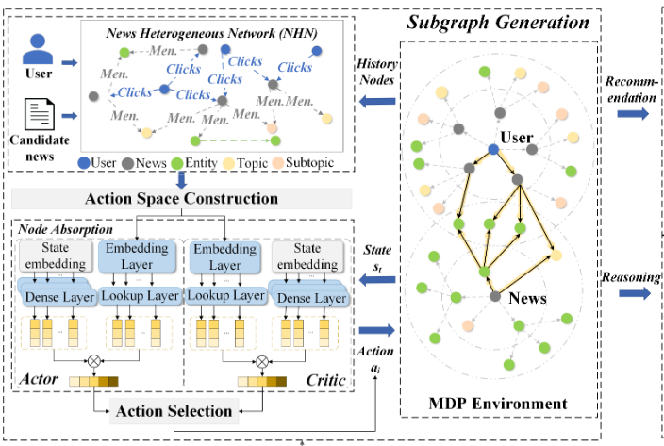
NHN
Reinforced Subgraph Generation
News Heterogeneous Network
Markov Decision Process
use the A3C algorithm with an Actor and a Critic for subgraph generation, where the Actor creates the absorbing policy, while the Critic assesses action quality

Slide 6
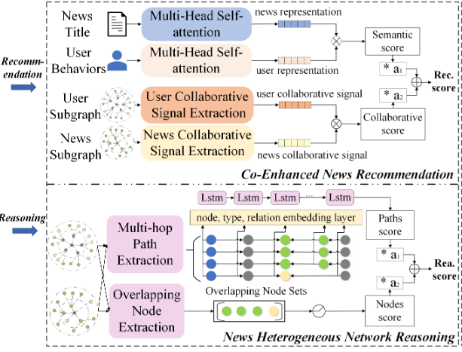
R2
News Heterogeneous Network Reasoning
Co-Enhanced News Recommendation
semantic information
-- NRMS framework
collaborative signals
-- node embedding
multi-hop paths -- LSTM
overlapping nodes -- dense layer

Slide 7
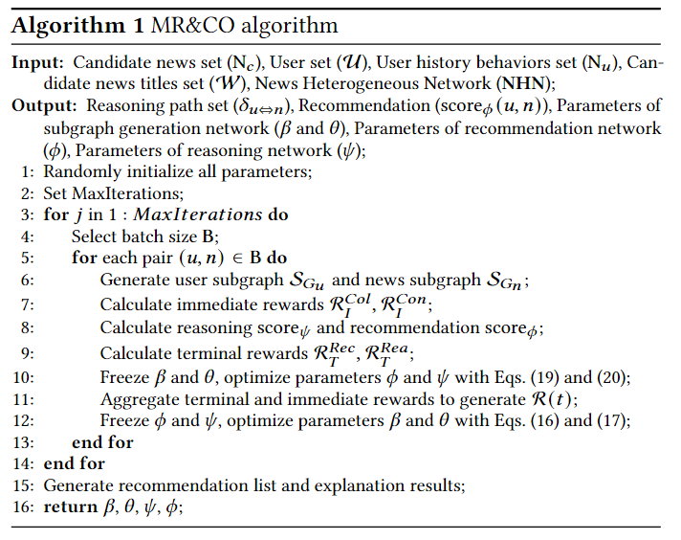
MR&CO
Reinforced & Contrastive Optimization
Joint Multi-task Optimization
Immediate Reward (IR)
Collaborative Reward (IR-ColR)
Contrastive Reward (IR-ConR)
Terminal Reward (TR)
Recommend Reward (TR-RecR)
Reasoning Reward (TR-ReaR)
Notes:
create a strong foundation for the upstream task (subgraph generation) that can support the downstream tasks (recommendation and reasoning), while also allowing these downstream tasks to guide the upstream task's generation

Slide 8
experiment
How effective is our model in recommendation and reasoning tasks compared to existing outstanding methods?
Dose the MR&CO improve the model's performance?
How effective are the generated subgraphs for both reasoning and recommendation tasks?
Does the model provide reasonable recommendations and explanations for specific recommended news instances?

Slide 9
experiment
RQ1
Encoder-based News Recommendation
Graph-based News Recommendation
Knowledge-based Recommendation
RQ3
These hyperparameters balance the collaborative signals and semantic signals in the recommendation, and the connection paths and overlapping nodes in the reasoning
RQ2
"2-D" subgraph reasoning
contrastive learning strategies
eliminates the steps of Pre-process and Beam-search

Slide 10
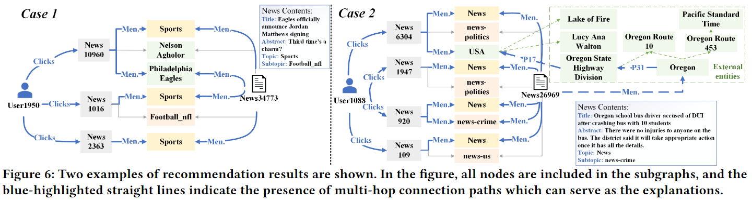
experiment
RQ4
can capture both explicit user interests presented in various news content and potential user interests embedded in external knowledge facts as explanations

