Slide 1
int main() {
atomic_int x = 2;
int y = 0;
{{{ x.store(3);
||| y = ((x.load()));
}}}; return 0;
}
int main() {
int x = 2;
int y = 0;
if (x == y+2) return 1;
else return 0;
}
void foo(int* p) {
*p = 3;
}
int main() {
int x = 2;
thread t1(foo, &x);
t1.join();
return 0;
}

Slide 2
int main() {
atomic_int x=0;
{{{ { x.store(1,memory_order_release);
x.store(2,memory_order_relaxed);
x.store(3,memory_order_relaxed);
x.store(4,memory_order_relaxed); }
||| { r2=x.load(memory_order_acquire).readsvalue(3);
x.store(5,memory_order_relaxed);
} }}} return 0;}

Slide 3
int main() {
atomic_int x = 0;
atomic_int y = 0;
{{{ x.store(1,mo_release);
||| { r1=x.load(mo_acquire).readsvalue(1);
y.store(1,mo_release); }
||| { r2=y.load(mo_acquire).readsvalue(1);
r3=x.load(mo_relaxed); }
}}} return 0;}

Slide 4
int main() { atomic_int x = 0; atomic_int y = 0; {{{ { r1 = x.load(memory_order_relaxed); y.store(1, memory_order_relaxed); } ||| { r2 = y.load(memory_order_relaxed); x.store(1, memory_order_relaxed); } }}} return 0;}
VC: (1,0,0)
O_{ab}=1, O_{bc}=1, O_{cd}=1, O_{be}=1, O_{ef}=1, Oac=1, O_{ad}=1, O_{ae}=1,
O_{af}=1, O_{bd}=1, O_{bf}=1, O_{ce}=⊥, O_{cf}=⊥, O_{de}=⊥, O_{df}=⊥
F_{fc}=1, F_{de}=1, M_{a}=1,M_{f}=2,M_{b}=1,M_{d}=2,
VC: (2,0,0)
VC: (2,1,0)
VC: (2,0,1)
VC: (2,2,0)
VC: (2,0,2)

Slide 5
(a)
(b)

Slide 6
(a) A consistent execution. O_{ab}=1, O_{bc}=1, O_{cd}=1, O_{be}=1, O_{ef}=1, Oac=1, O_{ad}=1, O_{ae}=1,
O_{af}=1, O_{bd}=1, O_{bf}=1, O_{ce}=⊥, O_{cf}=⊥, O_{de}=⊥, O_{df}=⊥
F_{fc}=1, F_{de}=1, M_{a}=1, M_{f}=2, M_{b}=1, M_{d}=2.
(b) A inconsistent.

Slide 7
(a) CoRR
(b) CoRW
(c) CoWR
(d) CoWW

Slide 8
(a)
(b)
(c)
(a)
(b)
(c)

Slide 9
initially, x=0, y=1, z=0;
T1 T2
1. a = x.load(memory_order_relaxed); 6. d = y.load(memory_order_relaxed);
2. b = x.load(memory_order_relaxed); 7. x.store(c, memory_order_relaxed);
3. c = z.load(memory_order_relaxed); 8. z.store(1, memory_order_relaxed);
4. if (a == b)
y.store(2, memory_order_relaxed);
printf(” %d, %d, %d, %d\n”, a, b, c, d);
E₀ -- Output: 1 1 0 1 (Consistent) E₂ -- Output: 0 0 0 2 (Consistent)
E₁ -- Output: 1 1 0 2 (Inconsistent) E₃ -- Output: 0 0 1 2 (Consistent)

Slide 10
Initially, x=y=0;
T1 T2
r1 = x.load(memory_order_relaxed); 3. r2 = y.load(memory_order_relaxed);
y.store(1, memory_order_relaxed); 4. x.store(1, memory_order_relaxed);
(a)
Initially, x=y=0;
T1 T2
while ((r1 = x.load(memory_order_relaxed)) != 1) {}; 3. r2 = y.load(memory_order_relaxed);
y.store(2, memory_order_relaxed); 4. x.store(1, memory_order_relaxed);
(b)

Slide 11


I₀: $∅$ ➔ {0,0}
I₀: {$∅$,$∅$} ➔ {0,0}
I₁: {r1(1)} ➔ {1,0}
I₂: {r2(1)} ➔ {0,1}
I₁: {r1(1)},{r2(0)} ➔ {1,0}
I₃: {r1(1)},{r2(1)} ➔ {1,1}
I₃: {r1(1),r2(1)} ➔ {1,1}
I₄: {r1(1),r2(1)} ➔ {1,1}
I₂: {r1(0)},{r2(1)} ➔ {0,1}
(a)
(b)

Slide 12
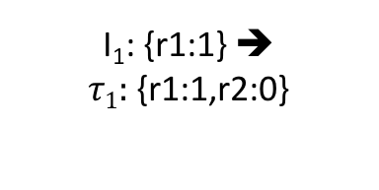
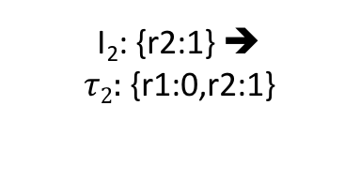
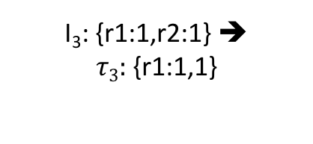
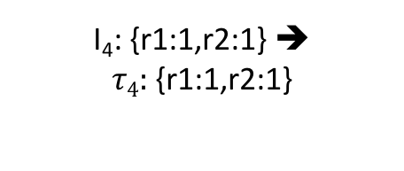
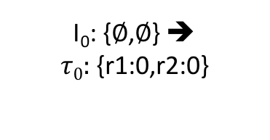
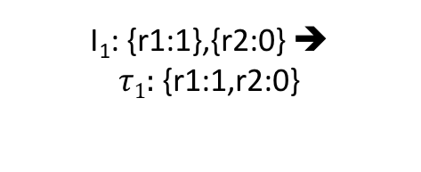
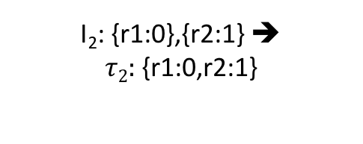
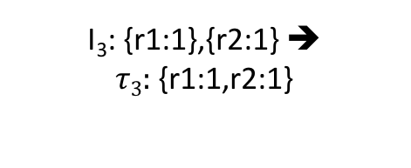
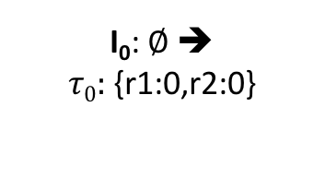
I₀: $∅$ ➔ $τ0:${r1:0,r2:0}
I₀: {$∅$,$∅$} ➔ $τ0:${r1:0,r2:0}
I₁: {r1:1} ➔ $τ1:${r1:1,r2:0}
I₂: {r2:1} ➔ $τ2:${r1:0,r2:1}
I₁: {r1:1},{r2:0} ➔ $τ1:${r1:1,r2:0}
I₃: {r1:1},{r2:1} ➔ $τ3:${r1:1,r2:1}
I₃: {r1:1,r2:1} ➔ $τ3:${r1:1,1}
I₄: {r1:1,r2:1} ➔ $τ4:${r1:1,r2:1}
I₂: {r1:0},{r2:1} ➔ $τ2:${r1:0,r2:1}
(a)
(b)

