Slide 1


3 demo scenarii in schemas

Slide 2
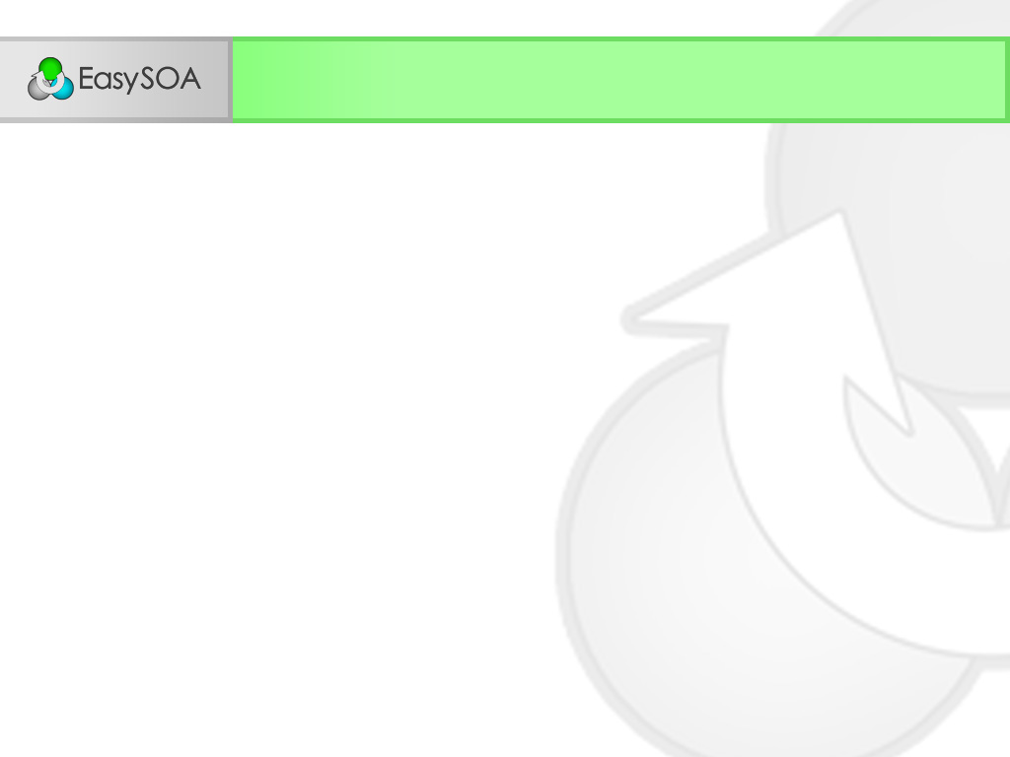
Demo scenarii
Light scenario
Design
Discover
Toolify
Develop
Release
Integration scenario with FraSCAti
Design
Discover
Toolify
Develop
Release
Integration scenario with an external runtime
Design
Discover
Toolify
Develop
Release

Slide 3
Light scenario

Slide 4
Light scenario
Goal : To add a business-layer above an existing service.
Let EasySOA protect
this service behind a sandboxing tunnel.
Design
Discover
Toolify
Develop
Release
Find the existing service we want to use.
a. Develop our business-oriented service.
b. Create a Service Scaffolder UI to use it.

Slide 5
Light scenario : Discover (1/3)
Deployed architecture
Existing
service
EasySOA model
Implementations
Existing
service
Environments
Existing
service
Master

Slide 6
Light scenario : Toolify (2/3)
Deployed architecture
Existing
service
EasySOA model
Will protect every external service called from this environment
Implementations
Existing
service
Environments
Existing
service
Light
Master

Slide 7
Light scenario : Develop (3/3) - a
Deployed architecture
New Light
service
Existing
service
Sandbox
(= Fuse + Monitoring)
EasySOA model
Implementations
New Light
service
Existing
service
Environments
New Light
service
Existing
service
Light
Master

Slide 8
Light scenario : Develop (3/3) - b
Deployed architecture
Scaffolder
UI
New Light
service
Existing
service
Default scaffolder tunnel
(= Monitoring)
Sandbox
(= Fuse + Monitoring)
EasySOA model
Implementations
Scaffolded
UI
New Light
service
Existing
service
Environments
Scaffolded
UI
New Light
service
Existing
service
Light
Master

Slide 9
Integration scenario : w/ FraSCAti

Slide 10
Integration scenario : w/ FraSCAti
Goal : To create a service from scratch.
(here, a simplified version of the SmartTravel example)
a. Record exchanges with the Meteo service
b. Create a Meteo mock
Design the SmartTravel architecture
Release in the master environment
Design
Discover
Toolify
Develop
Release
Import the architecture
Develop the SmartTravel service, to be hosted in the EasySOA code repository

Slide 11

FraSCAti scenario : Design (1/5)
Smart
Travel
Meteo

Slide 12
FraSCAti scenario : Discover (2/5)
Deployed architecture : dev. env.
Deployed architecture : master env.
Meteo
EasySOA model
Smart
Travel
Meteo
Contracts
Meteo
Implementations
Meteo
Environments
Master

Slide 13
FraSCAti scenario : Toolify (3/5) - a
Deployed architecture : dev. env.
Deployed architecture : master env.
Scaffolded
Client
Meteo
Meteo
EasySOA model
Smart
Travel
Meteo
Contracts
Scaffolded
Client
Meteo
Implementations
Exchanges
records
Scaffolded
Client
Meteo
Environments
Light
Master

Slide 14
FraSCAti scenario : Toolify (3/5) - b
Deployed architecture : dev. env.
Deployed architecture : master env.
Meteo
Mock
Meteo
EasySOA model
Smart
Travel
Meteo
Contracts
Exchanges
records
Meteo
Mock
Meteo
Implementations
Meteo
Mock
Meteo
Environments
Light
Master

Slide 15
FraSCAti scenario : Develop (4/5)
Deployed architecture : dev. env.
Deployed architecture : master env.
Smart
Travel
Meteo
Mock
Meteo
EasySOA model
Smart
Travel
Meteo
Contracts
Smart
Travel
Meteo
Mock
Meteo
Implementations
Smart
Travel
Meteo
Mock
Meteo
Environments
Light
Master

Slide 16
FraSCAti scenario : Deploy (5/5)
Deployed architecture : dev. env.
Deployed architecture : master env.
Smart
Travel
Meteo
Mock
Smart
Travel
Meteo
EasySOA model
Smart
Travel
Meteo
Contracts
Smart
Travel
Meteo
Mock
Meteo
Implementations
Smart
Travel
Meteo
Mock
Smart
Travel
Meteo
Environments
Light
Master

Slide 17
Integration scenario : Ext. runtime

Slide 18
Integration scenario : Ext. runtime
Goal : To ease an SOA evolution by providing mocking tools
and help configuration by environment
a. Create a mock
b. Generate environments configurations
Deploy the updated service with the matching configuration
Design
Discover
Toolify
Develop
Release
Learn about the existing SOA
Develop a new version of the existing service

Slide 19
Ext. runtime scenario : Discover (1/4)
Deployed architecture
Service V1
Required
service
EasySOA model
Required
service
Contracts
Service
Required
service
Implementations
Service
Required
service
Environments
Master

Slide 20
Ext. runtime scenario : Toolify (2/4) - a
Deployed architecture : dev. env.
Deployed architecture
Mock
Service V1
Required
service
EasySOA model
Can be built with :
- A set of requests/responses
- A script / template
Required
service
Contracts
Service
Mock
Required
service
Implementations
Mock
Service
Required
service
Environments
Development
Master

Slide 21
Ext. runtime scenario : Toolify (2/4) - b
Deployed architecture : dev. env.
Deployed architecture
Service V1
Mock
Service V1
Required
service
Dev.
_x0001_Conf.
EasySOA model
Dev. Conf.
- Service =
(URLServDev)
- RequiredService =
(URLMock)
Required
service
Contracts
Service
Mock
Required
service
Implementations
Master Conf.
- Service =
(URLServMaster)
- RequiredService =
(URLRequiredS.)
Service
Mock
Service
Required
service
Environments
Dev.
_x0001_Conf.
Development
Master
Conf.
Master

Slide 22
Ext. runtime scenario : Develop (3/4)
Deployed architecture : dev. env.
Deployed architecture
Service V2
Mock
Service V1
Required
service
Dev.
_x0001_Conf.
EasySOA model
Required
service
Contracts
Service
Mock
Required
service
Implementations
Service
Mock
Service
Required
service
Environments
Dev.
_x0001_Conf.
Development
Master
Conf.
Master

Slide 23
Ext. runtime scenario : Deploy (4/4)
Deployed architecture : dev. env.
Deployed architecture
Service V2
Mock
Service V2
Required
service
Dev.
_x0001_Conf.
Master
Conf.
EasySOA model
Required
service
Contracts
Service
Mock
Required
service
Implementations
Service
Mock
Service
Required
service
Environments
Dev.
_x0001_Conf.
Development
Master
Conf.
Master

