Slide 1


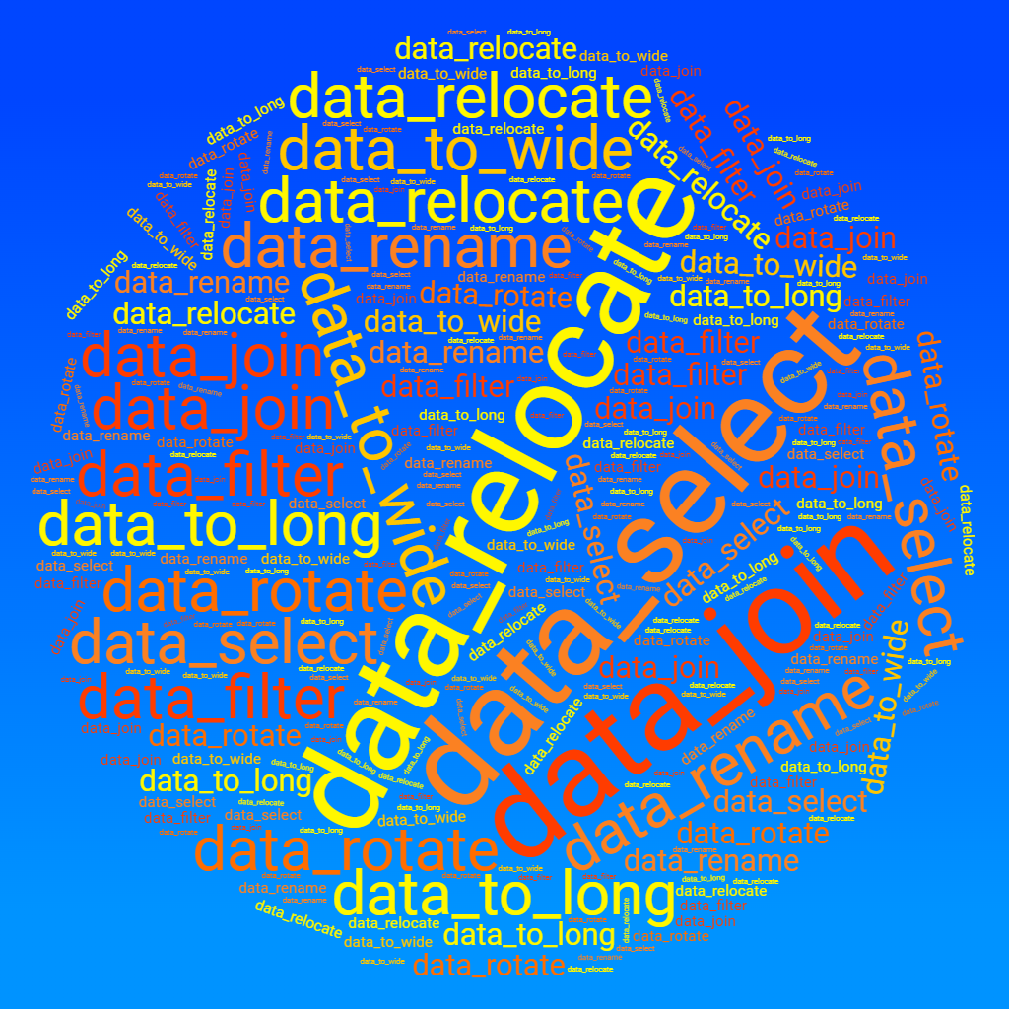


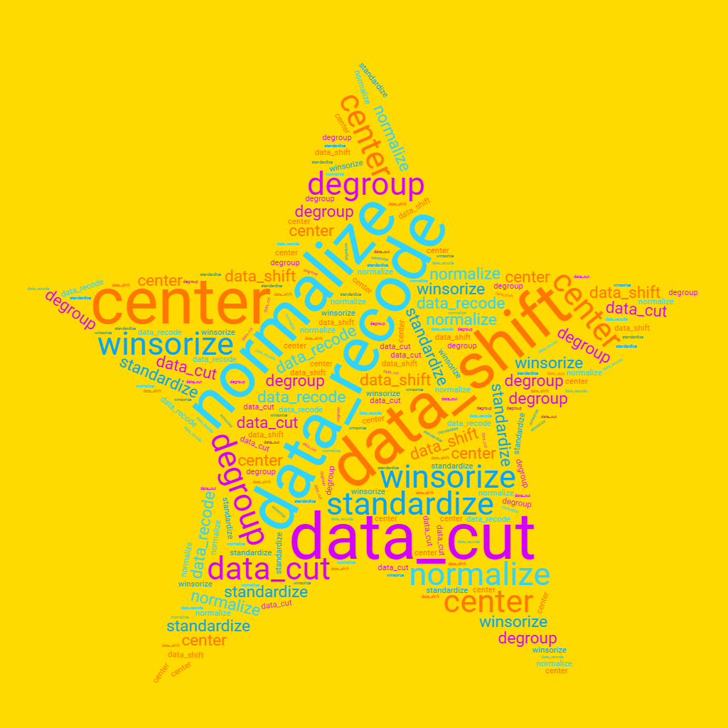
Using the datawizard R package
😍 No dependencies
😍 Easy to program with
😍 Tidyverse-friendly syntax
Messy Data
Preparation
Transformation

