Slide 1


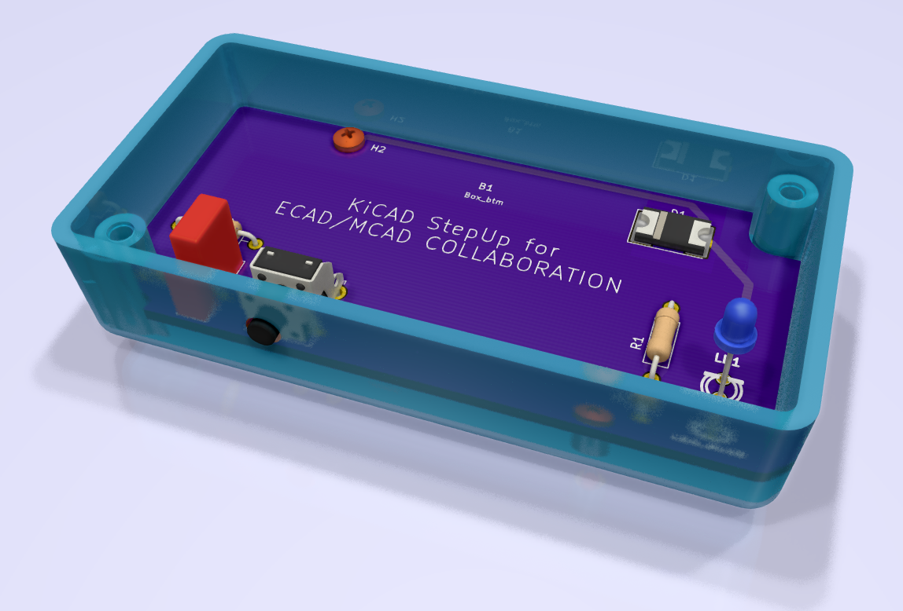
KiCAD StepUp goes to a new level of
ECAD / MCAD Collaboration and Synchronization:

Slide 2
KiCAD StepUp goes to a new level of
ECAD / MCAD Collaboration and Synchronization:
Push/Pull 3D model placement from/to KiCAD board to/from FreeCAD mechanical design.

Slide 3
KiCAD StepUp goes to a new level of
ECAD / MCAD Collaboration and Synchronization:
Push/Pull 3D model placement from/to KiCAD board to/from FreeCAD mechanical design.
It is possible to move 3D packages around on the 3D PCB mechanical sw, via both the X and Y axis.

Slide 4
KiCAD StepUp goes to a new level of
ECAD / MCAD Collaboration and Synchronization:
Push/Pull 3D model placement from/to KiCAD board to/from FreeCAD mechanical design.
It is possible to move 3D packages around on the 3D PCB mechanical sw, via both the X and Y axis.
Tracks will not be touched by the placements done in the MCAD sw. All the routing will remain in KiCAD.

Slide 5
KiCAD StepUp goes to a new level of
ECAD / MCAD Collaboration and Synchronization:
Push/Pull 3D model placement from/to KiCAD board to/from FreeCAD mechanical design.
It is possible to move 3D packages around on the 3D PCB mechanical sw, via both the X and Y axis.
Tracks will not be touched by the placements done in the MCAD sw. All the routing will remain in KiCAD.
Syncing between ECAD and MCAD can be done for:
changing the shape of the board
changing the placement of 3D component models

Slide 6
KiCAD StepUp goes to a new level of
ECAD / MCAD Collaboration and Synchronization:
The syncing process can be done even if the board is (fully) routed (i.e. when a new release requires some mechanical reviews).

Slide 7
KiCAD StepUp goes to a new level of
ECAD / MCAD Collaboration and Synchronization:
The syncing process can be done even if the board is (fully) routed (i.e. when a new release requires some mechanical reviews).
Pull KiCAD board inside FreeCAD
Move and Align the 3D model to the new placement in the
enclosure
Arrange the components nearby the new placement
Move and Align the mounting holes to the enclosure
support
Sync the kicad_pcb board file within the new design
Check the result inside KiCAD and reroute the tracks
that are affected by the new placement

