Slide 1

Evolution as a Tool
A new technology
for protein engineering
Peter Reintjes

Slide 2
Definitions
Protein (Protease, Protease Inhibitor)
A string of amino acids that folds up into a biological machine. Life is all about proteins bumping into other proteins and causing them to do (or not do) something.
DNA
A string a nucleotides (A,T,C,G) that specifies the sequence of amino acids that make up a protein
E. coli
A group of bacteria that includes the E. coli in your stomach and other harmless types that we use in the laboratory as well as Shigella and Salmonella
Bacterial Virus = Phage
A DNA strand (rogue code) in a package that can hijack a cell and cause the cell to produce copies of the virus
-stat
A device to maintain a set of conditions

Slide 3
Evolution as a Tool:
Use a virus (phage) to evolve a custom protein
PACE - Phage Assisted Continuous Evolution
(Esvelt et al. Nature, April 2011)
You need to build a Phagestat to maintain
a population of evolving virus (Husimi 1989)
Off the shelf hardware for about $30,000
- or -
DIY hardware + open source software ~$1000

Slide 4
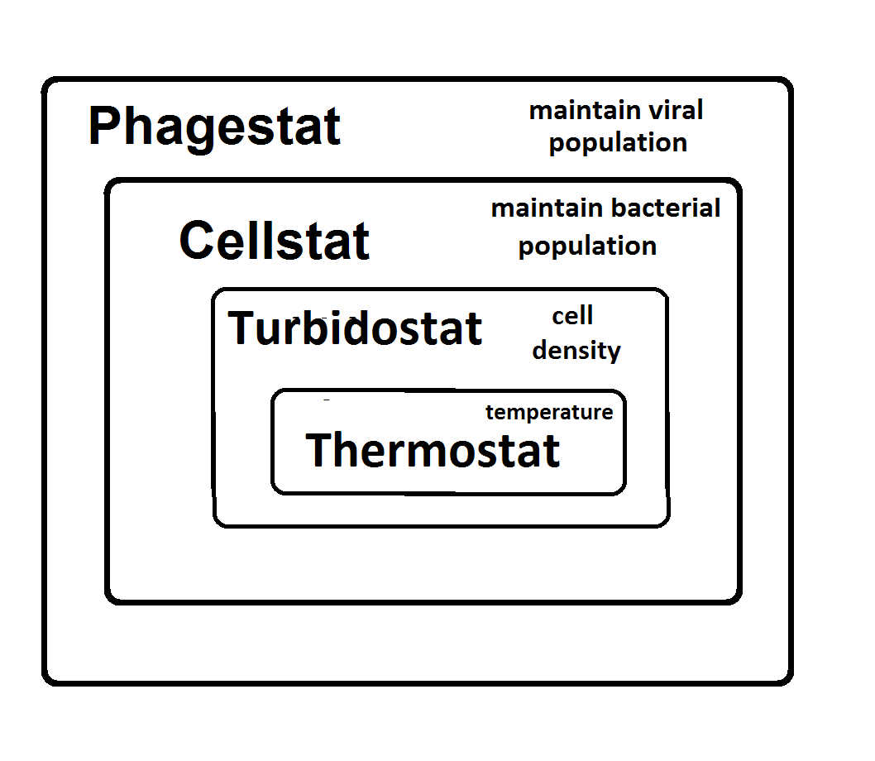

Slide 5
Motivation
Shigella kills 1,000,000 people – mostly children in the developing world – every year
Shigella without the extracellular proteases Pic and SepA is harmless
Hypothesis: We can evolve protease inhibitors with strong binding to Pic and SepA to diminish Shigella's virulence
Hypothesis: These engineered proteins produced by a probiotic (lactobacillus) could provide inexpensive, long-term immunity

Slide 6
Protein-based pharmaceuticals
Reduced side-effect potential
Proteins are easily metabolized
Proteins degrade quickly in the waste stream
Binding affinity is the principal characteristic of metabolic processes and pharmaceuticals
Increased binding affinity lowers dosage

Slide 7
Evolution = Variation + Selection
Bacterial virus replicates inside E. coli which creates variation by making mistakes when copying the viral DNA
E. coli creates more infectious viral particles in proportion to how tightly the evolving protein binds with the target.

Slide 8
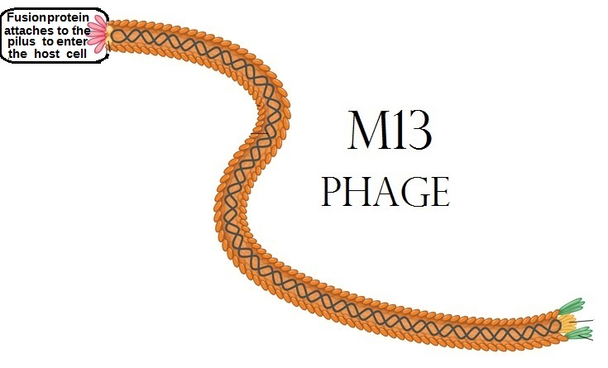

Slide 9
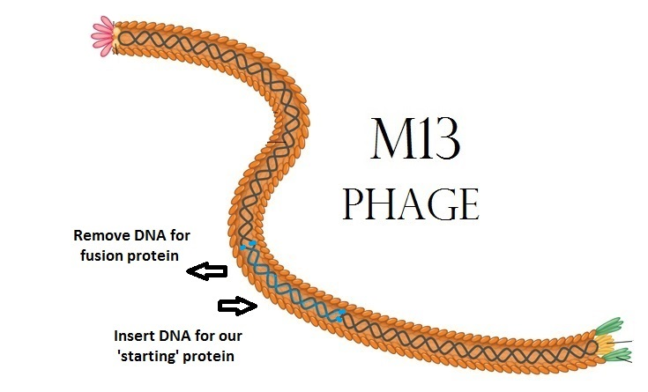
PACE: Phage Assisted Continuous Evolution

Slide 10
PACE: Phage Assisted Continuous Evolution
M13 virus (phage) with the sequence to evolve replacing its fusion gene
E. coli with two extra plasmids (chromosomes)
  Variation: Arabinose activated mutagenesis
  (error-prone DNA polymerase)
  Selection: M13 fusion gene activated when the evolving protein binds to a target
  (tighter binding causes more fusion protein to be made)
  E. coli host cells flow through “lagoons”
with populations of evolving viruses

Slide 11


Slide 12
Experiments can run from four to six days requiring automation and reliability
(1000 generations X a billion mutations)
Creating 10¹² variations of the 'starting' protein and always keeping the one with the tightest binding
Not 10¹² random variations, but a billion variations on the 'best so far' in each generation.

Slide 13

Biological Computation

Slide 14
Building a Phagestat
A device to maintain a stable population of bacterial phage (virus)
A Cellstat to produce (E. coli) host cells
Control of input and output flow
Inputs: Host cells and inducers
Output: Sampling and waste output

Slide 15
Building a Cellstat
To maintain a continuous supply of host cells (E. coli)
A Thermostat maintains cells at body temperature
A Turbidostat maintains cell density with nutrient dilution
Isolation from bacterial phage:
Cellstat output is the Phagestat input

Slide 16


Slide 17
For PACE the flow rate must be:
Fast enough to force host cells through in one cell lifetime, so the only mutations are in the phage sequence
Slow enough to prevent washout of phage even with large variations in the viral reproduction rate

Slide 18
Building a Phagestat
Off-the-shelf solution:
Cost ~$30,000
Requires integration of different parts
Hands-on oversight
(three shifts of lab personnel?)

Slide 19



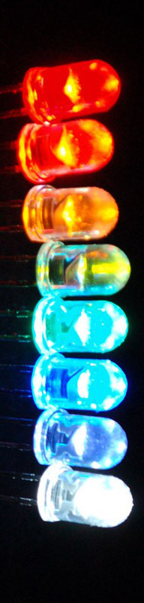
Raw Materials
Arduino micro-controller
Raspberry Pi / Linux
Webcam
Python programming language
OpenCV image processing software
PIR (Passive InfraRed) temp sensor
LEDs, resistors, motors, magnets
Discarded flatbed scanner
Styrofoam shipping containers
PVC plumbing hardware
3D printer

Slide 20
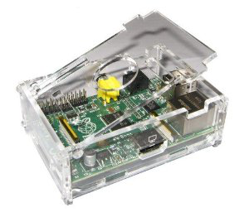
Design Principle #1
No Black Boxes
Replace expensive, precision equipment which is not fixable / hackable by team members with extremely simple hardware
Produce the required precision with computer control

Slide 21
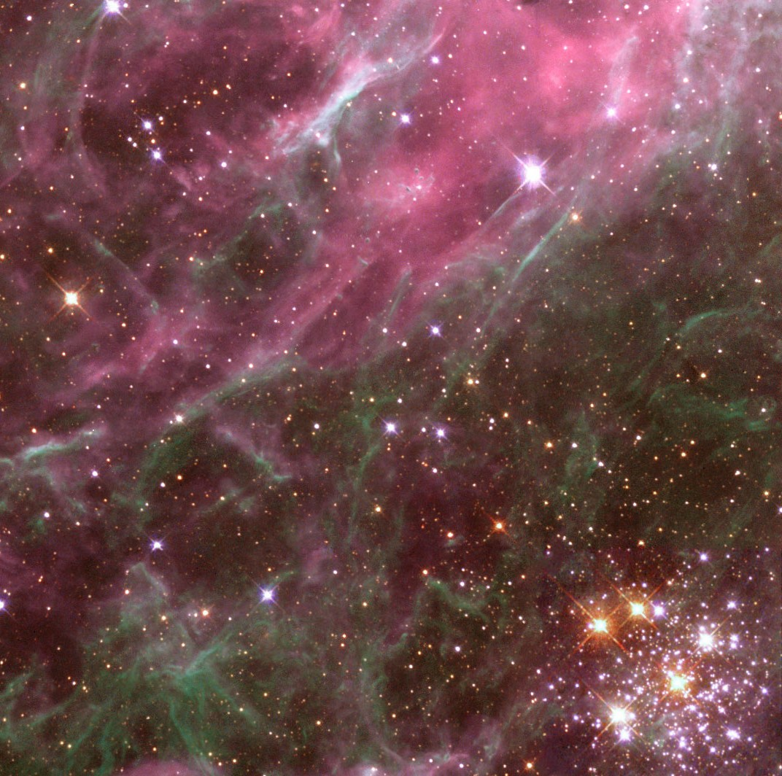
What can we learn from Astronomy?
.
Kepler 22b:
Twice as big as Earth, in the habitable zone, could be an ocean planet, 95% confidence that it has no moons greater than ½ Earth mass
It is 600 light-years away !
There is a lot of information in whatever signals happen to come your way

Slide 22
Design Principle #2
By considering the information (light) coming out, we can avoid specialized sensors inside the apparatus
We may be able to measure everything without physical contact with the biological materials

Slide 23

Non-contact level-sensing

Slide 24
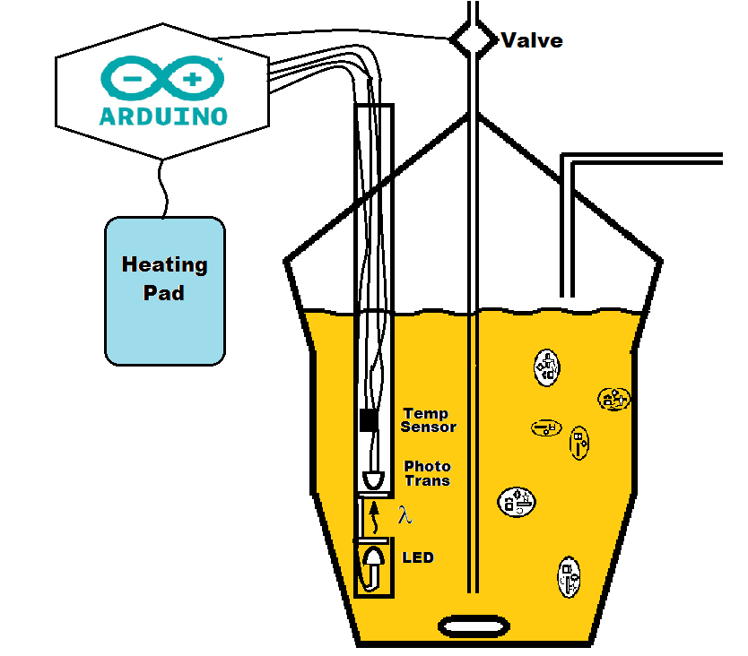
$25 vs.
$10,000
Turbidostat version 1.0

Slide 25
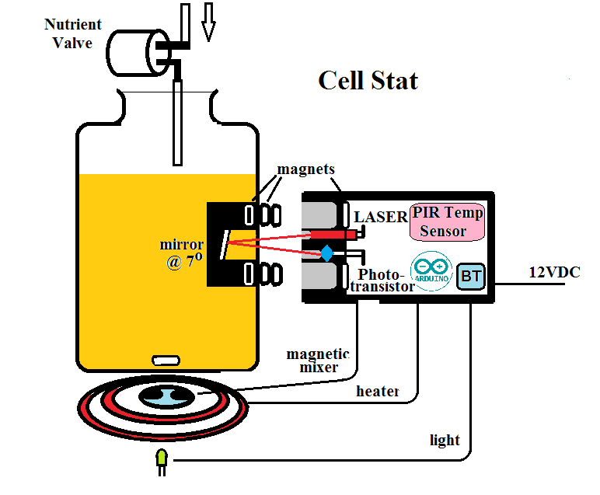

Slide 26

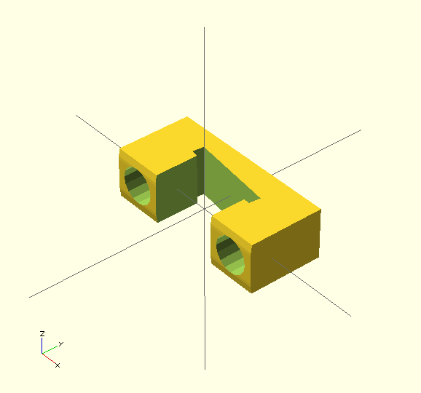
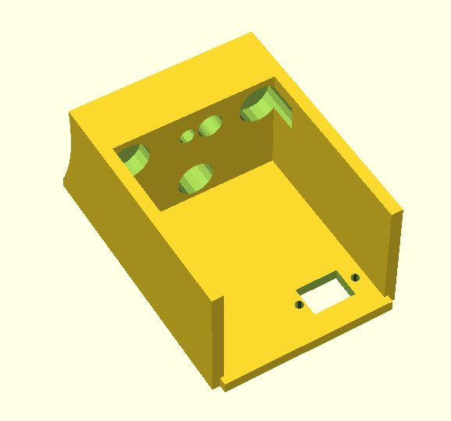
3D Printed :
Mirror holder for inside Cell-Stat
Sensor assembly with magnetic attachment

Slide 27
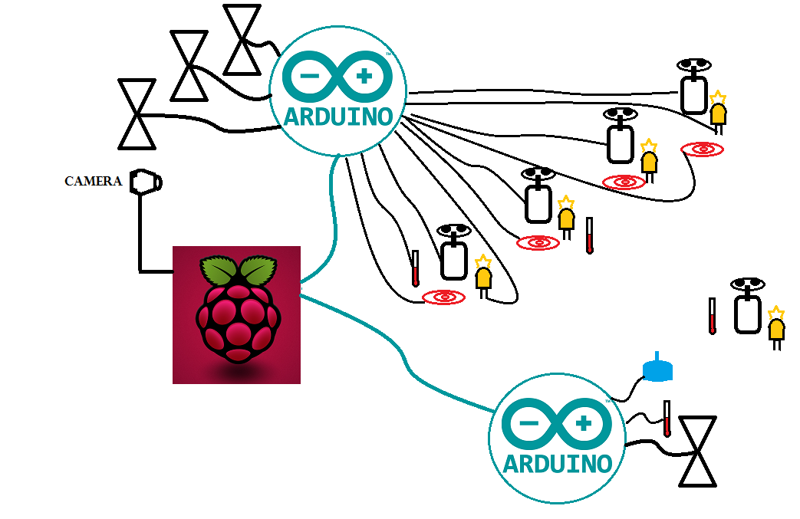

Slide 28
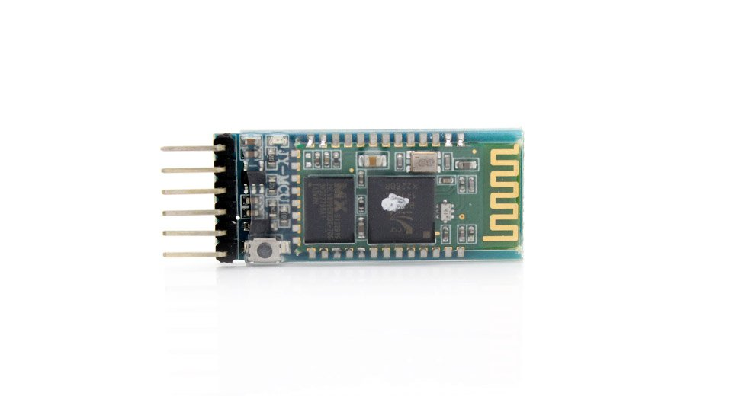
Bluetooth
To get rid of all the wiring

Slide 29
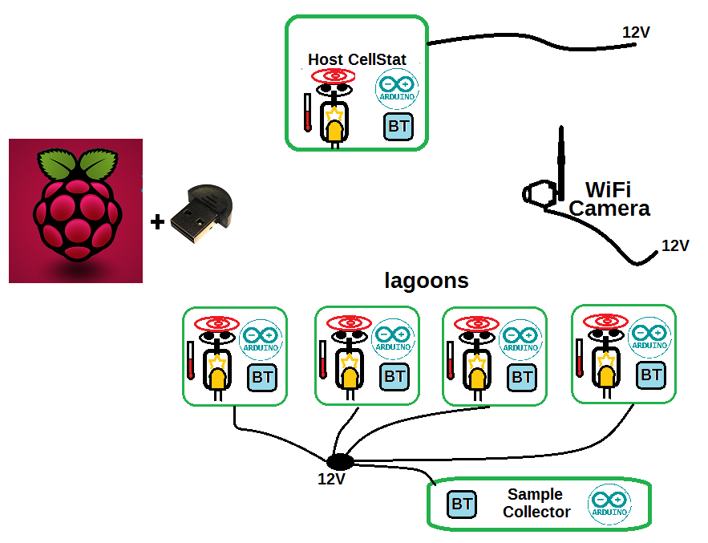

Slide 30
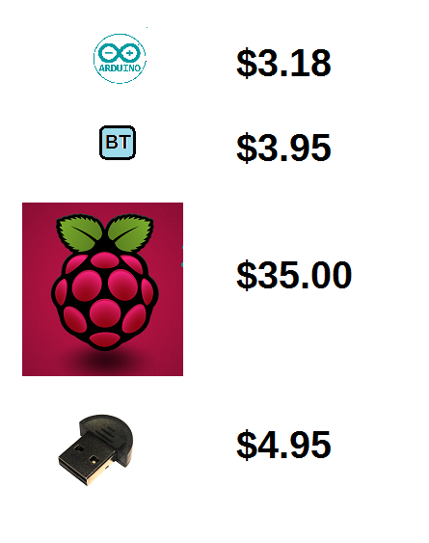

Slide 31
Material Costs for a “PACE capsule”
Raspberry PI main computer ($40)
Wide-angle IP Camera ($80)
6X Arduino + Bluetooth ($36)
PIR (passive infra-red) temperature sensor ($35)
Laser, LEDs, Photo transistor ($20)
Styrofoam boxes ($20 X 2)
Heating Elements ($25 X 2)
Stirring Motors w/magnets ($5 X 5)
Aquarium air pump ($35)
Valves, peristaltic pumps ($150)
Miscellaneous Hardware-PVC ($80)
12V Power Supply ($20)
Glassware ($200)
Tubing + Nutrient (operating cost)
$800

Slide 32
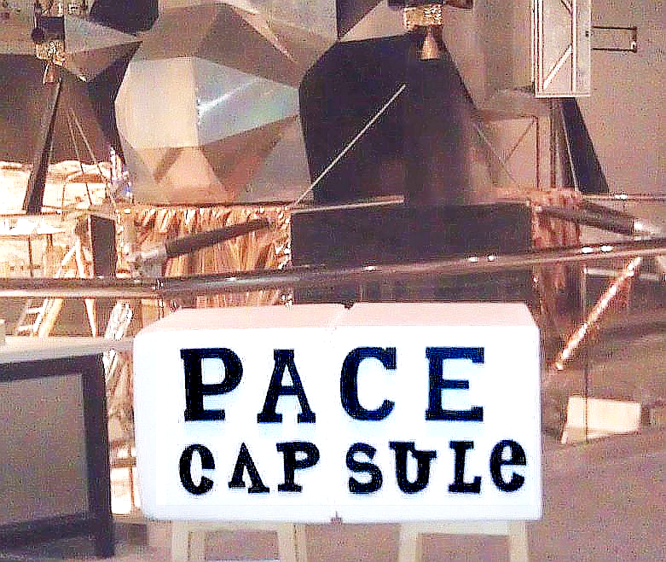

Slide 33
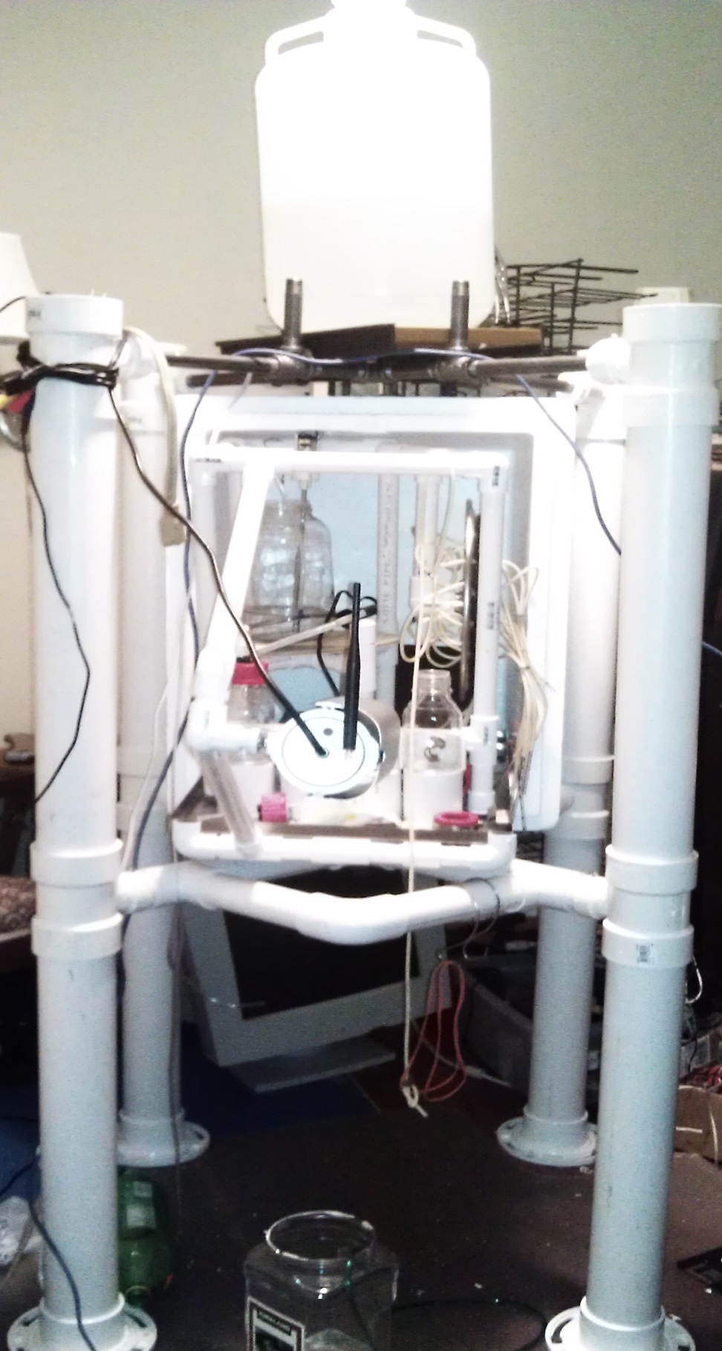

More like a 'lander' after adding $80 worth of PVC

Slide 34
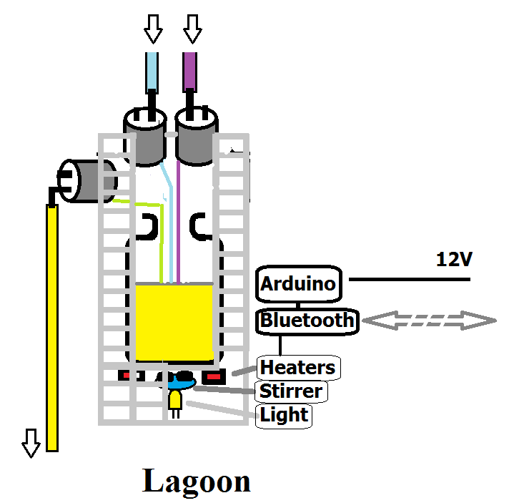

Slide 35

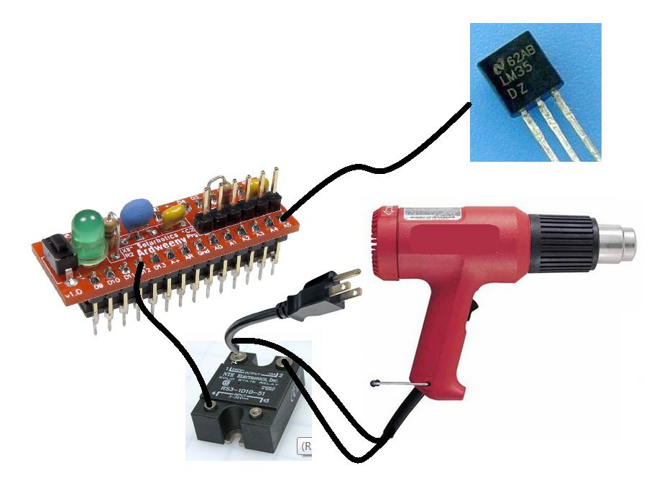
Problem:
The $10,000 environmental chamber failed catastrophically mid-experiment
Solution:
LM35DZ temperature sensor ($1.50)
Ardweeny ($10) running PID algorithm
1500W heat gun from Lowes ($25)
with a solid-state relay ($10)

Slide 36
Evolution as a Tool
A new technology
for protein engineering
Peter Reintjes

Slide 37
Bio-Hacking
ApE – an Open Source plasmid editor
PCR Thermocycler ($25): Ardweeny,Peltier Junction, Fan,drilled aluminum block
Gibson and Gateway assembly reagents (to assemble plasmids)
Phage Assisted Continuous Evolution
SPATEs*: The Achilles Heel of Microbial Pathogens? Tendon
*Serine Protease AutoTransporters of Enterobacteriaceae

Slide 38
Problems:
The $10,000 environmental chamber failed catastrophically mid-experiment
Bioluminescence detection requires expensive high-voltage photomultiplier tubes and complex plumbing
3D printers can't make stainless steel parts
DIY electronic sensors must be sterile, but fail after being autoclaved repeatedly
Silicon/Tyvek tubes ruptured after several days in a constantly running peristaltic pump

Slide 39
Problem:
Bioluminescence detection requires expensive high-voltage photomultiplier tubes and complex plumbing
Solution:
In a dark room, point a heat gun at a webcam and take a picture, this is your camera's noise image
Then take 100 pictures and add the frames up using: +Green–(Red+Blue)/2 finally, subtract the noise image

Slide 40
Problem:
3D printers can't make stainless steel parts
Solution:
Perhaps you simply need parts with stainless steel edges or surfaces
Buy uncoated stainless steel welding rods $6/lb and design plastic 3D parts with openings for rods and/or plates

Slide 41
Problem:
DIY electronic sensors must be sterile, but fail after being autoclaved repeatedly
Solution:
Use non-contact sensing
PIR (passive InfraRed) Temperature sensor
Camera, laser and LED lighting, OpenCV image processing for turbidity(cloudiness), bioluminescence, pH, and level sensing

Slide 42
Problem:
Tyvek tubes ruptured after several days in a constantly running peristaltic pump
Solution:
Design the system for gravity/siphon flow and use peristaltic pumps for priming
Peristaltic pumps now only run for a fraction of the total experiment duration

Slide 43
Summary of Hacks:
Styrofoam boxes for thermal isolation
Black garbage bags for optical isolation
Ardweeny controlling a heat gun
Stovetop coil + 36V printer power supply,
50 ohm 10W power resistors
for low-voltage heating (up to 40ºC)
Motor($1),T-nut,2 magnets = Magnetic stirrer
Camera + image processing = sensors
Flatbed scanner, motor, 3D parts = sampler

Slide 44
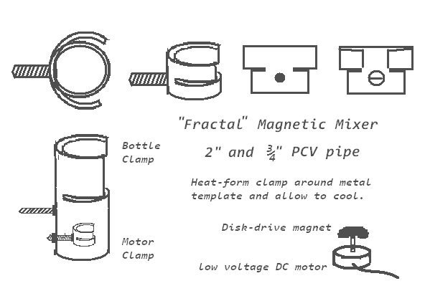

Details
Minimize pressure and stress required for tube-valve

