Slide 1
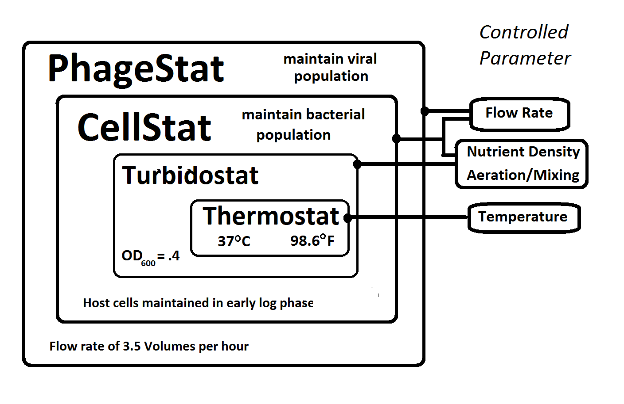
What has Reintjes been up to?

Slide 2
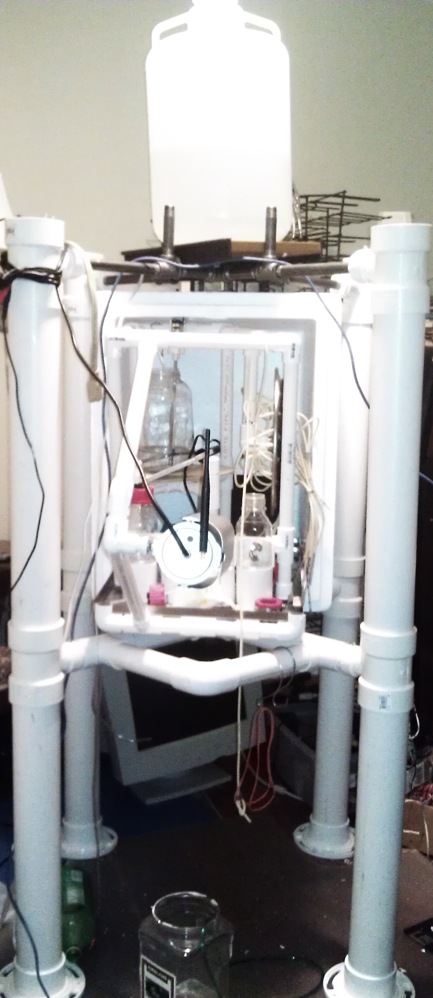
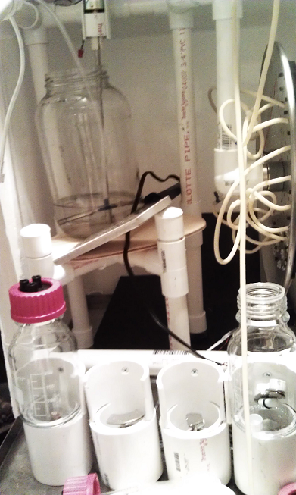
Am I Crazy?

Slide 3
My Goals
Do interesting work, even if it doesn't pay
Build an inexpensive, reliable, self-calibrating phagestat (virusstat) system
Address specific needs/failures we've had:
Peristaltic pump tubing failure
Temperature control
Lack of on-site personnel
Avoid combining high-voltages + liquids
Failures of various 'black boxes'
(e.g. commercial products with no schematics, code, warranty or service agreements)

Slide 4
Features
Many derive from a camera + image processing
Non-contact turbidity and temperature sensors
Non-contact level sensing
Custom magnetic stirrers
Bio-luminescence detection
Fold-able stainless aeration sparger ring
Network control and communication
Low impact sample collector
Inexpensive and easy to repair

Slide 5
Features
Many derive from a camera + image processing
Non-contact turbidity and temperature sensors eliminating the need for autoclave/sterilization of probe and bio-film problems.
Non-contact level sensing providing feedback for a simplified liquid flow system
Custom magnetic stirrers (I didn't want to do this) allowing optimal visual placement of host cell vessel and lagoons and computer control of spin-up spin-down to recover from stalling
Optical image integration for bio-luminescence detection replacing high-voltage (black box) spectrophotometer.
Fold-able stainless aeration sparger ring to fit through narrow vessel neck yet lay flat around the bottom diameter, directing the bubble flow to help scrub the vessel walls.

Slide 6
Features (continued)
Networked phagestat sends text messages and images to report leaks, temperature or turbidity fluctuations, and bio-luminescence spikes which may indicating evolutionary traction.
Integrated (low impact) quad sample collector
Other color indicators (not fluorescent or luminescent) could be used for properties or activities such as pH or phage population before pIII production.
Incremental material cost of each additional phagestat:
$1000 (labor not included)

Slide 7
Phagestatus
Documentation is in the form of a patent application but may be more useful as a trade secret. I am willing to present the entire project as open-source hardware ( Publicity vs. VC money? )
Needs debugging, software development, additional 3D-printed parts (months, not years, it could be limping along in a few weeks).
Suggests an alternate business model providing 'Phagestat Service' to customers who will create their own AP, MP, and SP plasmids and competent cells.

Slide 8


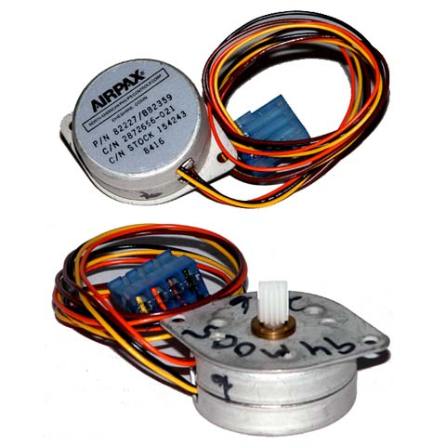
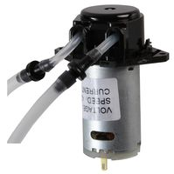
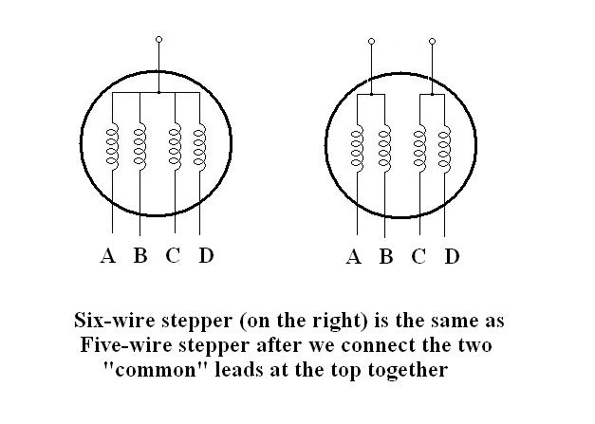
Am I Crazy?
Python C Prolog SMS ABS
Linux Raspberry Pi ULN2003 PVC

