Slide 1
Building a PhageStat
A device to maintain a stable population of bacterial phage (virus)
To build a Phagestat, you need:
A Cellstat producing a supply of (E. coli) host cells .
Precise control of multiple input and output flows
Inputs: Host cells and inducers
Outputs: Sampling and waste output

Slide 2
Building a CellStat
A device maintaining a population of un-infected
host cells (E. coli) at optimal growth conditions
To build a Cellstat you need:
A Thermostat, to maintain the culture at 37˚ C (98.6˚ F)
A Turbidostat, to maintain cell density with nutrient dilution
Isolation from bacterial phage:
Cellstat outflow is the Phagestat inflow

Slide 3
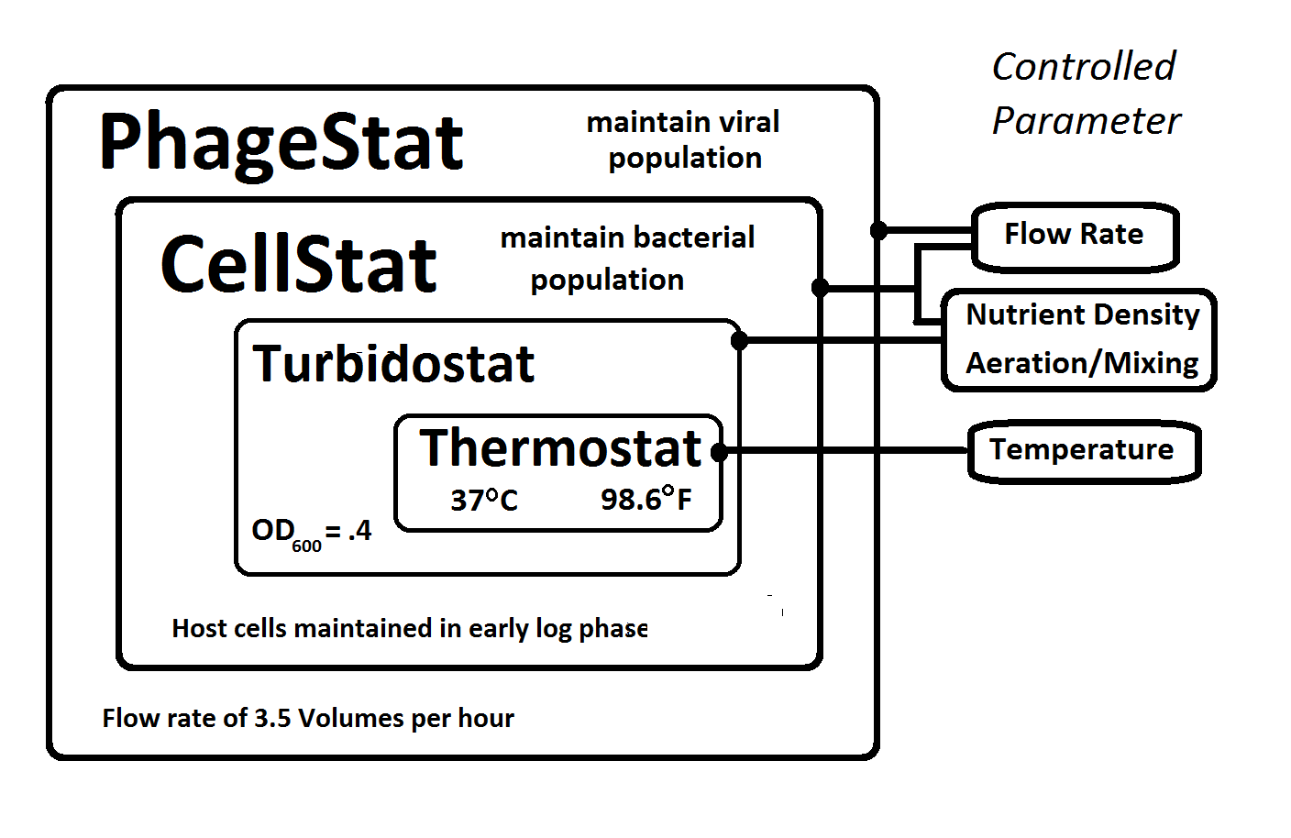

Slide 4
Flow rate control
The ideal Phagestat has:
A flow rate sufficient to allow host cells to flow through in one cell lifetime, so the only mutations are in the phage sequence.
A flow rate low enough to prevent washout of phage even with large variations in the viral reproduction rate.
Like all 'stats', a Phagestat cannot maintain an exact viral population count, but rather keeps it within a range. In the case of mutation experiments, the viral population numbers may have considerable variance within the two requirements above.

