Slide 1
“Evolution as a Tool”
Phage Assisted
Continuous Evolution
...on a budget

Slide 2
Overview
PACE (Esvelt et. al. Nature, April 2011 )
Use a virus to evolve a custom protein
Off the shelf hardware for only $30,000
- or -
Open-source Hardware/Software ~$1000

Slide 3
Innatrix Motivation #1
Shigella kills 1,000,000 people per year, mostly children in the developing world
Shigella without the proteases Pic and SepA is harmless
Hypotheses: Protease inhibiters with strong binding affinity to Pic and SepA would short-circuit Shigella's virulence
Hypotheses: Engineered proteases produced by lactobacillus or other probiotic could provide inexpensive, long-term immunity

Slide 4
Technology Potential
Protein binding affinity is the principal characteristic of metabolic processes and pharmaceuticals
Higher binding affinity would lower dosage for any protein therapeutic
Large protein molecules have reduced side-effect potential over small-molecule pharmaceuticals which easily cross metabolic barriers and have more interaction potential
Proteins degrade quickly in waste stream
Proteins can be easily metabolized without stressing renal function

Slide 5
PACE: Phage Assisted Continuous Evolution
Evolution: Selection and Mutation
E. coli rewards improvements to evolving protein by providing a protein that increases viral infection
Virus replicates inside E. coli which uses an error-prone DNA polymerase to increase mutations

Slide 6
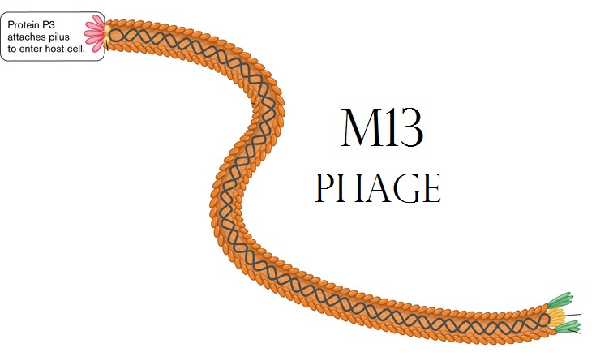

Slide 7
PACE: Phage Assisted Continuous Evolution
M13 virus (phage) but substitute sequence to evolve for its fusion gene
E. coli with two extra plasmids (chromosomes)
  Mutation: Arabinose activated mutagenesis
  (error-prone DNA polymerase)
  Selection: M13 'fusion' gene activated by
  a particular protein interaction
  E. coli host cells flow through “lagoons”
containing populations of evolving viruses

Slide 8
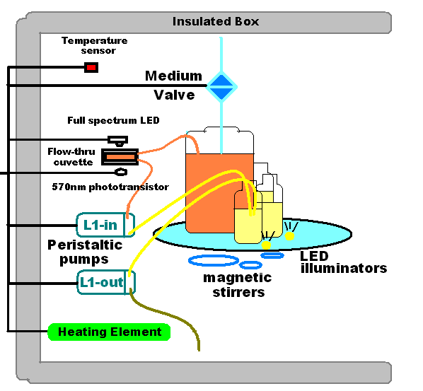

Slide 9
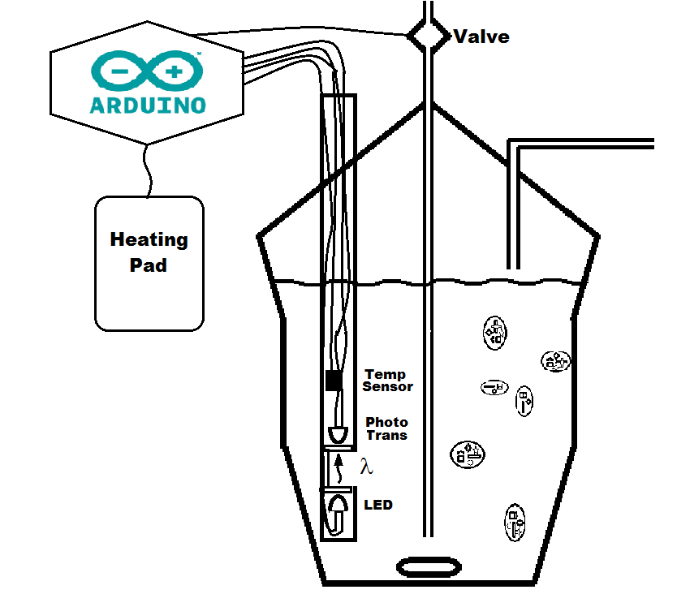
Turbidostat version 1.0

Slide 10
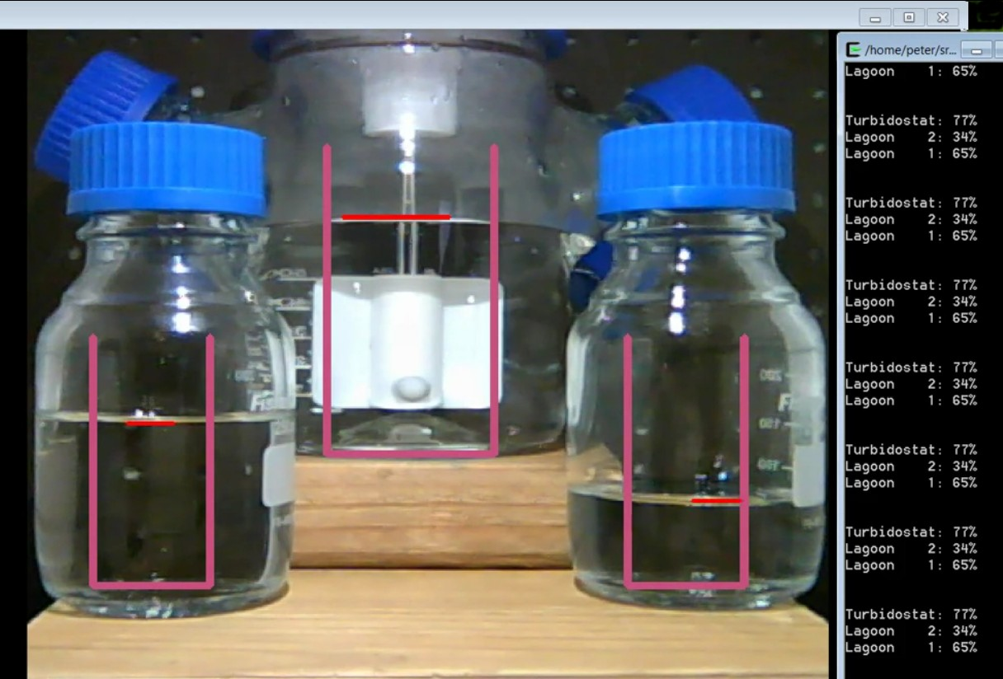
Non-contact level-sensing

Slide 11
Material Costs for a “PACE capsule” < $1000
Raspberry PI main computer ($40)
Wide-angle USB or IP Camera ($100)
Ardweeny + FTDI board ($25 X 2)
PIR (non contact)Temperature Sensor ($50)
Laser, LEDs, Temp IC, Photo transistor ($10)
Insulated boxes (Uline Styrofoam) ($100)
Heating Pads ($30)
Magnetic Stir Motors ($20 X 5)
Valves, Rotary valve motors ($100)
Miscellaneous Hardware-PVC ($150)
5V and 12V Power Supplies ($20)
Glassware ($200)
Tubing + Nutrient (operating cost)

Slide 12
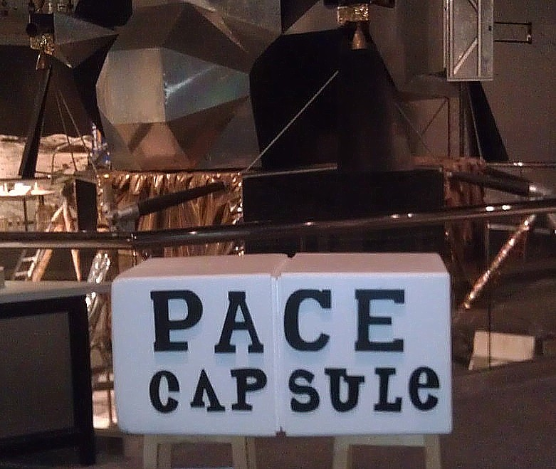

Slide 13
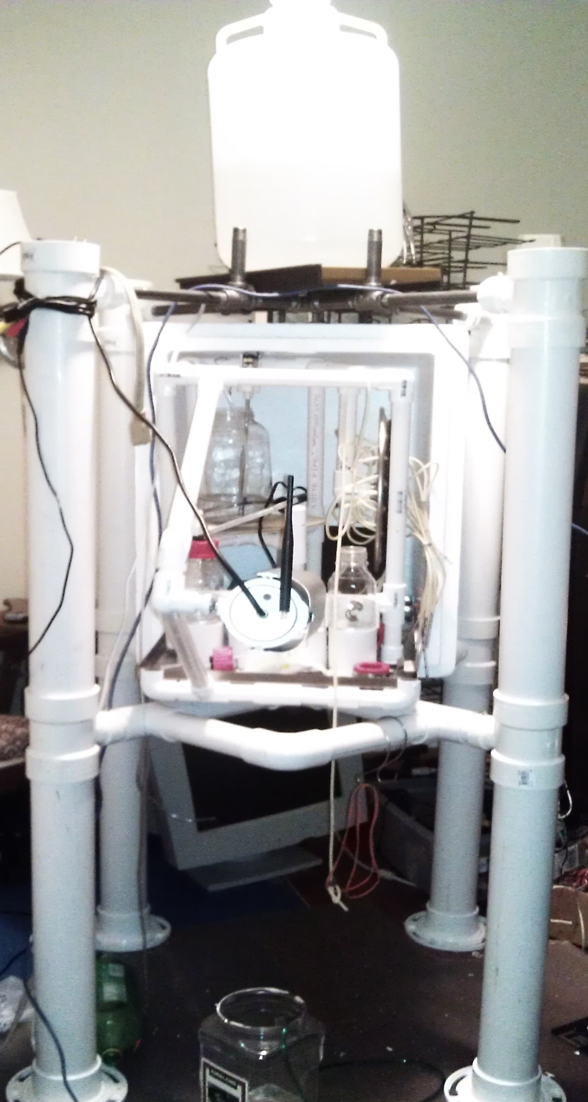
More like a 'lander' after the addition of $80 worth of PCV

Slide 14
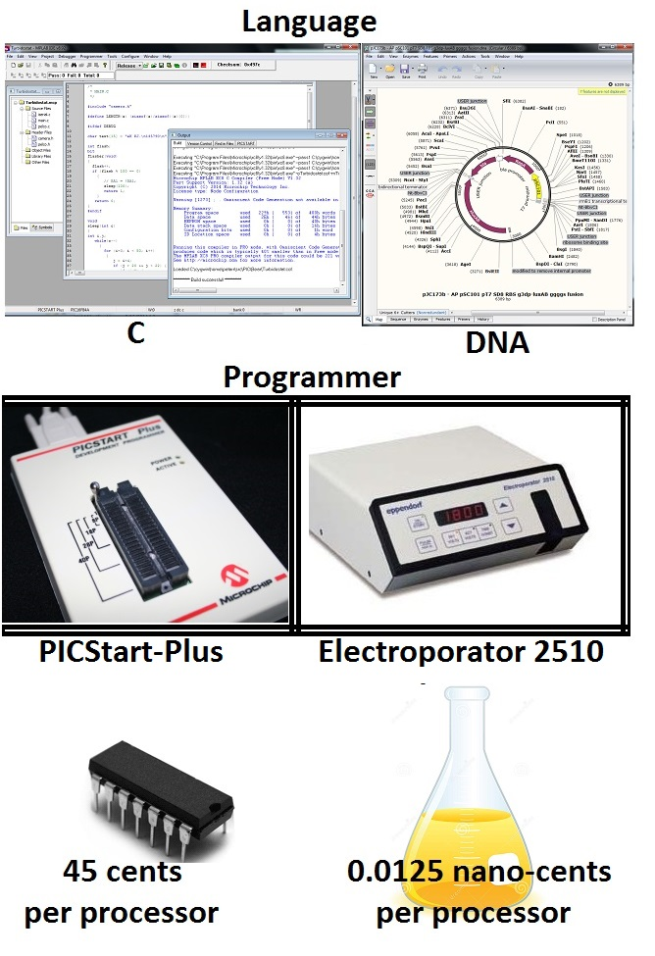
Know Wonder Moment

