Slide 1
Open Source Evolution
Phage Assisted
Continuous Evolution
...on a budget

Slide 2
Overview
PACE (Esvelt et. al. Nature, April 2011 )
Use a virus to evolve a custom protein
Off the shelf hardware for only $30K
- or -
Open-source Hardware/Software ~$1000

Slide 3
Innatrix Motivation #1
Shigella kills 1,000,000 people per year, mostly children in the developing world
Shigella without the proteases Pic and SepA is harmless
Hypotheses: Protease inhibiters with strong binding affinity to Pic and SepA would short-circuit Shigella's virulence
Hypotheses: Such proteins added to LactoBacillus or other probiotic could provide inexpensive, long-term immunity

Slide 4
Technology Potential
Protein binding affinity is the principal characteristic of metabolic processes and pharmaceuticals
Higher binding affinity would lower dosage for any protein therapeutic
Large protein molecules will have reduced side-effect potential of small-molecule pharmaceuticals which easily cross metabolic barriers and have more interaction potential
Proteins degrade quickly in waste stream
Proteins can be easily metabolized without stressing renal function

Slide 5
PACE: Phage Assisted Continuous Evolution
Bacterial virus (M13) evolves the protein
Virus replicates inside E. coli
Increase mutation rate by a factor of 100
E. coli rewards improvements by providing a protein that increases viral infection.

Slide 6
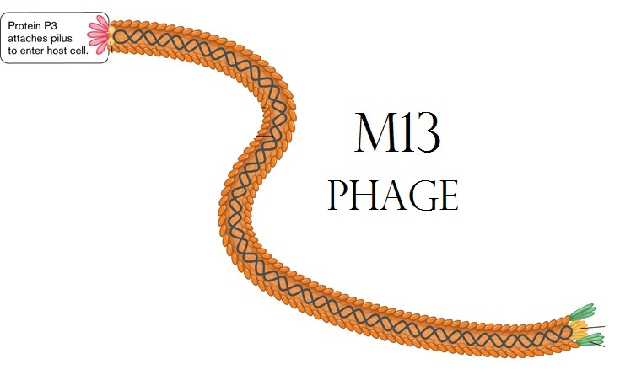

Slide 7
PACE: Phage Assisted Continuous Evolution
M13 virus (phage) but substitute a sequence of the protein to evolve for its fusion gene.
E. coli with two extra plasmids (chromosomes)
  Mutation: Arabinose activated mutagenesis
  (error-prone DNA polymerase)
  Selection: M13 'fusion' gene activated by
  a particular protein interaction
  E. coli host cells flow through “lagoons”
containing populations of evolving viruses

Slide 8
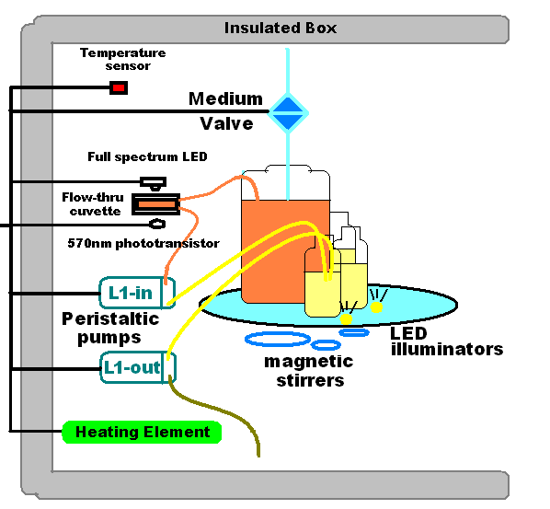

Slide 9
Principal Ideas
Virus life cycle is shorter than E. coli
No Arabinose in E. coli hatchery (no mutation)
E. coli pass through lagoons containing Arabinose in less than one generation
(e. g. not enough time to create E. coli mutants)
Several phage generations occur during the flow-through time of the lagoon
Different kinds of interaction can trigger production of the 'infection' protein

Slide 10
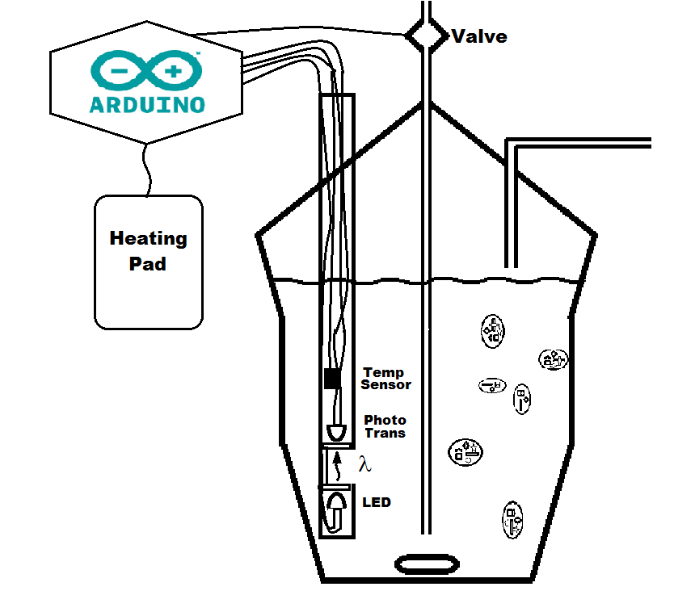
Turbidostat version 1.0

Slide 11
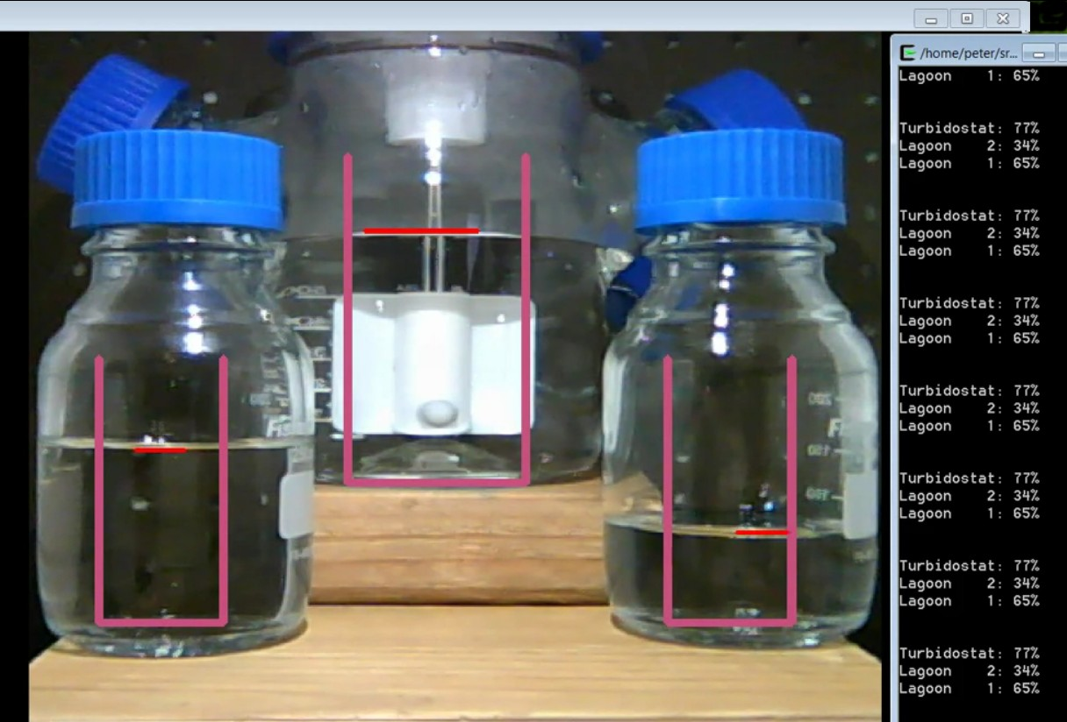
Non-contact level-sensing

Slide 12
Conclusions
PACE
Can observe evolutionary divergence and convergence in different lagoons.
Inexpensive and fast to modify a gene
Multiple PACE stages can radically alter genes (e.g. create a protein to recognize a new promoter)
Implementation
Arduino is ideal for analog inputs and real-time control a PACE device
Low-cost system controller (Raspberry Pi) can manage multiple devices

Slide 13
Material Costs for a “PACE capsule” < $1000
Raspberry PI main computer ($40)
Wide-angle USB or IP Camera ($100)
Ardweeny + FTDI board ($25 X 2)
PIR (non contact)Temperature Sensor ($50)
Laser, LEDs, Temp IC, Photo transistor ($10)
Insulated boxes (Uline Styrofoam) ($100)
Heating Pads ($30)
Magnetic Stir Motors ($20 X 5)
Valves, Rotary valve motors ($100)
Miscellaneous Hardware-PVC ($150)
5V and 12V Power Supplies ($20)
Glassware ($200)
Tubing + Nutrient (operating cost)

Slide 14
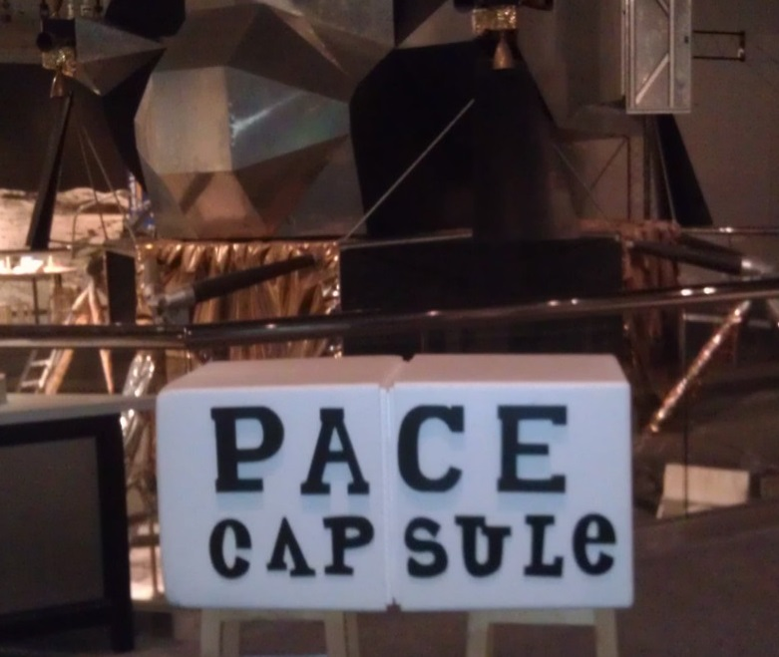

Slide 15
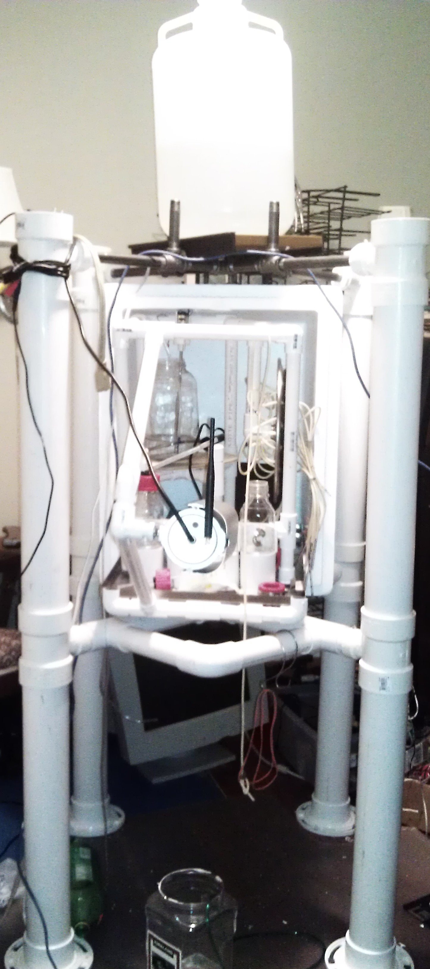
More like a 'lander' after the addition of $80 worth of PCV

