Slide 1
Open Source Evolution
Phage Assisted Continuous Evolution
on a budget

Slide 2
Overview
PACE (Harvard University, April 2011)
Use a virus to evolve a custom protein
With off the shelf hardware for only $25K
– or –
Arduino + Scrap Exchange for $200

Slide 3
PACE: Phage Assisted Continuous Evolution
Bacterial virus (M13) evolves the gene/protein
Virus replicates inside E. coli.
Increase mutation rate by a factor of 100
E. coli rewards improvements to the evolving
gene by providing the virus with the protein
that makes its progeny more infectious.

Slide 4
PACE: Phage Assisted Continuous Evolution
M13 virus (phage) minus its 'fusion' gene
(can still infect E. coli, but with 10⁻⁸ efficiency)
E. coli with two extra plasmids (chromosomes)
  Accessory Plasmid: M13 'fusion' gene activated by
  a particular protein interaction.
  Mutagenic Plasmid: Arabinose activated
  mutagenesis (error-prone DNA polymerase)
E. coli host cells flow through “lagoons”
containing populations of evolving viruses

Slide 5
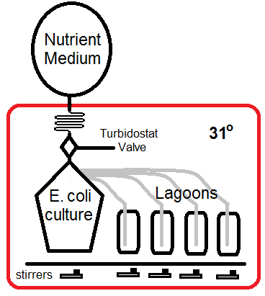

Slide 6
Principal Ideas
Virus/Phage life cycle is shorter than E. coli
No Arabinose in E. coli hatchery (no mutation)
E. coli pass through lagoons containing Arabinose in less than one generation
(e. g. not enough time to create E. coli mutants)
Several phage generations occur during
the flow-through time of the lagoon
Different kinds of interaction can trigger production of the 'infective' protein

Slide 7
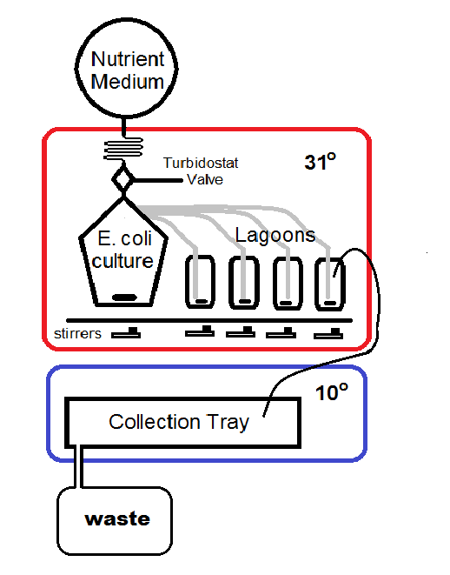

Slide 8
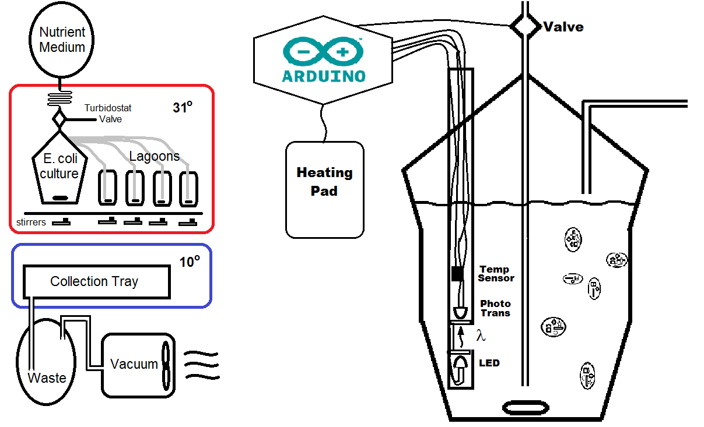

Slide 9
Conclusions
We can observe evolutionary divergence and
convergence in different lagoons
Inexpensive and fast to modify a gene
Multiple PACE stages can radically alter genes
(create a protein to recognize a new promoter)
Arduino is ideal for analog inputs and realtime
control of a single PACE apparatus
Raspberry Pi will be the system controller

Slide 10
Material Costs for a “PACE capsule” ~ $900 (vs. $30K for Harvard setup)
Raspberry PI main computer ($40)
Wide-angle USB Camera ($100)
Ardweeny + FTDI board ($25 X 2)
PIR (non contact)Temperature Sensor ($50)
Laser, LEDs, Temp IC, Photo transistor
Insulated boxes (Uline Styrofoam) ($100)
Heating Pads ($30)
Magnetic Stir Motors ($20 X 5)
Valves, Rotary valve motors ($100)
Miscellaneous Hardware ($50)
5V and 12V Power Supplies ($20)
Glassware ($200)
Tubing + Nutrient (operating cost)

Slide 11

OpenCV / Python level detection

