Slide 1
Automating Evolution Experiments
Potential to revolutionize drug discovery
  Uses viral evolution to enhance or avoid specific binding properties
  Protein design/modification via evolution avoids some of the toughest problems in protein engineering
  Proteins can perform better than small molecules with side effects, renal impact, and waste-stream contamination (proteins readily metabolized)
Assisting technologies that come into play
  Image processing: non-contact sensing avoids contamination and biofilm interference (OpenCV open-source image processing software).
  3D printer technology for prototyping of specialized parts
  Robotic control using Arduino open micro-controller technology.
  Smart phone interface for control and reporting of ongoing experiments.

Slide 2
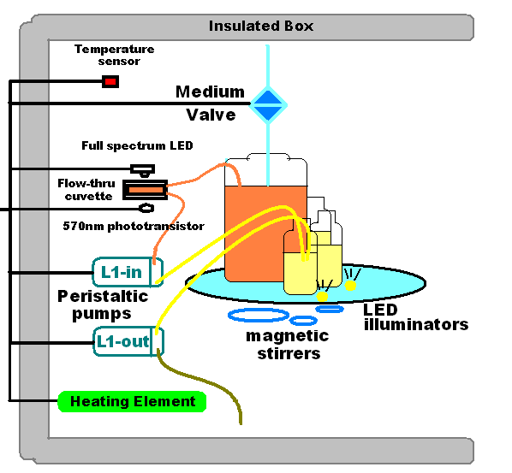


USB
Camera
PC
USB serial link

Slide 3
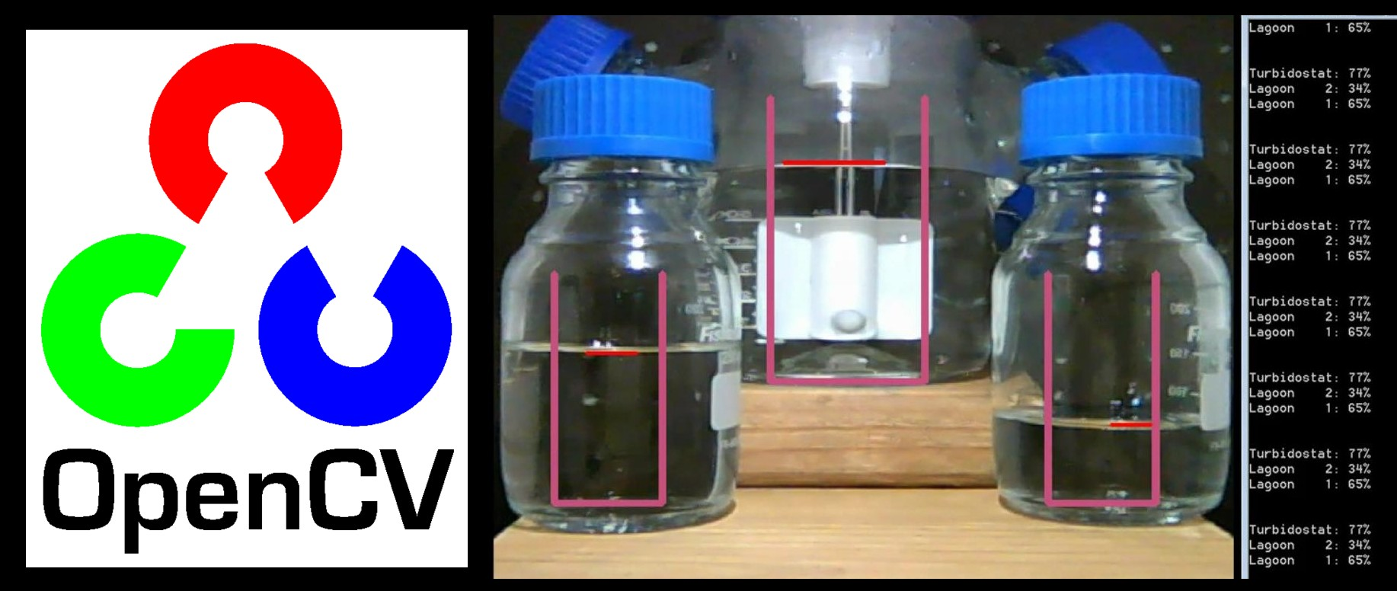

Slide 4
A Phagestat maintains a population of
evolving viruses by controlling:
TEMPERATURE / TURBIDITY / FLOW-RATE
Temperature sensor provides thermostatic control of heating element
Light control/laser digital camera non-contact turbidity measurement
Turbidity calibration via Arduino control of current to LEDs
Turbidity maintained via Arduino control of medium valve
Flow rate maintained by 3 pumps and 12 compression valves
LEDs light up meniscus for level detection / flow rate

Slide 5
Phagestat estimated parts cost
Host Computer (Raspberry Pi) $40.00
3 Peristaltic Pumps @ $25.00 $75.00
Arduino $35.00
IP/USB Camera $100.00
Power Supplies (5V, 12V, 19V) $40.00
Heating Pads $30.00
Electronic Parts $150.00
Glassware/Tubing $200.00
Machining Parts / Assembly ???
~ $700.00

