Slide 1

The Evolution
of the EvoStat
Automated platform
for Continuous Evolution
Peter Reintjes

Slide 2
Definitions
CellStat
The primary vessel for host cell cultivation and by extension the Bluetooth/Arduino controller maintaining and monitoring its environmental conditions. There is one Cellstat per EvoStat.
Lagoon
A vessel containing a population of evolving virus and by extension its controller. The current design supports up to four Lagoons per EvoStat
AutoSampler
The flow control and sampling subsystem of the EvoStat
Phagestat
The generic name for an EvoStat
EvoStat™
Our automated phagestat

Slide 3
Technologies:
Control Software for Windows and Linux
OpenCV image processing for level and fluorescence monitoring
Web Interface for monitoring and control
Texting to report nominal and exceptional behavior
Semi-autonomous Arduino/Bluetooth™ devices maintain environmental conditions in the absence of primary control
3D printed septa, pinch-valves, turbidostat, and autosampler
Microscopic USB camera with active cooling
User-editable configuration file
- and NO -
I didn't go out of my way to use every trendy, cutting-edge, technology fad. It just kinda happened.

Slide 4
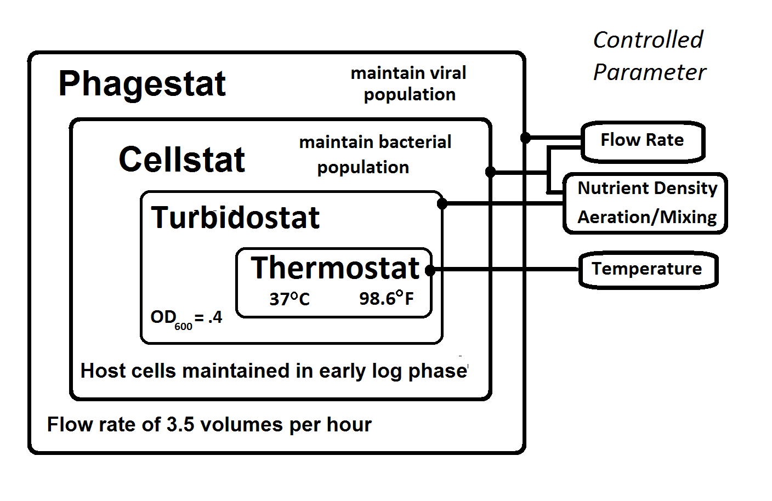

Slide 5
Design Principle #1
No Black Boxes
Design Principle #2
We may be able to measure everything without physical contact with the biological materials

Slide 6

Non-contact level-sensing

Slide 7
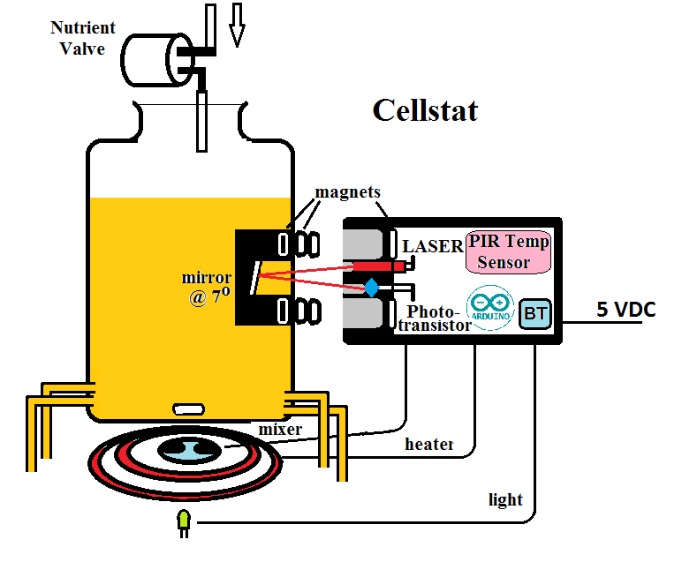

Slide 8
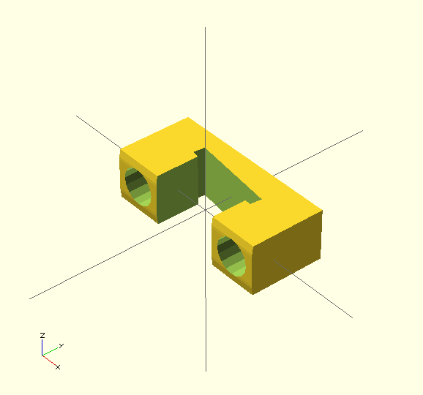
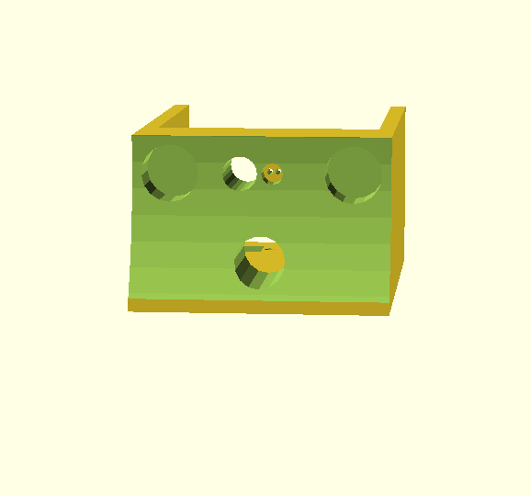
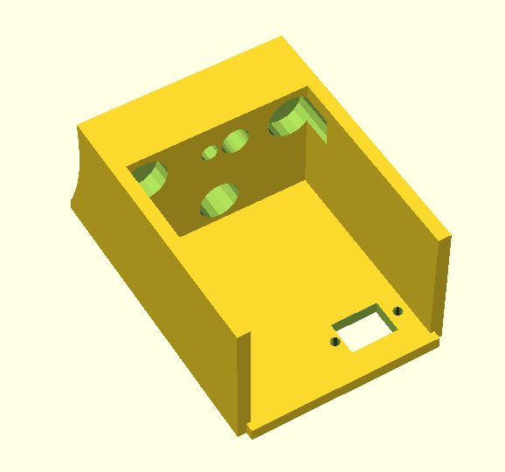
3D Printed :
Mirror holder for inside Cell-Stat
Sensor assembly with magnetic attachment

Slide 9
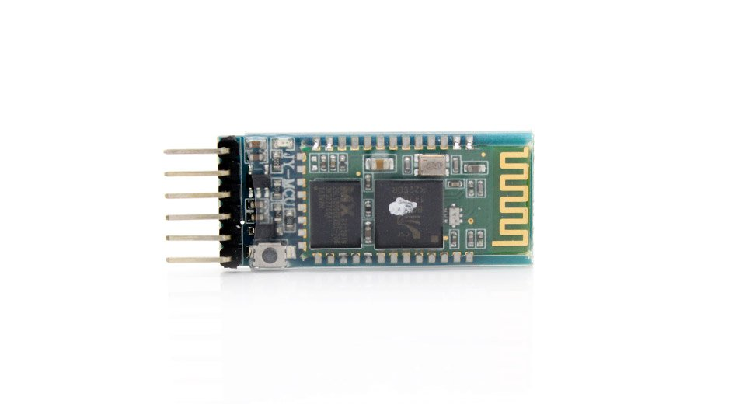
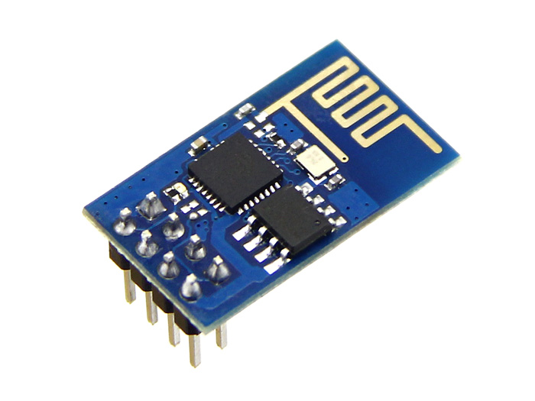
Serial Communications
Bluetooth Wifi
HC06 ESP8266
To get rid of all the wiring

Slide 10
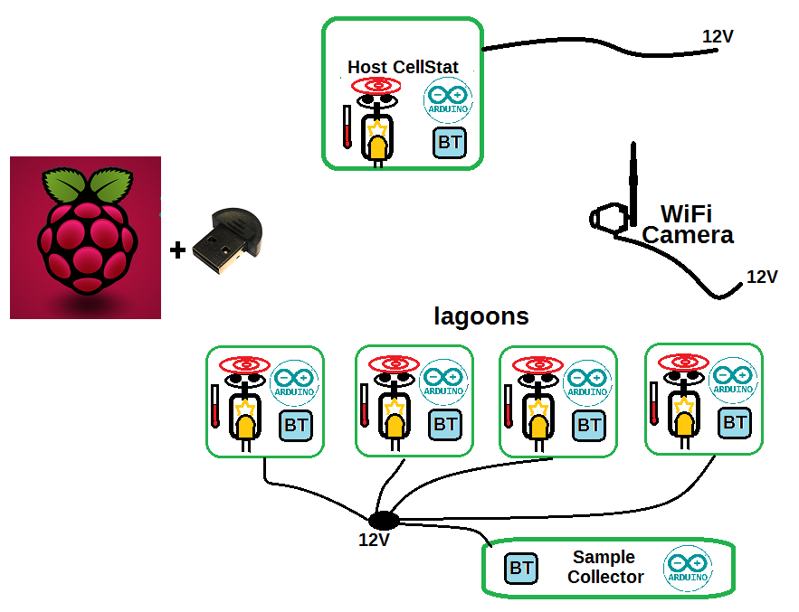

Slide 11
Material Costs for a “PACE capsule”
Raspberry PI main computer + SD card ($40)
Wide-angle USB Camera ($40)
6X Arduino + Bluetooth ($36)
PIR (passive infra-red) temperature sensor ($35)
Laser, LEDs, Photo transistor ($20)
Styrofoam boxes ($20 X 2)
Heating Element ($25)
Stirring Motors w/magnets ($5 X 5)
Aquarium air pump ($35)
Valves ($50)
Miscellaneous Hardware-PVC ($180)
5- 12-V Power Supply ($30)
Glassware ($200)
Tubing + Nutrient (operating cost)
<$800

Slide 12
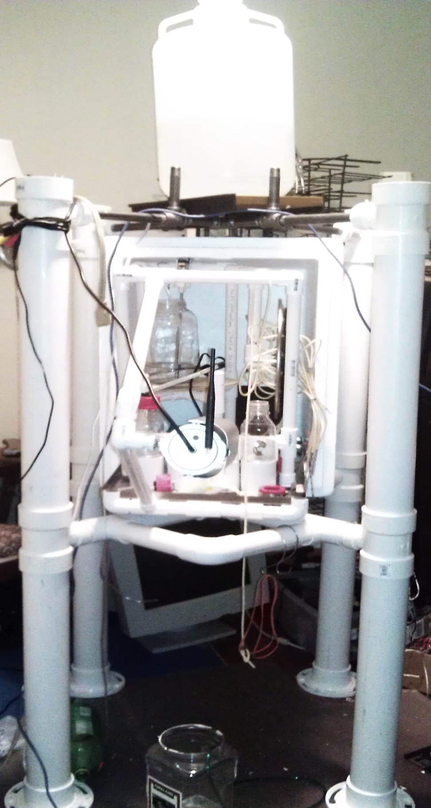

More like a 'lander' after adding $80 worth of PVC

Slide 13
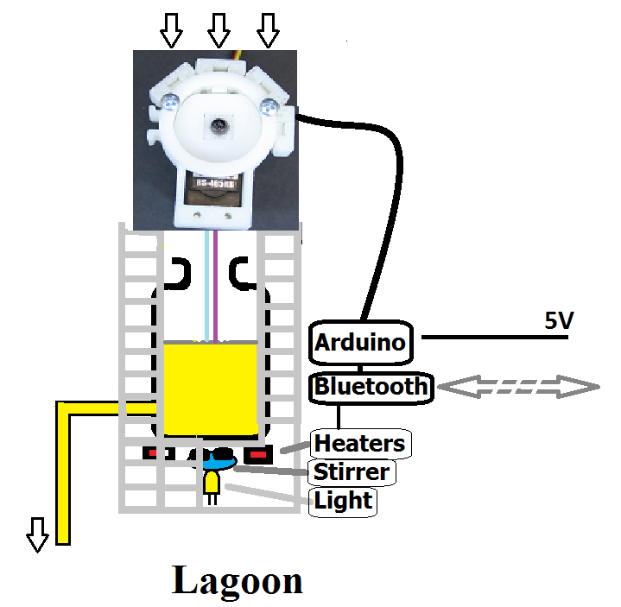

Slide 14
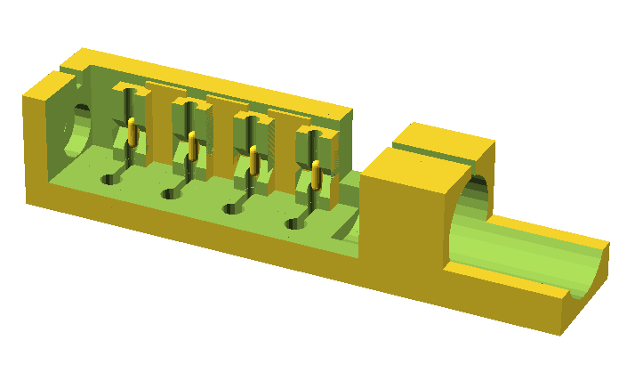
Autosampler frame

Slide 15
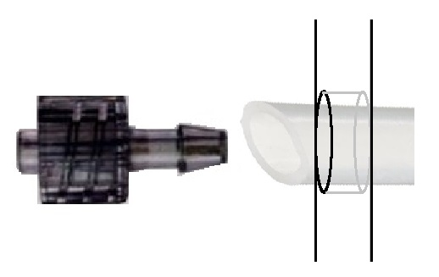
Avoid expensive glassware
with a lower side-arm exit
by drilling commodity glassware:
$20 diamond bit
Luer low-pressure fitting
Silicon tubing

Slide 16
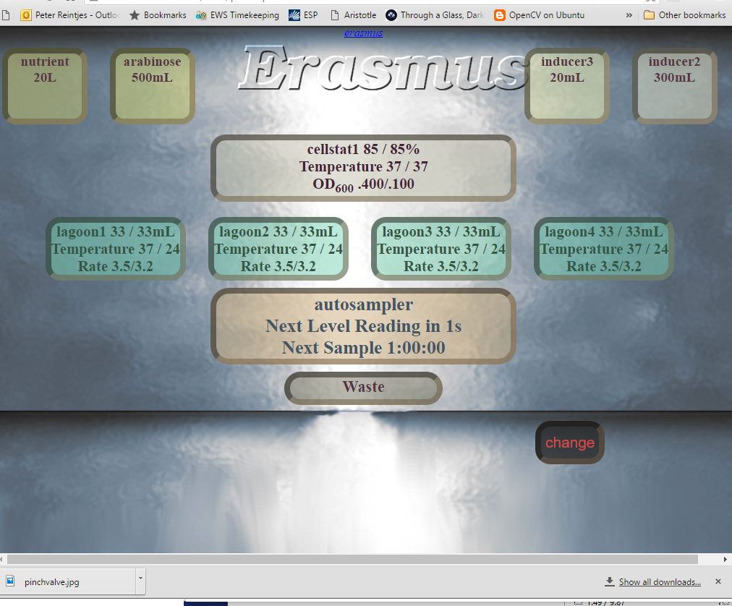

Slide 17
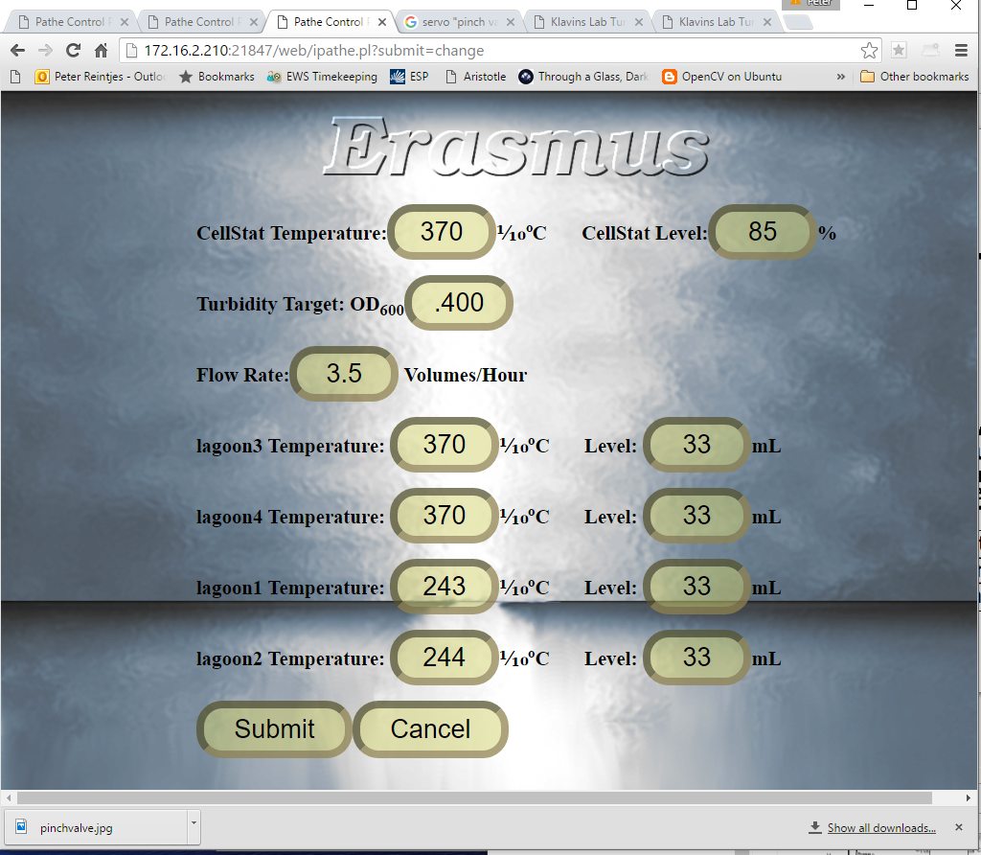

Slide 18
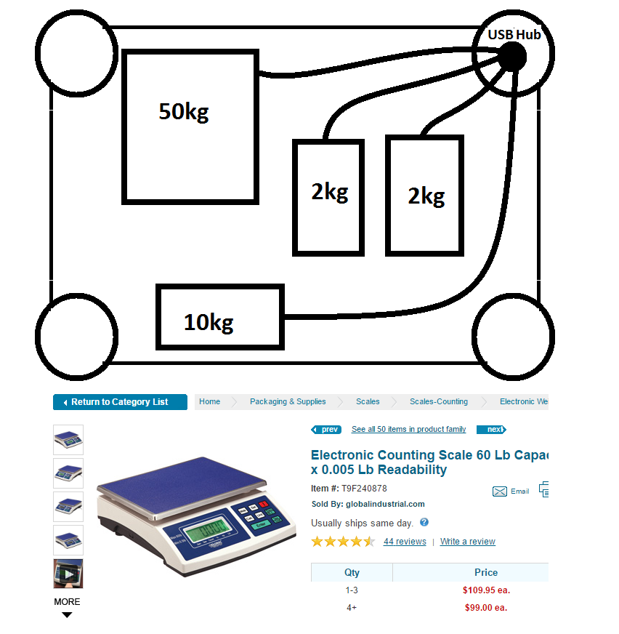
What's Next: Supply Monitoring

Slide 19
The Evolution
of the EvoStat
Peter Reintjes

