Slide 1
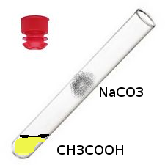
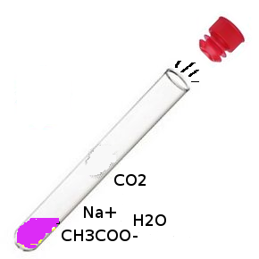
Put a Cork in it!!!!
Soldering Iron + block of Aluminum + Arduino = Top Agar Heating Block
Drill Motor + 3D printed holder + Plastic Tub = Centrifuge
Peltier junction + Aluminum block + Arduino + temperature sensors = PCR Thermocycler
Test Tube + Cork + Vinegar + Baking Soda = WMD
(Weapon of Minimal Destruction)

