Slide 1
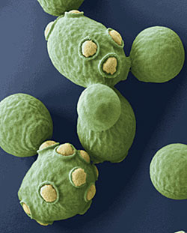
“Live” The Science of Sour
Music Sacc “Mo” Bud by
The Yeastie
Boys The cultural event
Fun Guy Cervezo event of the season
Brewer
Breadloaf
Performing
JailHouse Bock
And
The Beer Canon

