Slide 2
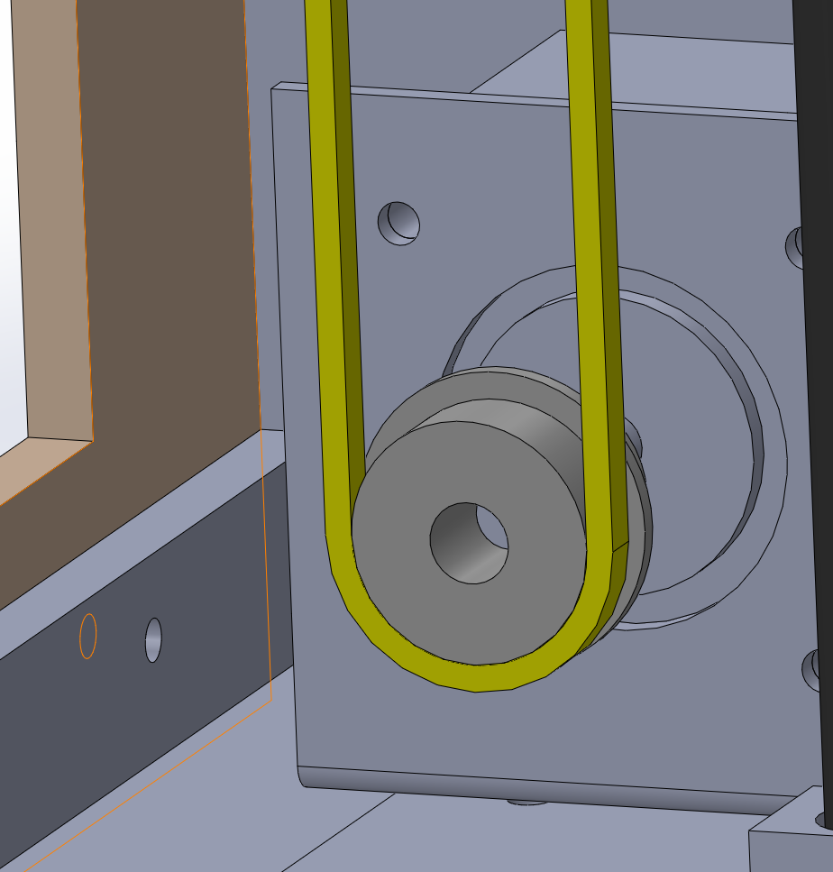
Belt
Pulley
18.25mm

Slide 3
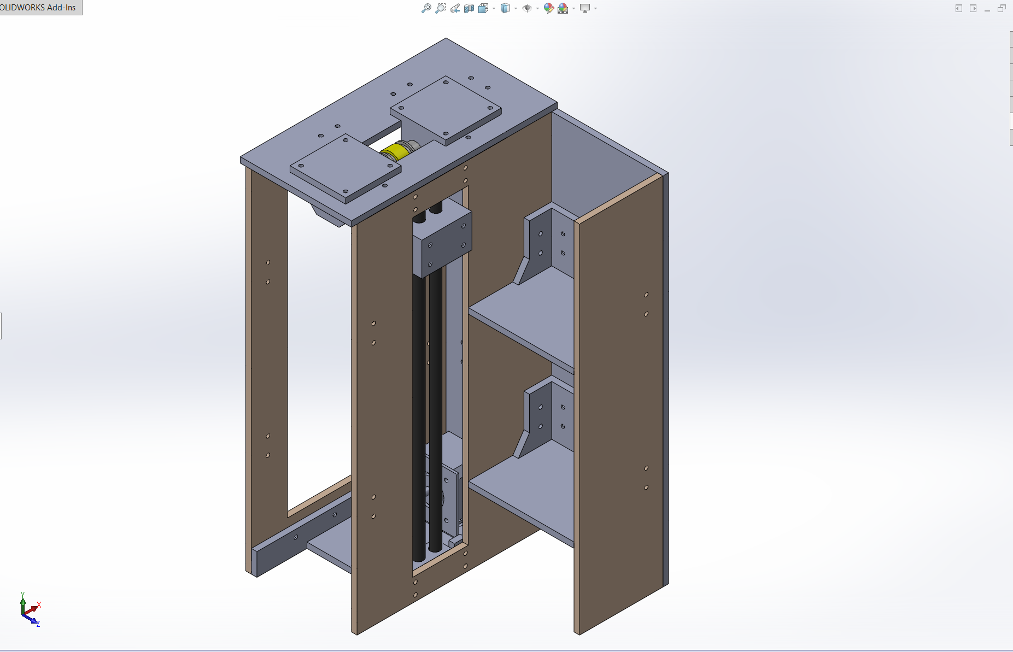
135mm
65mm

