Slide 1
Introduction to Power BI
Ekarat Rattagan
DADS, NIDA

Slide 2
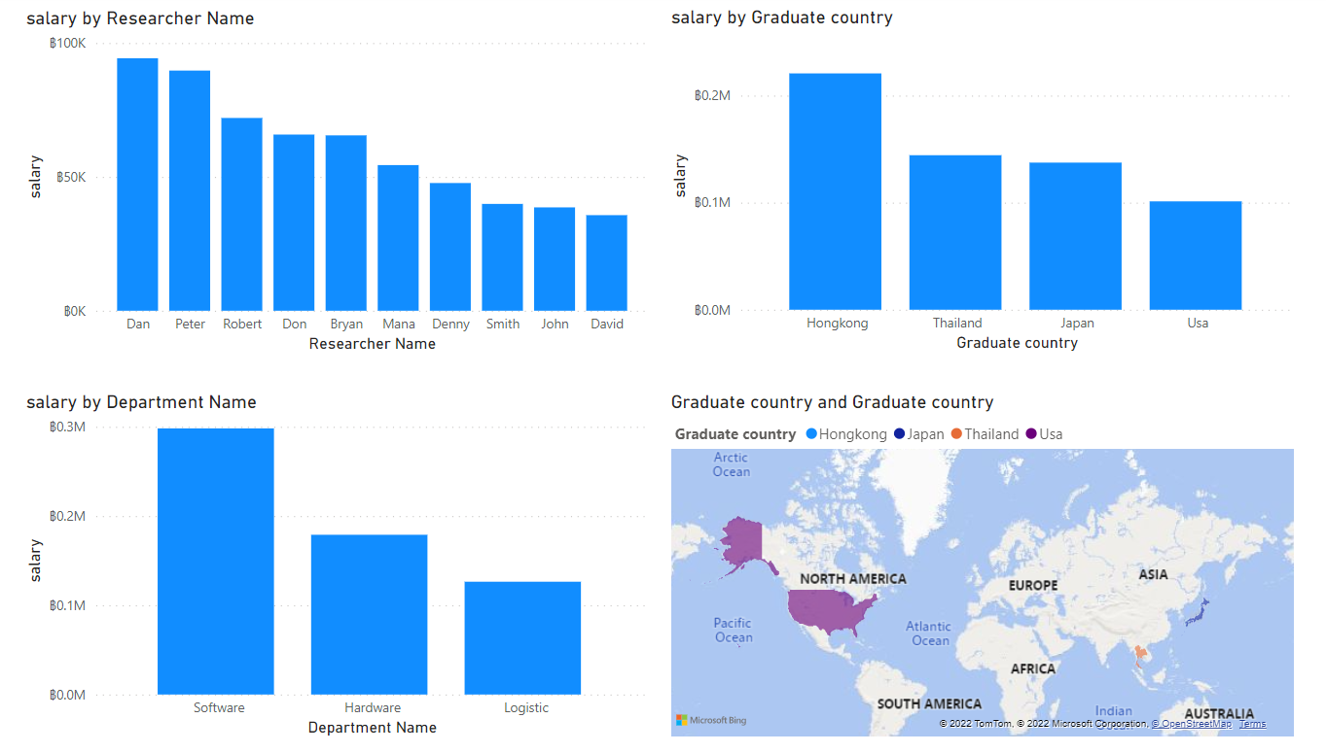
Power BI
https://powerbi.microsoft.com/en-us/why-power-bi/

Slide 3
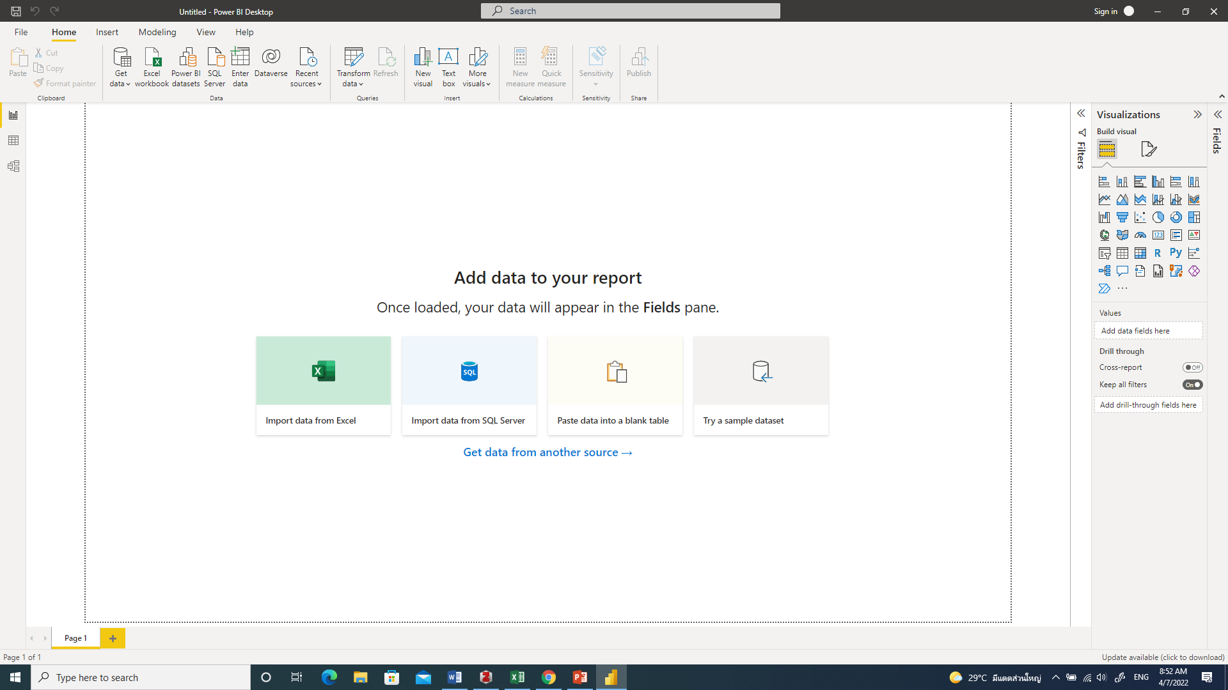
Power BI interface

Slide 4
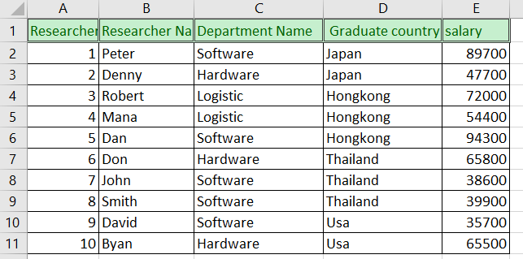
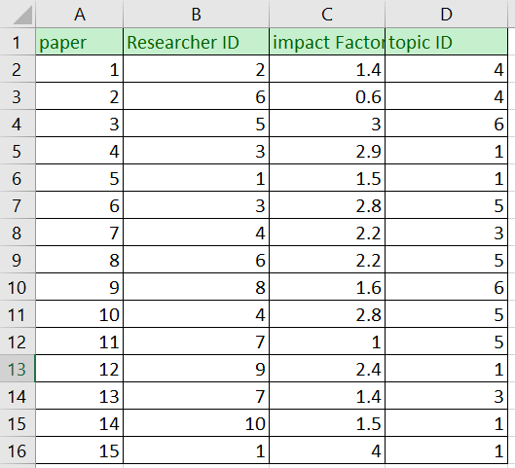
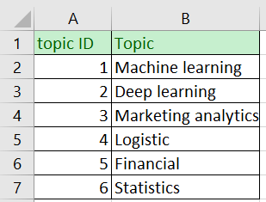
Dataset
Table: tbResearcher
Table: tbPaper
Table: tbPaperTopic

Slide 5
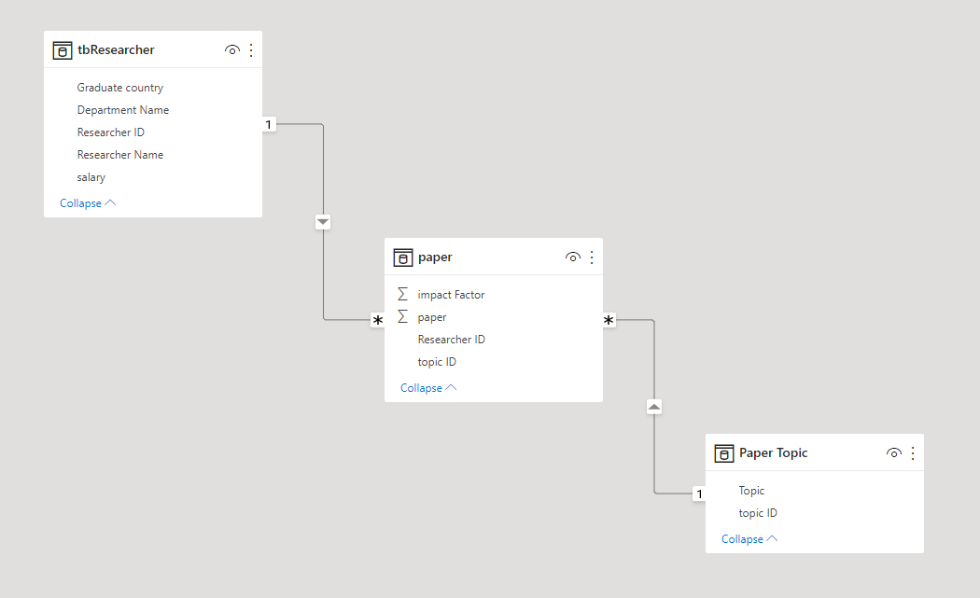
Data model

Slide 6
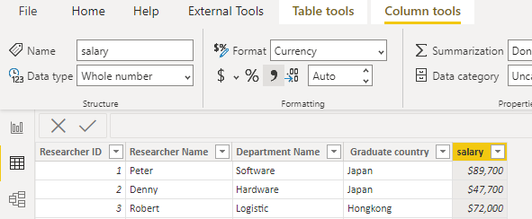
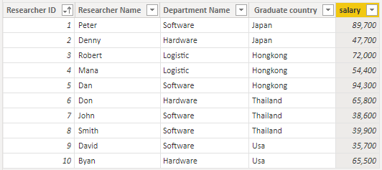
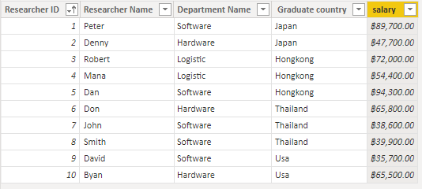
Transform

Slide 7
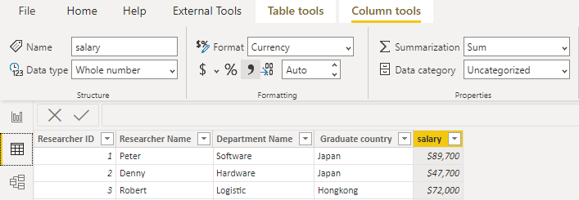
Summarization

Slide 8
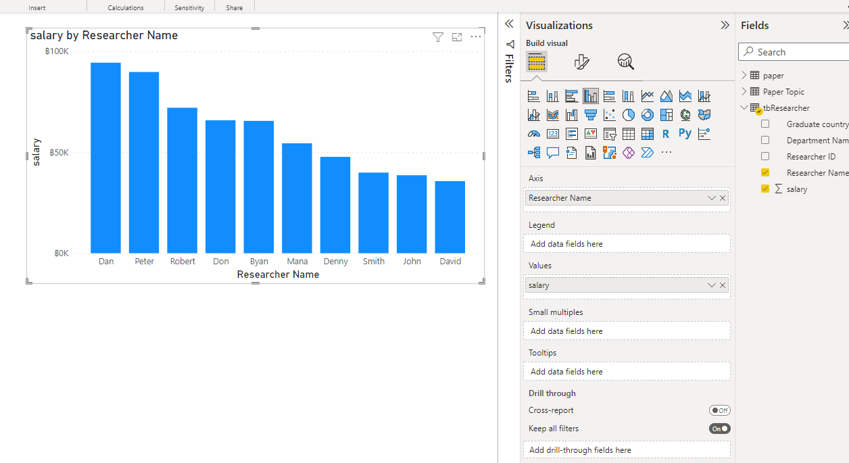
Report 1: salary by researcher name

Slide 9
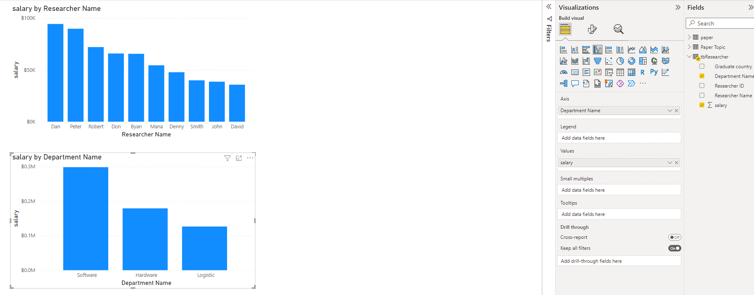
Report 2: salary by department name

Slide 10
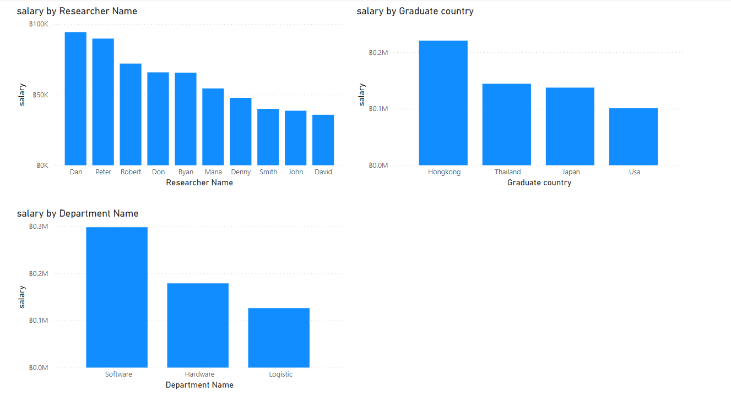
Report 3: salary by Graduated country

Slide 11
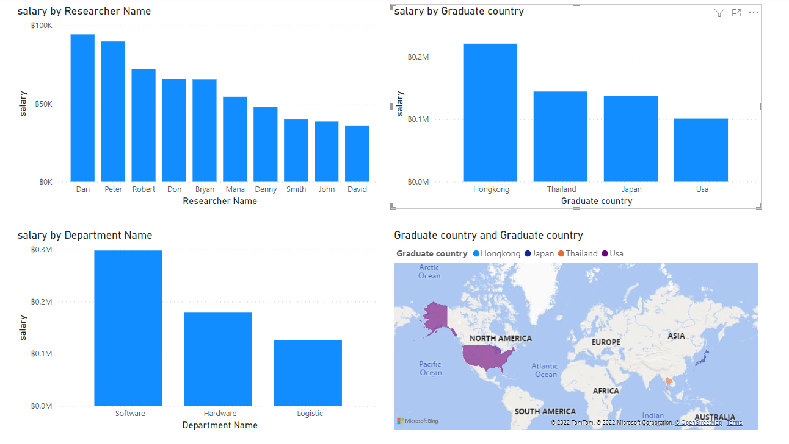
Report 4: Map of graduated country

Slide 12
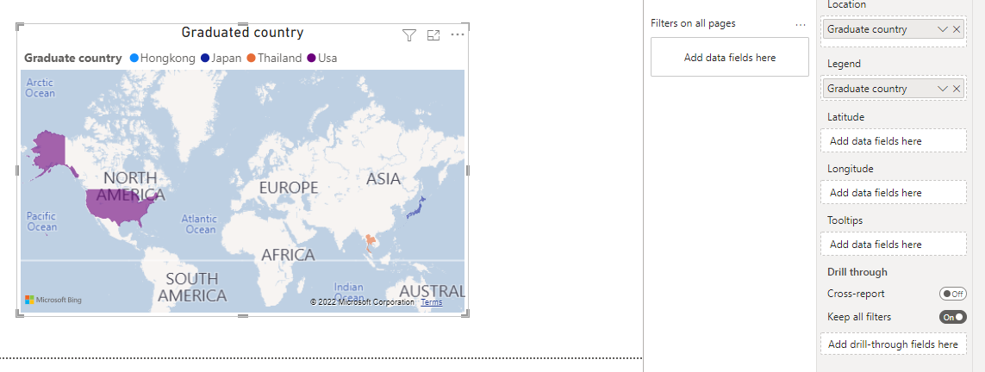
Report 4: Map of graduated country

Slide 13
Exercise 1
In the “research name column”, change “byan” to “bryan”

Slide 14
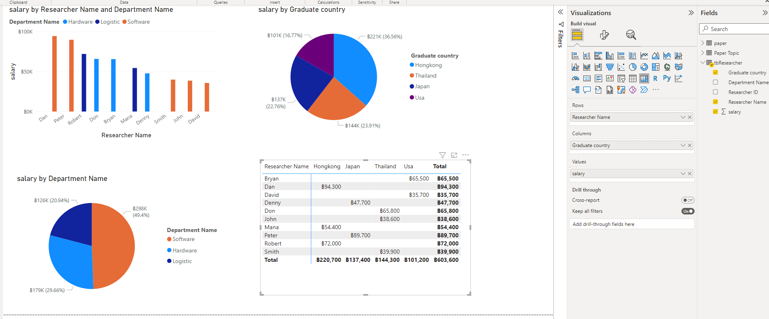
Page 2 (Matrix)
1
2
3
How about Table? Try it by yourself.
Notes:
What is the difference between a table and a matrix?
Tables and matrices have a tabular layout and their data comes from a single dataset, built on a single data source.
The key difference between tables and matrices is that tables can include only row groups, where as matrices have row groups and column groups.

Slide 15
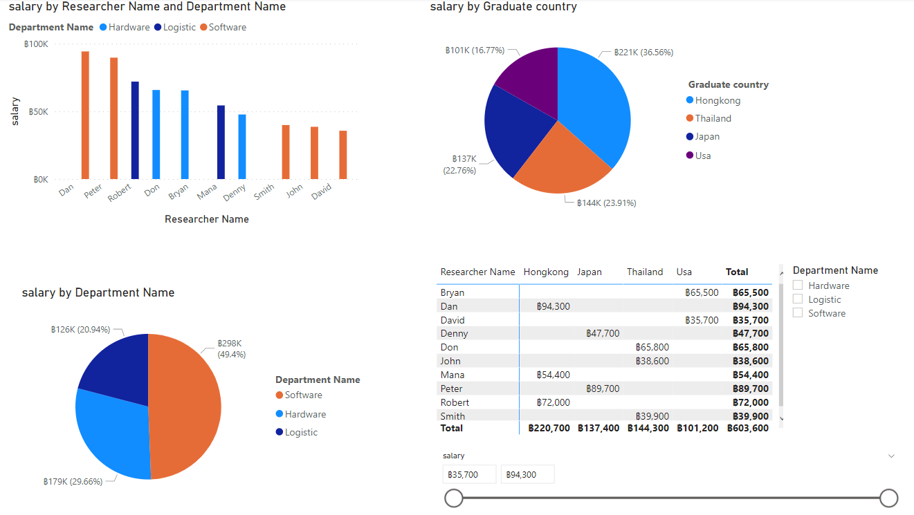
Page 2 (Slicer)

Slide 16
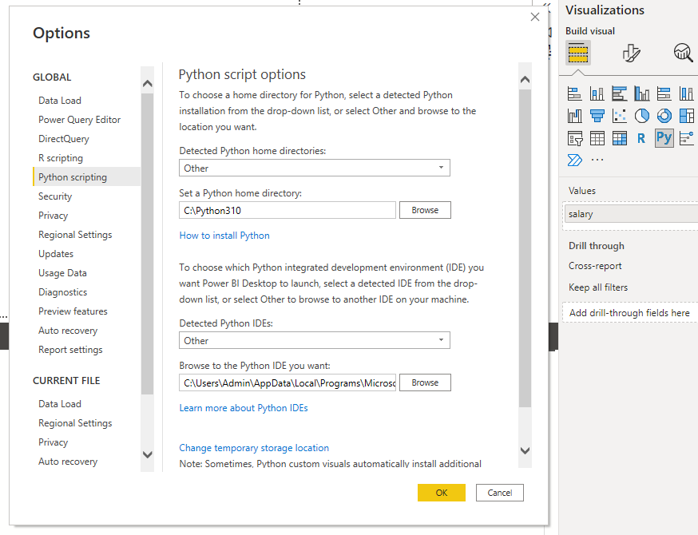
Python script setup

Slide 17
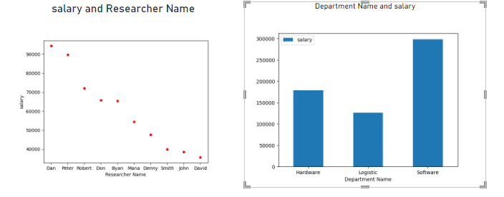
Python script
import matplotlib.pyplot as plt
dataset.plot(kind='scatter', x='Researcher Name', y='salary', color='red')
plt.show()
import matplotlib.pyplot as plt
dataset.plot(kind='bar',x='Department Name',y='salary', rot=0)
plt.show()

Slide 18
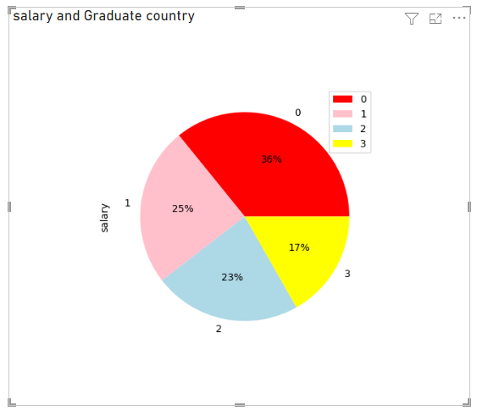
Exercise 2
Create a pie chart by using Python

Slide 19
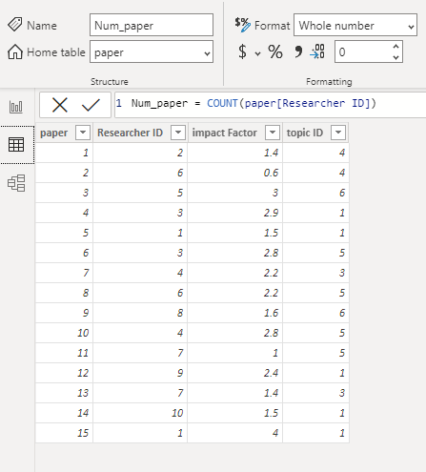
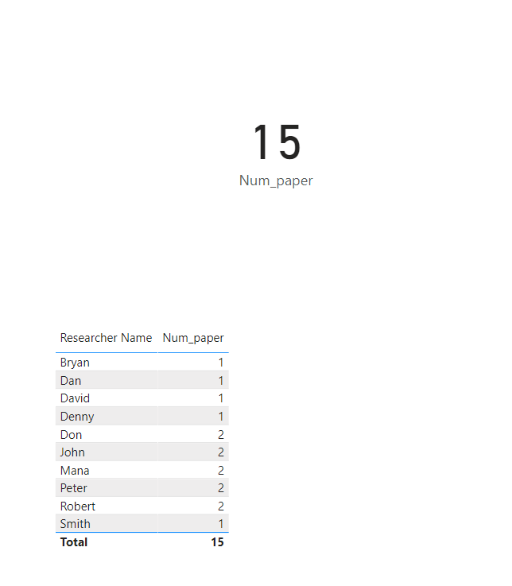
Table tools: new measurement
Num_paper = COUNT(paper[Researcher ID])

Slide 20
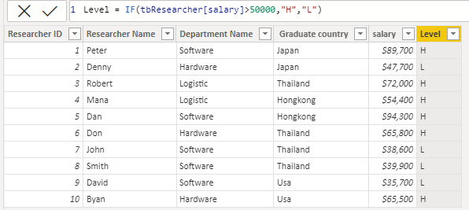
Table tool: new column
Level = IF(tbResearcher[salary]>50000,"H","L")

Slide 21
Exercise 3
Create your own data and plot some graphs

Slide 22
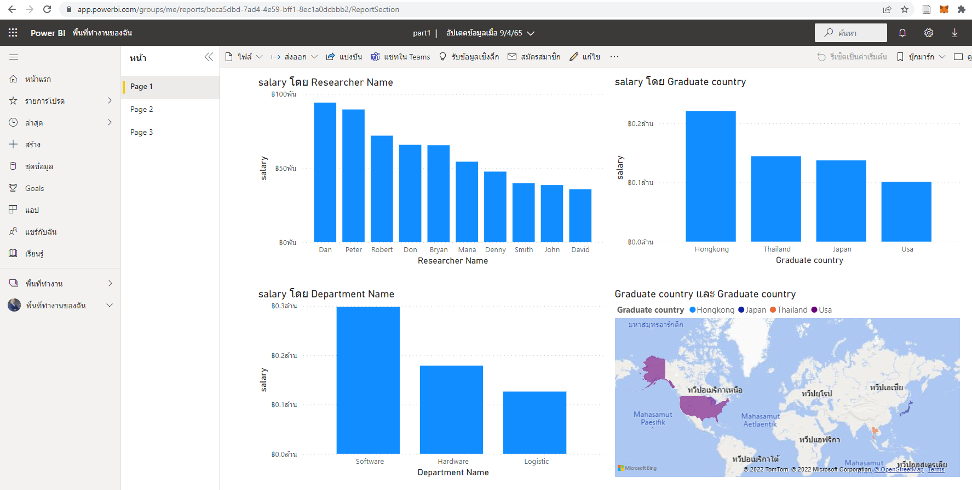
Publish your work
https://app.powerbi.com/groups/me/reports/beca5dbd-7ad4-4e59-bff1-8ec1a0dcbbb2/ReportSection

