Slide 1
Introduction to Power BI-DAX
Ekarat Rattagan
DADS, NIDA
Ref: https://docs.microsoft.com/en-us/dax/dax-overview

Slide 2
DAX Overview
Data Analysis Expressions (DAX) is a formula expression language used in Analysis Services, Power BI, and Power Pivot in Excel.
DAX formulas include functions, operators, and values to perform advanced calculations and queries on data in related tables and columns in tabular data models.
DAX formulas are used in measures, calculated columns, calculated tables, etc.

Slide 3
DAX Calculation (Measures)
Measures are dynamic calculation formulas where the results change depending on context. Measures are used in reporting that support combining and filtering model data by using multiple attributes such as a Power BI report or Excel PivotTable or PivotChart.
A formula in a measure can use standard aggregation functions automatically created by using the Autosum feature, such as COUNT or SUM, or you can define your own formula by using the DAX formula bar.
E.g., Total Sales = SUM([Sales Amount])

Slide 4
DAX Calculation (Calculated columns)
A calculated column is a column that you add to an existing table (in the model designer) and then create a DAX formula that defines the column's values.
= [Calendar Year] & " Q" & [Calendar Quarter]
D&G = [Department Name] & " -" & [ Graduate country]

Slide 5
DAX Calculation (Calculated tables)
A calculated table is a computed object, based on a formula expression, derived from all or part of other tables in the same model. Instead of querying and loading values into your new table's columns from a data source, a DAX formula defines the table's values.
Western Region Employees = UNION('Northwest Employees', 'Southwest Employees')

Slide 6
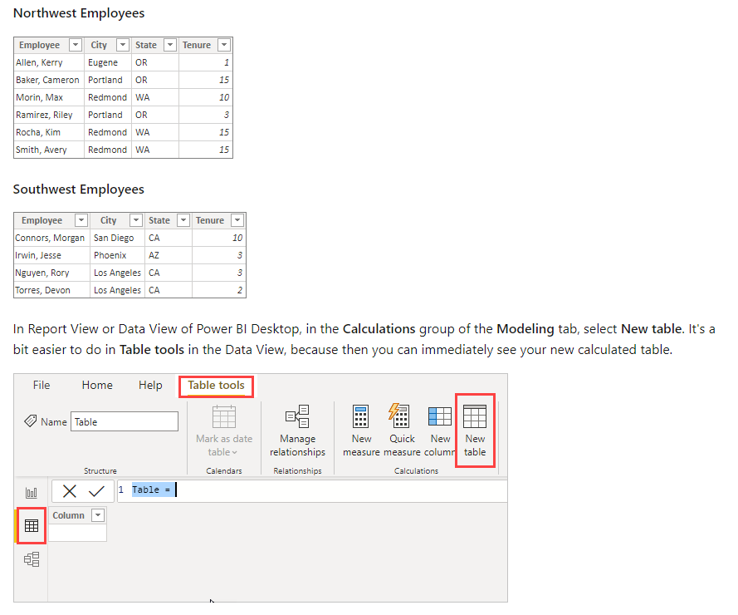

Slide 7
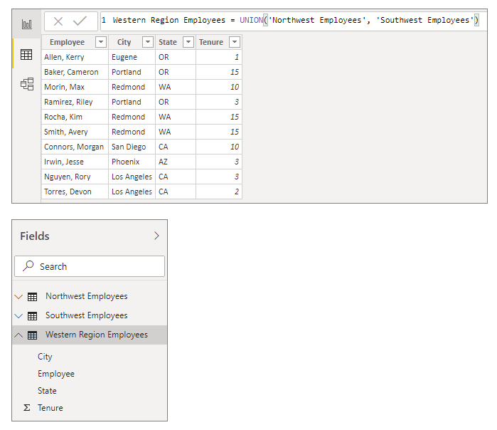

Slide 8
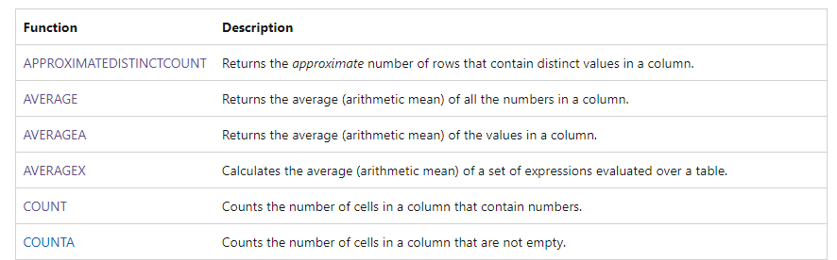
DAX formula (Aggregation)
calculate a (scalar) value such as count, sum, average, minimum, or maximum for all rows in a column or table as defined by the expression.
https://docs.microsoft.com/en-us/dax/aggregation-functions-dax

Slide 9
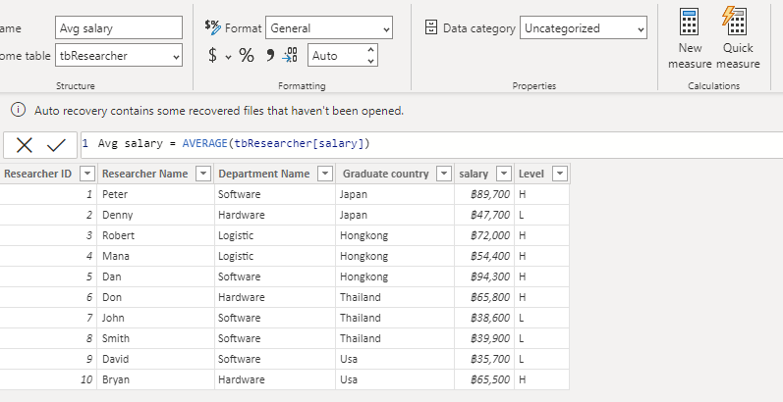
DAX formulas (Aggregation)

Slide 10
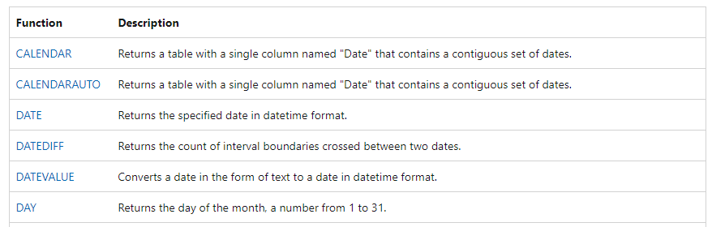
DAX formula (Date and time)
These functions help you create calculations based on dates and time. Many of the functions in DAX are similar to the Excel date and time functions. However, DAX functions use a datetime data type, and can take values from a column as an argument.
https://docs.microsoft.com/en-us/dax/date-and-time-functions-dax

Slide 11
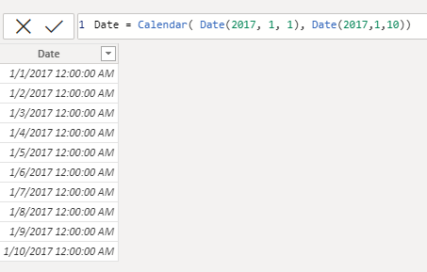
DAX formula (Date and time)
Another example: Measure_week = DATEDIFF(MIN( April[Date] ), MAX( April[Date]), WEEK )

Slide 12
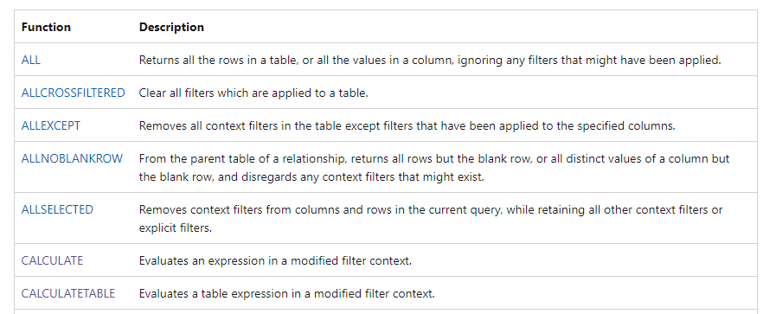
DAX formula (Filter)
The filter and value functions in DAX are some of the most complex and powerful, and differ greatly from Excel functions. The lookup functions work by using tables and relationships, like a database. The filtering functions let you manipulate data context to create dynamic calculations.
https://docs.microsoft.com/en-us/dax/filter-functions-dax

Slide 13
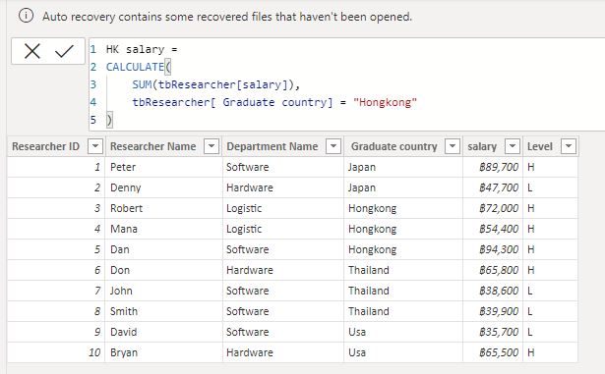
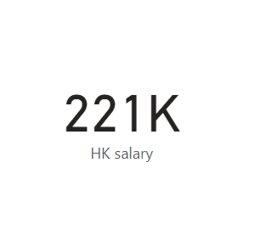
Dax formula (Filter)

Slide 14
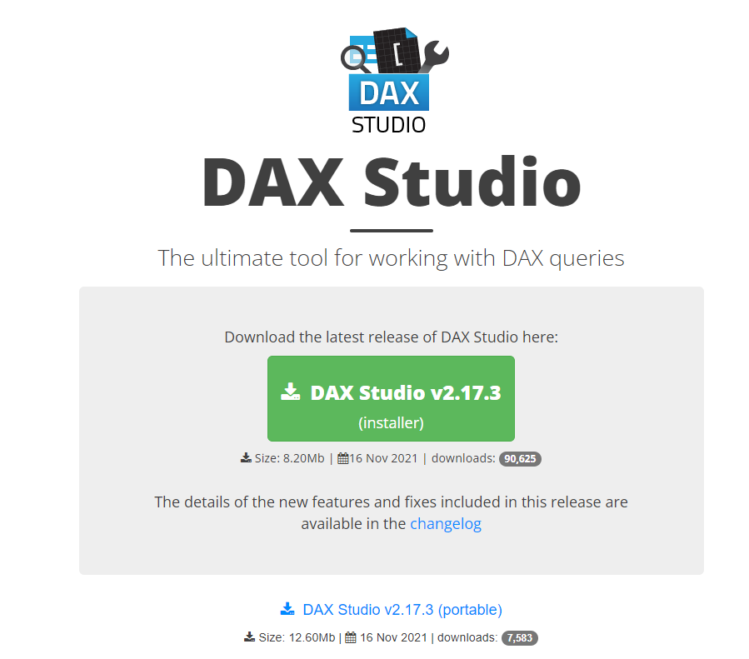
DAX query
DAX queries can be created and run in SQL Server Management Studio (SSMS) and open-source tools like DAX Studio.
Unlike DAX calculation formulas, which can only be created in tabular data models, DAX queries can also be run against Analysis Services Multidimensional models. DAX queries are often easier to write and more efficient than Multidimensional Data Expressions (MDX) queries.
A DAX query is a statement, similar to a SELECT statement in T-SQL. The most basic type of DAX query is an evaluate statement.
For example,
EVALUATE ( FILTER ( 'tbResearcher', [salary] < 40000 ) ) ORDER BY [Researcher Name] ASC
https://daxstudio.org/
https://docs.microsoft.com/en-us/dax/dax-queries

Slide 15
What’s next
https://docs.microsoft.com/en-us/learn/paths/dax-power-bi/
https://daxstudio.org/tutorials/writing-dax-queries/

