Slide 1
Introduction to Power BI
Ekarat Rattagan
DADS, NIDA

Slide 2
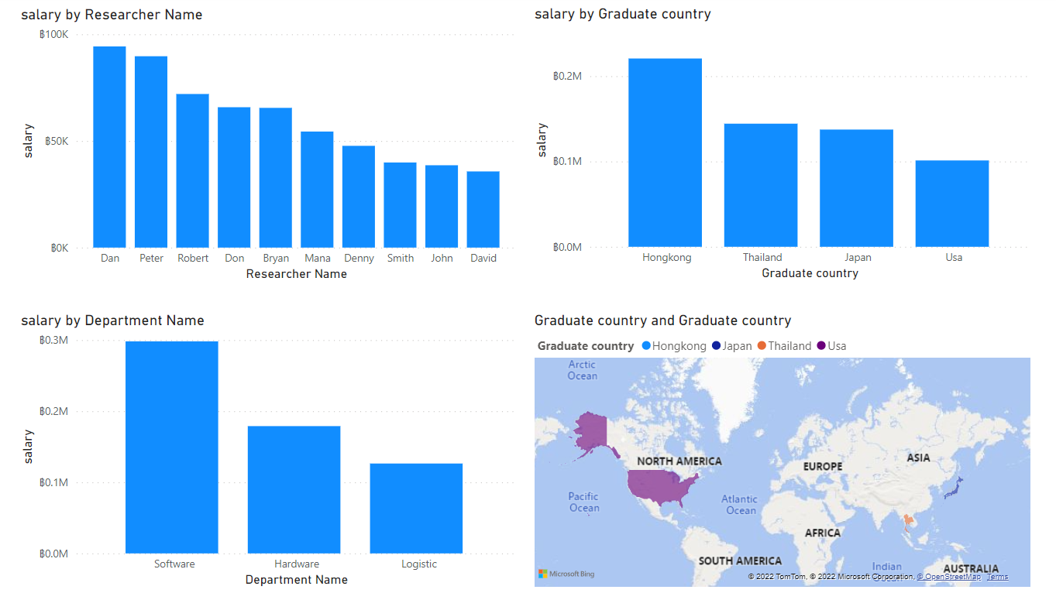
Power BI
https://powerbi.microsoft.com/en-us/why-power-bi/

Slide 3
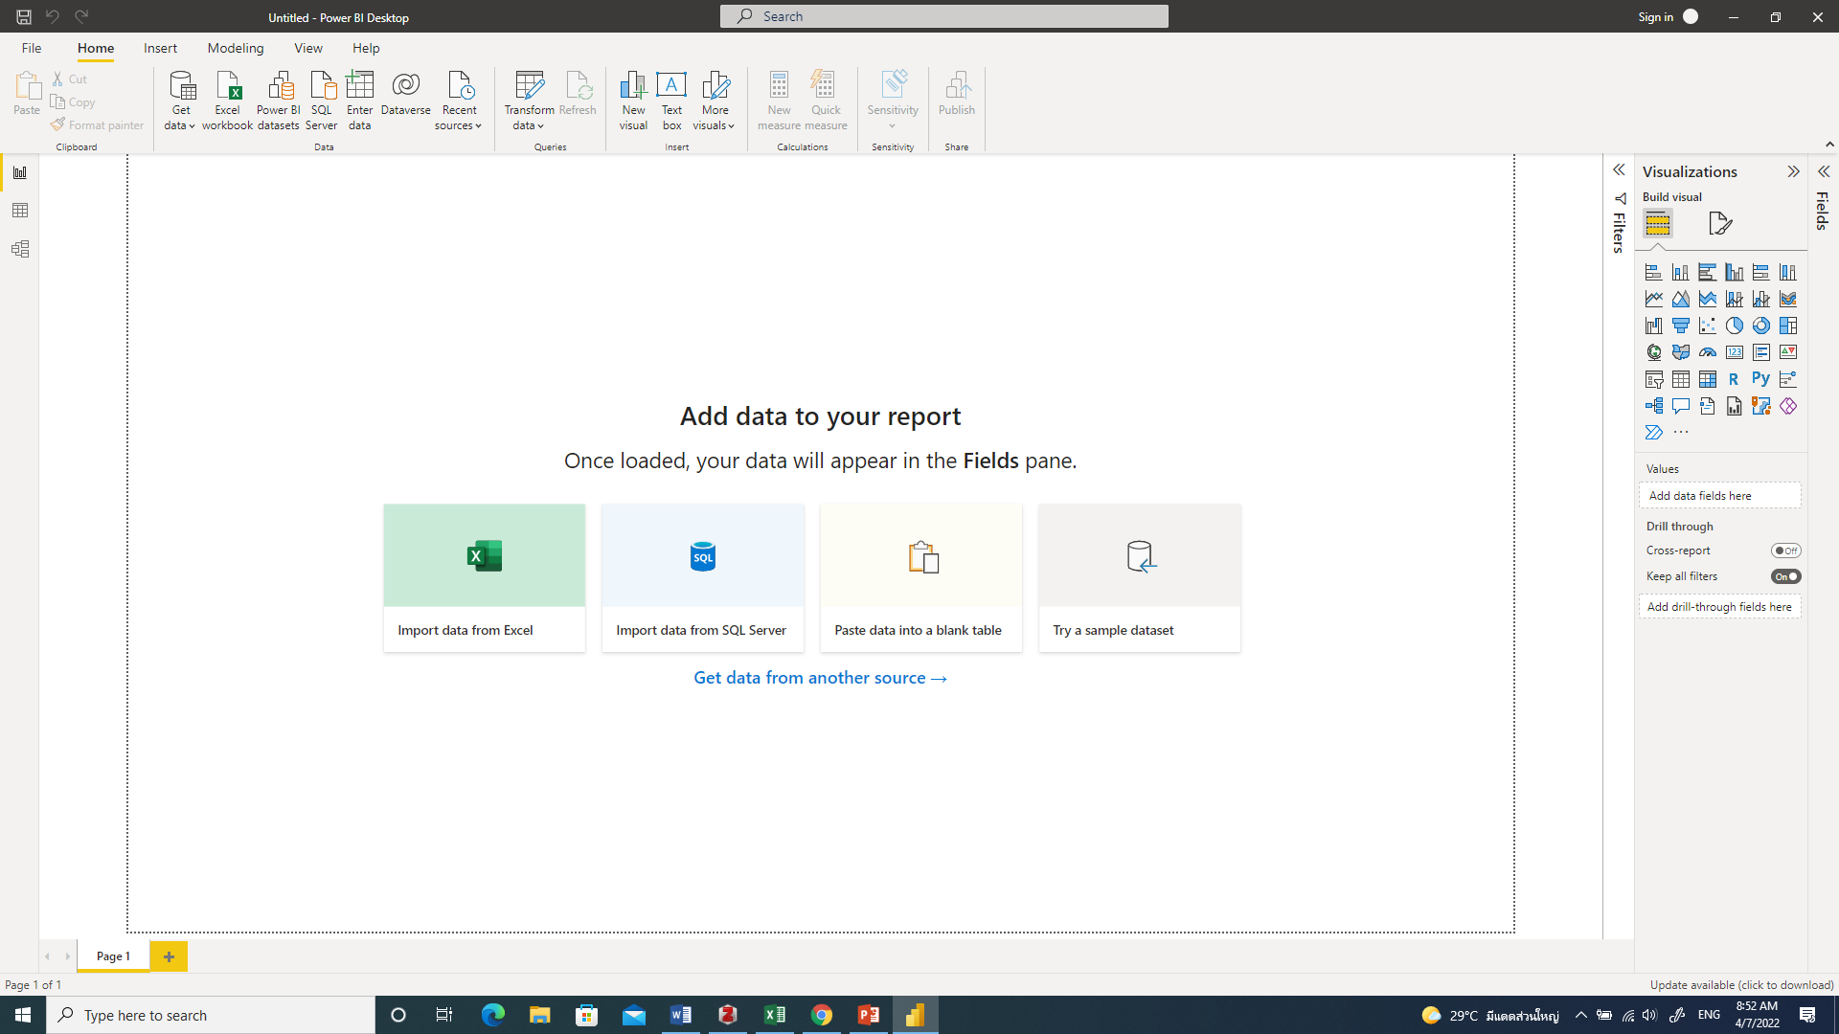
Power BI interface

Slide 4
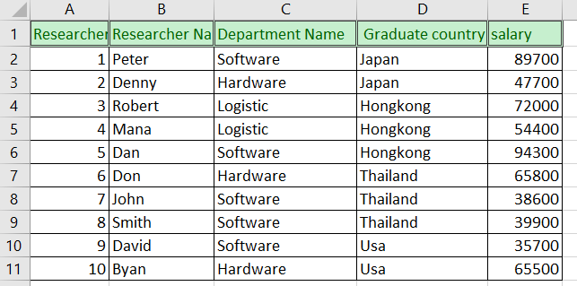
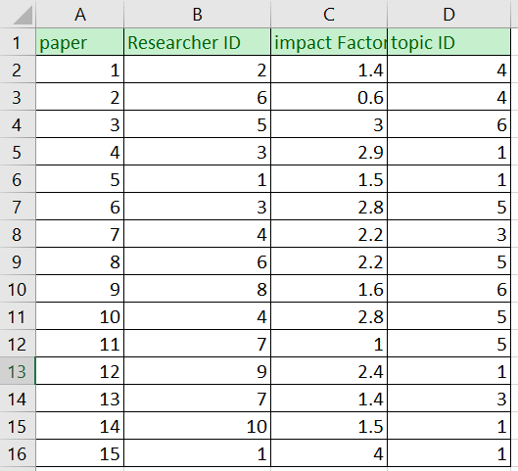
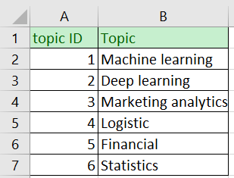
Dataset
Table: tbResearcher
Table: tbPaper
Table: tbPaperTopic

Slide 5
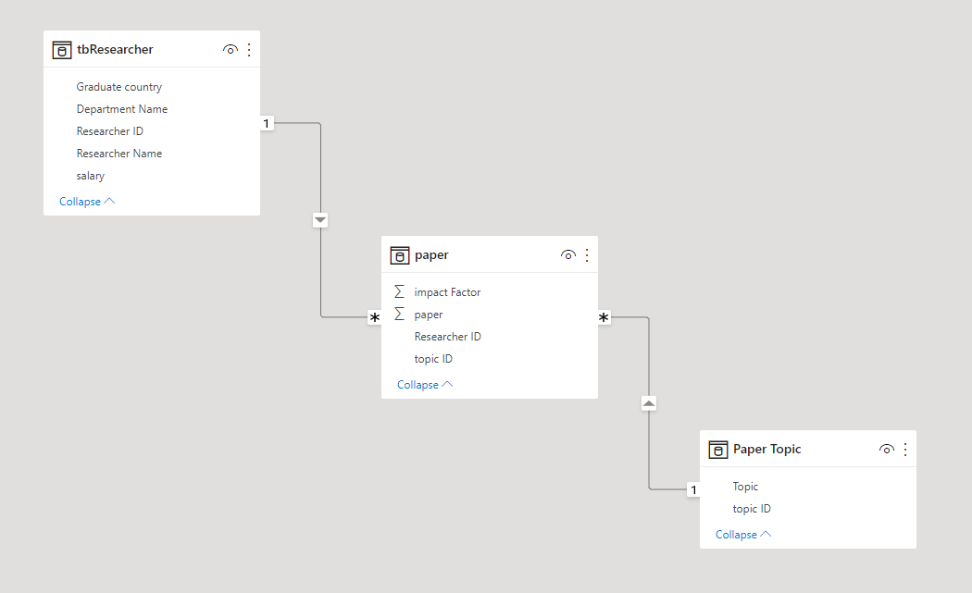
Data model

Slide 6
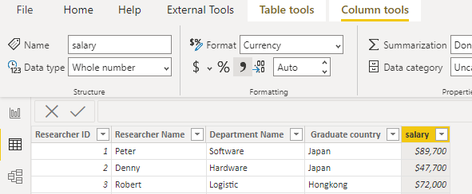
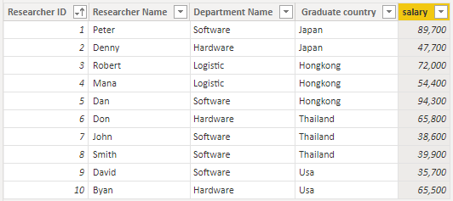
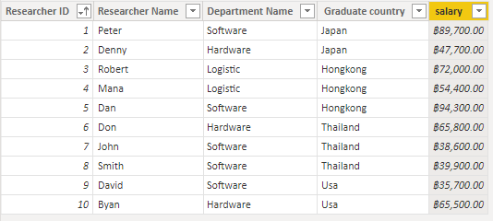
Transform

Slide 7
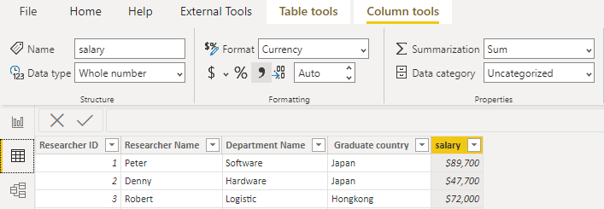
Summarization

Slide 8
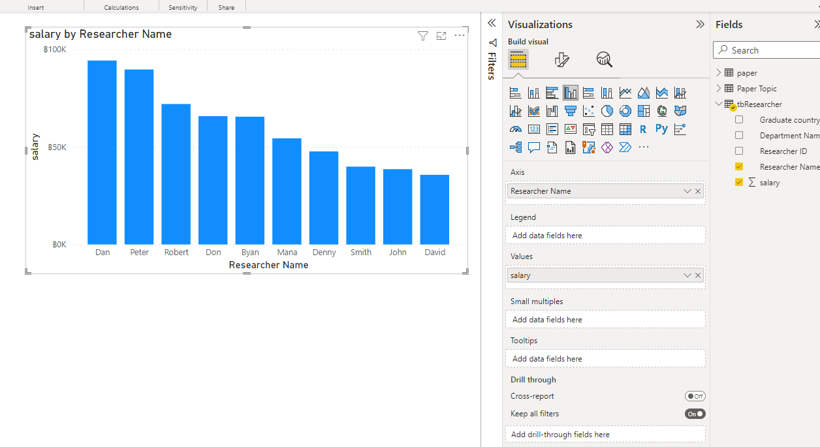
Report 1: salary by researcher name

Slide 9
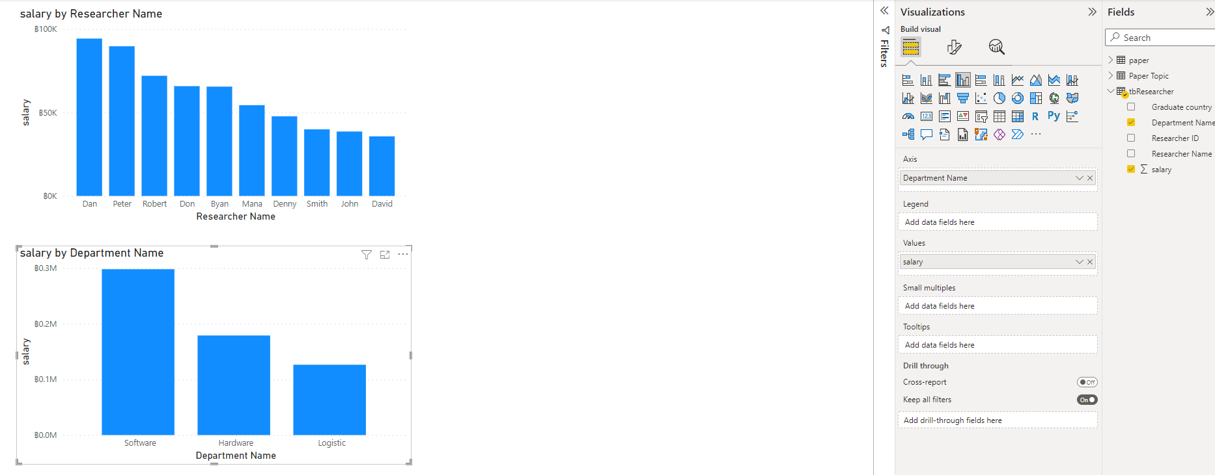
Report 2: salary by department name

Slide 10
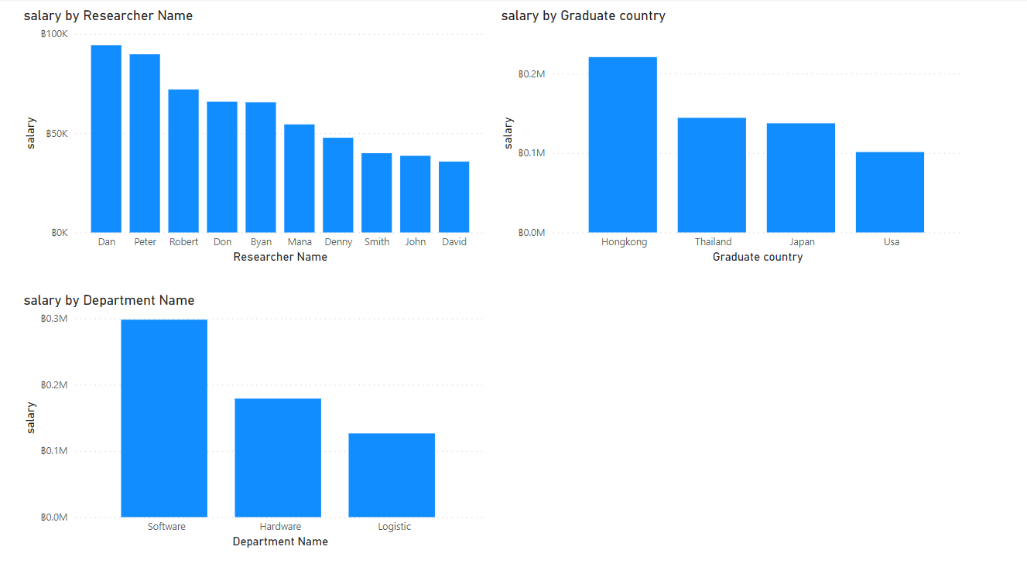
Report 3: salary by Graduated country

Slide 11
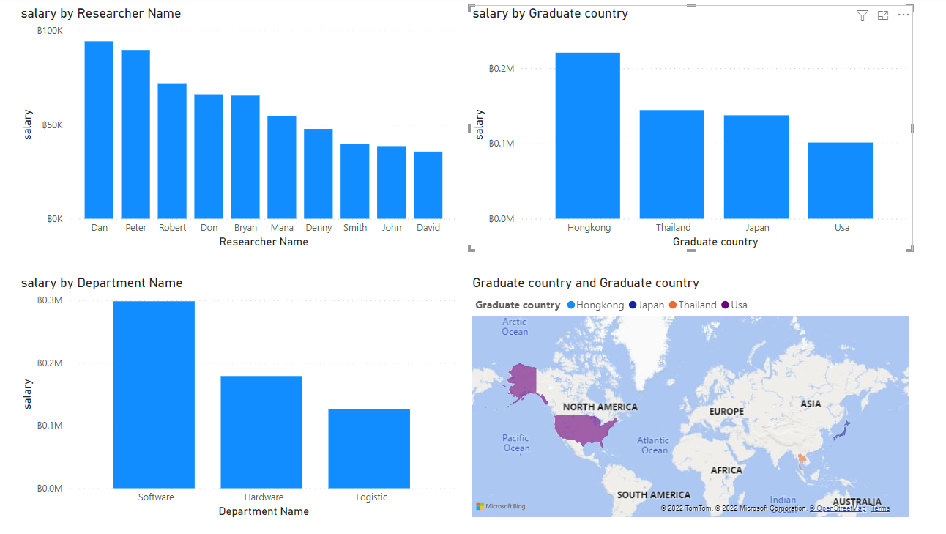
Report 4: Map of graduated country

Slide 12
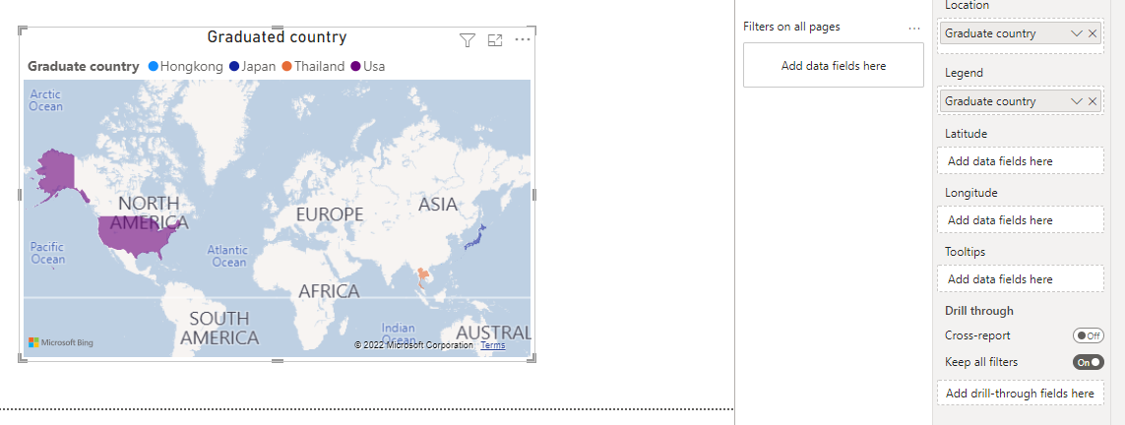
Report 4: Map of graduated country

Slide 13
Exercise 1
In the “research name column”, change “byan” to “bryan”

Slide 14
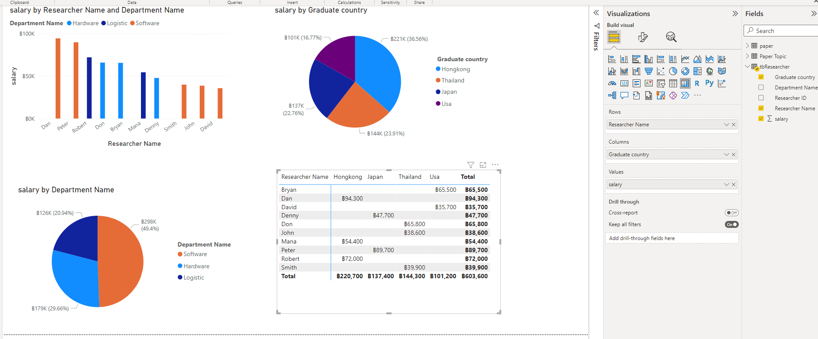
Page 2

Slide 15
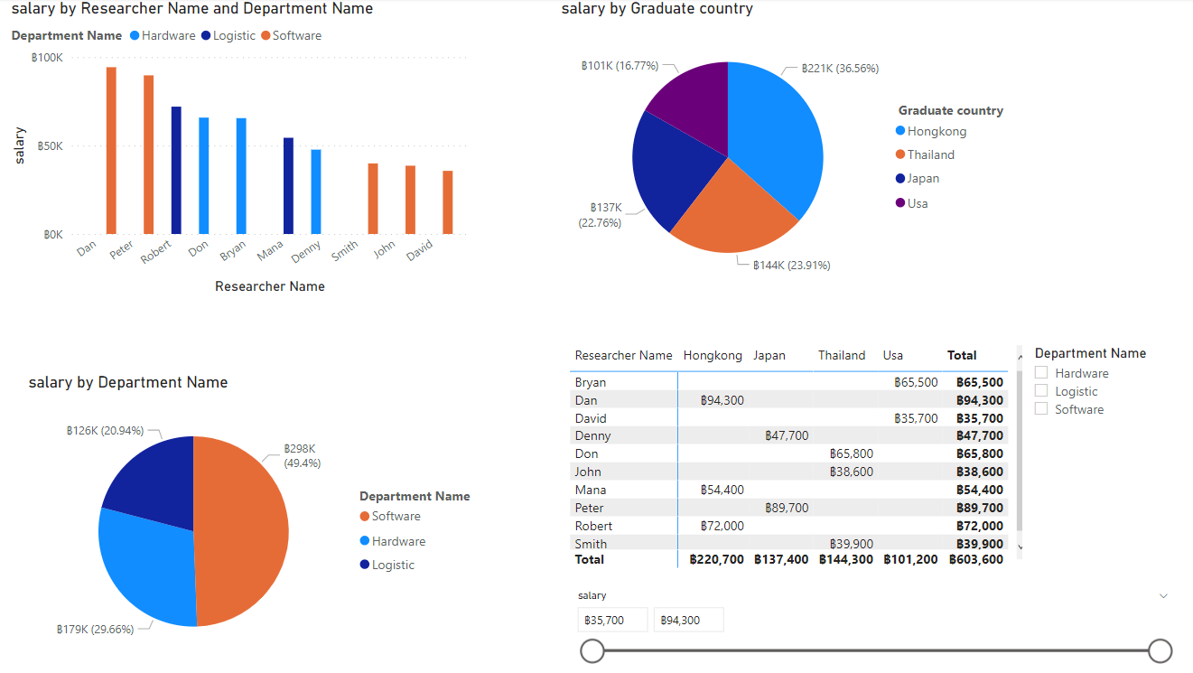
Page 2: slicer

Slide 16
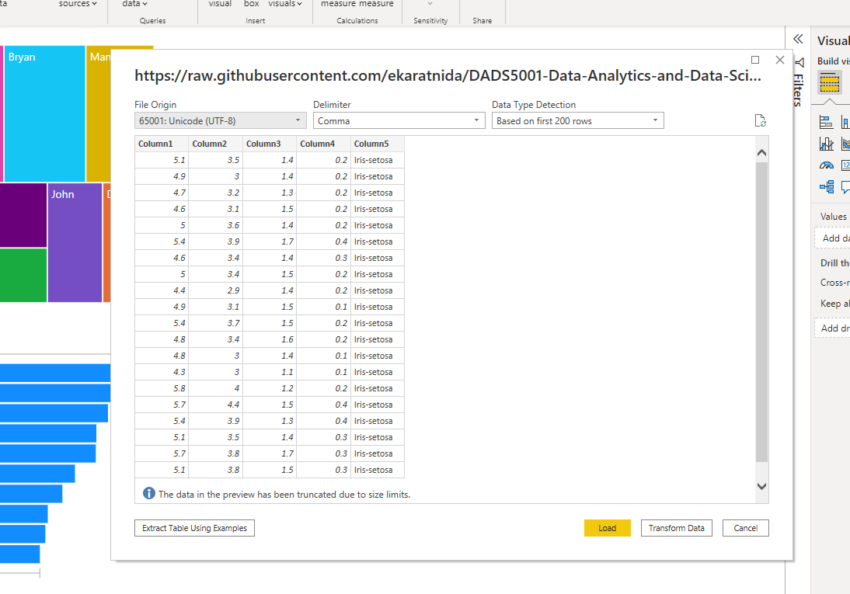
Get data
Load dataset
from web
https://raw.githubusercontent.com/ekaratnida/DADS5001-Data-Analytics-and-Data-Science-Tools-and-Programming/main/datasets/iris.data

Slide 17
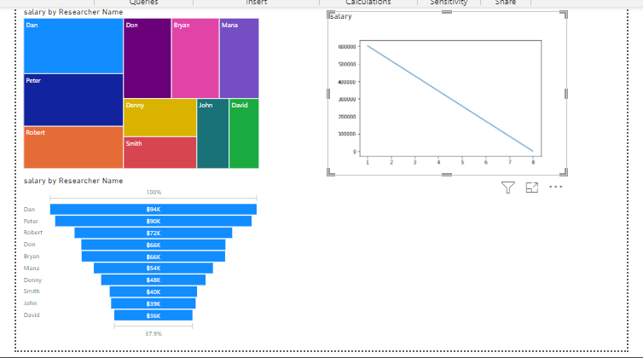
Python script I
import matplotlib.pyplot as plt
import numpy as np
x1 = dataset["salary"][0]
xpoints = np.array([1, 8])
ypoints = np.array([x1, 10])
plt.plot(xpoints, ypoints)
plt.show()

Slide 18
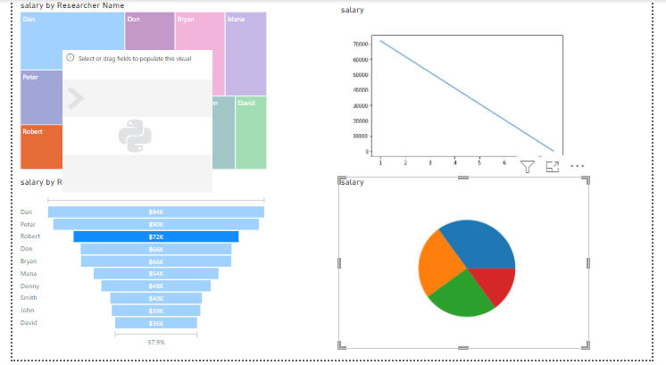
Python script II
import matplotlib.pyplot as plt
import numpy as np
y = np.array([35, 25, 25, 15])
plt.pie(y)
plt.show()

Slide 19
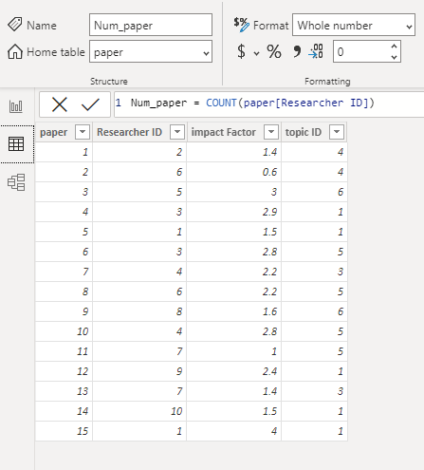
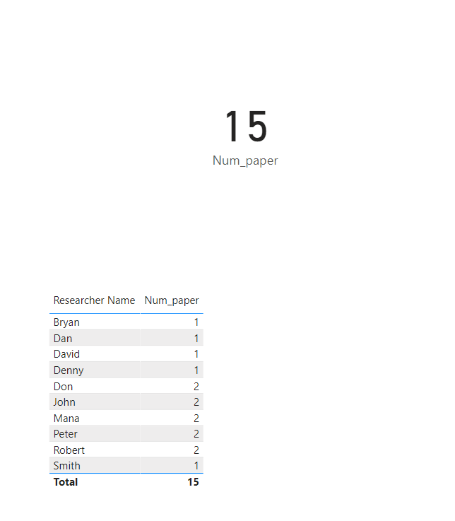
Table tools: new measurement
num_paper = COUNT(paper[Researcher ID])

Slide 20
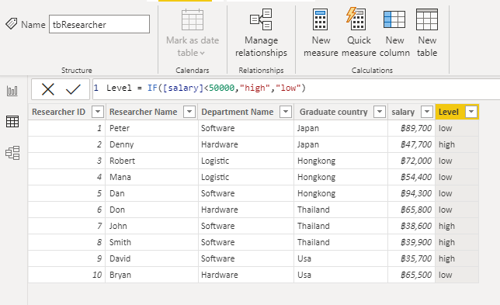
Table tool: new column
Level = IF([salary]>50000,"H","L")

Slide 21
Exercise 2
Create your own data and plot some graphs

Slide 22
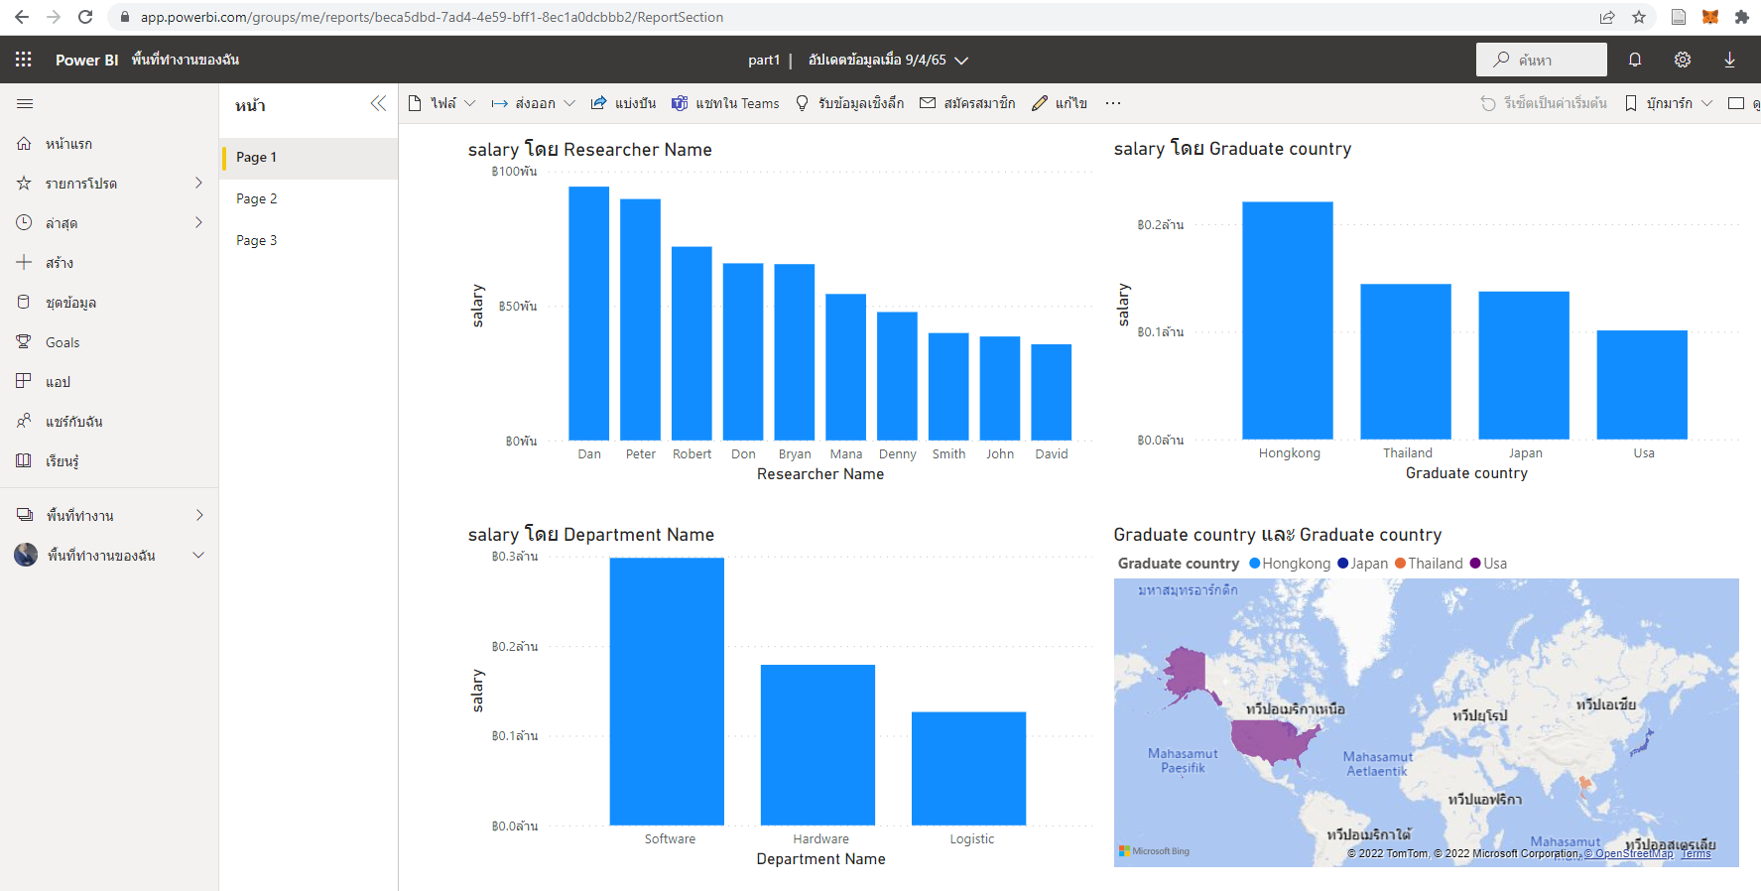
Publish your work
https://app.powerbi.com/groups/me/reports/beca5dbd-7ad4-4e59-bff1-8ec1a0dcbbb2/ReportSection

