Slide 1
Instrumenting your Xamarin Forms application using App Center

Slide 2
Hola!
I am Enmanuel Toribio
I am a Sr. Software Engineer at Megsoft Consulting and I’m here because I love App Center.
You can find me everywhere @eatskolnikov

Slide 3
The agenda for Today
What is Visual Studio App Center?
What is instrumentation?
App Center Analytics
Overview
Events
Log flow
App Center Diagnostics
Crash Reports
Error reports
A little practical example

Slide 4
1.
What is Visual Studio App Center?
Just most useful tool since the invention of fire
Notes:
Visual Studio App Center is a brings together multiple services commonly used by mobile developers into an integrated cloud solution. Developers use App Center to Build, Test, and Distribute applications. Once the app's deployed, developers monitor the status and usage of the app using the Analytics and Diagnostics services, and engage with users using the Push service.

Slide 5
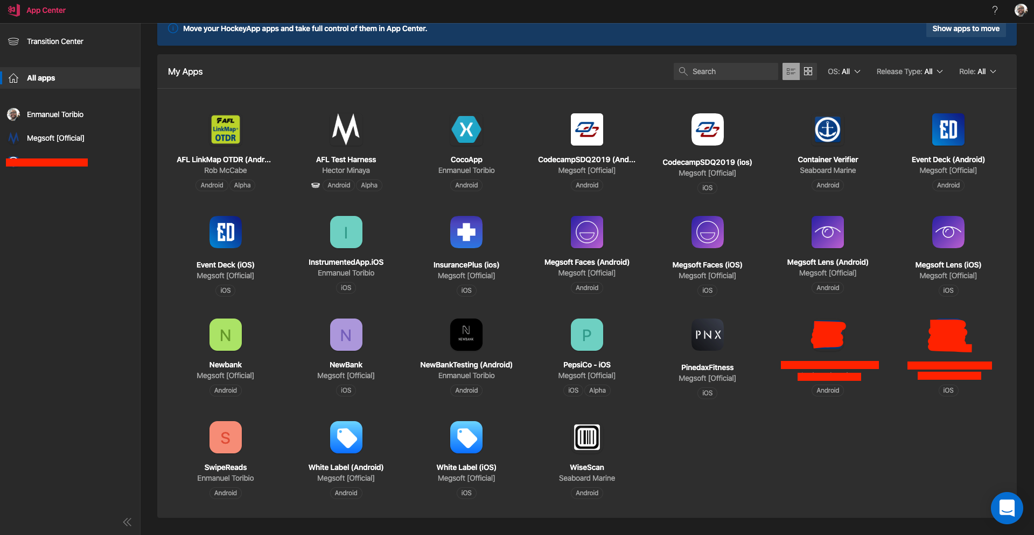
Visual Studio App Center

Slide 6
2.
What’s is instrumentation?
The scientific term for measuring things
Notes:
Instrumentation is a collective term for measuring instruments that are used for indicating, measuring and recording quantities

Slide 7
3.
App Center Analytics
Notes:
App Center Analytics will help you understand more about your app users and their behavior when using your app.

Slide 8
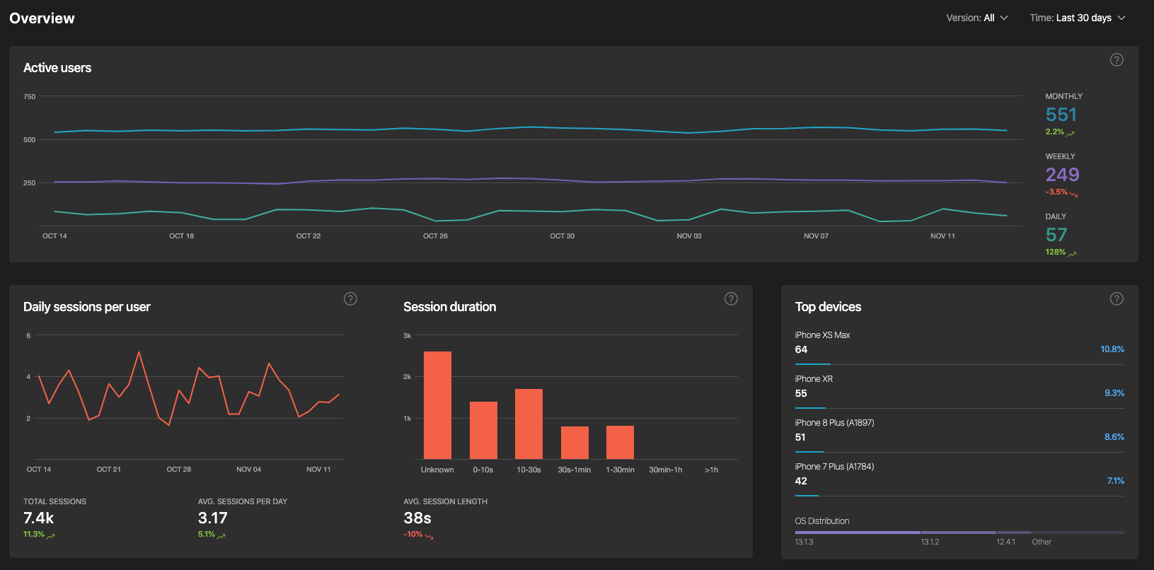
Analytics
Overview

Slide 9
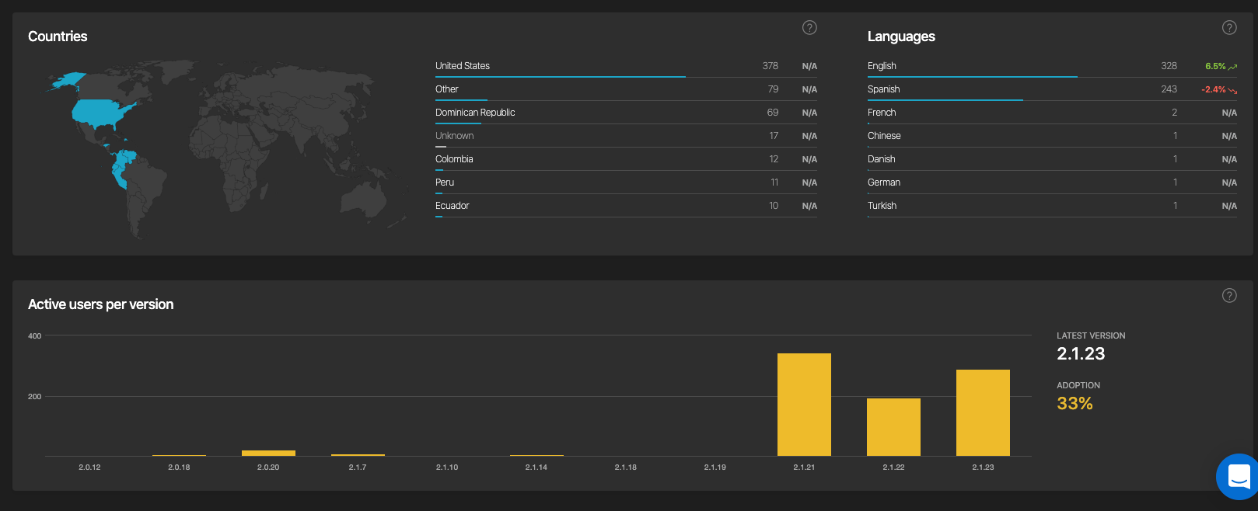
Analytics
Overview

Slide 10
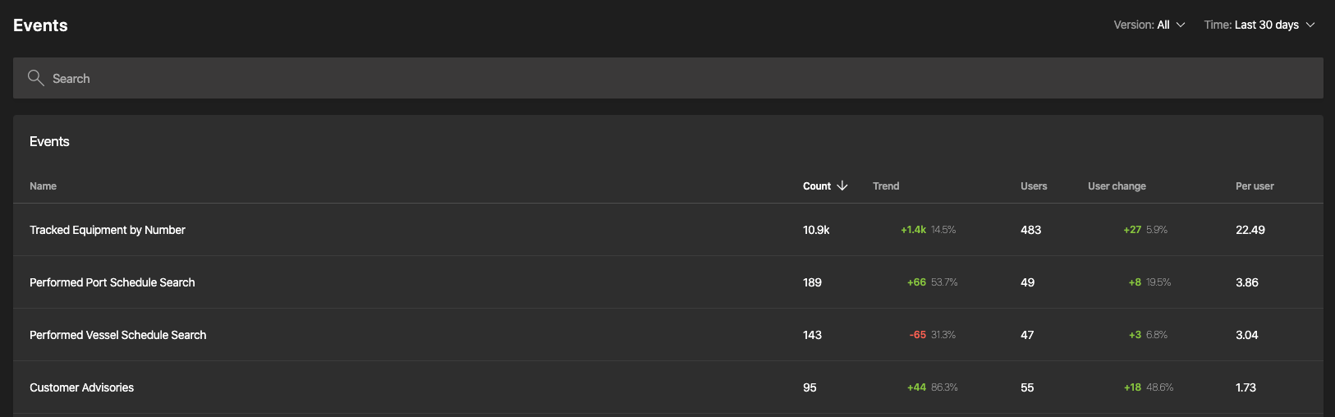
Analytics
Events
Notes:
Events are actions that users take in your app. By tracking events in your app, you will learn more about your users' behavior and understand the interaction between your users and your apps. Attaching properties to your events will provide you with contextual information about the events.
Tracking events in your app allows you to answer questions like:
What is the top N content viewed?
What is the most liked content?
What type of files do my users send?

Slide 11
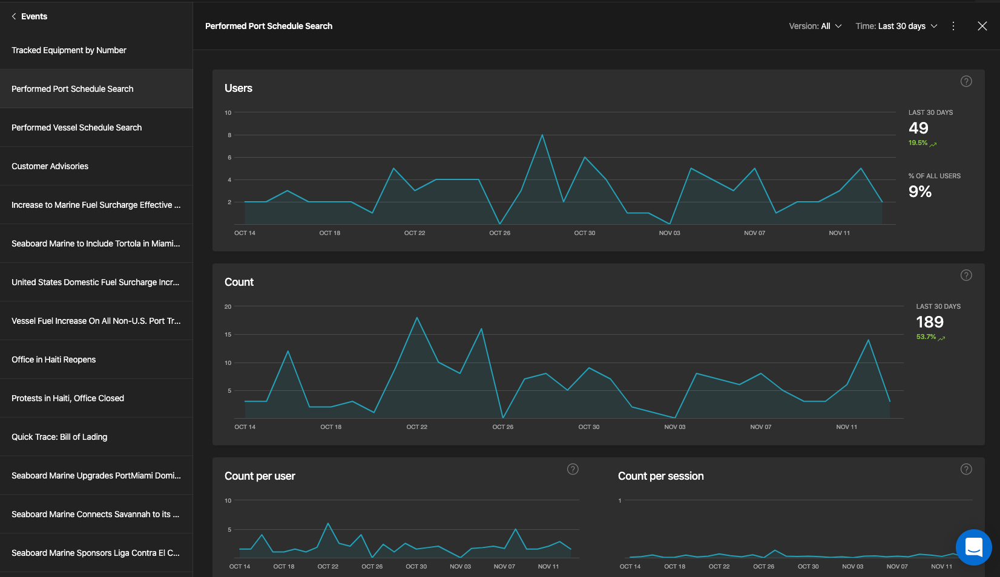
Analytics
Events

Slide 12
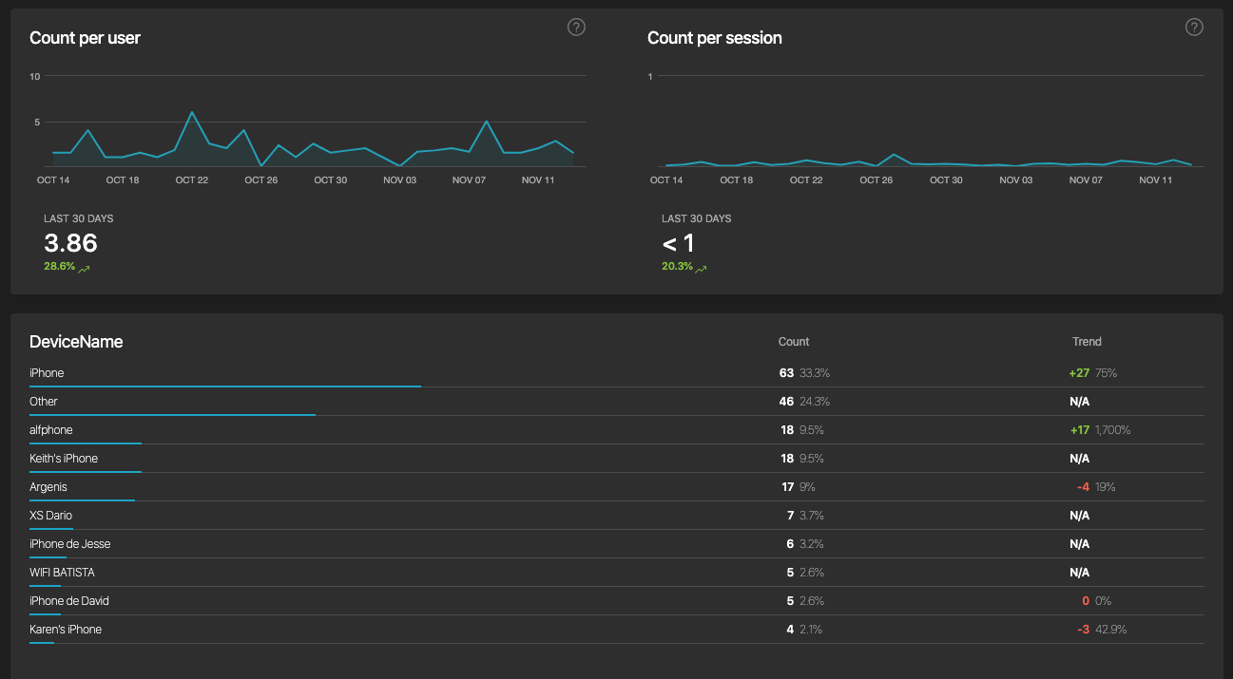
Analytics
Events

Slide 13
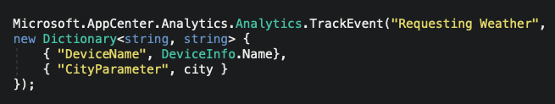
How do we do it?

Slide 14
4.
App Center Diagnostics
Notes:
App Center Diagnostics is a cloud service that helps developers monitor the health of an application, delivering the data needed to understand what happens when an app fails during testing or in the wild. The App Center Diagnostics SDK collects information about crashes and errors in your apps and uploads them to the App Center portal for analysis by the development team - eliminating the guesswork about what really happened in the app when it failed.

Slide 15
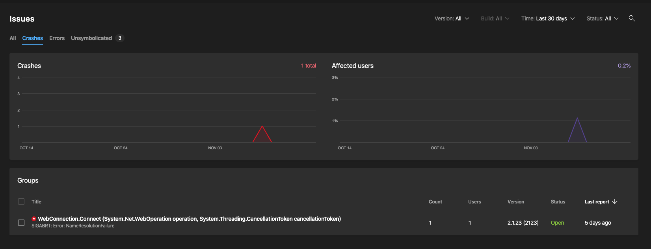
Diagnostics
Crashes

Slide 16
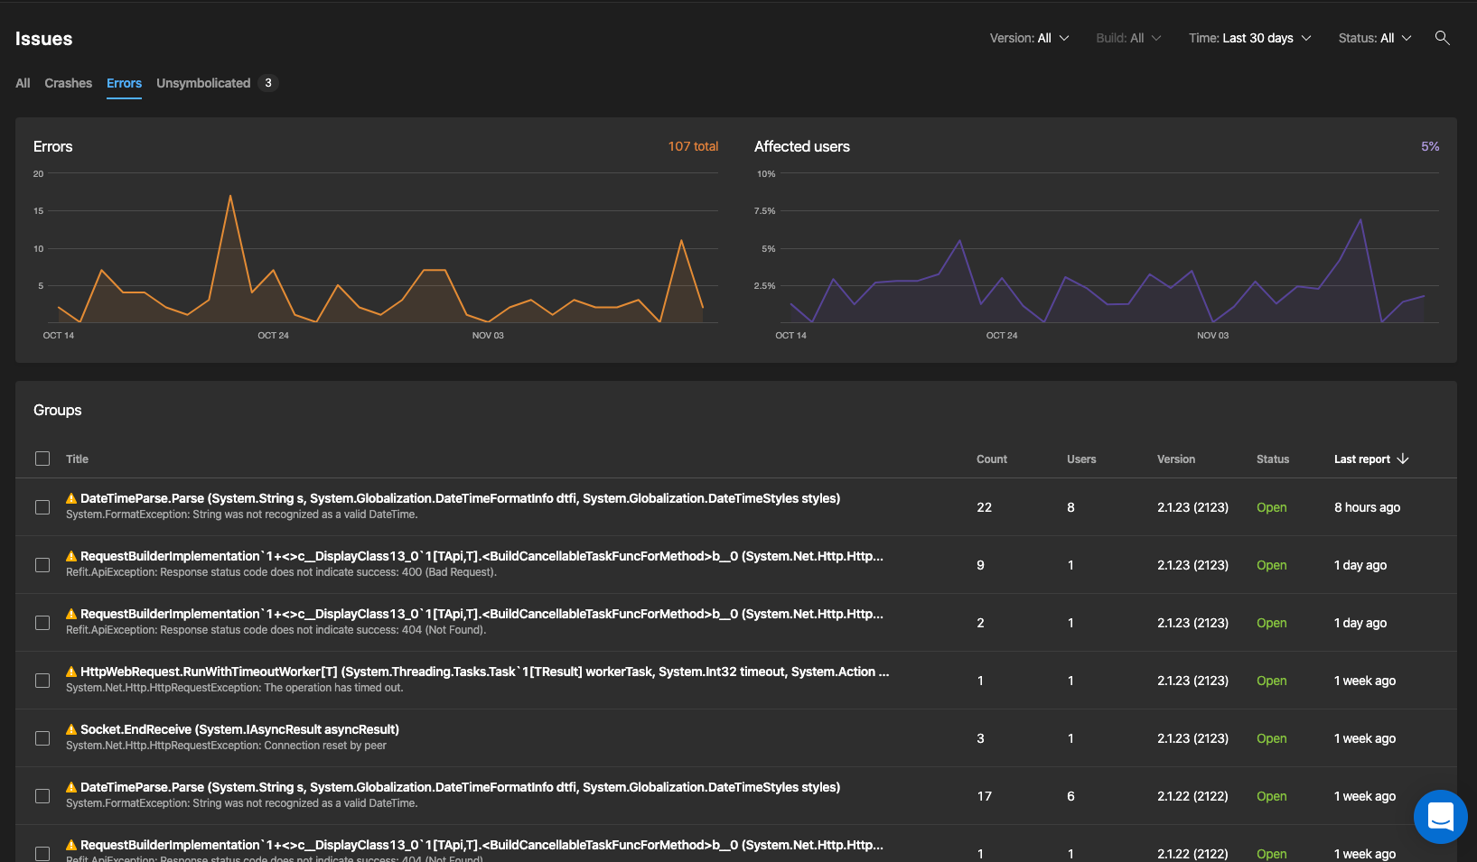
Diagnostics
Errors

Slide 17
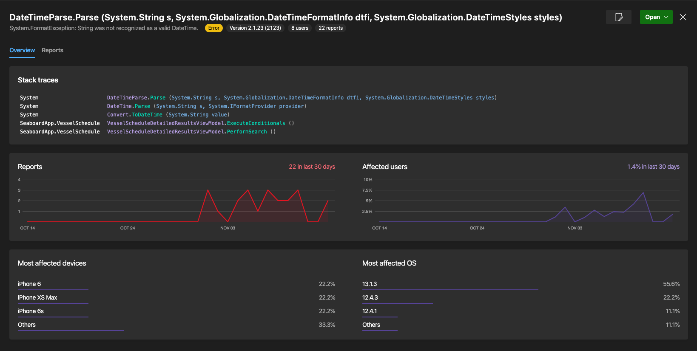
Diagnostics
Errors

Slide 18
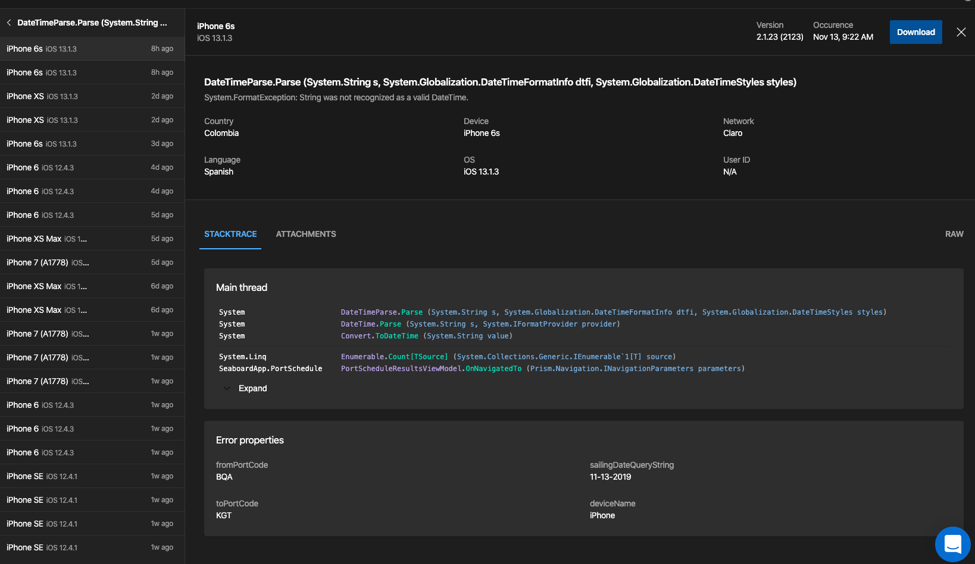
Diagnostics
Errors

Slide 19

A practical case
The weather App.

Slide 20
That which cannot be measured cannot be improved

Slide 21
THANKS!
Any questions?
You can find me at @eatskolnikov or email me at enmanuel@megsoftconsulting.com

