Slide 1

4• 25• 2024
Dust in the Parker Spiral
Authors:
Tien Vo
Peter Tatum
Tien vo

Slide 2
1. About me
I’ve done these projects
Student/staff page
Website changes
AWS
LunGradCon

Slide 3
2. Dust accelerator AWS web application
IMPACT AWS remote Aurora Server
React frontend
impact.colorado.edu (host)
Python local backend server

Slide 4
CONTENTS
01
Model Goals
Implications for Biology
02
03
Model validation
Effects of Albedo and Zenith Angle on Surface UV Fluence
Constraints on the Early Terrestrial Surface UV Environment Relevant to Prebiotic Chemistry
04
05
Dependence on Atmospheric Composition

Slide 5
2. Implications for biology
Focused on two photochemical processes. Surface radiance is used to calculate the “biologically effective dose rate (BED)”. Relevant for the RNA world hypothesis, where life on Earth began with a simple RNA molecule that could copy itself without help from other molecules.
Uridine Monophosphate (UMP) photolysis:
N-Glycosidic Bond Cleavage
“Measures a stressor for abiogenesis”.
UMP is an RNA monomer. “When irradiated by UV, UMP cleaves the glycosidic bond that joins the nucleobase to the sugar” (bad for biology).
CuCN3 Cyanocuprate photoionization:
Photoionization
“Measures a eustressor for abiogenesis”.
Produces aquated electrons relevant for glycoaldehyde and glyceraldehyde production. This can then produce nucleotides and amino acids

Slide 6
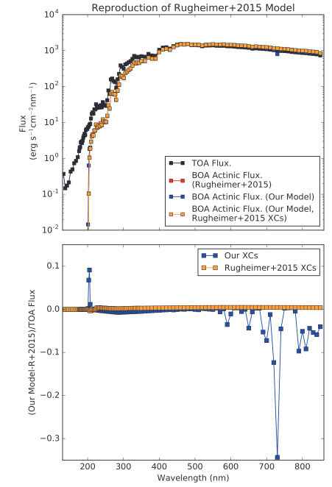
3. Model validation
In order to validate their two-stream radiative transfer model, Ranjan and Sasselov compared their calculations to published works. The flux as a function of wavelength is compared to the Rugheimer, 2015 model of the 3.9 Ga Earth (upper right).
The difference between the Rugheimer 2015 and this model’s flux was calculated using both their cross sections and the other (lower right). In both cases, the model well reproduces the results of Rugheimer, 2015.

Slide 7
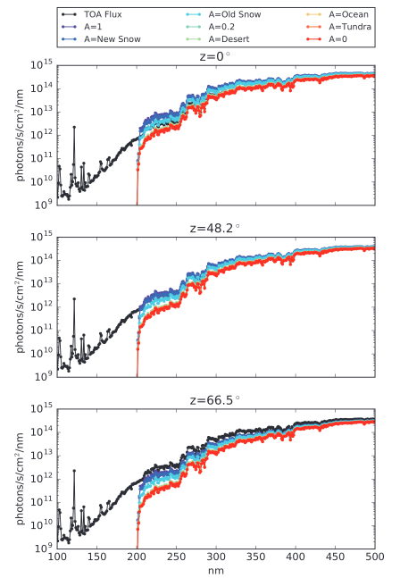
4. Effects of Albedo and Zenith Angle on Surface UV Fluence
Assuming an atmosphere corresponding to the model of Rugheimer et al. (2015) and a range of solar zenith angles and surface albedos, variations in spectral surface radiance can be as high as a factor of 20.6 for wavelengths greater than 204 nm at a 1 nm resolution. This applies to Earth's surface radiance at 3.9 Ga, indicating that albedo and zenith angle must be considered for these calculations.

Slide 8
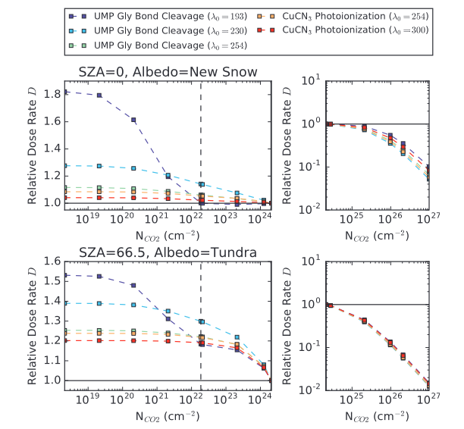
5. Dependence on Atmospheric Composition (CO2)
CO2: Strong shielder at sufficient densities. for NCO 2 ‡ 2.09 · 1023 cm-2, photons shortward of 193 nm are effectively completely blocked from the surface

Slide 9
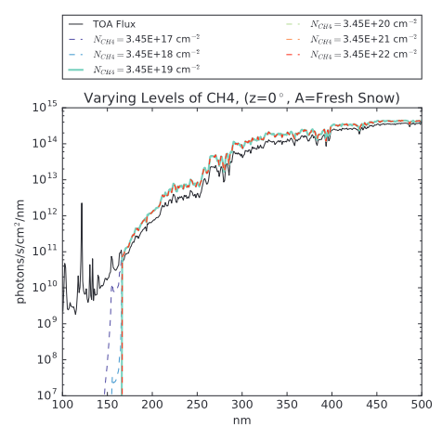
5. Dependence on Atmospheric Composition (CH4)
CH4: Ineffective shielder.
A CH4 level of NCH4 = 3.45 e 22 cm-2 is needed to extinct the fluence short-
ward of 165 nm.

Slide 10
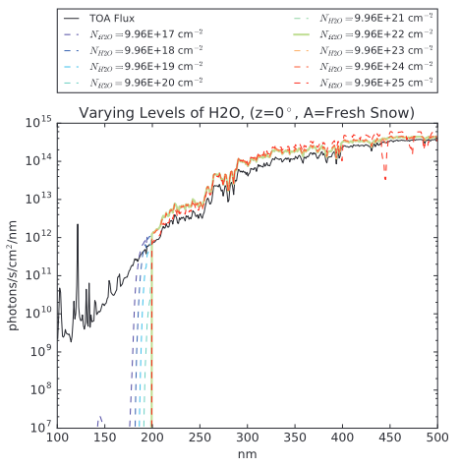
5. Dependence on Atmospheric Composition (H2O)
H2O: Strong absorber, but likely not enough water vapor on prebiotic Earth.
NH 2 O = 9.96 · 10 21 cm-2 (0.1 · the Rugheimer
et al., 2015, level) is enough to block fluence for wavelengths < 198 nm.

Slide 11
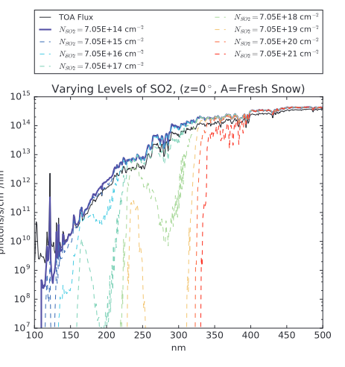
5. Dependence on Atmospheric Composition (SO2)
SO2: Higher absorber than CO2, but prone to loss processes. Possibly higher levels due to volcanic activity
At NSO 2 = 7.05 ·e17 cm-2, SO2 starts to sharply reduce fluence at wavelengths
(<=200 nm. For NSO2 ‡ 7.05 · 10 20 cm-2 (*36 ppm in theRugheimer et al., 2015, model), all fluence shortward of 327 nm is shielded out.

Slide 12
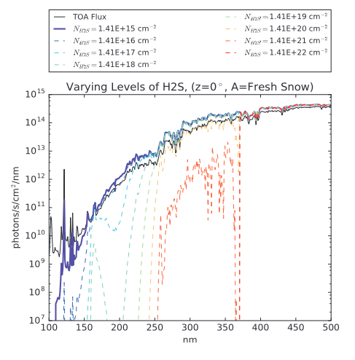
5. Dependence on Atmospheric Composition (H2S)
H2S: stronger and broader absorber than O2, also generated from volcanic outgassing, also vulnerable to photolysis and reactions with oxidants. Therefore not considered a major constituent of the atmosphere.

Slide 13
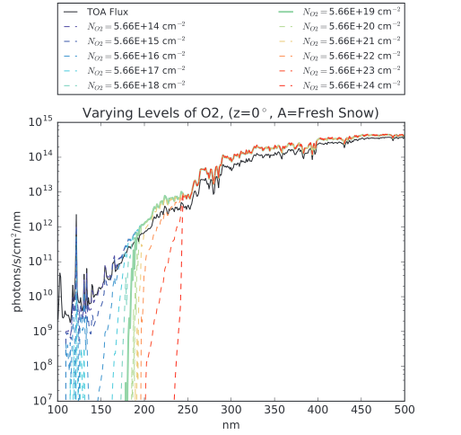
5. Dependence on Atmospheric Composition (O)
O2: Not enough of it or O3 to effectively shield the 3.9 Ga Earth
At the Rugheimer et al. (2015) level of NO 2 = 5.66 ·1019 cm-2
, O2 blocks fluence at l < 183 nm. Two orders of magnitude less than CO2.

Slide 14
THANK YOU!
ETHMAN Ethan RUSSELL ayari
ethan.ayari@colorado.edu
(303)-549-3424

