Slide 1
An Introduction to Consensus with Raft
Diego Ongaro John Ousterhout
Stanford University
http://raftconsensus.github.io

Slide 2
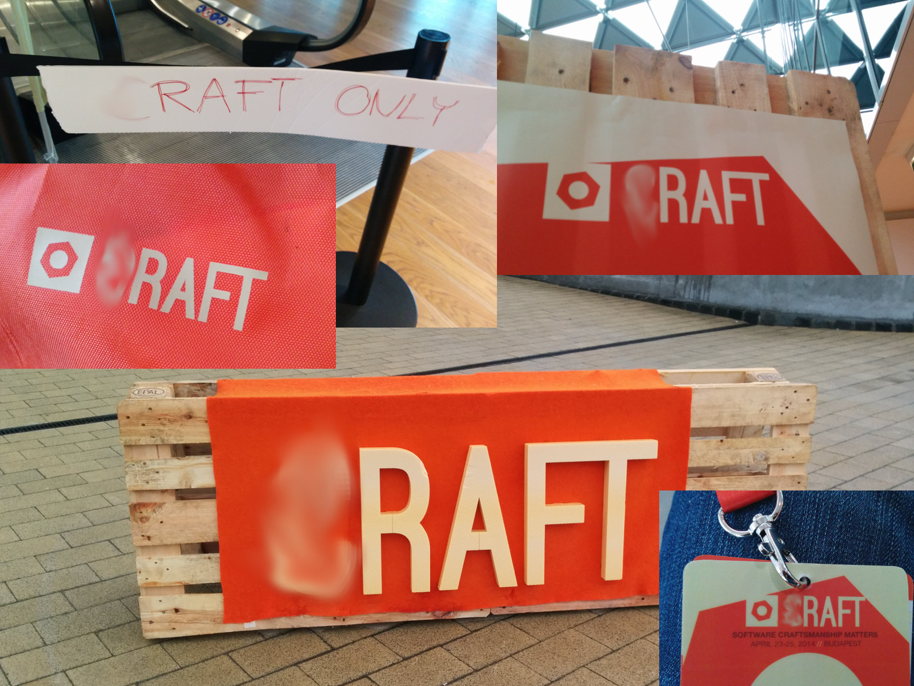

Slide 3
Distributed Systems
availability or consistency

Slide 4
Inside a Consistent System
TODO: eliminate single point of failure
An ad hoc algorithm
“This case is rare and typically occurs as a result of a network partition with replication lag.”
Watch out for @aphyr
– OR –
A consensus algorithm (built-in or library)
Paxos, Raft, …
A consensus service
ZooKeeper, etcd, consul, …

Slide 5
What is Consensus?
Agreement on shared state (single system image)
Recovers from server failures autonomously
Minority of servers fail: no problem
Majority fail: lose availability, retain consistency
Servers

Slide 6
Why Is Consensus Needed?
Key to building consistent storage systems
Top-level system configuration
Which server is my SQL master?
What shards exist in my storage system?
Which servers store shard X?
Sometimes used to replicate entire database state (e.g., Megastore, Spanner)

Slide 7

Goal: Replicated Log
Clients
z←6
Consensus Module
State Machine
Consensus Module
State Machine
Consensus Module
State Machine
x | 1
y | 2
z | 6
x | 1
y | 2
z | 6
x | 1
y | 2
z | 6
Servers
Log
Log
Log
x←3
y←2
x←1
z←6
x←3
y←2
x←1
z←6
x←3
y←2
x←1
z←6
Replicated log ⇒ replicated state machine
All servers execute same commands in same order
Consensus module ensures proper log replication
System makes progress as long as any majority of servers are up
Failure model: fail-stop (not Byzantine), delayed/lost messages

Slide 8
Paxos Protocol
Leslie Lamport, 1989
Nearly synonymous with consensus
Hard to understand
“The dirty little secret of the NSDI community is that at most five people really, truly understand every part of Paxos ;-).” – Anonymous NSDI reviewer
Bad foundation for building systems
“There are significant gaps between the description of the Paxos algorithm and the needs of a real-world system…the final system will be based on an unproven protocol.” – Chubby authors

Slide 9
Raft’s Design for Understandability
We wanted the best algorithm for building real systems
Must be correct, complete, and perform well
Must also be understandable
“What would be easier to understand or explain?”
Fundamentally different decomposition than Paxos
Less complexity in state space
Less mechanism

Slide 10
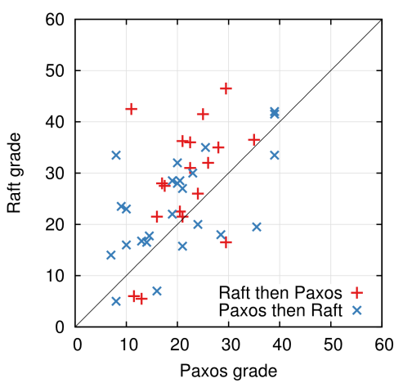
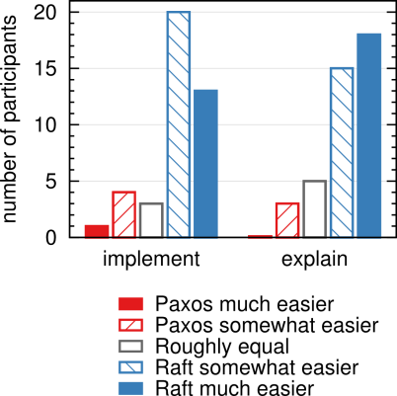
User study
Quiz Grades
Survey Results

Slide 11
Raft Overview
Leader election
Select one of the servers to act as leader
Detect crashes, choose new leader
Log replication (normal operation)
Leader takes commands from clients, appends them to its log
Leader replicates its log to other servers (overwriting inconsistencies)
Safety
Only elect leaders with all committed entries in their logs

Slide 12
Server States
At any given time, each server is either:
Follower: completely passive replica (issues no RPCs, responds to incoming RPCs)
Candidate: used to elect a new leader
Leader: handles all client interactions, log replication
At most one viable leader at a time
time out, start election
receive votes from majority of servers
start
Follower
Candidate
Leader

Slide 13
Terms
Term 1
Term 2
Term 3
Term 4
Term 5
time
Elections
Split Vote
Normal Operation
Time divided into terms:
Election
Normal operation under a single leader
At most one leader per term
Each server maintains current term value
Key role of terms: identify obsolete information

Slide 14
Leader Election
Leaders send heartbeats to maintain authority.
Upon election timeout, start new election:
Increment current term
Change to Candidate state
Vote for self
Send Request Vote RPCs to all other servers, wait until either:
Receive votes from majority of servers:
Become leader, send heartbeats to all other servers
Receive RPC from valid leader:
Return to follower state
No-one wins election (election timeout elapses):
Increment term, start new election

Slide 15
Leader Election Visualization
The Secret Lives of Data http://thesecretlivesofdata.com
Visualizes distributed algorithms, starting with Raft
Project by Ben Johnson (author of go-raft)

Slide 16
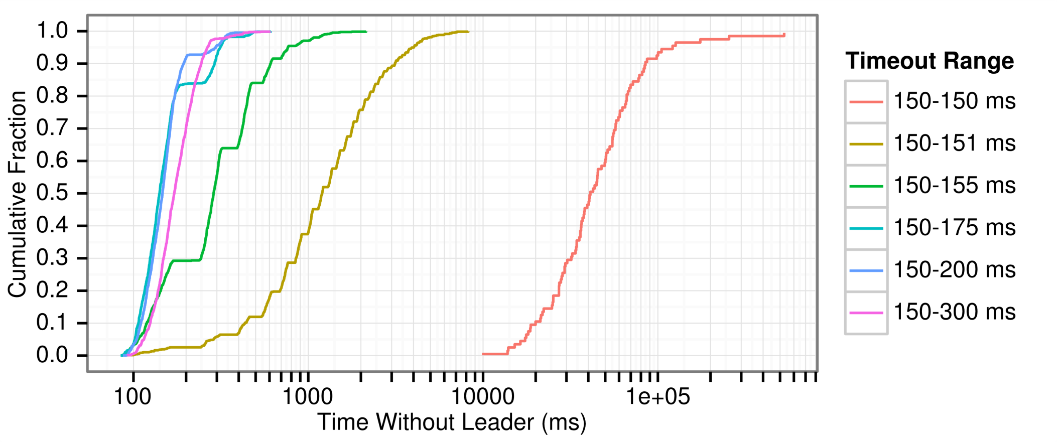
Randomized Timeouts
If we choose election timeouts randomly,
One server usually times out and wins election before others wake up

Slide 17
Raft Paper
Log replication
Client interaction
Cluster membership changes
Log compaction
To appear: 2014 USENIX Annual Technical Conf.
June 19-20 in Philadelphia
Draft on Raft website

Slide 18
Raft Implementations
kanaka/raft.js | JS | Joel Martin
go-raft | Go | Ben Johnson (Sky) and Xiang Li (CoreOS)
hashicorp/raft | Go | Armon Dadgar (HashiCorp)
LogCabin | C++ | Diego Ongaro (Stanford)
ckite | Scala | Pablo Medina
peterbourgon/raft | Go | Peter Bourgon
rafter | Erlang | Andrew Stone (Basho)
barge | Java | Dave Rusek
py-raft | Python | Toby Burress
ocaml-raft | OCaml | Heidi Howard (Cambridge)
…

Slide 19

Best Logo: go-raft
by Brandon Philips (CoreOS)

Slide 20
Summary
Consensus is key to building consistent systems
Design for understandability
Raft separates leader election from log replication
Leader election uses voting and randomized timeouts
More at http://raftconsensus.github.io:
Paper draft, other talks
10 to 50+ implementations
raft-dev mailing list
Diego Ongaro @ongardie

