Slide 1
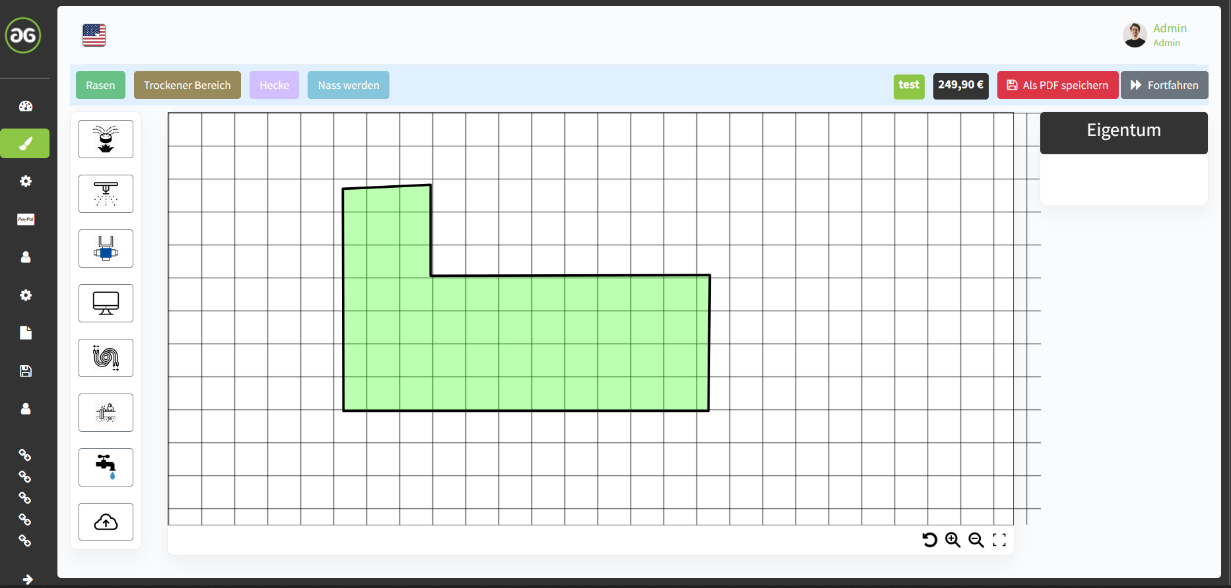






The chronological order should look like shown here
and fits better to the calculations, needs to be done,
see video explanation.

Slide 2
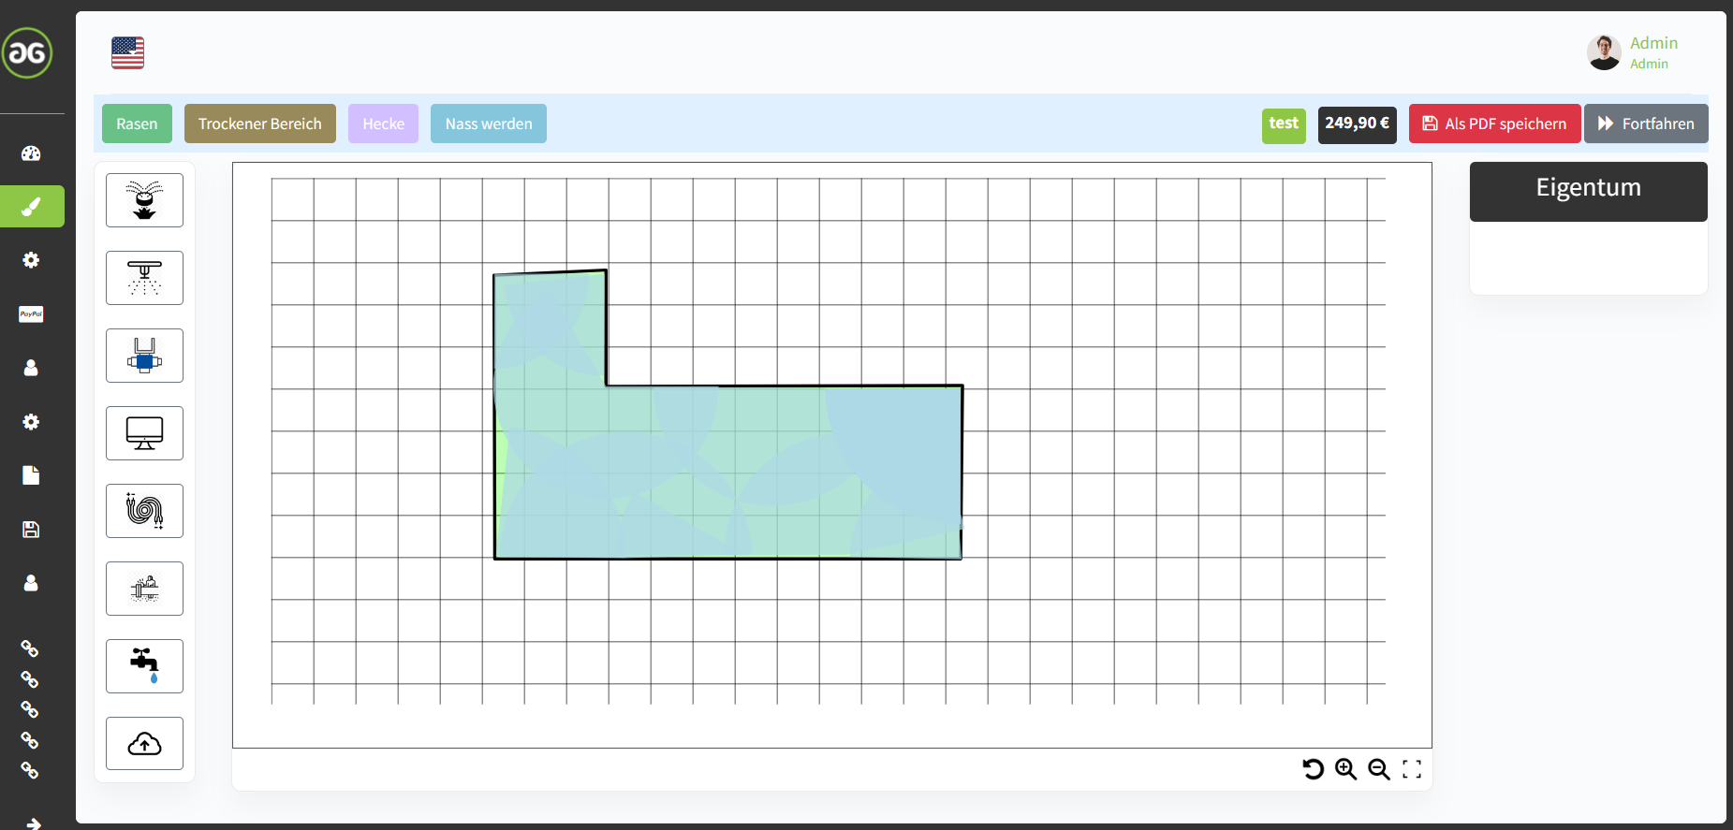

0,2m³/h
0,2m³/h
1,05m³/h
1,14m³/h
0,63m³/h
0,42m³/h
0,29m³/h
0,29m³/h
0,07m³/h
0,07m³/h
0,29m³/h
2m³/h
1,4m³/h
-30%

