Slide 1
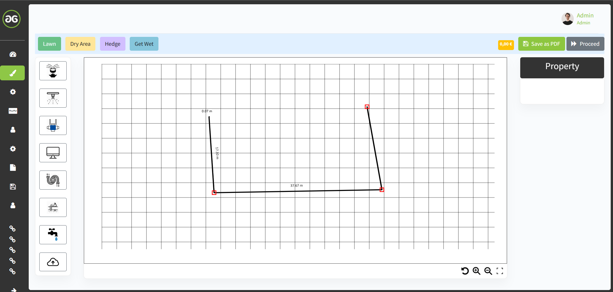
Length should be shown
While sketching the line
to enable customer better
understanding of dimensions
Move function would
be good to navigate (left/right/up/down)
throughThe sketch
The shape edge points are not positioned
At the place, where the mouse is placed
Should be adjusted, to meet edge points
more precisely
Repeat function would
be good

Slide 2
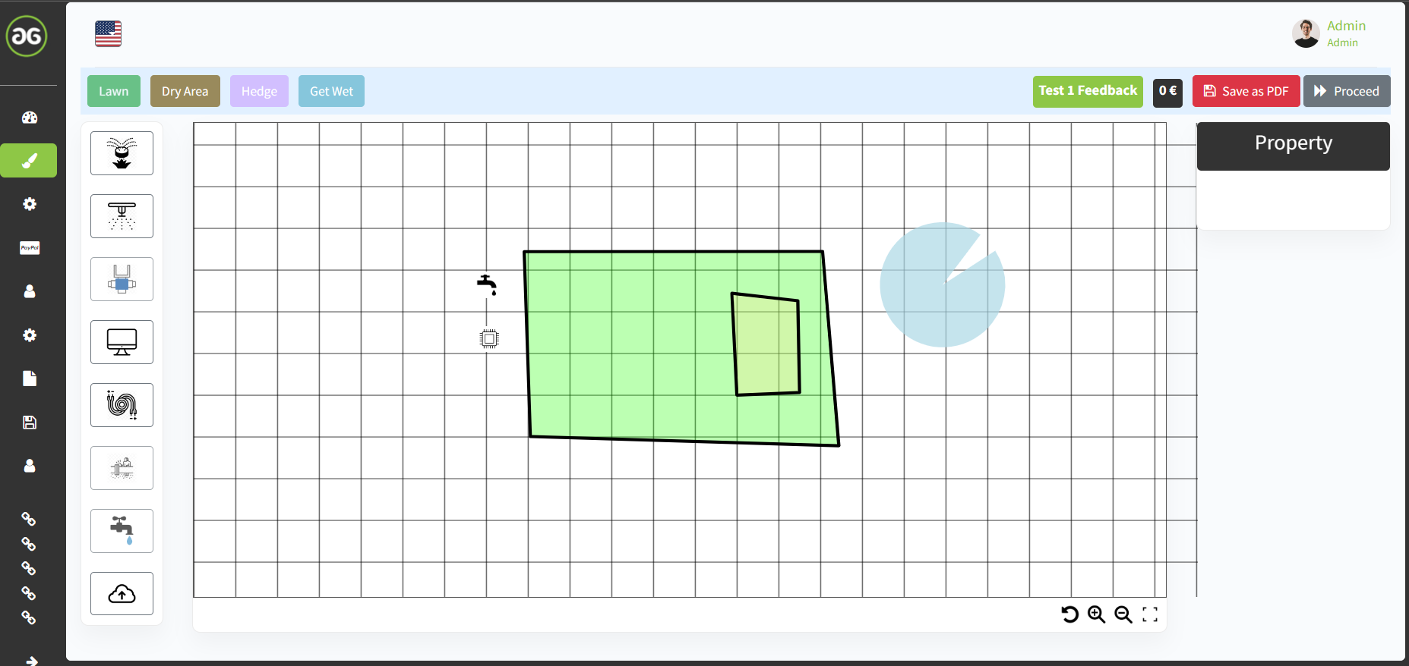
Delete all would be good, if customer wants to restart

Slide 3
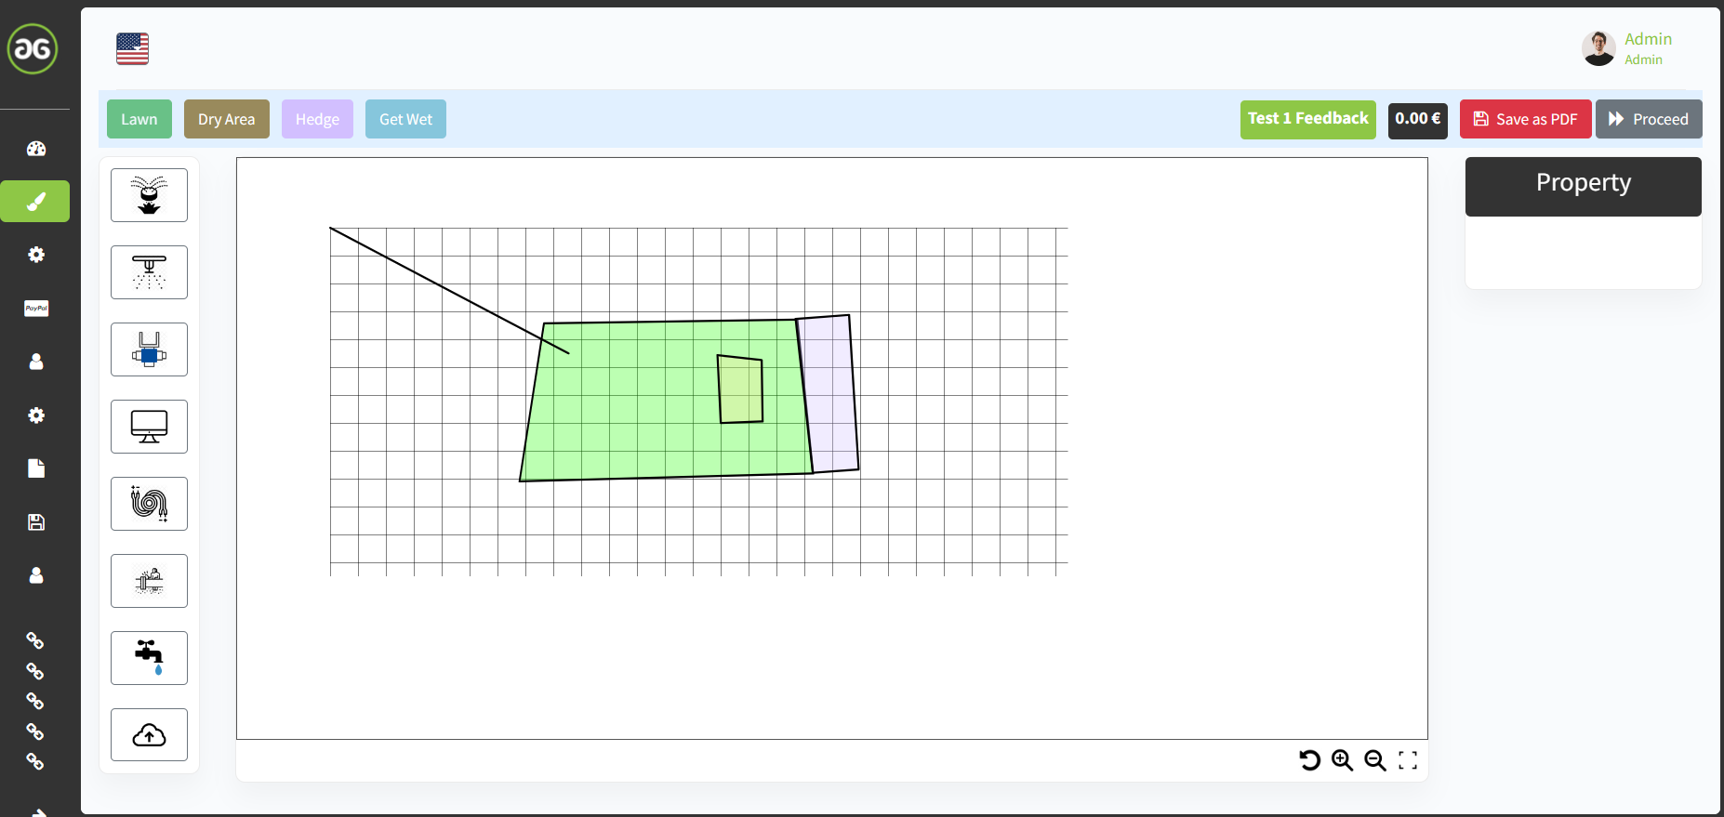
After switching to for example dry area and then back to lawn
Button, it seemingly selects sketch point outside the canvas area
and then cannot stop drawing. Seems to be a bug.
Would be good, if sketching is only able, if mouse is on canvas area.
Would also be good, if interrupt operation button would be available
To enable the customer stopping unpredicted actions.

Slide 4
Would be good, if customer gets information about current operation is ongoing.
If for example customer is sketching the lawn,
the „lawn“ button needs to be represented as pushed button like sprikler is shown while hovering with the mouse over it.
Same visualization mode would be good for all operation buttons
for better understanding for the customer.

Slide 5
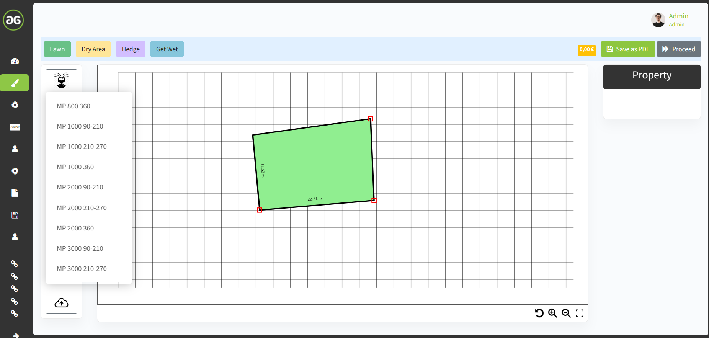
Sprinkler Implementation
Actually the sprinkler implementation containts drowdown menu and the customer has to select sprinkler without knowing the right one for him.
Therefore I would prefer one sprinkler, without definition and dropdown menu.
The customer implements one sprinkler and then adjusts length and angle he would like to have and fits his lawn area.
Based on his adjustment he gets on the property area the related sprinkler, he needs.
The limits (min. throw lenght / max. throw length) herefore are the properties in the XLS file I have provided.
Min. Throw length is MP800 90-210°. Max. Throw length is MP3500.
If customer tries to adjust smaller / higher than min. / max. throw width, he should get error message and adjustment of throw lenth to be
Limited accordingly.

Slide 6
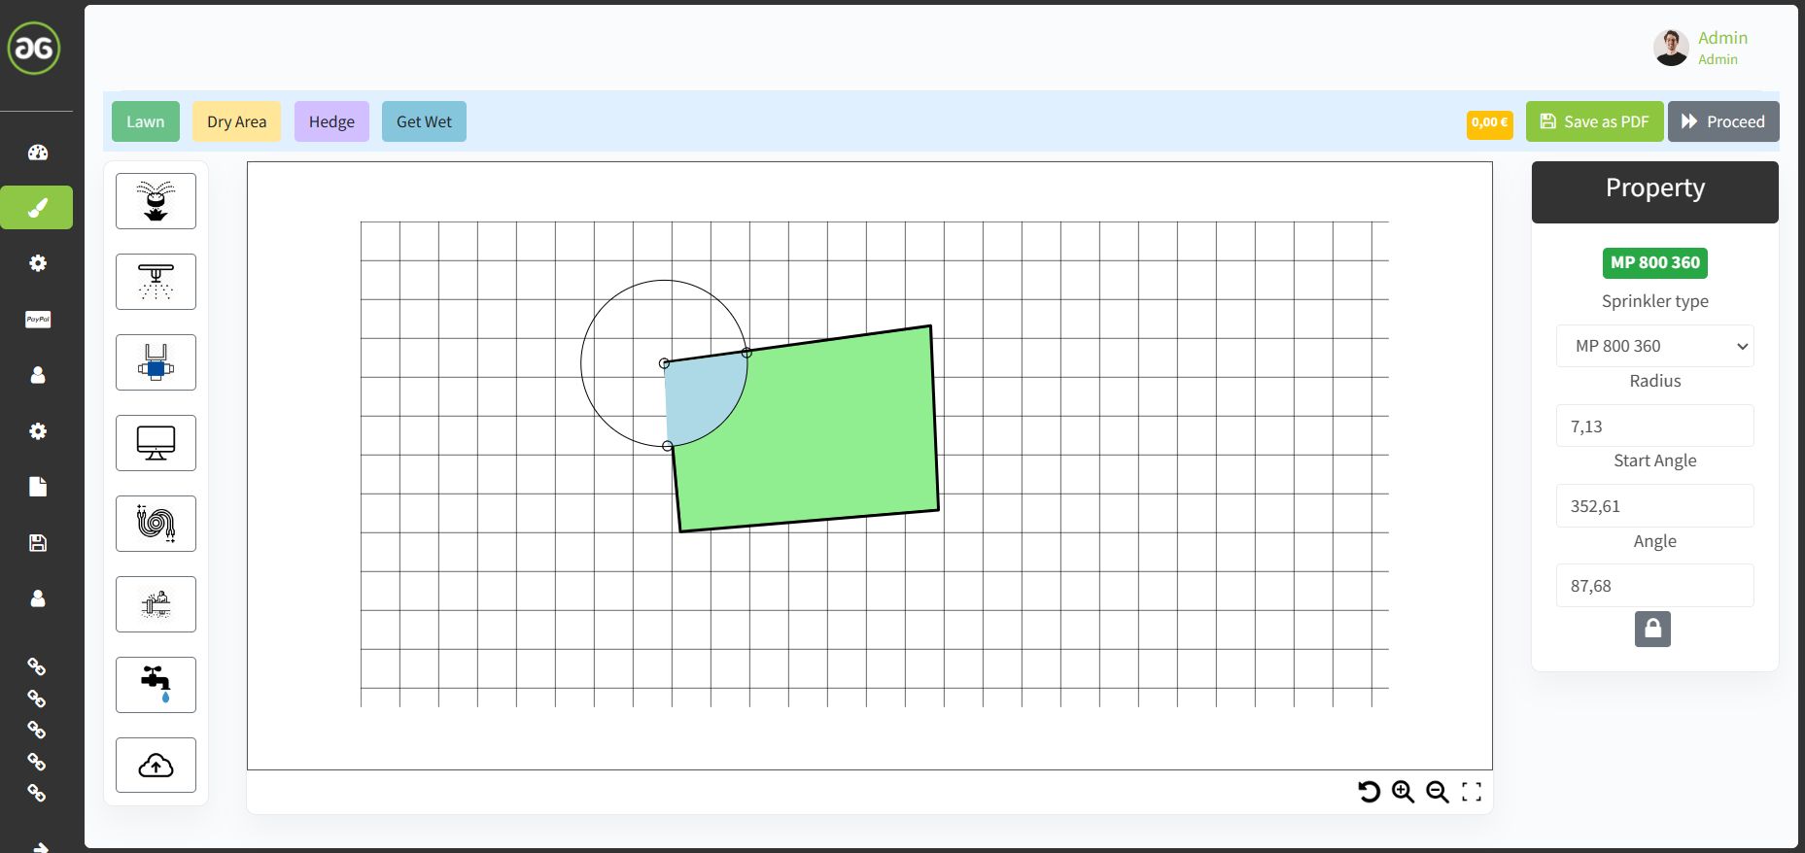
The Sprinkler type, as mentioned on page before should be defined by length and angle adjusted by customer
Adjusment not working correct → works always into positive direction, even if trying to reduce start angle
While adjusting one end of the angle
The other one actually moves (length is okay, but angle not)
It should be stable after adjusting and not
changing

Slide 7
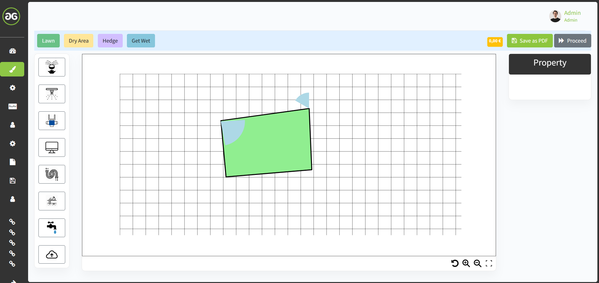
After implementing
Sprinkler it needs to be adjustable
By clicking on it
Actually not adjustable
Outer contour should be a black line
Center point should have colour acc. to XLS sprinkler types I have provided for later better understand for the customer where to install which sprinkler type

Slide 8
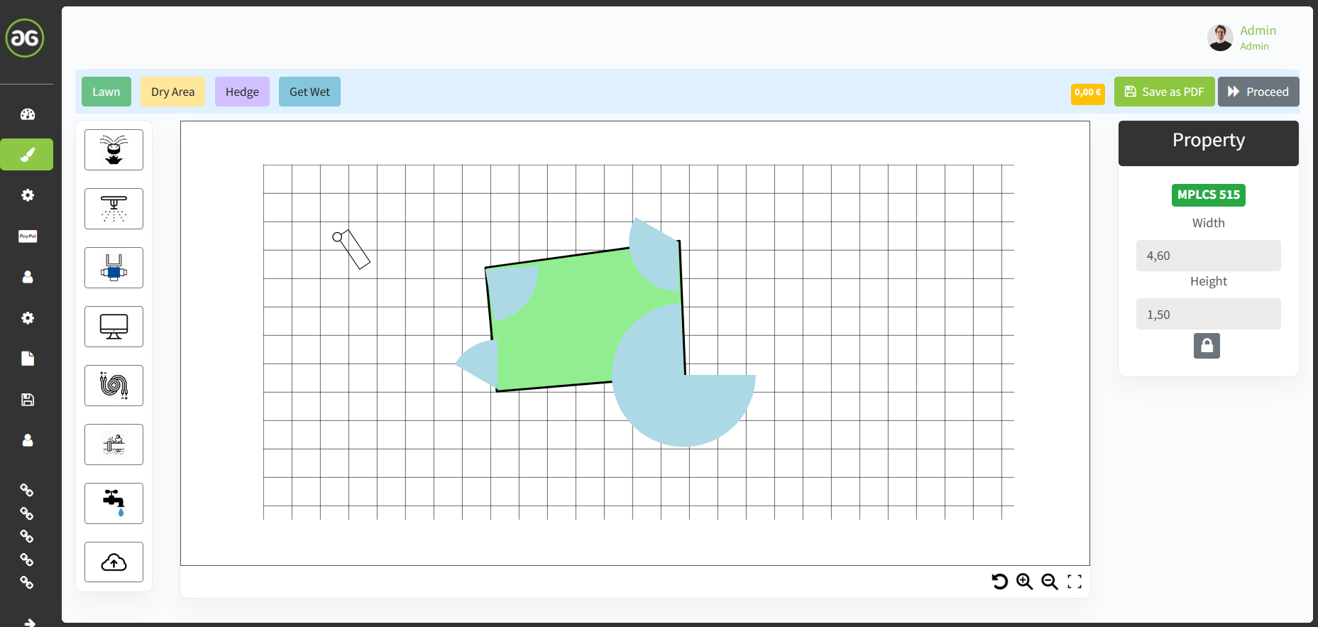
Rotation of the square sprinkler happens
by clicking onto the centre
Not intuitive for customer
Would be better by picking the squared shape
Translating right/left/up/down would be better by picking the centre
Inner geometry of square shape should be also filled with blue (water)
Centre point colour should be acc. to XLS provided

Slide 9
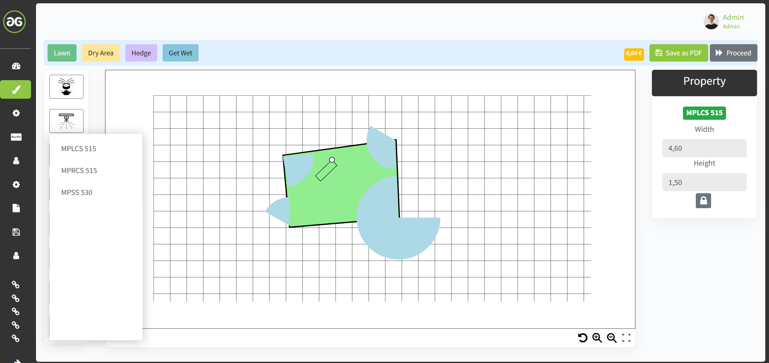
For square shaped sprinkler it would also be better not to have
a drop down menu.
Better would be a drop down menu on property area, which is: left corner / right corner / centre

Slide 10
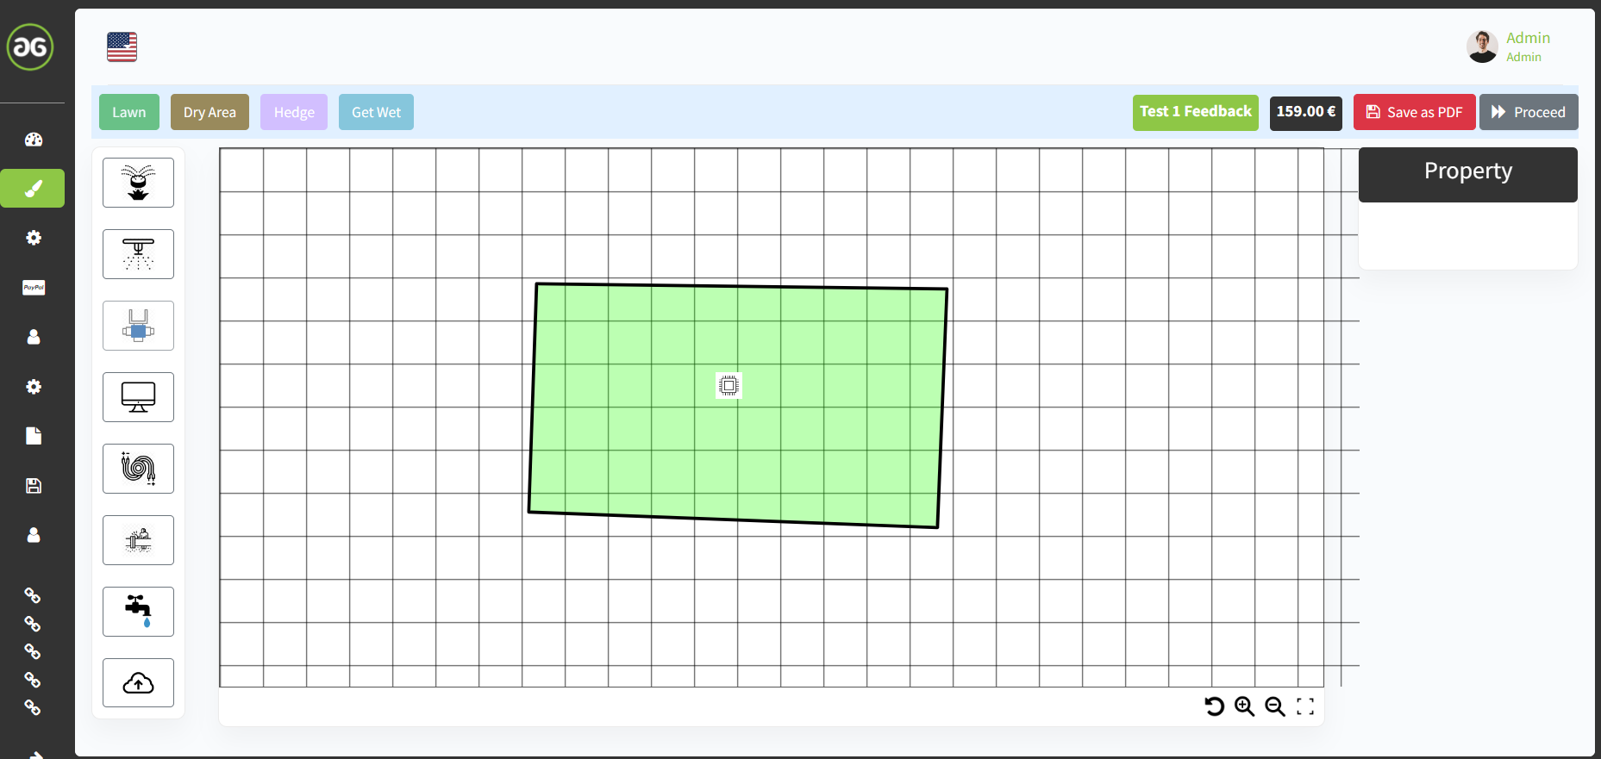
The valve box should be without drop down menu.
It instead should be driven by the quantity of PE pipeline circles.
See, if for example totally 3 circles planned by customer it automatically
Should be adjusted to equal 3 stations. If 5 circles, then 5 stations.
Instead of current drow down menu, customer should chose water source, see:
Well water → This automatically defines valve box with filter
Drinking water → This automatically defines valve box without filter and additionally preselects „Trinkwasser Trennstation“ → under Property folder customer should be able to deselect it, if he likes to or already have
Rain water → This automatically defines valve box with filter

Slide 11
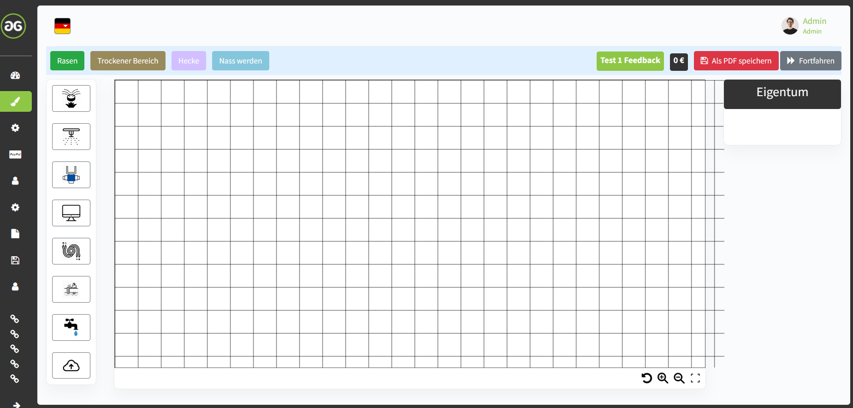
The irrigation computer should be without drop down menu.
It instead should be driven by the quantity of PE pipeline circles.
See, if for example totally 3 circles planned by customer it automatically
should be adjusted to next possible quantity of stations, see 4 stations. If 5 circles, then 6 stations.
Instead of current drow down menu, customer should chose following:
Installation location → Options: indoor or outdoor
Control Option → Options: Manual or Wifi/Wlan
Driven by selection 1. / 2. that effects following automatic selection for the customer:
For indoor installation → „iE“ Series
For outdoor installation → „E“ Series
For Wifi/Wlan and Smartphone control and indoor installation → „HC“ Series
For Wifi/Wlan and Smartphone control and outdoor installation → „E“ Series with WAND Modul

Slide 12
The irrigation wiring should be without drop down menu.
It instead should be driven by the quantity of PE pipeline circles.
See, if for example totally 3 circles planned it means wiring cable have to have 3+1 wire = 4 wires
(if 4 circles, then 4+1 = 5 wires, and so on) and it automatically
should select next possible quantity of 5 wiring cable → 5-adrig. If 6 circles, means 7 wires , then 7-adrig.

Slide 13
The irrigation pipeline should be without drop down menu.
It instead should be driven by the length of all sketched PE pipelines.
See, if for example totally 55m sketched it automatically should select next possible length,
which is 50m + 25m roll.
If for example total sketched length is 83meters, it automatically has to select 100m roll

Slide 14
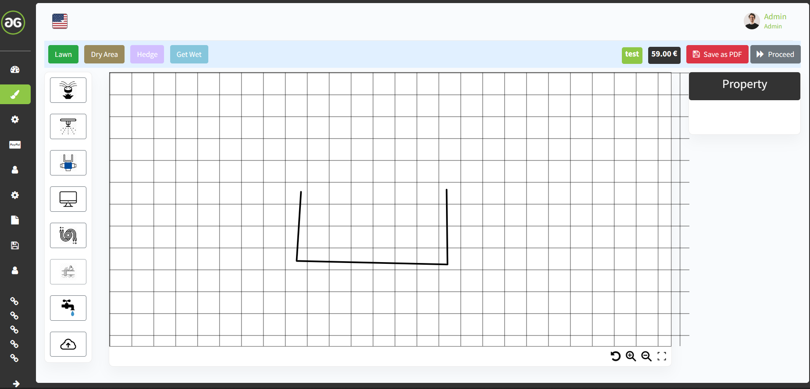
Actually planner allows only sketching 1 circle.
It should allow up to 14 circles and each circle should have different colour.

Slide 15
The image upload for PDF, jpg is not working right now

Slide 16
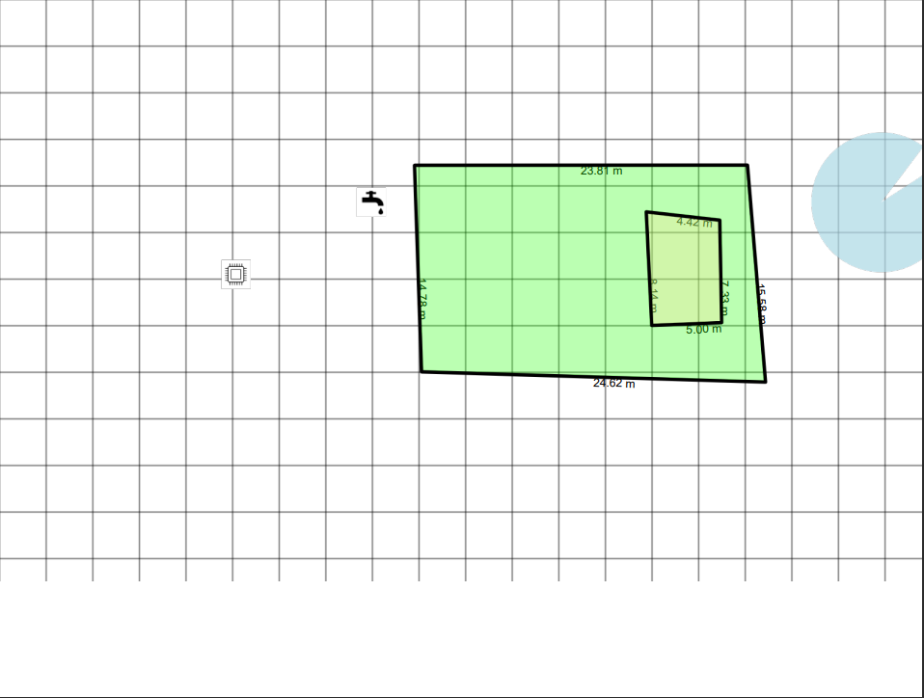
Saving it as PDF shows different result than Canvas

Slide 17
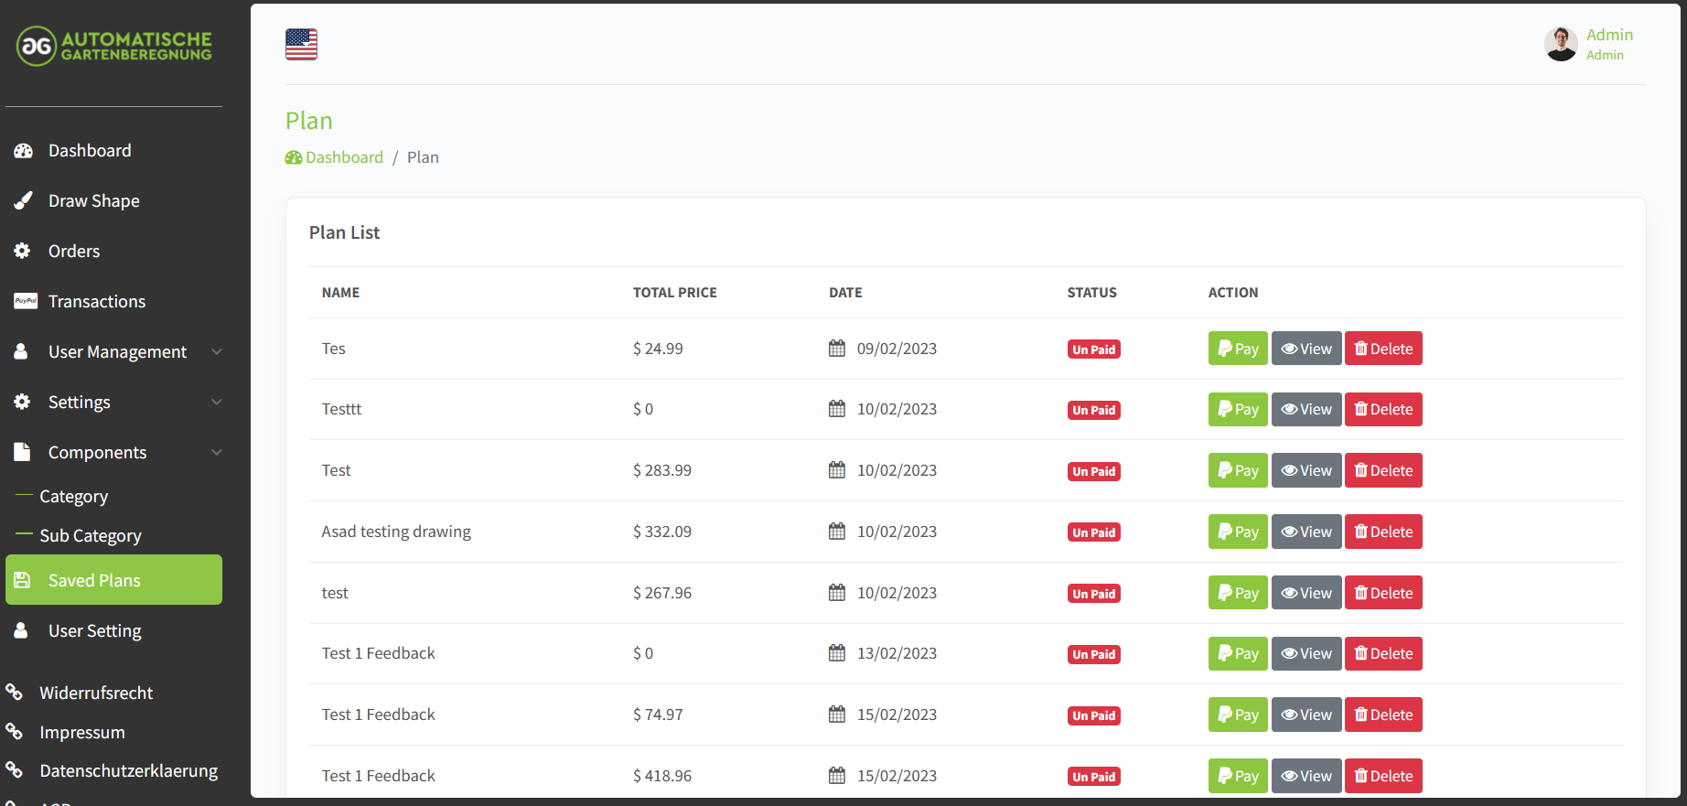
Viewing the saved plans is actually not possible

Slide 18
I could not access the the customer panel:
→ Please check the User and PW
Customer: eazisol@gmail.com customer123@

