Slide 1
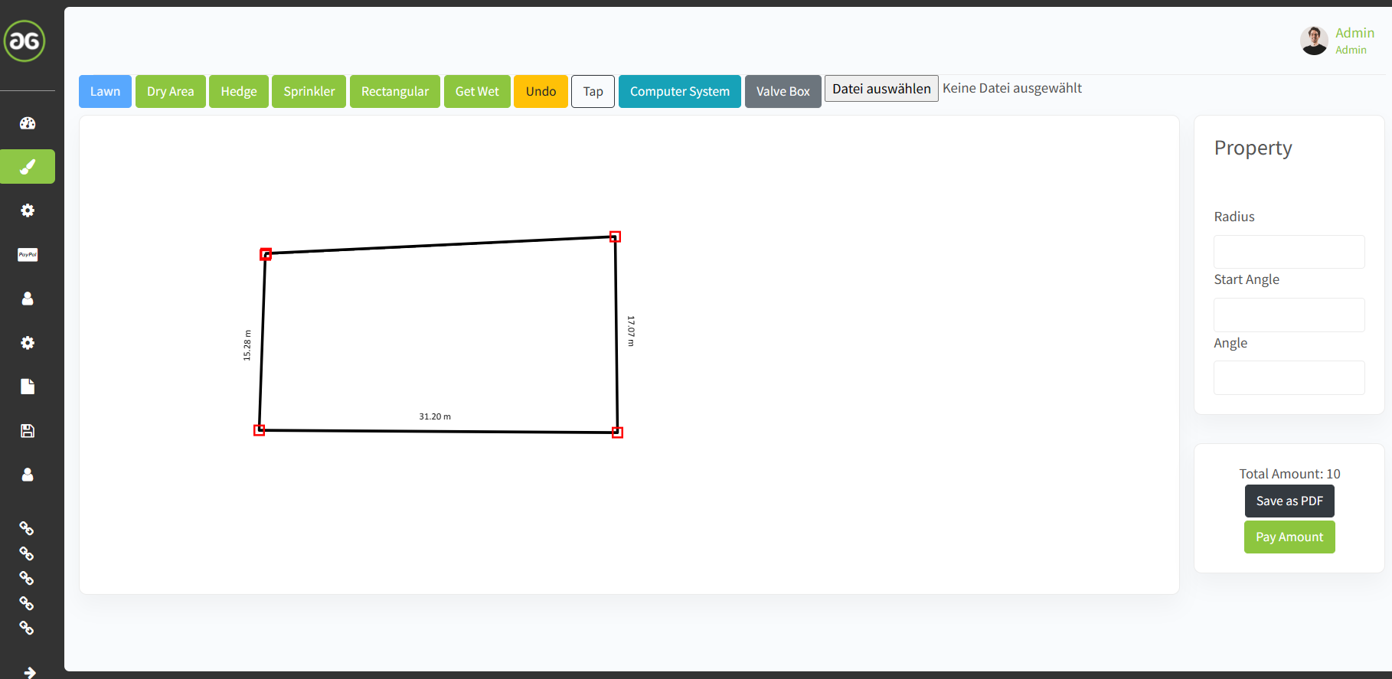
While sketching the lawn, and setting the 4th point, or generally last point
it should find automatically the 1st point to close the lawn area
4
3
0
1
2

Slide 2
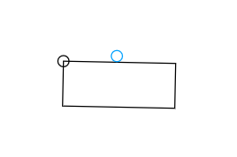
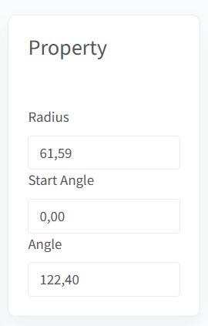
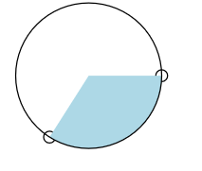
Rectangular sprinkler should be rotated around that circle instead of blue circle
In property input area should also be one direct selection field (drop down list) for different
sprinklers out of provided XLS sheet, see:
Circle radius should be automatically
adjusted to mediate throw width of XLS list:
Throw Distance Min. | Throw Distance max. | Throw Width | Throw Height | m³/h general
2,3 | 3
2,3 | 3
3,1 | 4,1
3,1 | 4,1
3,1 | 4,1
4,4 | 5,8
4,4 | 5,8
4,4 | 5,8
6,8 | 9,1
6,8 | 9,1
6,8 | 9,1
8,0 | 10,7
3,1 | 4,1
 |  | 4,6 | 1,5 | 0,05
 |  | 4,6 | 1,5 | 0,05
 |  | 9,1 | 1,5 | 0,1
Sprinkler type
MP 800 90-210
MP 800 360
MP 1000 90-210
MP 1000 210-270
MP 1000 360
MP 2000 90-210
MP 2000 210-270
MP 2000 360
MP 3000 90-210
MP 3000 210-270
MP 3000 360
MP 3500 90-210
MP Corner
MPLCS 515
MPRCS 515
MPSS 530
Circle shaped srinkler angle should be limited to relevant angle (red lines)
Instead of inside whole circle

