Slide 1
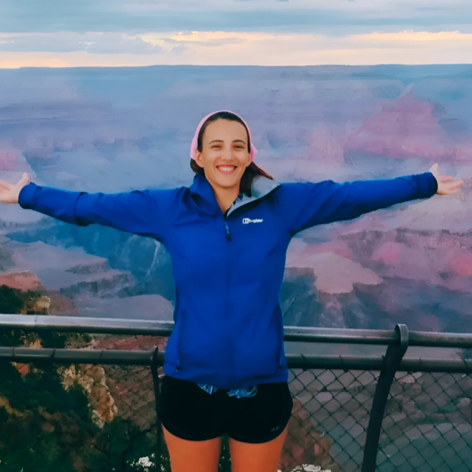
Vassar College Geo- morphology (2025)
Research Skills, Internships, Grad School
(2021)
Alexandra Orona (2021)
UT Austin Planetary Geology (2023)
Korbin Lawson (2021)
Laura Arango (2020)
Cambridge 1A & 1B Sediments, Climate (2025)
Guest Lectures
UT Austin Geosciences Undergraduate Research Trainee Experience (RTX)
UT Austin Intro Geology (2021)
Junior Graduate Students
Practicals & Labs
UT Austin Geosciences Planetary Surface Processes (PSP) Lab
Moderator for SkillsGap UK tech industry skills workshops (2021-2023)
Class Teaching
Irineo Sanchez (Honors Research) (2021)
Tutoring GCSE Science (2018-2020)
Mentoring
Field Teaching
Massachusetts Institute of Technology (MIT) Gaia Lab Graduate Students
Kerala Graduate student field course at Lonar Crater, India
Lonar Impact Crater
2023
Department of Geology, University of Kerala Graduate Students
Ze-Wen Koh (2025)
UT Austin undergraduate honors field course to Germany
Ries & Steinheim Craters, Mesozoic Sediments & Paleontology
2023
Cambridge undergraduate field course to Dorset
Mesozoic Sediments, Paleontology & Structure
2025
Grace Fanson (2025)
Video: How to collect samples for in-situ cosmogenic nuclide age determination
Sadeeda Marjan (2023)

