Slide 1

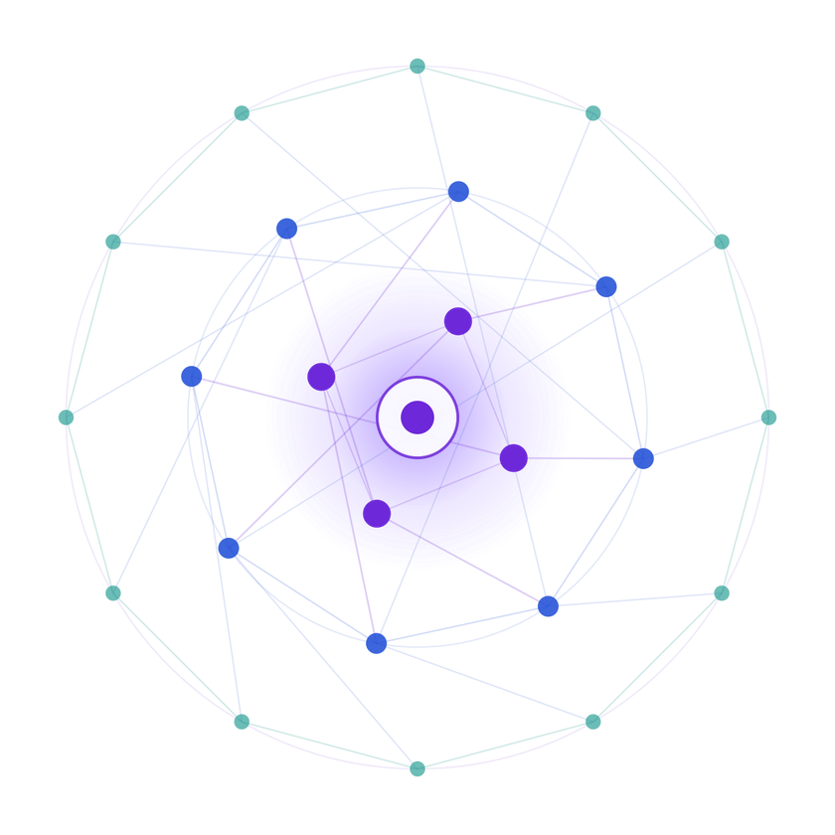
SAMSUNG PRISM
Generative AI
Hackathon
3rd Edition 2026 – 27
  Theme ID - 4
  Team Name - Hackmatrix
  College Name - SRM Institute of Science and Technology
  Member Name & Email 1- kavzzreads@gmail.com
  Member Name & Email 2- rajvinderkaurpersonal@gmail.com
  Member Name & Email 3- annmary9c@gmail.com
  Submission Github link - https://github.com/eb1124/Streaming-Live-RAG

Slide 2

Theme
PRISM GenAI Hackathon 2026
StreamingLiveRAG
Grounded answers you can verify.
Honest refusals when it can’t.

Slide 3
Existing Solutions & Gaps
  Chat-with-your-PDF tools (ChatPDF-style): fluent answers, loose or no citations, no way to refuse when evidence is weak
  Basic RAG pipelines: retrieve then generate, never verify the output; can’t handle two documents or dated policy versions
  University policy search pages: keyword search returns documents, not answers; no synthesis or follow-ups
  Raw LLM, no retrieval: states a dollar threshold or deadline with full confidence, sourced from nothing

Slide 4
Our Solutions & Architecture Diagram
→
→
→
Retrieval +
Generation
→
→
Answer or
abstain
User
API
Orchestrator
Verifier
  RabbitMQ (job queue)
  Redis (sessions)
  PostgreSQL (metadata)
  MCP (tool access)
  OpenTelemetry (tracing)
An async job queue connects API and orchestrator; every answer is gated by a verifier before the user sees it.

Slide 5
Demo & Product Walkthrough
Live proof 1: grounded answer
Live proof 2: honest abstention
  Q: What are the procurement thresholds that require competitive bidding?
  A: Competitive bids are required for all purchases with an aggregate value of $50,000 or more. [1]
  [1] 2305 Compliance with Procurement Policies, University of Pennsylvania, effective 1990-09, pp. 2–3
  Q: What is Harvard University’s policy on travel expense reimbursement?
  A: The retrieved documents do not contain enough evidence to answer this question.
  Status: Abstained. Harvard isn’t in the document set, so it said so instead of inventing an answer.
Demo video: https://drive.google.com/file/d/1M74sb6NFH8FlprWxU1pLssUKaQGRzh8t/view?usp=sharing

Slide 6
Tools and tech stack used
Stack
AI usage, disclosed
  LLM: openai/gpt-oss-20b via Groq
  Embeddings: Snowflake arctic-embed-m-v1.5 (best of 5 benchmarked)
  Reranker: cross-encoder ms-marco-MiniLM-L-6-v2
  Search: dense + BM25 indexes fused by Reciprocal Rank Fusion, no external vector DB
  Backend: Python, FastAPI, Pydantic, Uvicorn
  Frontend: React, TypeScript, Vite
  PDF parsing: PyMuPDF
  Infra: RabbitMQ (job queue), Redis (sessions), PostgreSQL (metadata), MCP (tool server), OpenTelemetry (tracing)
  4 independent services; deploys with or without Docker
  v0 by Vercel: initial visual design direction
  Claude Sonnet 5: implementation, bug fixes, local dev tooling, documentation, testing support
  Every AI-assisted change was verified against the running app

Slide 7
Impact & Use case
  Users: staff checking policy (a traveler’s reimbursement deadline, a buyer’s bidding threshold) without reading a 94-page PDF
  Corpus: 12 policy documents, 10 institutions, 221 pages, 466 indexed chunks
  Retrieval: Recall@5 98.6%, MRR@10 0.867 on a 69-case benchmark, best of 5 embedding models
  Speed: ~99 ms mean retrieval time on CPU (top-10)
  Reliable: same retrieve-or-abstain decision in 27 of 27 live-LLM cases across two runs

Slide 8
Innovation highlights, results and limitations
Innovation
Results
Limitations
  Verifier checks every claim against the source text
  Answer or abstain, never an unverified answer
  Multi-intent splitting, temporal versioning, follow-up memory
  843 automated tests passing
  Recall@5 98.6%, MRR@10 0.867 (69-case benchmark)
  Service layer matches the direct pipeline: 69/69 turns, 42/42 conversations identical
  Live-LLM runs (27 cases, 2 runs): 100% same retrieve-or-abstain decision, 70% identical wording
  4 services, 10 build phases, 2 deployment paths; re-verified from a clean copy
  Answers only from the indexed document set (e.g. Harvard isn’t included, so it abstains)
  One query at a time per API process; no concurrency yet
  Synchronous wait for answers; no job-status endpoint
  Service calls have no auth, retries or TLS (fine for a hackathon, not production)
  CPU-only inference

Slide 9
What’s next
  Concurrent query handling, removing the one-at-a-time limit
  Expand the corpus to more policy domains and institutions
  Job-status endpoint so the frontend can poll instead of waiting on one long request
  Authenticated, multi-tenant deployment for real institutional rollout

Slide 10
Brownie points slide( differentiation)
  Verifier gate: every claim checked against source text before it is shown
  Honest abstention: “not enough evidence” instead of an invented answer
  Multi-intent: one question naming two universities becomes two separately cited answers
  Temporal versioning: Feb 2026 vs July 2026 versions of a policy stay distinct and cited separately
  Follow-up memory: “does that still apply currently?” narrows to the current version automatically
  843 tests, re-verified from a clean, freshly extracted copy

Slide 11
Checklist- Updated on Public GitHub
  Working prototype code, public GitHub repo: Y (github.com/eb1124/Streaming-Live-RAG)
  README with reproducible setup instructions: Y (verified from a fresh copy)
  Demo video, max 5 minutes: Yes (Google Drive link on the Demo slide and in the README)
  Presentation file (PPT or PDF): Yes (this deck, exported from Canva)

Slide 12
Thank you
Organised by the Language AI Team and the PRISM Team, Samsung R&D Institute India

