Slide 1

ICCAT Workshop: investigation into bycatch estimation methodologies
Module 2A: Design-based approaches to bycatch estimation
Facilitators:
Dr. Beth Babcock
Dr. Ana Adao

Slide 2
Design-based and model-based approaches to bycatch estimation
Design-based estimators, based on the sampling design:
Estimates are calculated directly from data using arithmetic formulas
e.g., stratified ratio, stratified delta-lognormal
Model-based estimators:
We fit a linear model to the data, then use fitted model to predict bycatch.
Properties of the estimates depend on the joint likelihood of estimated parameters
Note: If the observer program has a stratified random sampling design, the stratification variables must be included in both design-based and model-based estimates

Slide 3
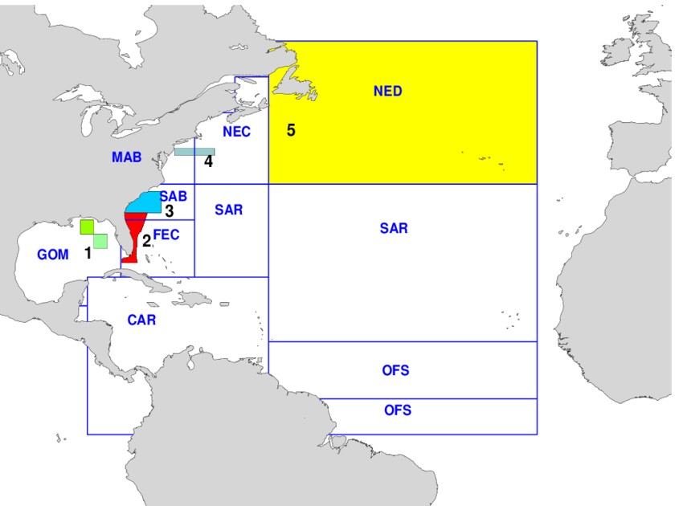
Example stratified random design
Example of USA Pelagic longline fishery in the Atlantic​
Observers allocation scheme:
Multiply target observer coverage (8%) times sets in the area x season stratum last year to get number of sets to sample
Randomly select vessels in the stratum proportional to their number of sets last year
Area and season strata should be included in model or design-based estimators
Brown 2001
Christman 2019

Slide 4


Design-based estimators
Stratified Ratio Estimator:
Calculates the ratio R_{i} in each stratum i, of mean observed catch (c_{i}) to mean observed effort (e_{i}, in number of hooks) in the observed data as:
Total bycatch C is calculated as the sum of the ratio times the total logbook effort E_{i}:

Slide 5

Design-based estimators
Stratified ratio estimator:
The variance of the total bycatch is (Rao 2000):
f is the fraction of the effort observed
n is the number of sample units observed
s is the standard deviations and covariances between effort and catch in the observed data.
Variance decreases with fraction sampled (f), thus, variance decreases with higher sampling fraction (finite sample correction)

Slide 6
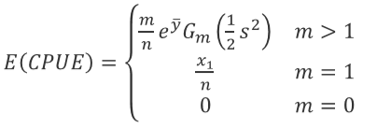
Design-based estimators
Stratified delta-lognormal estimator (Pennington 1983):
This estimator for the mean CPUE in each stratum is:
m is the number of positive observation out of n samples,
y and s are the mean and sd of the log of the positive observations
x₁ is the positive CPUE if only one value is positive (m=1)
G_{m} is a bias correction function

Slide 7
Design-based estimators
Stratified delta-lognormal estimator (Pennington 1983):
In each stratum, the mean CPUE is multiplied by total effort to get total bycatch, and the totals are summed across strata
The CPUE variances are multiplied by effort squared and summed to calculate the total variance

Slide 8
Design-based estimators
Variance estimation, considerations:
Design-based estimators have variance formulas and are calculated directly
They include a finite sample correction, meaning that sampling a higher fraction of the population reduces variance
Strata are independent in design-based estimation, because the data are independent, and the estimator is calculated directly from data.

Slide 9
Design-based estimators – Pooling algorithm
Data sets can be stratified into multiple variables (e.g., year, season, area, fleet, etc)
If a stratum has no observations (or too few; fail to achieve min. observations), then the CPUE must be imputed
Pooling data across strata is a commonly used imputation method
Area 1
95 samples
Area 2
26 samples
Area 3
0 samples
Pool across areas to get estimate for area 3

Slide 10
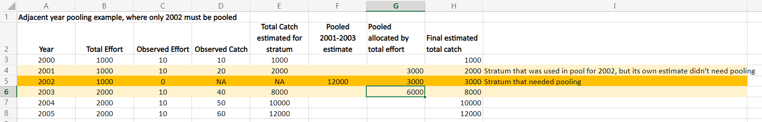
Design-based estimators – Pooling algorithm
Pooling algorithm across years – Excel example
Estimate the design-based estimate across the observer and logbook data in the pool
Calculate the total bycatch of stratum i as the total bycatch in its pool times the fraction of the total effort in the pool that is in stratum i
The variance is also allocated to stratum i based on the fraction of effort

Slide 11
Design-based estimators – Pooling algorithm
User specifies:
Minimum number of sample units below which strata should be pooled
Variables to pool over in the order which the variables are entered (e.g. year, season, area)
Can pool across adjacent x years (before and after)
Can specify more aggregated variable to pool over
e.g. 2 seasons rather than 4
Can pool over all levels of a variable (e.g. areas)
e.g. If <30 sets in a stratum, pool by year (3 years pooling), then season, then area

Slide 12
Summary
Design-based estimators:
Faster, and requires less thought in setting up
Ratio estimators do the finite sample correction automatically
Unsampled strata are a serious problem
Pooling scheme may introduce bias

Slide 13
References
Brown, C.A. 2001. Revised estimates of bluefin tuna dead discards by the U.S. Atlantic pelagic longline fleet, 1992-1999. Collect. Vol. Sci. Pap. ICCAT 52(3):1007-1021.
Christman 2019. Review of estimation methods for the delta-lognormal estimator.
Rao, P. S. R. S. 2000. Sampling Methodologies with Applications. 1st Edition. Chapman; Hall/CRC.
Pennington, M. 1983. “Efficient Estimators of Abundance, for Fish and Plankton Surveys.” Journal Article. Biometrics 39 (1): 281–86. https://www.jstor.org/stable/2530830.
See “documents” folder

