Slide 1

MBE 713: Marine Population Dynamics 6: Life tables and Leslie matrices
Elizabeth A. Babcock

Slide 2
Age-structured models
Leslie matrices and other demographic methods
Incorporate the idea that mortality rates and fecundity rates vary by age and sometimes sex
Generally no density dependence
These methods are often used to derive priors for r in logistic models
They are often used directly for protected species like sea turtles, marine mammals.

Slide 3
Life tables
Age or stage structured models require age (or stage) specific mortality and fecundity rates
Life table keeps track of numbers and mortality at age (or stage) to get the age specific mortality rates

Slide 4
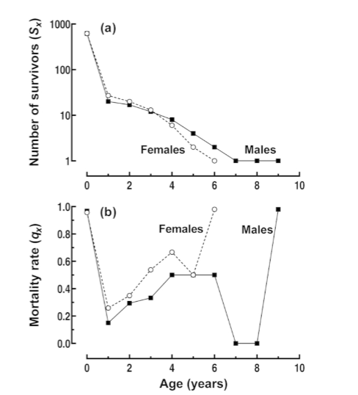
Galapagos finch
Survivors to each age Sx. Called a survivorship curve in demographic analysis. Plotted in log scale
Fraction dying by age qx
From Neal book, chapter 6

Slide 5
Cohort life table.
 | Males |  |  | Females
Age | Survivors At | No. | Mortality | Survivors. At | No. | Mortality
interval | start of | dying in | fraction in | start of | dying in | fraction in
(years) | interval | interval | interval | interval | interval | interval
x | Sx | Dx = Sx - Sx+1 | qx = Dx/Sx | Sx | Dx = Sx - Sx+1 | qx = Dx/Sx
0 - 1 | 225.5 | 127.5 | 0.565 | 225.5 | 129.5 | 0.574
1 - 2 | 98 | 51 | 0.52 | 96 | 53 | 0.552
2 - 3 | 47 | 10 | 0.213 | 43 | 18 | 0.419
3 - 4 | 37 | 10 | 0.27 | 25 | 10 | 0.400
4 - 5 | 27 | 9 | 0.333 | 15 | 8 | 0.533
5 - 6 | 18 | 8 | 0.444 | 7 | 6 | 0.857
6 - 7 | 10 | 5 | 0.5 | 1 | 1 | 1
7 - 8 | 5 | 3 | 0.6 | 0 | 0
8 - 9 | 2 | 2 | 1
9 - 10 | 0 | 0
Cohort: Animals born in same year. Follow one cohort over time (e.g. marked animals).
Age 0 are not aged, so assigned half to each
From Neal chapter 6

Slide 6
Vertical life table
Estimate the mortality rate of each age group at the time of the study.
Assuming that the same age-specific mortality rates apply for all cohorts, calculate the numbers for each cohort.
Assumes mortality rates do not vary by year

Slide 7
Example vertical life table
Age class |  | Sample size | Deaths per year in sample | Years in ageclass | annual mortality rate | Numbers per 1000
0 | 1 | 200 | 5 | 1 | 0.025 | 1000.0
1 | 5 | 200 | 1 | 4 | 0.005 | 975.0
5 | 10 | 200 | 3 | 5 | 0.015 | 955.6
10 | 15 | 200 | 4 | 5 | 0.02 | 886.1
15 | 20 | 200 | 10 | 5 | 0.05 | 801.0
20 | 25 | 100 | 15 | 5 | 0.15 | 619.8
25 | 30 | 50 | 10 | 5 | 0.2 | 275.0
30 | 35 |  |  | 5 | N | 90.1
From Neal book, chapter 6

Slide 8
Fecundity
We also need age-specific fecundity to track population dynamics
Demographic models are often conducted for females only, as tracking females gives number of births (for dioecious animals: with two fixed sexes)
2-sex models are needed if mating system involves possible limitation in fecundity with fewer males (e.g. sea turtles)

Slide 9
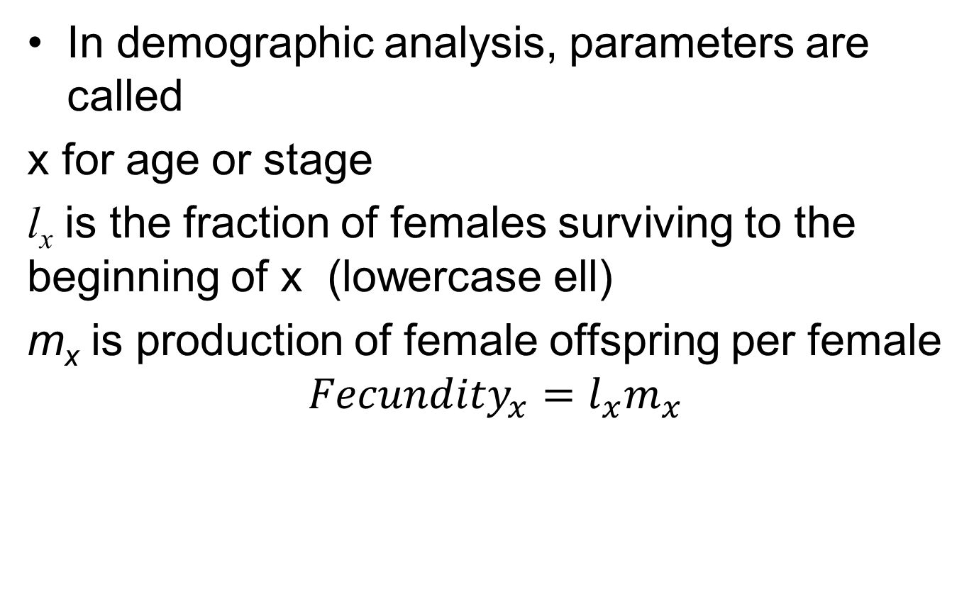
Demographic terminology
In demographic analysis, parameters are called
x for age or stage
l_{x} is the fraction of females surviving to the beginning of x (lowercase ell)
m_{x} is production of female offspring per female
$$Fecundity_{x}=l_{x}m_{x}$$
Neal book, chapter 7

Slide 10
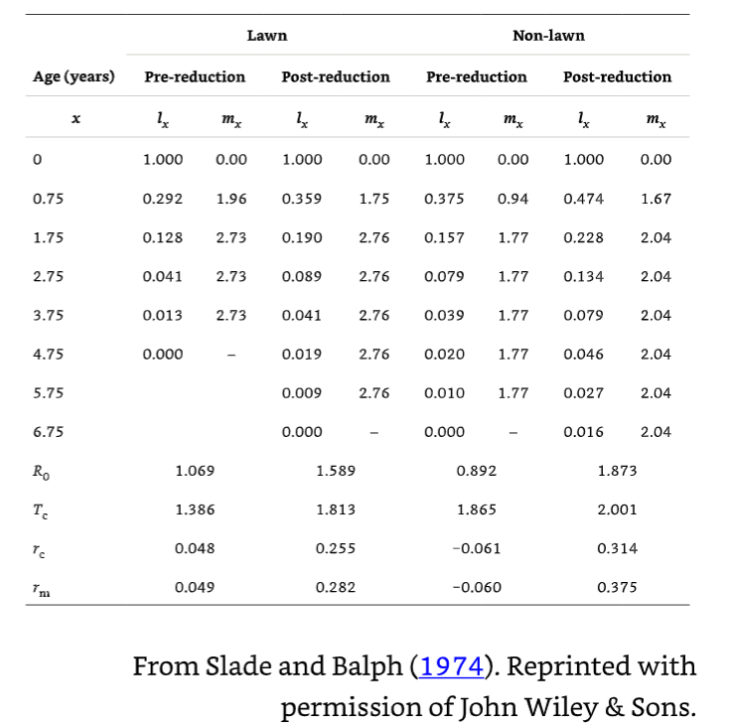
Ground squirrel example
l_{x}= survival m_{x}=fecundity
Neal book, chapter 7

Slide 11
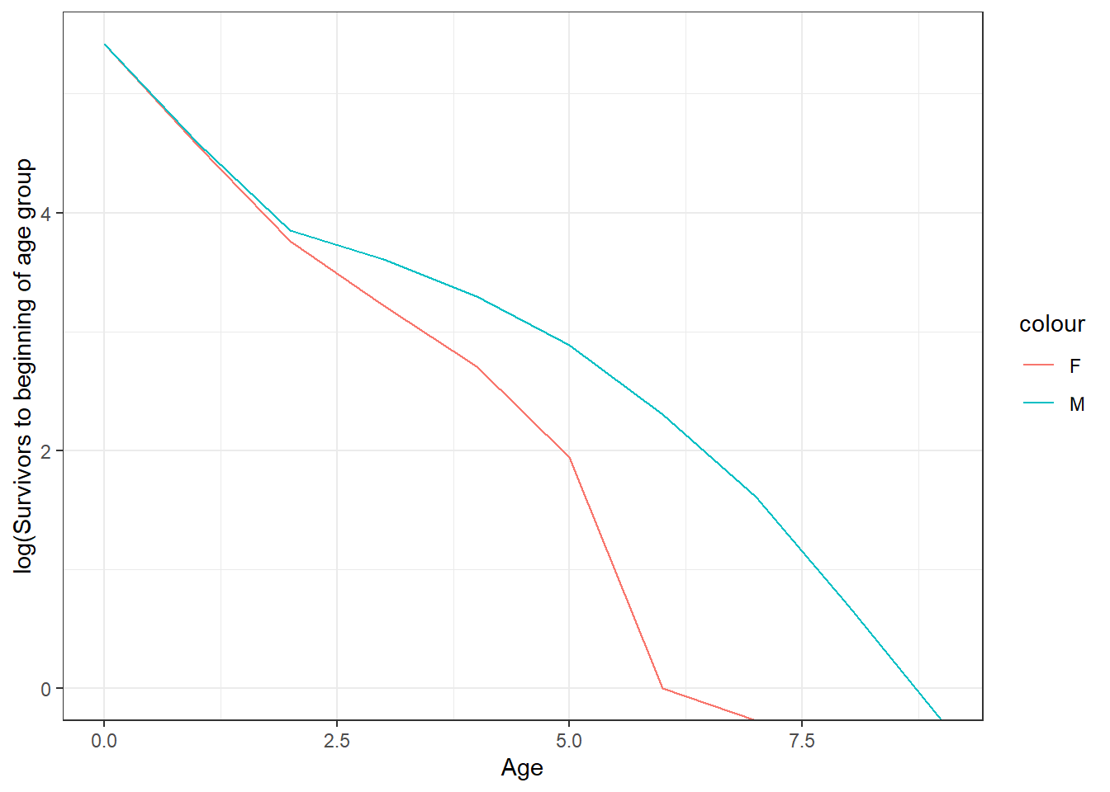
Squirrels

Slide 12
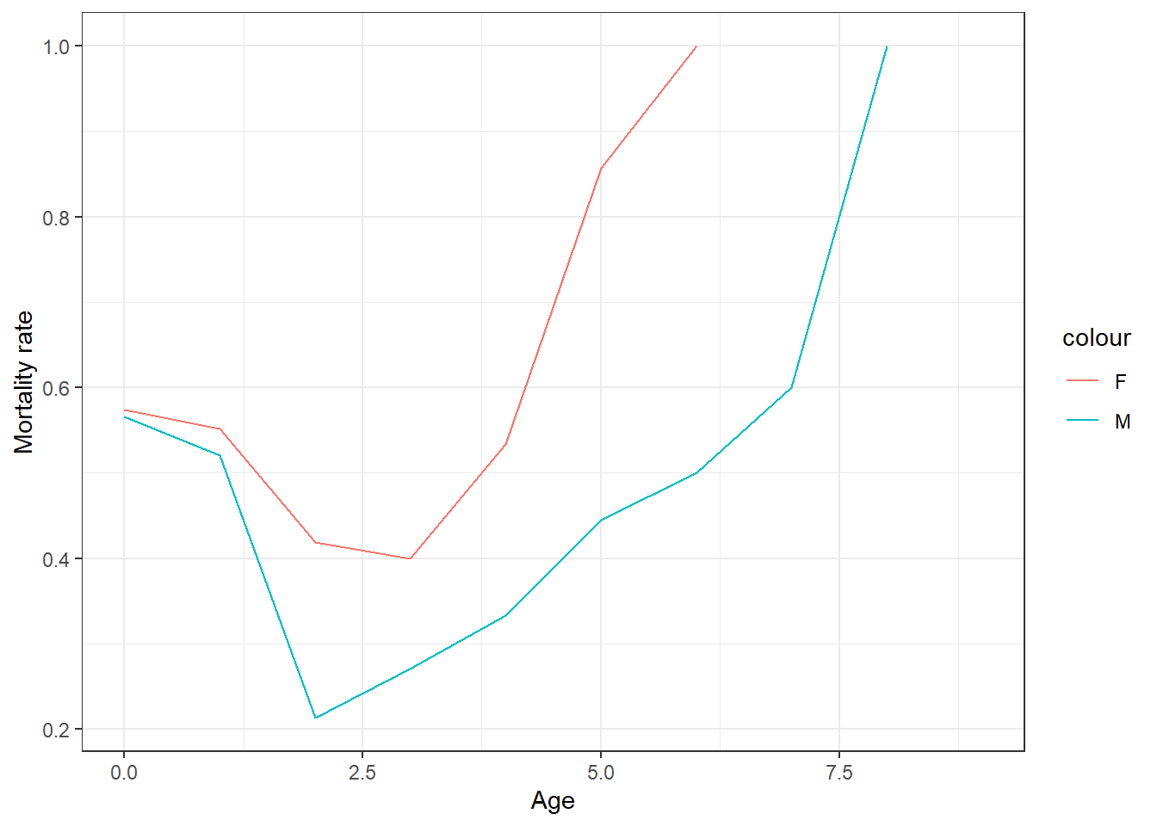
Squirrel mortality rate

Slide 13
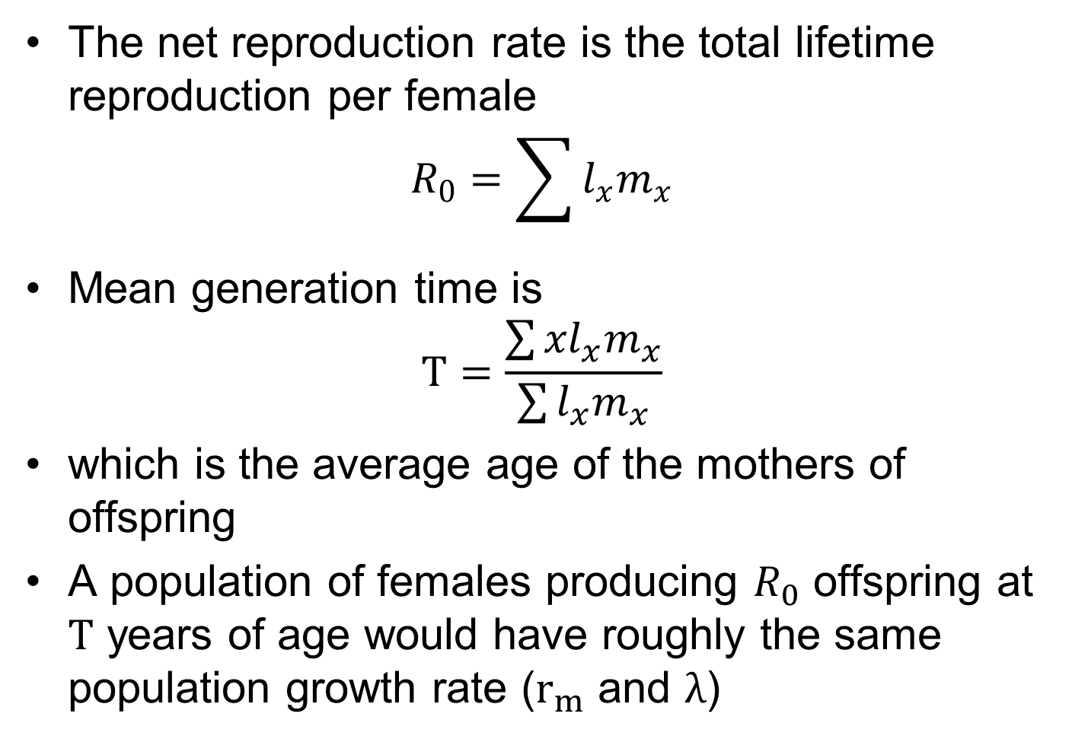
Population growth parameters
The net reproduction rate is the total lifetime reproduction per female
$$R_{0}=\sum{l_{x}m_{x}}$$
Mean generation time is
$$T=\frac{\sum{{xl}_{x}m_{x}}}{\sum{l_{x}m_{x}}}$$
which is the average age of the mothers of offspring
A population of females producing $R_{0}$ offspring at $T$ years of age would have roughly the same population growth rate ($r_{m}$ and $λ$)
Neal book, chapter 7

Slide 14

How to calculate $r_{m}$ and $λ$
Euler-Lotka equation
Leslie matrix methods
Neal book, chapter 7

Slide 15
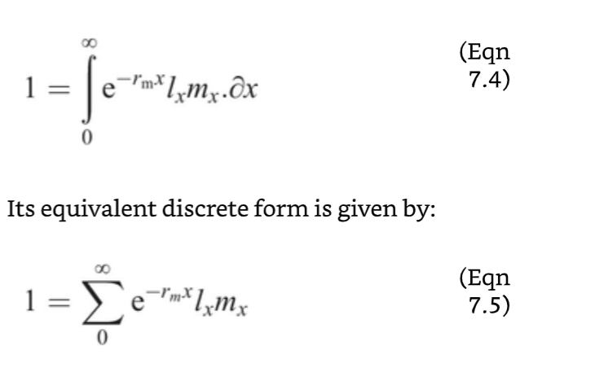
Euler-Lotka method
Use function minimizer to estimate
Neal book, chapter 7

Slide 16
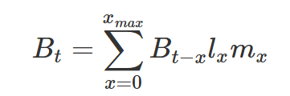
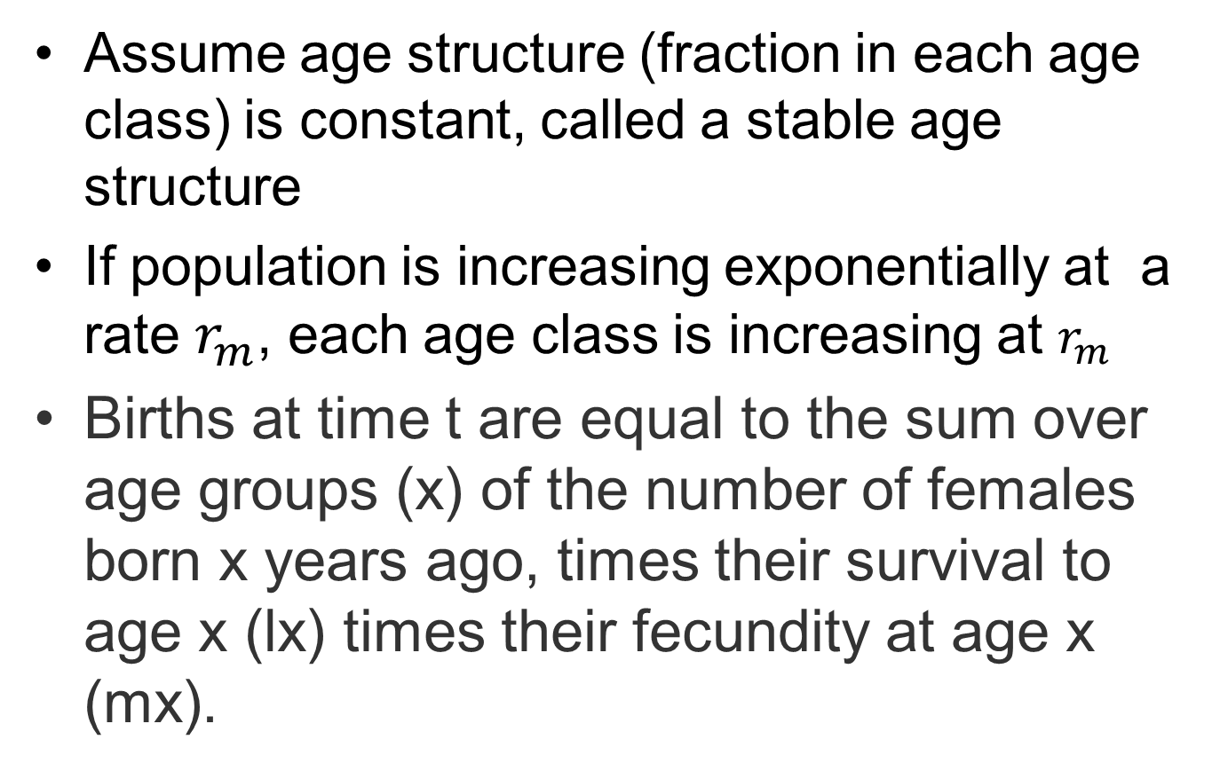
Euler-Lotka assumption
Assume age structure (fraction in each age class) is constant, called a stable age structure
If population is increasing exponentially at a rate $r_{m}$, each age class is increasing at $r_{m}$
Births at time t are equal to the sum over age groups (x) of the number of females born x years ago, times their survival to age x (lx) times their fecundity at age x (mx).
Neal book, chapter 7

Slide 17
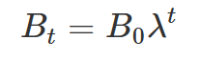

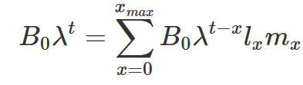

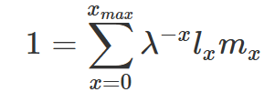
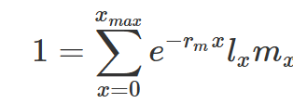
Euler equation
And population is growing (or declining) at rate
So births are
Substituting
cancels out, leaving
Or equivalently
Solve numerically for rm
Neal book, chapter 7

Slide 18
Euler-Lotka interpretation
is a female’s lifetime reproduction discounted by the fact that ones born later contribute less to population growth
This must equal 1 to maintain a stable age structure

Slide 19

Squirrel example
r_{m}=0.0488
Similar to what you would get from
r_{c}=0.0482
Neal book, chapter 7

Slide 20
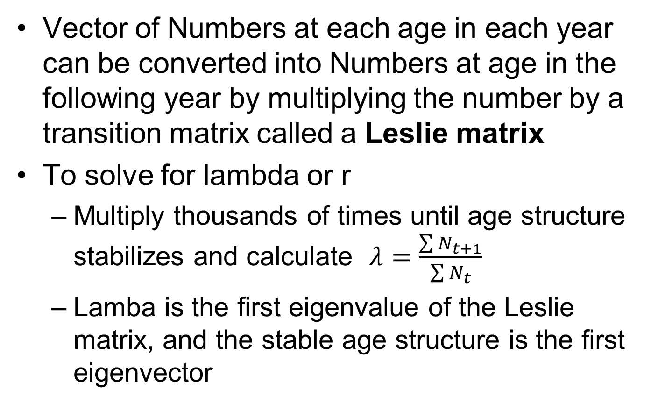
Matrix methods
Vector of Numbers at each age in each year can be converted into Numbers at age in the following year by multiplying the number by a transition matrix called a Leslie matrix
To solve for lambda or r
Multiply thousands of times until age structure stabilizes and calculate $λ=\frac{\sum{N_{t+1}}}{\sum{N_{t}}}$
Lamba is the first eigenvalue of the Leslie matrix, and the stable age structure is the first eigenvector
Neal book, chapter 7

Slide 21
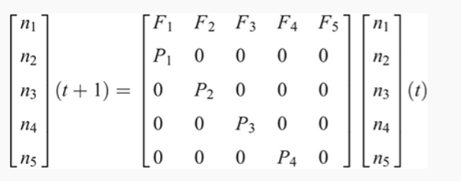
Squirrel example
Must have equal-duration (annual) time steps.
Leslie matrix has fecundity at each age in top row and probability of survival from age t to t+1 one below the diagonal
Neal book, chapter 7

Slide 22
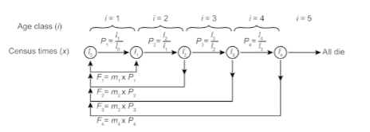
Timing of census
In squirrel example, the animals are counted when the pubs are born. So the pups are all alive, but the females have had one year of mortality since their last census.
Different census timing would change the calculations

Slide 23
Squirrel example
F₁ is fecundity of age 1 times survival to age 1
F₁ is fecundity of age 2 times survival to age 2 from age 1
P₁ is survival from age 1 to age 2
Neal book, chapter 7

Slide 24
Leslie matrix
 | [,1] | [,2] | [,3] | [,4] | [,5]
[1,] | 0.572 | 1.197 | 0.874 | 0.866 | 0
[2,] | 0.292 | 0 | 0 | 0 | 0
[3,] | 0 | 0.438 | 0 | 0 | 0
[4,] | 0 | 0 | 0.320 | 0 | 0
[5,] | 0 | 0 | 0 | 0.317 | 0

Slide 25
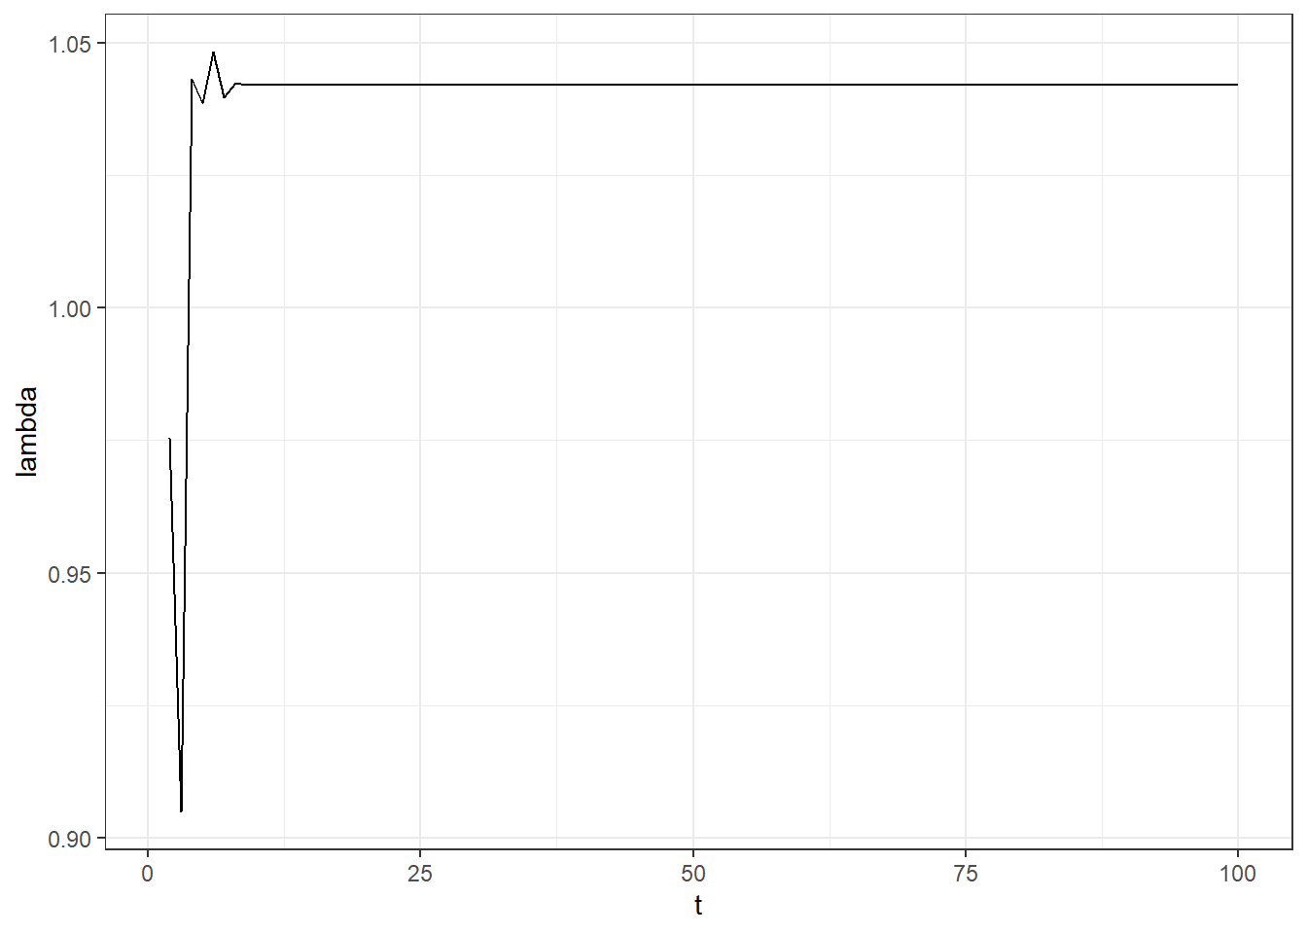
Results from Leslie matrix multiplied over time
Lambda=0.042. rm=0.041
Note that the Euler-Lotka method would be identical if the timing of
events was the same

Slide 26
Elasticity analysis
Elasticity is how much lambda changes for a given change in a cell in the Leslie matrix
Ages or parameters with higher elasticity are more influential on population growth, so are more important for conservation actions
Often protecting older females from mortality is more important than protecting juveniles, because of their high fecundity
Elasticity can be calculated with matrix algebra
Elasticities are additive, so you can calculate the total elasticity of a life stage (Juvenile, adult, etc.)

Slide 27



Elasticity calculations
Elasticity is change in proportional change lambda with change in a cell in the Leslie matrix (A)
Elasticity=
From sensitivity matrix
w is the stable age distribution = right eigenvector of A, scaled to sum to 1
v is the age specific mortality vector = left eigenvector of A (eigenvector of transpose), scaled so first value is 1
The inner product is the sum of w1*v1+w1*v2, etc.
Heppell 2007

Slide 28
Elasticity for squirrels
 | [,1] | [,2] | [,3] | [,4] | [,5]
[1,] | 0.34 | 0.20 | 0.06 | 0.02 | 0
[2,] | 0.28 | 0 | 0 | 0 | 0
[3,] | 0 | 0.08 | 0 | 0 | 0
[4,] | 0 | 0 | 0.02 | 0 | 0
[5,] | 0 | 0 | 0 | 0 | 0
Read as proportional change in lambda with proportional change in the cell of the Leslie matrix.
E.g. 10% change in probability of surviving to age 1 and reproducing is a 3.4% change in lambda

Slide 29
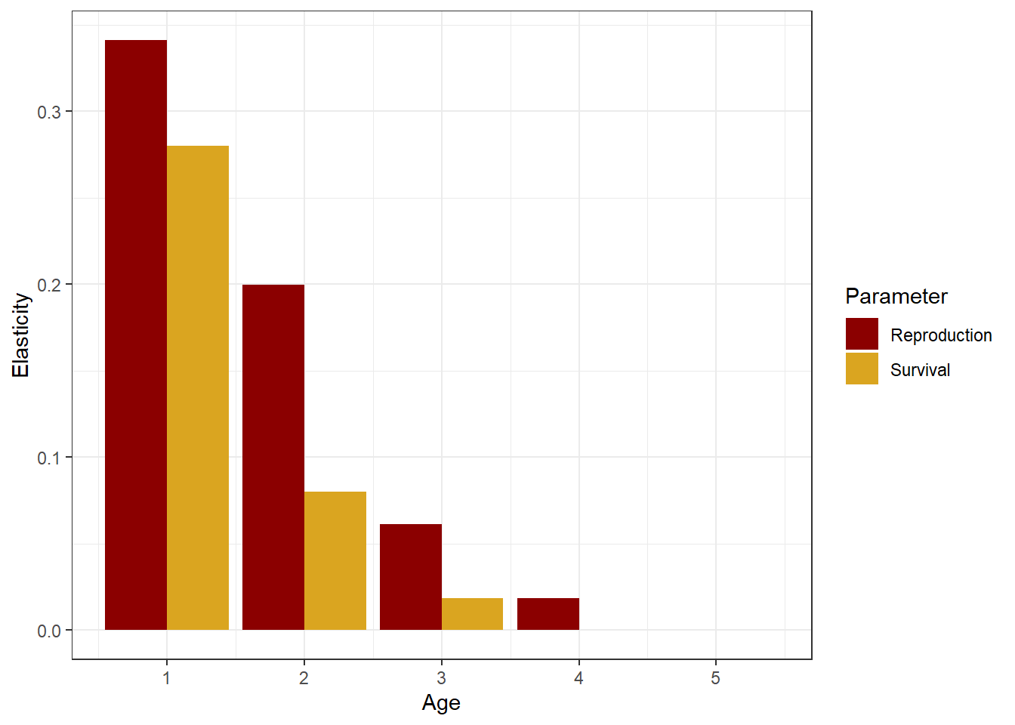
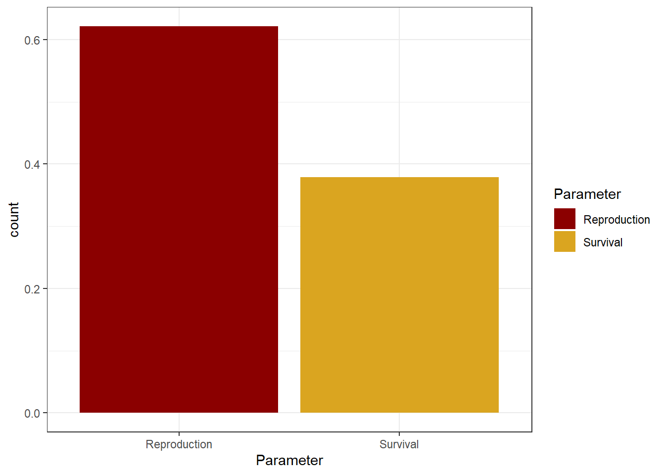
Elasticity summaries
Young animals are more important
For every age, reproduction matters more than survival

Slide 30
Adding uncertainty and variability
Estimates of lx and mx are not known without error
They are often calculated from models fitted to data for maturity at size, etc.
Can add uncertainty to the estimates and get confidence intervals.

Slide 31
Monte Carlo simulation
Define all the relevant parameters with a statistical distribution
Draw random values from each distribution
Recalculate lambda, R0, etc.
Calculate mean, sd, quantiles to get confidence intervals

Slide 32
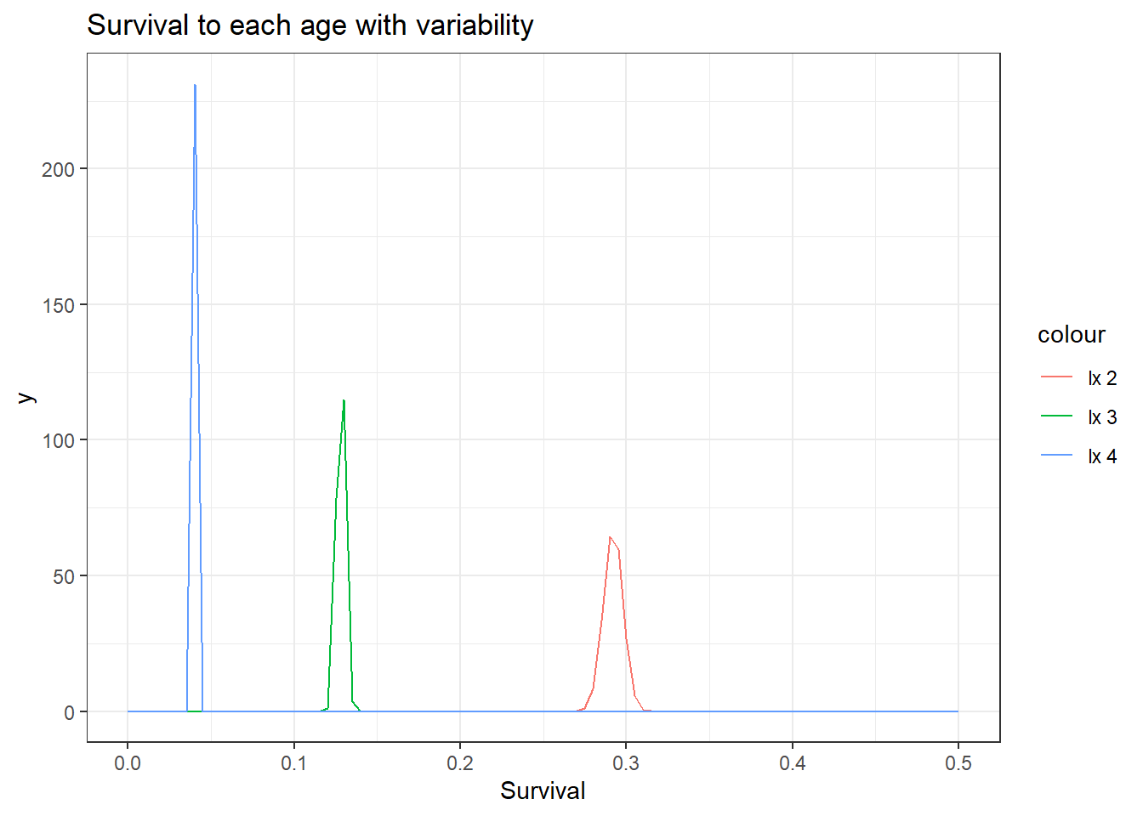
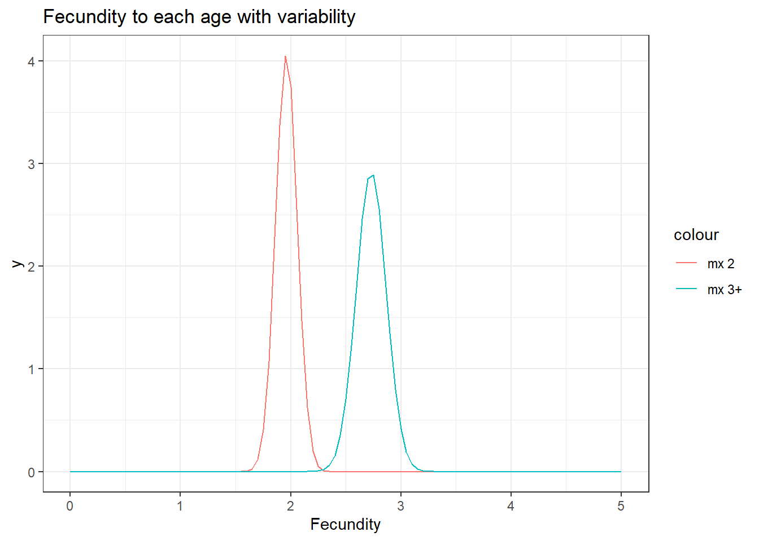
Distributions

Slide 33
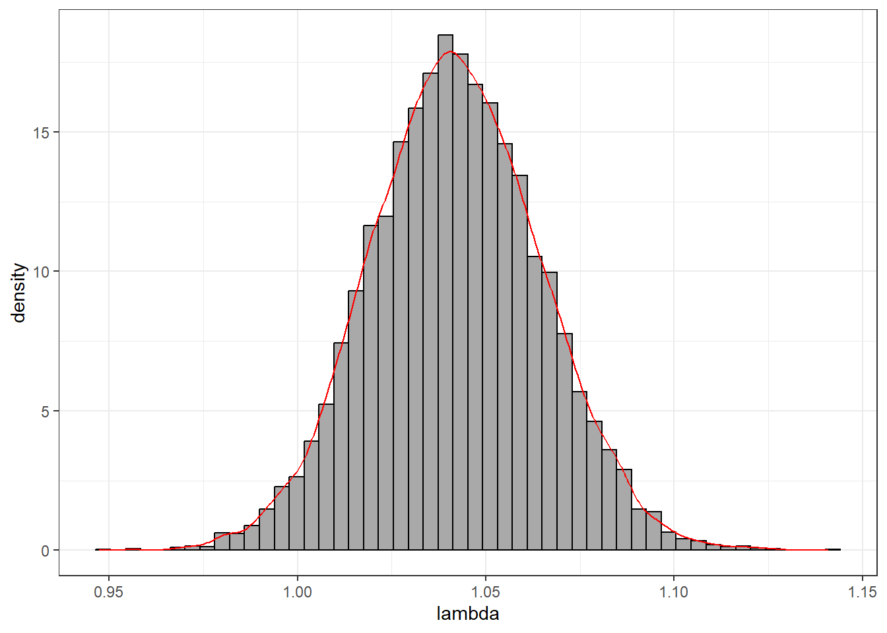
Squirrel example
Add a CV of 0.02 to all lx values, and 0.05 to mx values, with normal error
Results, 95% confidence interval of lambda is 0.95 to 1.14.

Slide 34
Effect of density-dependence
In logistic growth models rm is the growth at low population size.
Lambda and r_{m} calculated from demographic methods is the value at the population level when the survival and fecundity rates were calculated.
If population is currently at half of K, then the calculated r could be half of rm if logistic model is right

Slide 35
Density dependence
Logistic
Demographic exponential growth
Demographic: no density dependence, so demographic r would be same as logistic r if the population was low when the fecundity, etc. were estimated
If the population was at MSY demographic r should be increased by a factor of about 2.
Mcallister et al. 2002

Slide 36
References
Cortes, 2002. ​Incorporating Uncertainty into Demographic Modeling: Application to Shark Populations and Their Conservation
Cortes, 2012. Perspectives on the intrinsic rate of population growth
McAllister, et al. 2001. ​Using demographic methods to construct Bayesian priors for the intrinsic rate of increase in the Schaefer model and implications for stock rebuilding
Heppell. 2007. Elasticity analysis of green sturgeon life history

