Slide 1

Scientific surveys for animal abundance
Elizabeth A. Babcock

Slide 2
Data for trends in animal abundance from best to worst
scientific surveys
standardized indices from fishery catch rates or other opportunistic data
Unstandardized mean catch rate

Slide 3
Surveys
Standardized gear/methods means that the trend is not biased by changes in catchability/detection probability related to methods
However, often have relatively low sample size

Slide 4
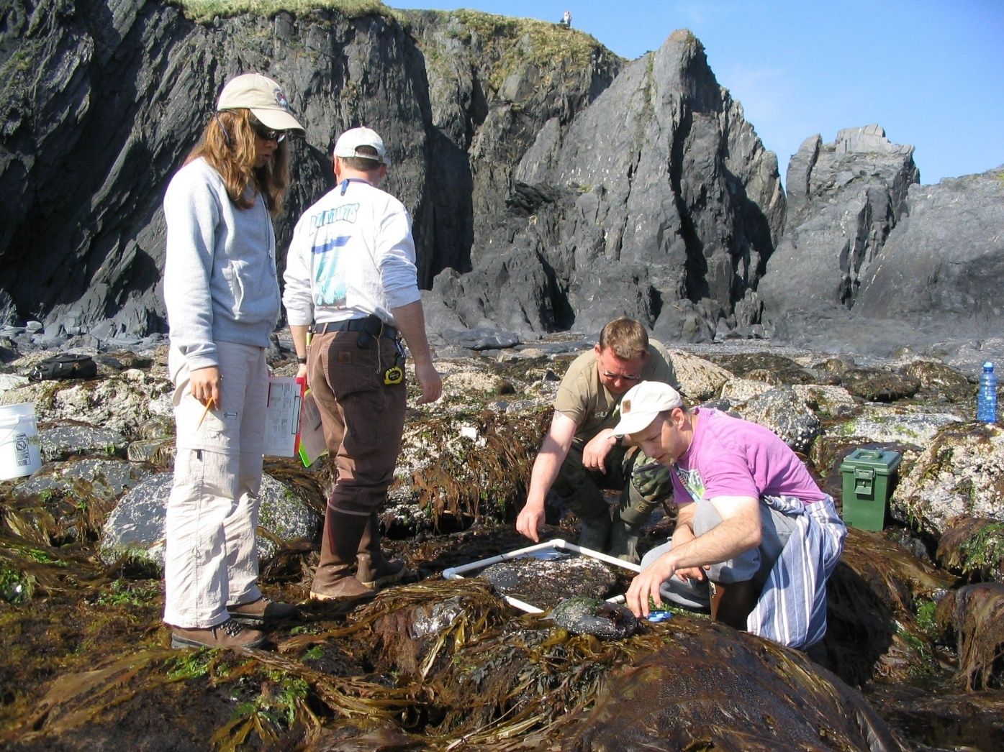
Quadrats
Photo, video, or counted in situ
Dr. Bradley Stevens University of Maryland Eastern Shore

Slide 5
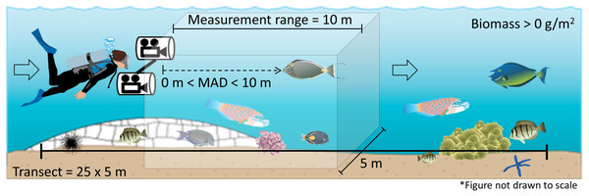
Visual Transect
Photo, video, or counted in situ
https://peerj.com/articles/9246/

Slide 6
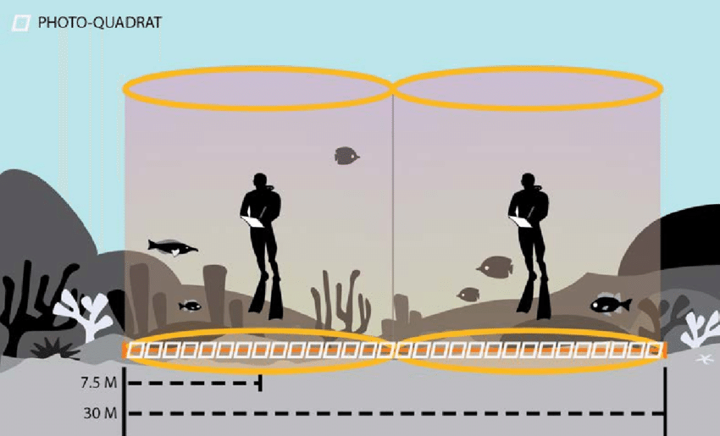
Stationary point count
https://www.researchgate.net/publication/312328092_Pacific_Reef_Assessment_and_Monitoring_Program_Data_Report_Ecological_monitoring_2016_-_reef_fishes_and_benthic_habitats_of_the_main_Hawaiian_Islands_Northwestern_Hawaiian_Islands_Pacific_Remote_Islan

Slide 7
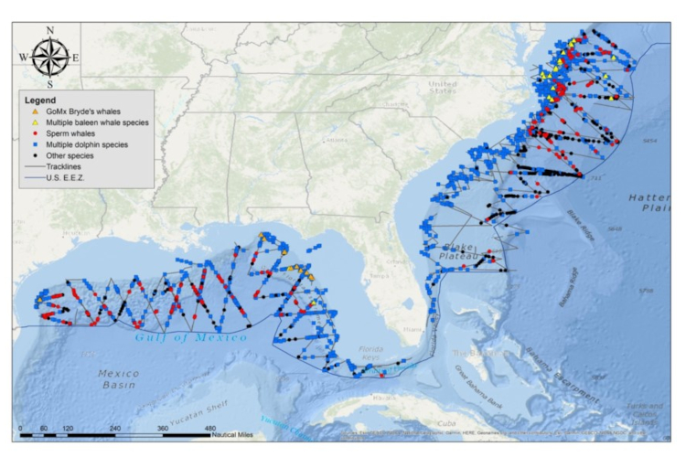
Boat-based visual surveys
https://www.fisheries.noaa.gov/southeast/population-assessments/marine-mammal-research-surveys-noaas-southeast-region

Slide 8
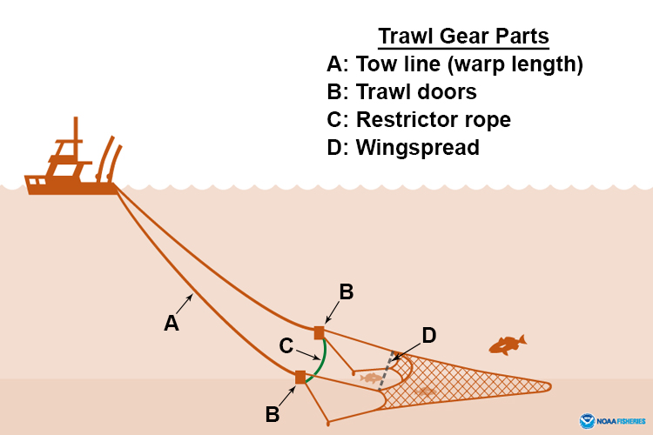
Trawl survey

Slide 9
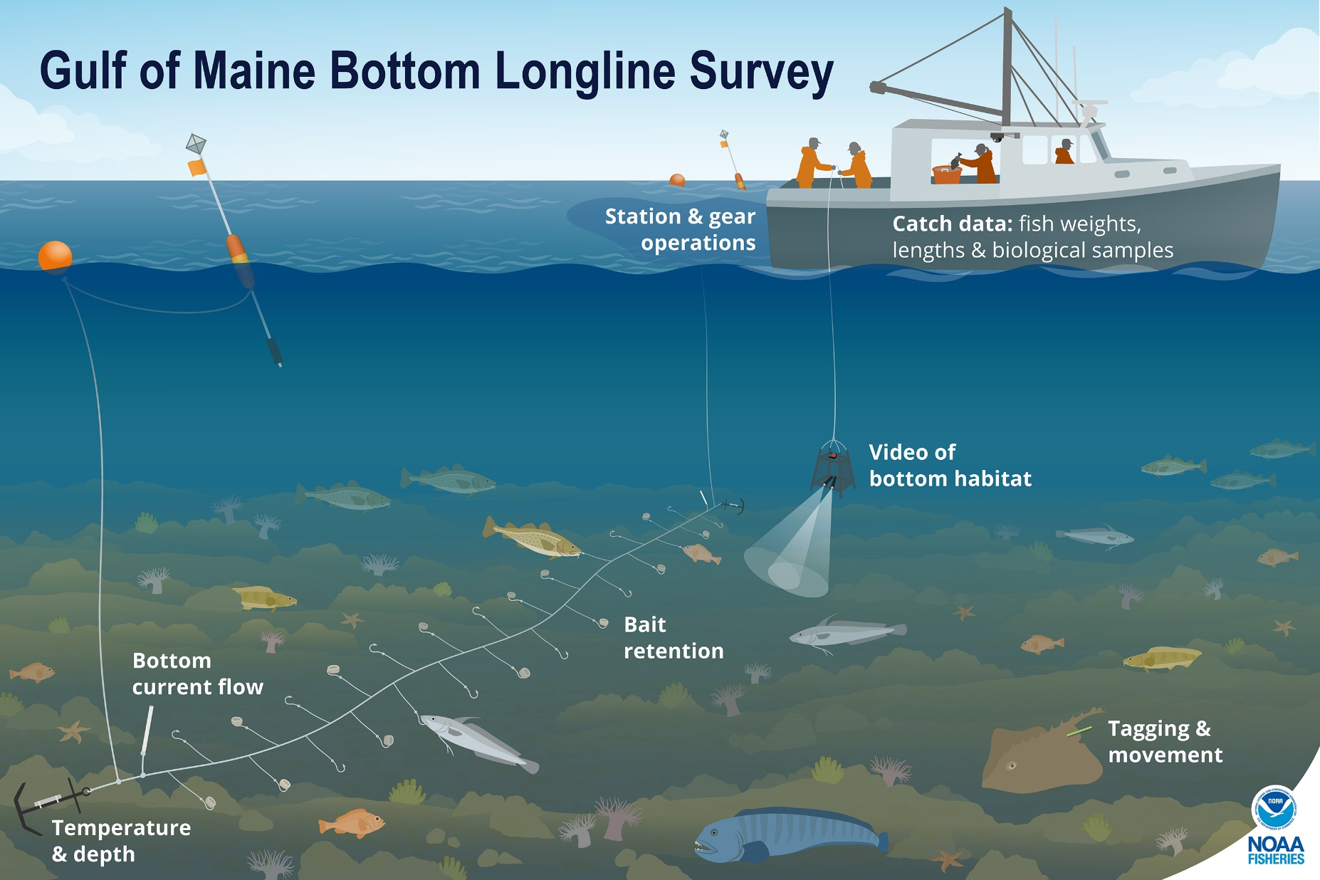
Longline survey

Slide 10
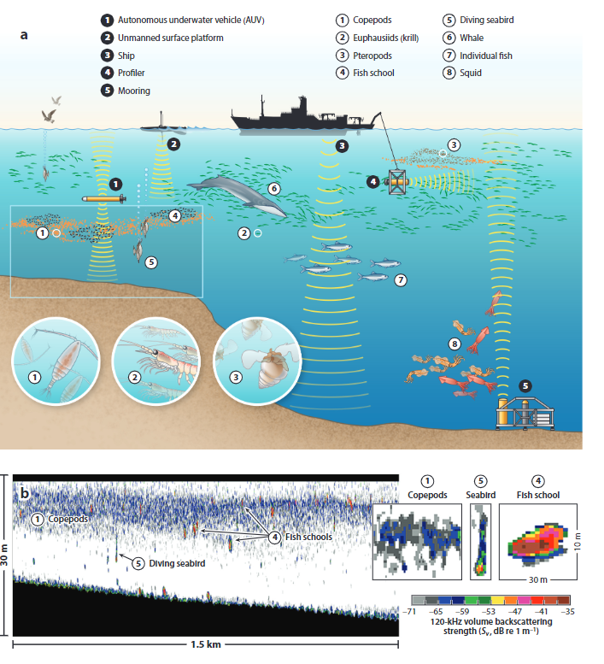
Acoustic surveys
https://www.fisheries.noaa.gov/science-blog/all-out-acoustics

Slide 11
Types of surveys
Area swept methods
Transects, quadrats, stationary point counts,
Area sampled is known, can calculate
density =number / area
trawl surveys, beach seines, etc. area can be calculated approximately
Boat-based or aerial surveys may record distance from transect line and use distance-sampling methods to get density

Slide 12
Types of surveys
Relative abundance methods
Baited hooks, baited remote underwater video, gillnets, traps
Area of attraction is not known, so can’t calculate density
Acoustics.
Require models to interpret the backscatter, groundtruthing to verify species composition, etc.

Slide 13
NOAA surveys
https://www.fisheries.noaa.gov/national/science-data/research-surveys

Slide 14
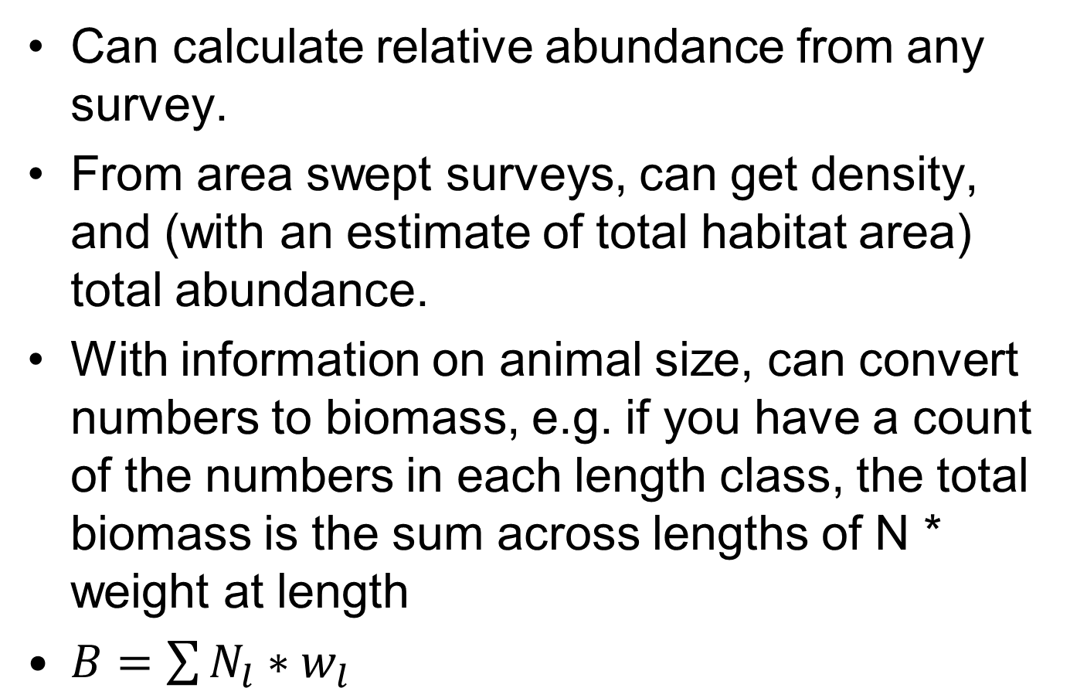
Using surveys to estimate animal abundance
Can calculate relative abundance from any survey.
From area swept surveys, can get density, and (with an estimate of total habitat area) total abundance.
With information on animal size, can convert numbers to biomass, e.g. if you have a count of the numbers in each length class, the total biomass is the sum across lengths of N * weight at length
$B=\sum{N_{l}∗w_{l}}$

Slide 15
Survey design
Surveys generally involve randomness and must involve replication, to achieve a representative sample of the population
Spatial and temporal heterogeneity must be covered by sampling effort
Potential bias if, for example, the sampling frame of the survey doesn’t include the whole range of the population, especially if population moves due to climate change, or seasonal movements
Detection probability is assumed to be either constant or modeled correctly
e.g. for species composition, assume all equally likely to be detected.

Slide 16
Potential bias: animal behavior
Fish may avoid or be attracted to divers
Fish may be herded into trawl nets, or escape from them
Schooling fish are more visible than cryptic benthic fish
Time of day: Diel vertical migration or migration from reefs/mangroves to seagrass

Slide 17
Survey Designs
Random Sampling
Every site has equal opportunity to be chosen.
Systematic Sampling
e.g. evenly spaced transects along a coast
Repeated measurements at fixed sites
Good for estimating trends, but not spatial patterns
Stratified Random Sampling.
Divide region into strata with similar habitat, etc, and focus sampling in areas with more variability or more abundance.
Adaptive sampling, cluster sampling, and other complex designs

Slide 18
Methods for analyzing survey data
Design-based methods
Statistical methods to calculate numbers or density directly from data, with variance estimators
Model-based methods
Fit a generalized linear model and use the model to estimate mean density
Allow estimation of detection probability, incorporating variables, etc.
We will get to this with fisheries CPUE data
Distance sampling, etc. used design-based estimates with estimate detection probability

Slide 19
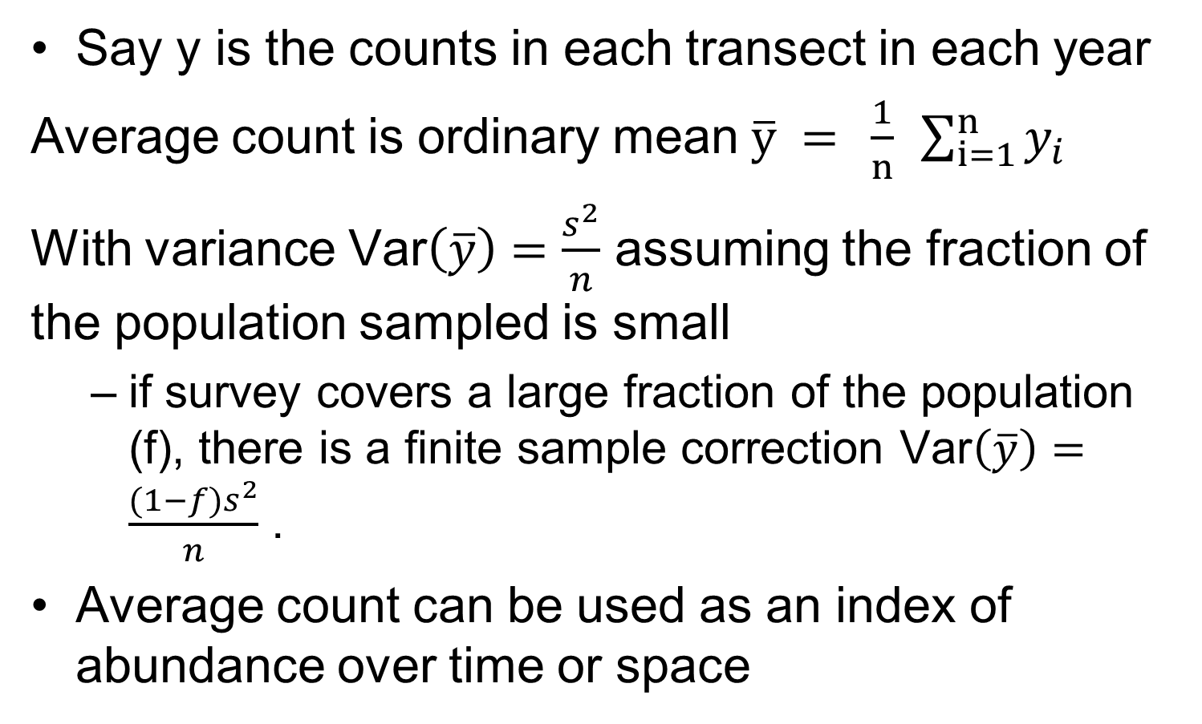
Design-based estimate for simple random sample
Say y is the counts in each transect in each year
Average count is ordinary mean $\overline{y} = \frac{1}{n} \sum_{i=1}^{n}{y_{i}}$
With variance $\text{Var}\left(\overline{y}\right)=\frac{s^{2}}{n}$ assuming the fraction of the population sampled is small
if survey covers a large fraction of the population (f), there is a finite sample correction $\text{Var}\left(\overline{y}\right)=\frac{{(1−f)s}^{2}}{n}$ .
Average count can be used as an index of abundance over time or space
Rao 2000

Slide 20
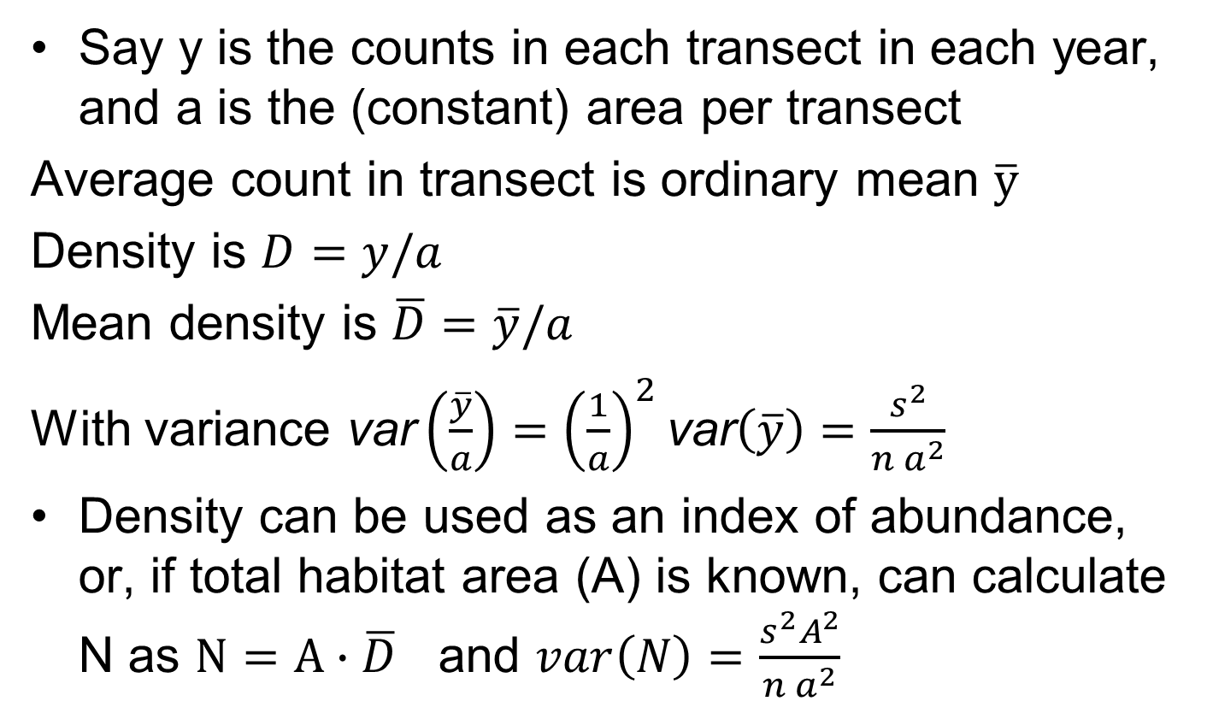
Design-based estimates for simple random sample, area swept
Say y is the counts in each transect in each year, and a is the (constant) area per transect
Average count in transect is ordinary mean $\overline{y}$
Density is $D=y/a$
Mean density is $\overline{D}=\overline{y}/a$
With variance $\text{var}\left(\frac{\overline{y}}{a}\right)={\left(\frac{1}{a}\right)}^{2}\text{var}\left(\overline{y}\right)=\frac{s^{2}}{{n a}^{2}}$
Density can be used as an index of abundance, or, if total habitat area (A) is known, can calculate N as $N=A∙\overline{D}$ and $var\left(N\right)=$ $\frac{s^{2}A^{2}}{{n a}^{2}}$

Slide 21
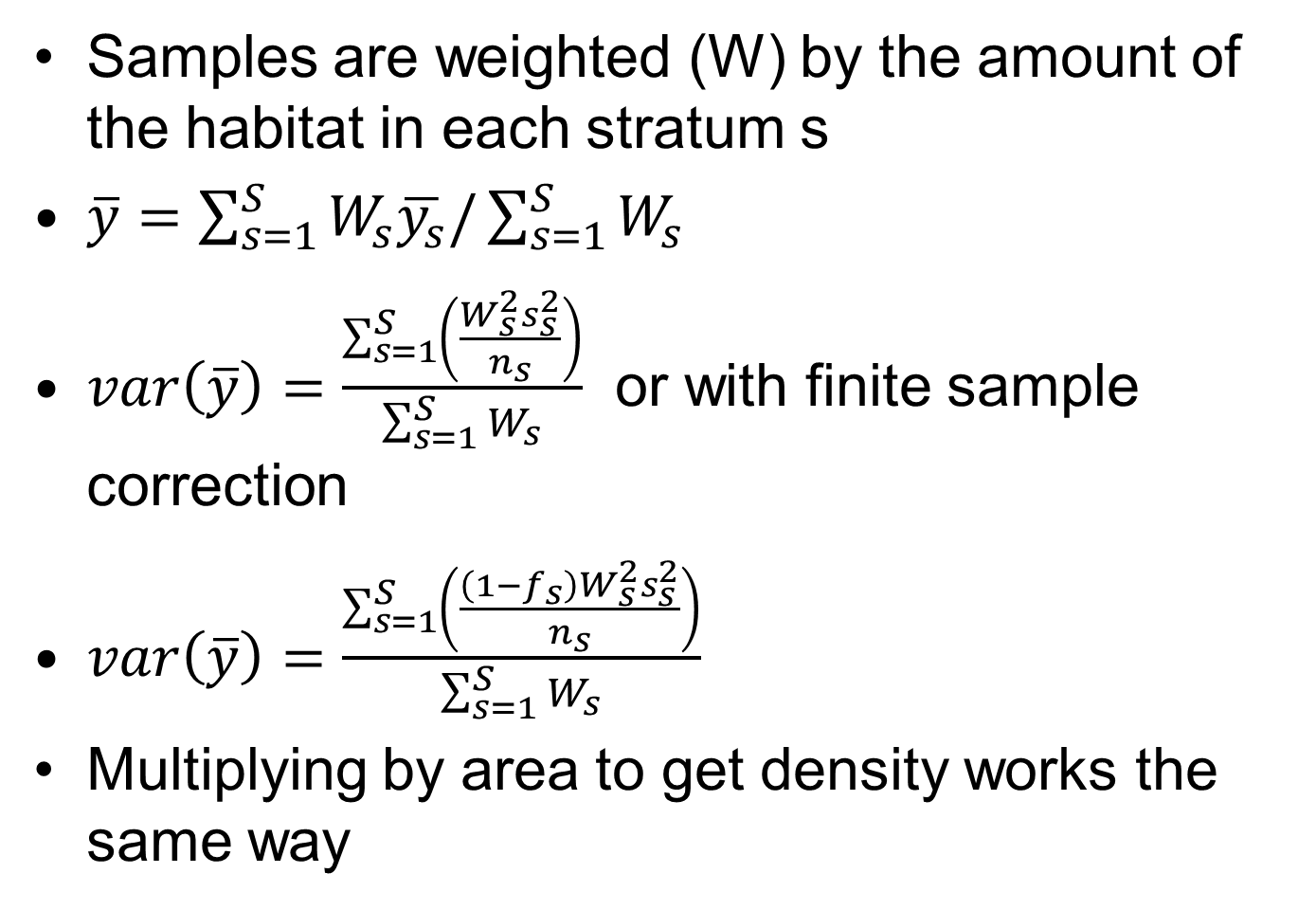
Stratified random sample
Samples are weighted (W) by the amount of the habitat in each stratum s
$\overline{y}=\sum_{s=1}^{S}{W_{s}\overline{y_{s}}/\sum_{s=1}^{S}{W_{s}}}$
$var\left(\overline{y}\right)=\frac{\sum_{s=1}^{S}{\left(\frac{W_{s}^{2}s_{s}^{2}}{n_{s}}\right)}}{\sum_{s=1}^{S}{W_{s}}}$ or with finite sample correction
$var\left(\overline{y}\right)=\frac{\sum_{s=1}^{S}{\left(\frac{\left(1−f_{s}\right)W_{s}^{2}s_{s}^{2}}{n_{s}}\right)}}{\sum_{s=1}^{S}{W_{s}}}$
Multiplying by area to get density works the same way

Slide 22
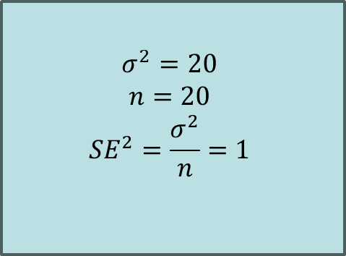



Stratified sample allocation by variance
$$σ^{2}=10$$
$$n=10$$
$$SE^{2}=\frac{σ^{2}}{n}=1$$
$$σ^{2}=20$$
$$n=20$$
$$SE^{2}=\frac{σ^{2}}{n}=1$$
$$σ^{2}=30$$
$$n=30$$
$$SE^{2}=\frac{σ^{2}}{n}=1$$
$$σ^{2}=10$$
$$n=10$$
$$SE^{2}=\frac{σ^{2}}{n}=1$$
Sampling proportional to variance makes standard error similar in each stratum, reduces overall variance of N estimate

Slide 23
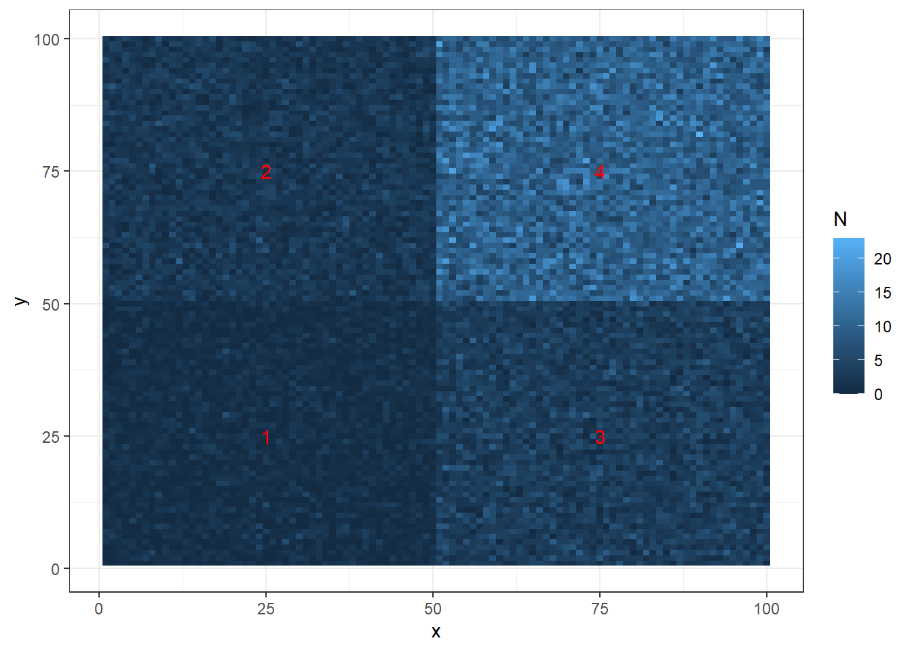
Simulated example (100 x 100 units) Poisson numbers

Slide 24

Random sample (n)

Slide 25
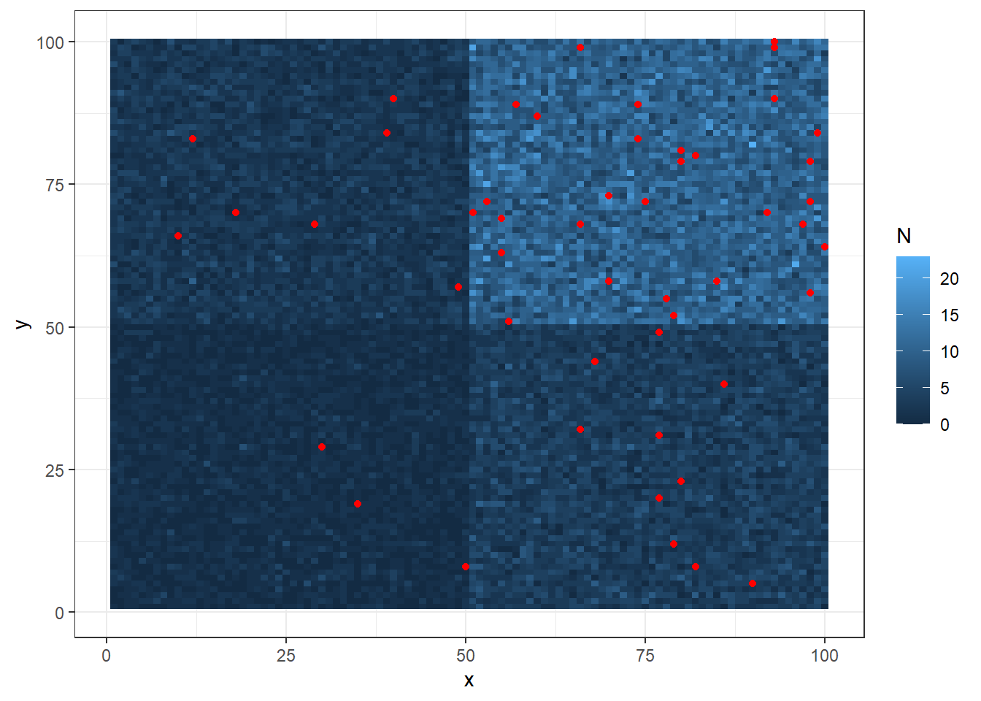
Stratified sample, n=c(3,7,10,30)

Slide 26
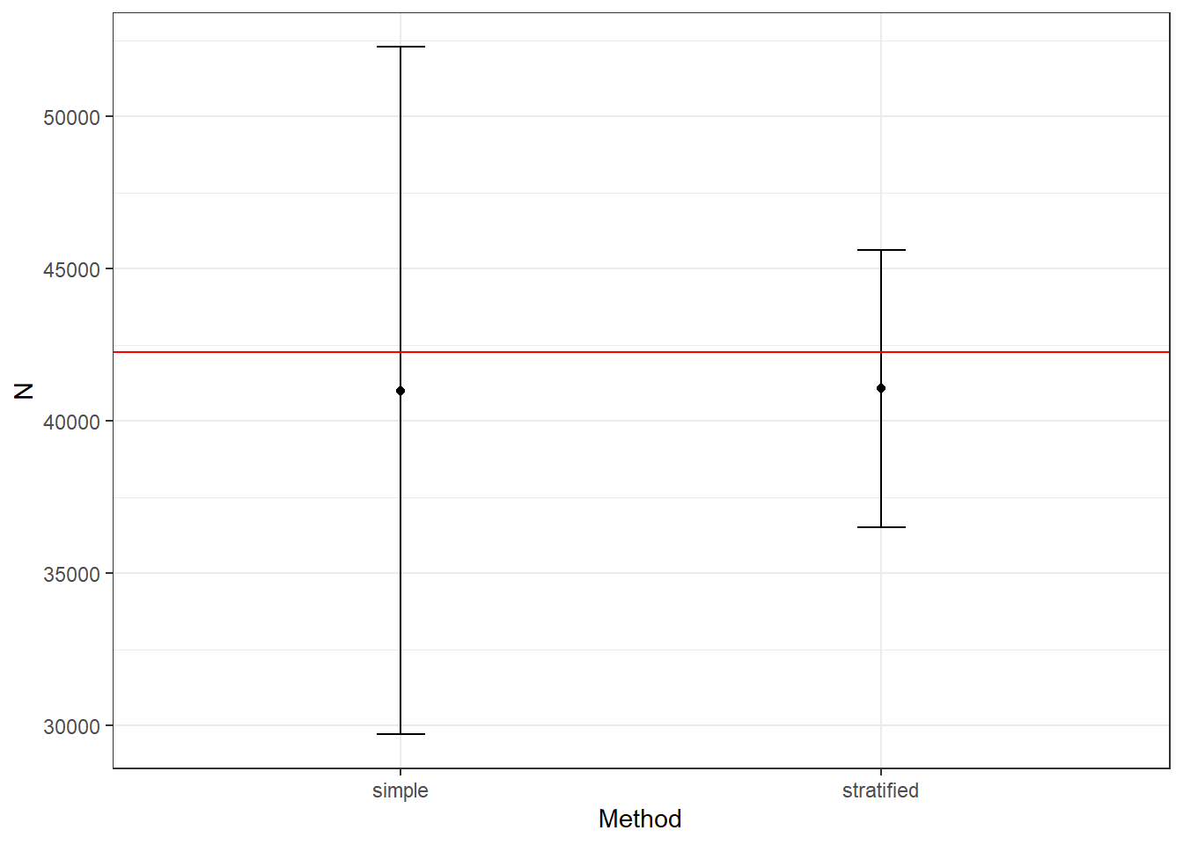
Simple vs. stratified estimate
Both are accurate, but the stratified version is more precise

Slide 27
Example
2006 NMFS trawl survey data for Georges Bank (GB) yellow tail flounder (YTF)
All tows are 0.01 n.mi²
Tow data : GB_YTF_2006_Tows.csv
Stratum, tow #, # fish, total weight, season
strata.csv contains area (n.mi² ) for each spatial stratum
Keep spring and fall surveys separate
From Brad Stevens, UMES

Slide 28
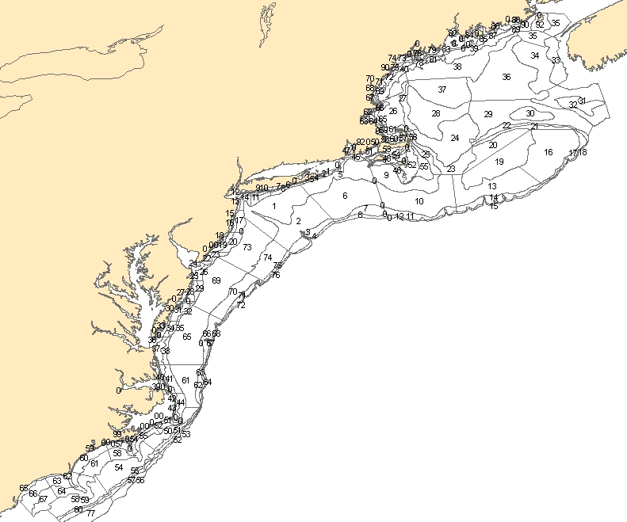
Georges Bank
NMFS Survey Strata

Slide 29
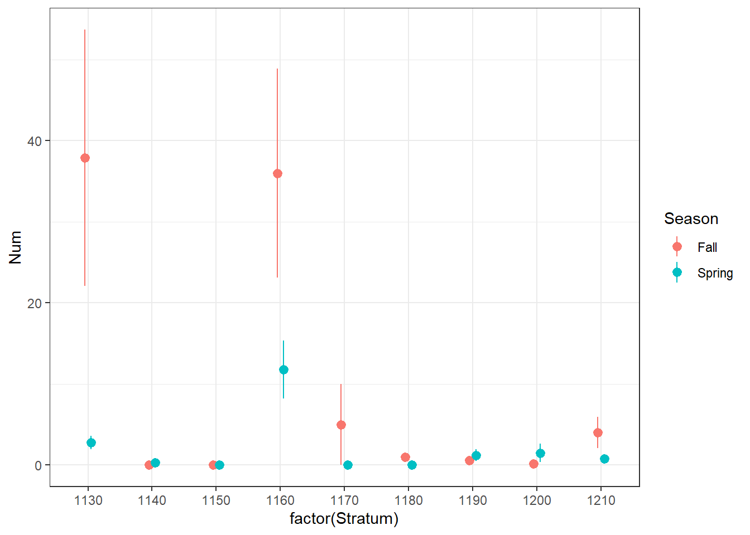
Mean with SE

Slide 30
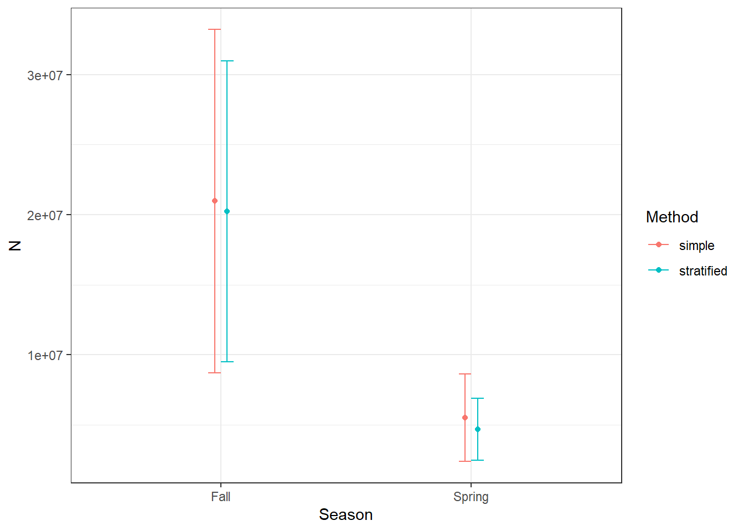
Total N estimates
Simple random and stratified estimates gave similar results
How to deal with strata with no data?
pool strata (e.g. combine across years)
model-based methods

Slide 31
Example 2: Shark bottom longline
This is raw data, not yet cleaned
Catch data includes data on individual sharks caught
Station data has information on sampling stations
Correct sample unit is the individual stations. Need to use the catch data to summarize number of each species caught without losing the zeros.

Slide 32
Data cleaning
Count the number of each species in each station/date/cruise in “catch”
Left_join station with catch on station/date/cruise
Fill in zeros for stations with no catch of each species
Analyze catches per station/date/cruise

Slide 33
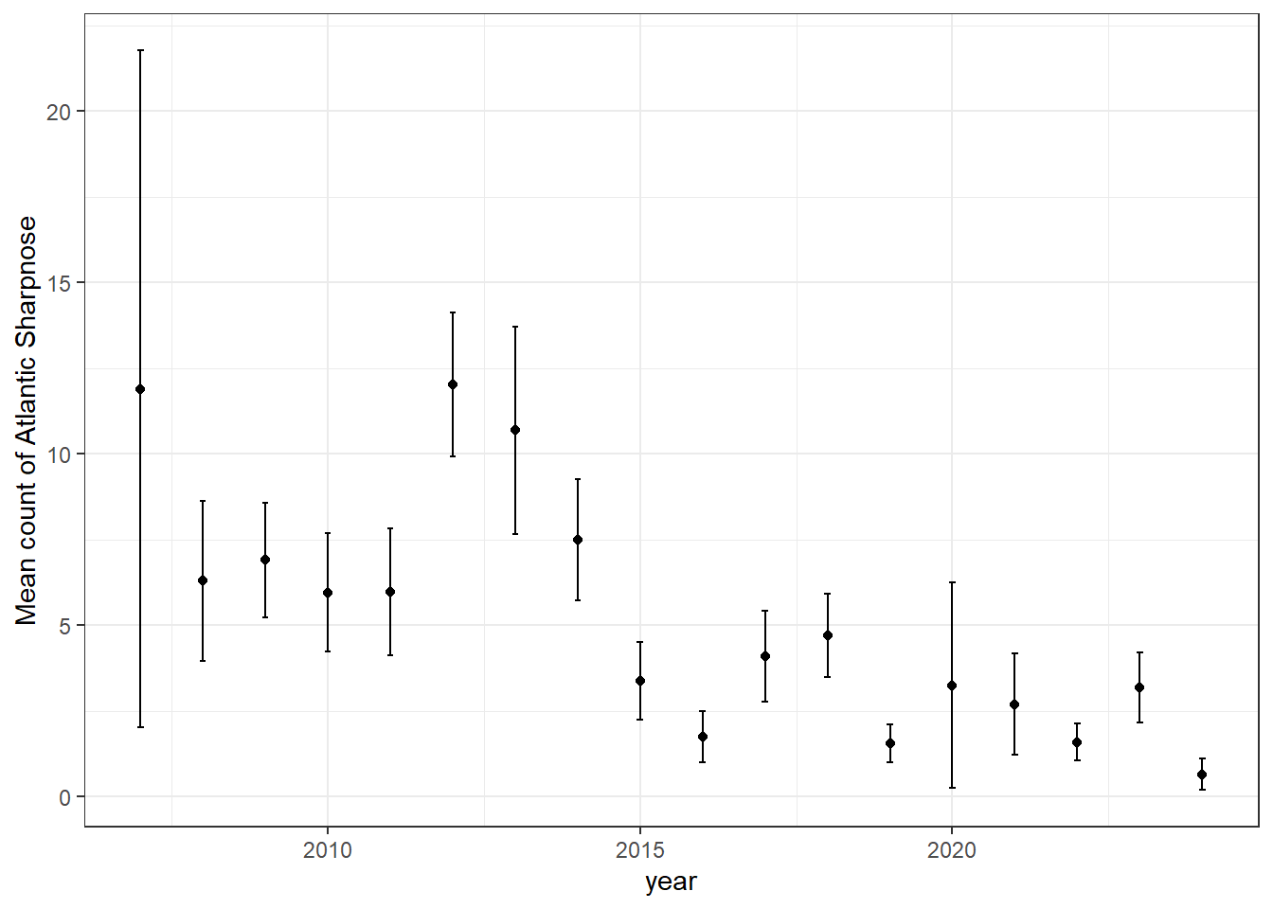
Atlantic sharpnose

Slide 34
Distance sampling
For visual transects, record distance from observer to animal,
Probability of detection decreases with distance
Adjust sampling area for detection distance
Examples from Distance library in R
https://distancesampling.org/Distance/articles/lines-distill.html
https://distancesampling.org/Distance/articles/web-only/points/pointtransects-distill.html

Slide 35

Line transect distance sampling
Observer travels a certain distance L, records animals observed and
Right angle distance from animal sighted to observer (y)
Calculate detection probability (p) as a function of distance from line, and use to adjust number caught
y
L

Slide 36
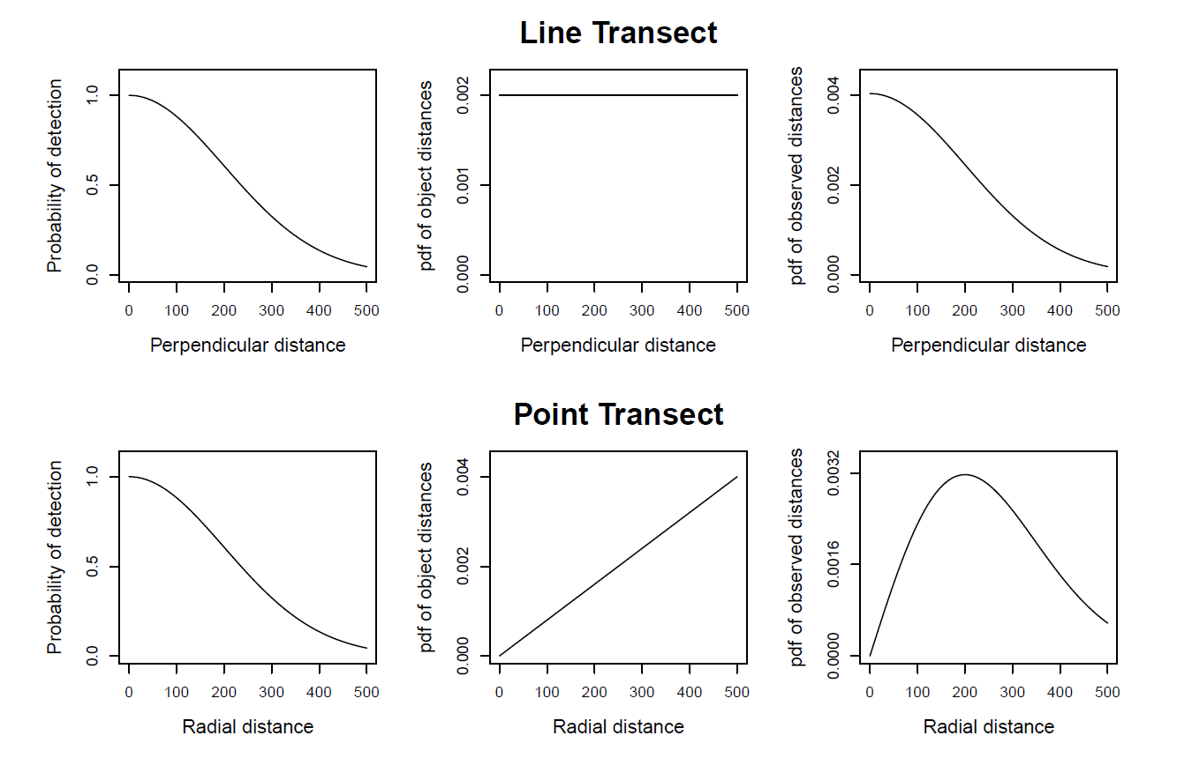
Assumptions, line vs. point
Animals are randomly distributed
Detection probability drops with distance
X
Miller et al. 2019

Slide 37
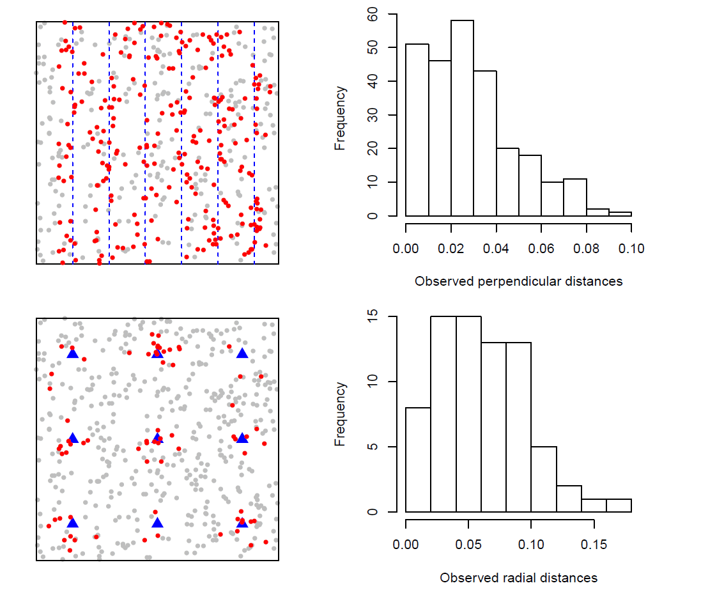
Assumptions, line vs. point
Miller et al. 2019

Slide 38
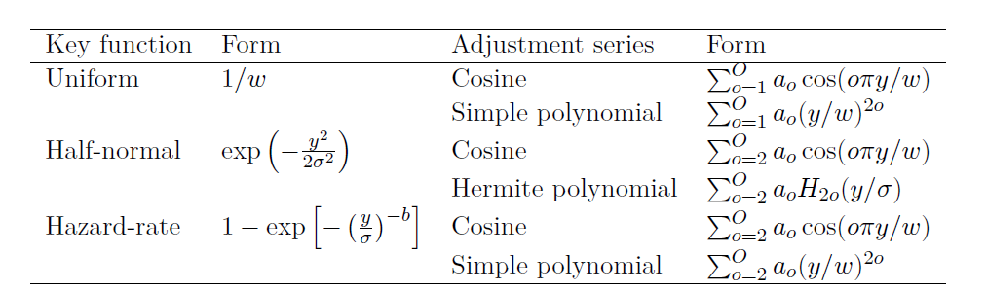
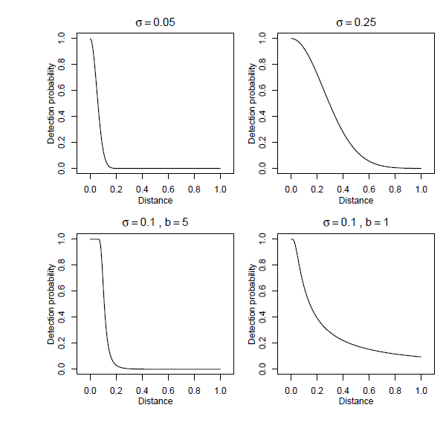
Possible detection functions
Estimate parameters of detection function with likelihood, Choose detection function with AIC, etc.

Slide 39
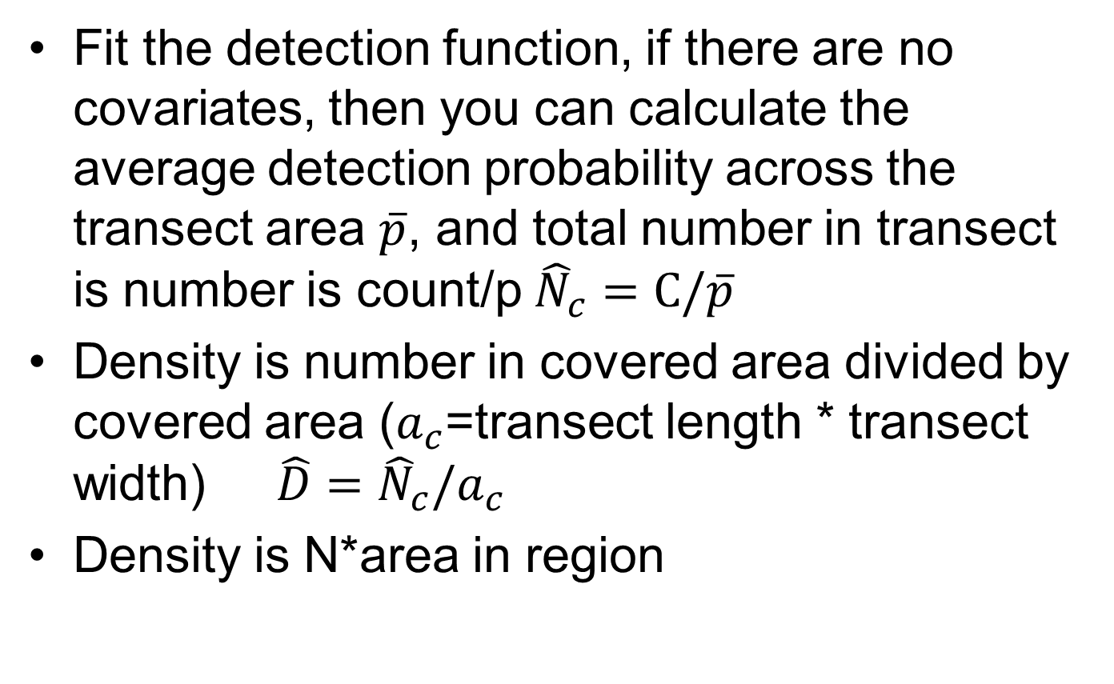
Calculations
Fit the detection function, if there are no covariates, then you can calculate the average detection probability across the transect area $\overline{p}$, and total number in transect is number is count/p ${\hat{N}}_{c}=C/\overline{p}$
Density is number in covered area divided by covered area ($a_{c}$=transect length * transect width) $\hat{D}={\hat{N}}_{c}/a_{c}$
Density is N*area in region

Slide 40
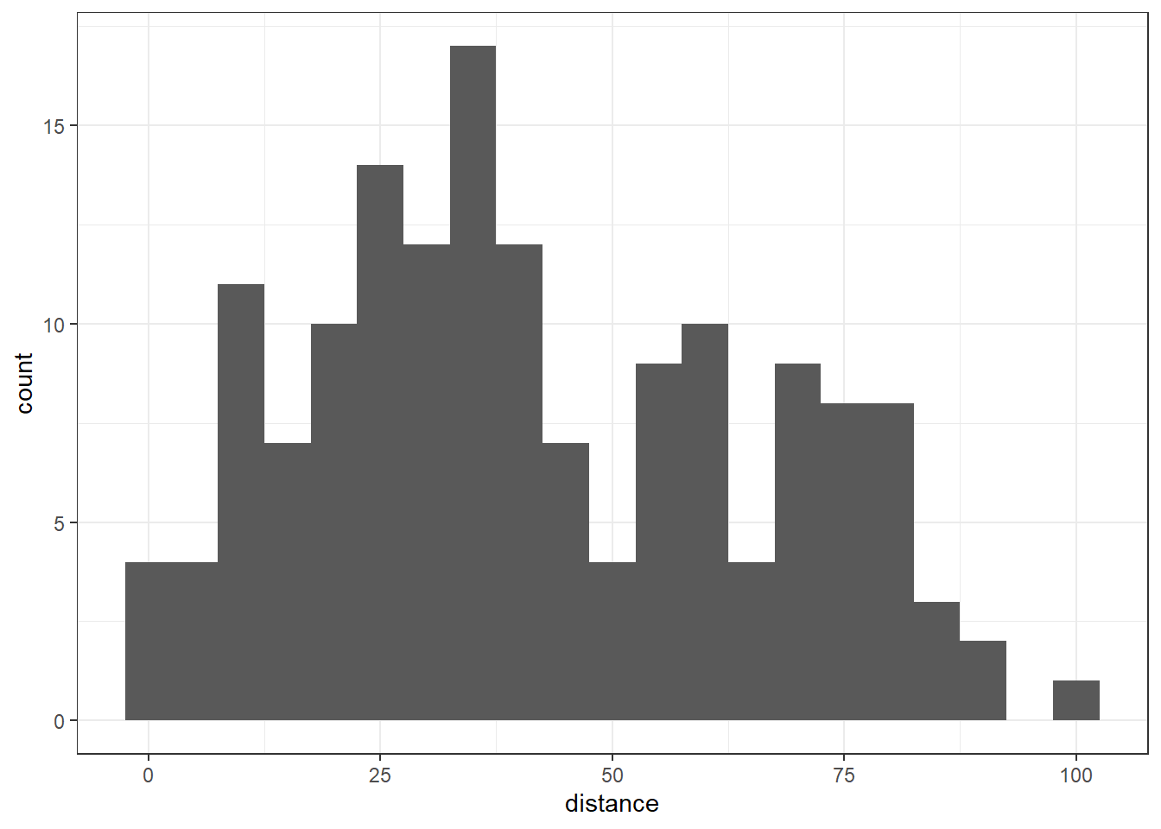
Wren line transect from Distance library

Slide 41
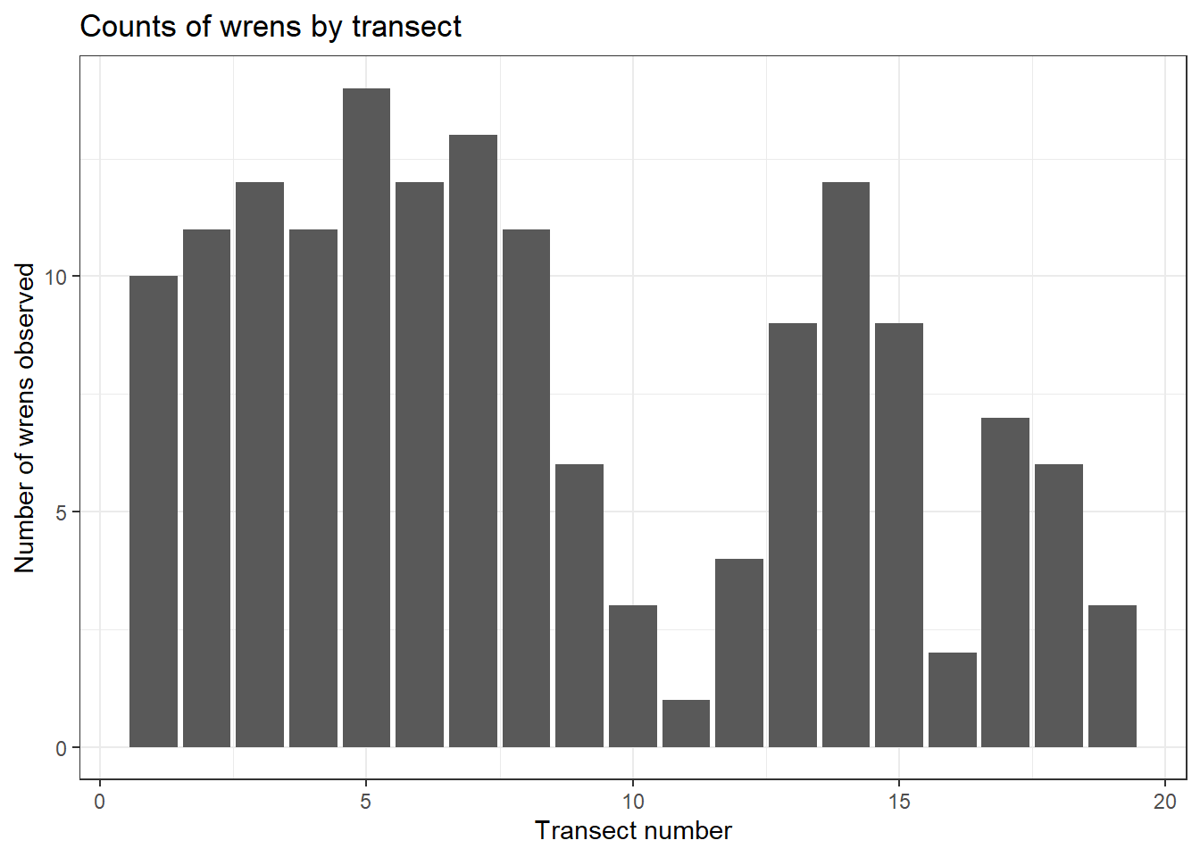
Wren counts
19 transects,
each 0.416 wide,
Max distance is 100,
so area sampled is
100*2*19*0.416
156 wrens observed

Slide 42
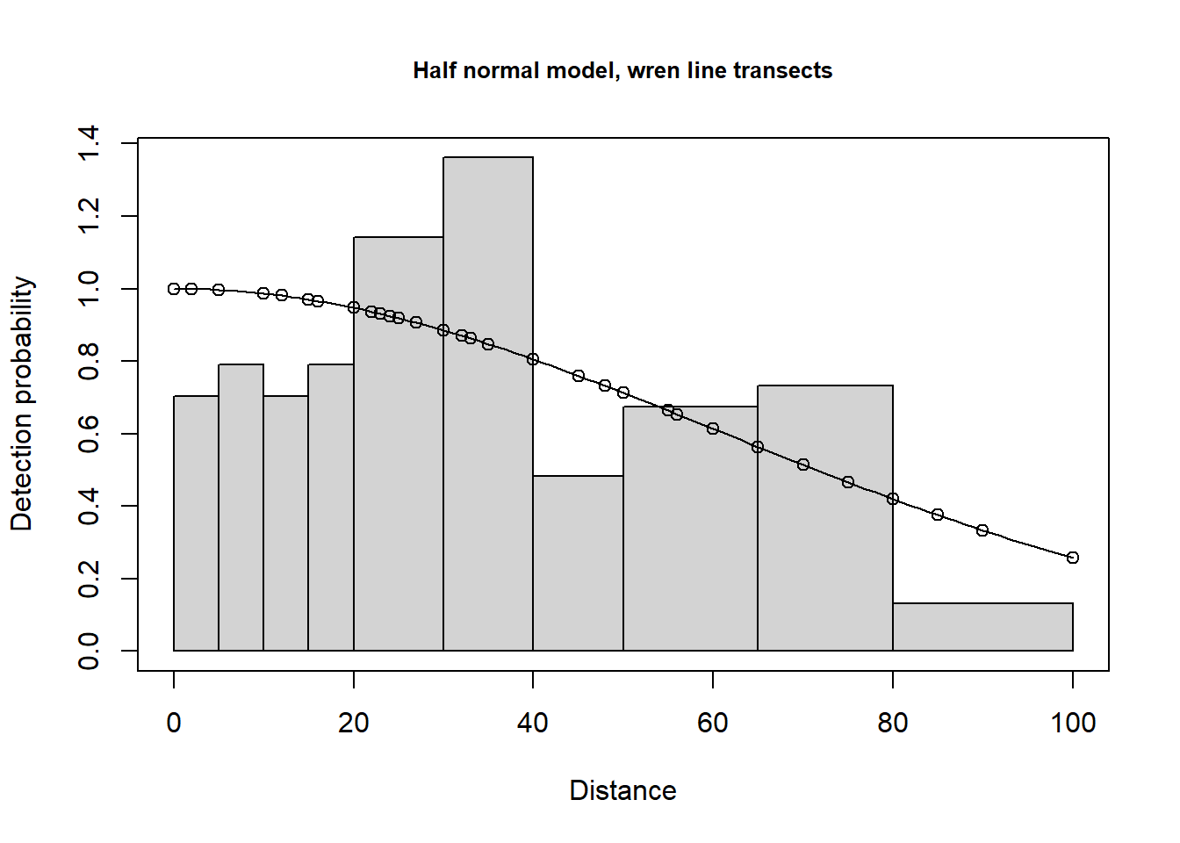
Half normal function

Slide 43
Summary values
 | Estimate | SE
Detection Scale | 4.11 | 0.13
Average p | 0.68 | 0.057
N in covered region | 227.72 | 0.094
Region | Area | CoveredArea | Effort | n | k | ER | se.ER
Montrave | 33.2 | 193.2 | 9.66 | 156 | 19 | 16.15 | 1.23
 | Estimate | se
Density: | 1.18 | 0.13
N in covered region is the number observed (156) divided by average p
Effort is sum of transect lengths in km
Covered area is Effort time max distance*2 in hectares
ER is encounter rate per transect
Density is N in covered area/covered area
Abundance is density times region area

Slide 44
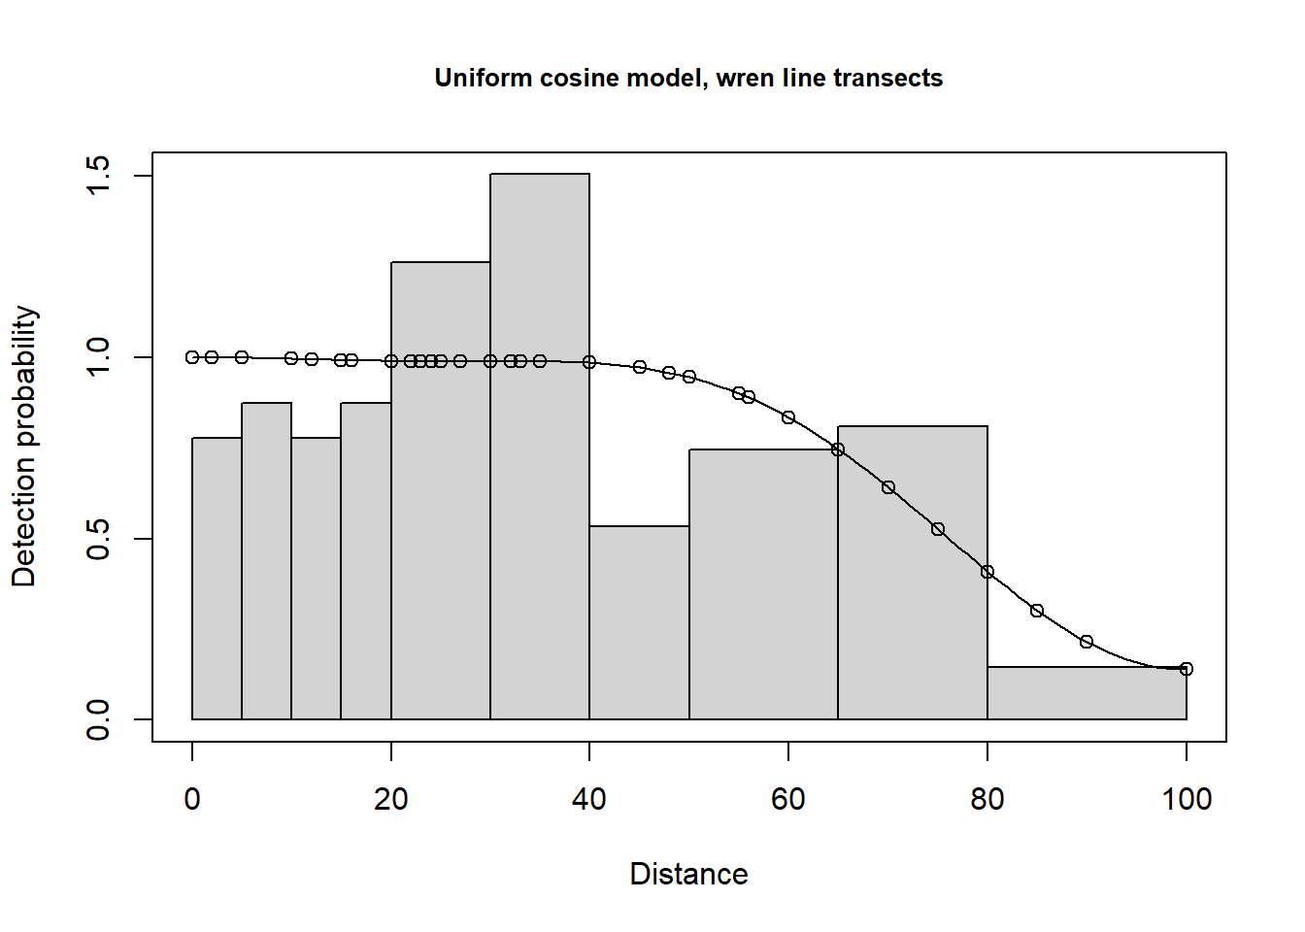
Compare distance functions with AIC
df AIC
wren.hn 1 1418.188
wren.hr.poly 2 1412.133
wren.unif.cos 3 1416.431

Slide 45
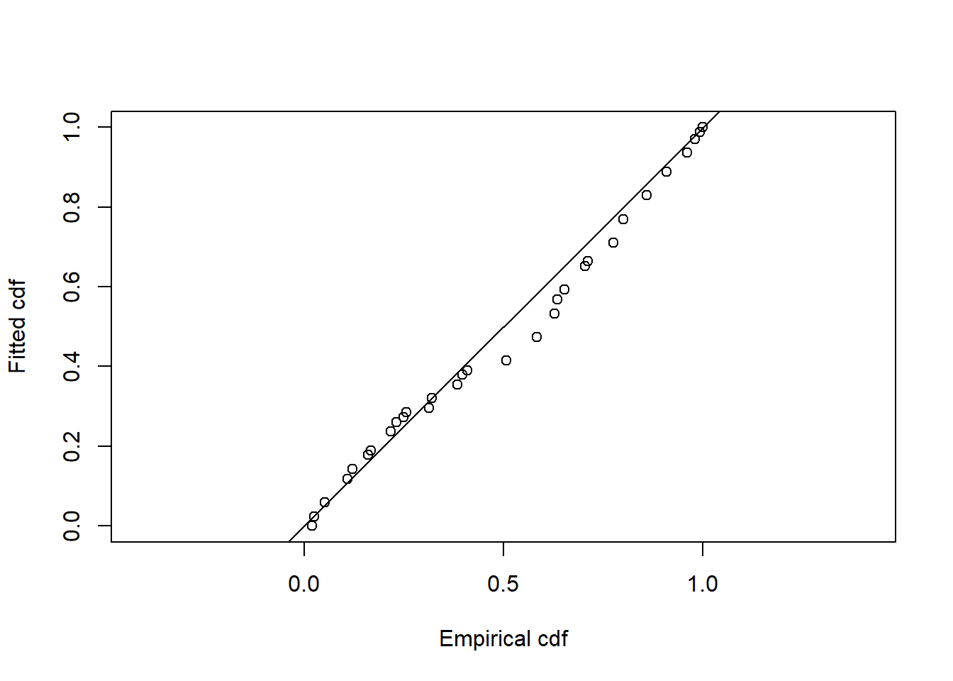
Fit of best model

Slide 46
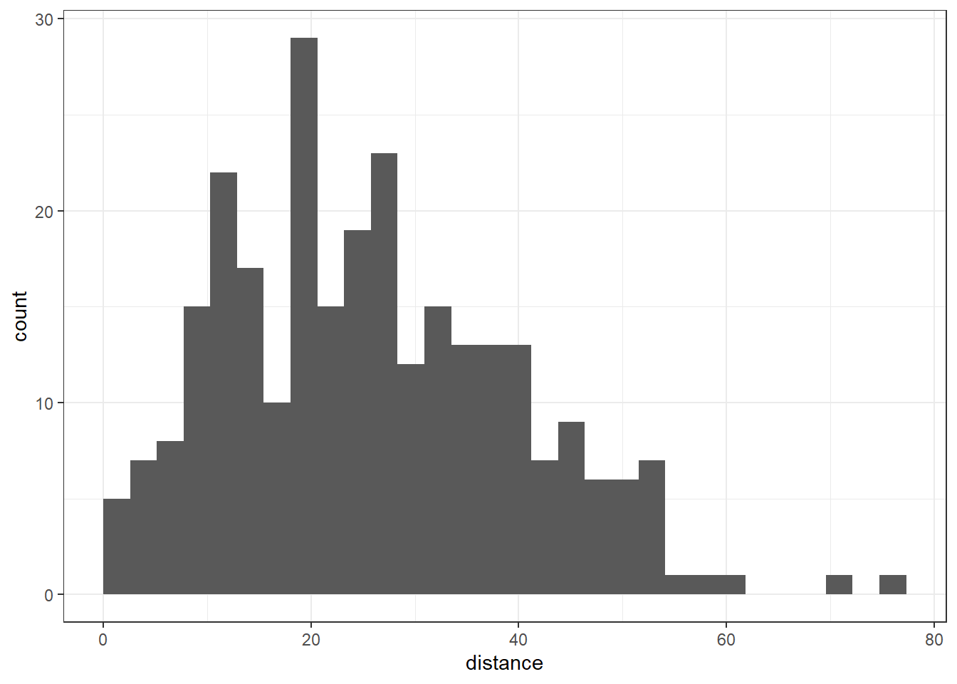
Savannah Sparrow point transect example

Slide 47
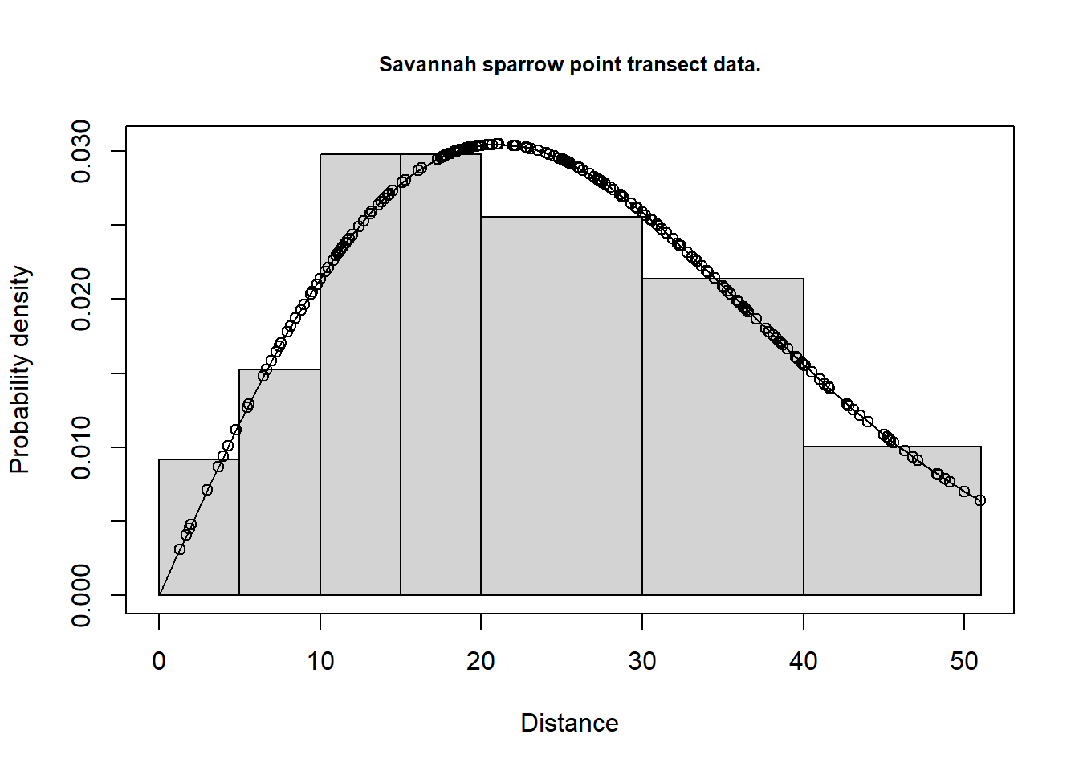
Sparrow model

Slide 48
Reading
Salvanes et al. Marine Ecological Field Methods, Chapter 2 on survey types
Miller et al. on Distance Sampling

