Slide 1

Getting started with R, RStudio and GitHub
Elizabeth A Babcock

Slide 2
Getting started
Install everything
Install R
Install Rstudio
Install Git
In RStudio, install the following libraries: tidyverse, ggplot2
Make sure you can
Open and run Rstudio
Clone the class GitHub repository

Slide 3
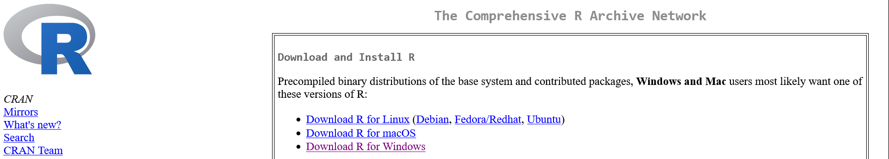
Installing R
https://cran.r-project.org/
Choose the correct operating system, then base/install R for the first time.
Save the file for your operating system, then run it and follow the instructions to install

Slide 4
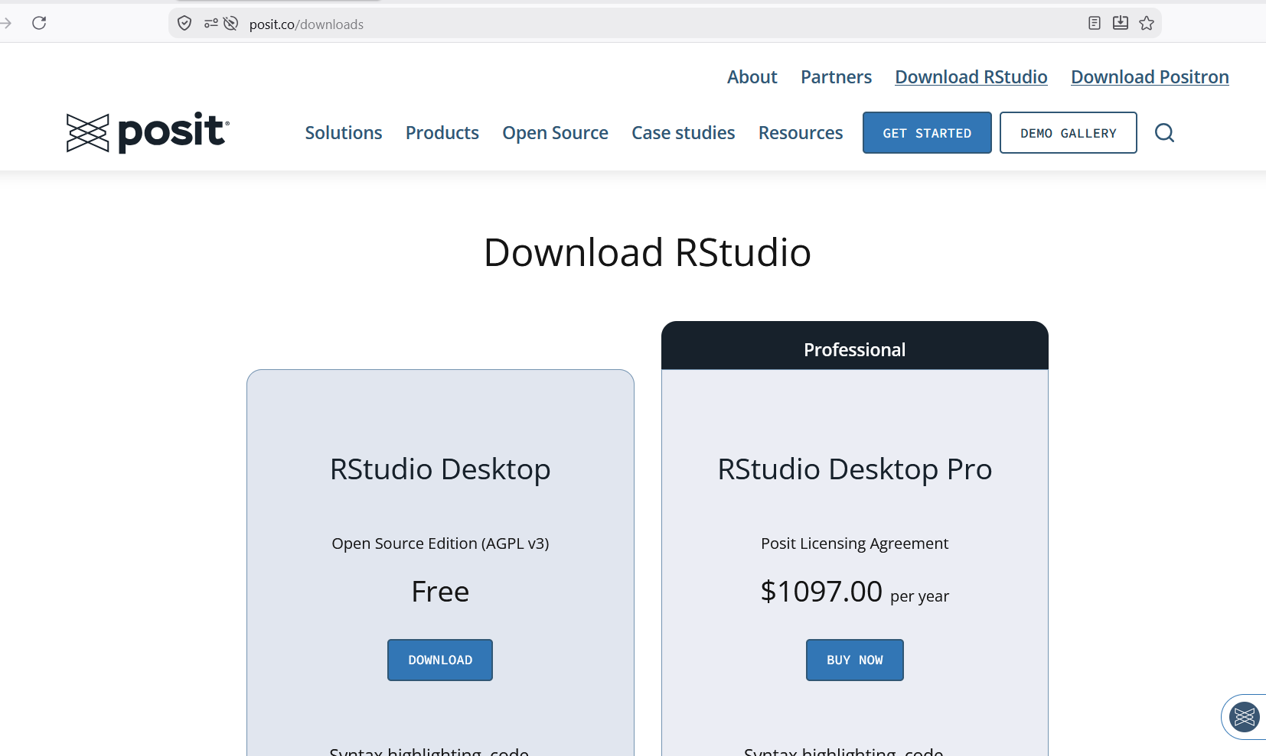
Installing RStudio
https://posit.co/downloads
Select RStudio desktop free download and download the file for your operating system
Click on the file to run and follow all the instructions

Slide 5
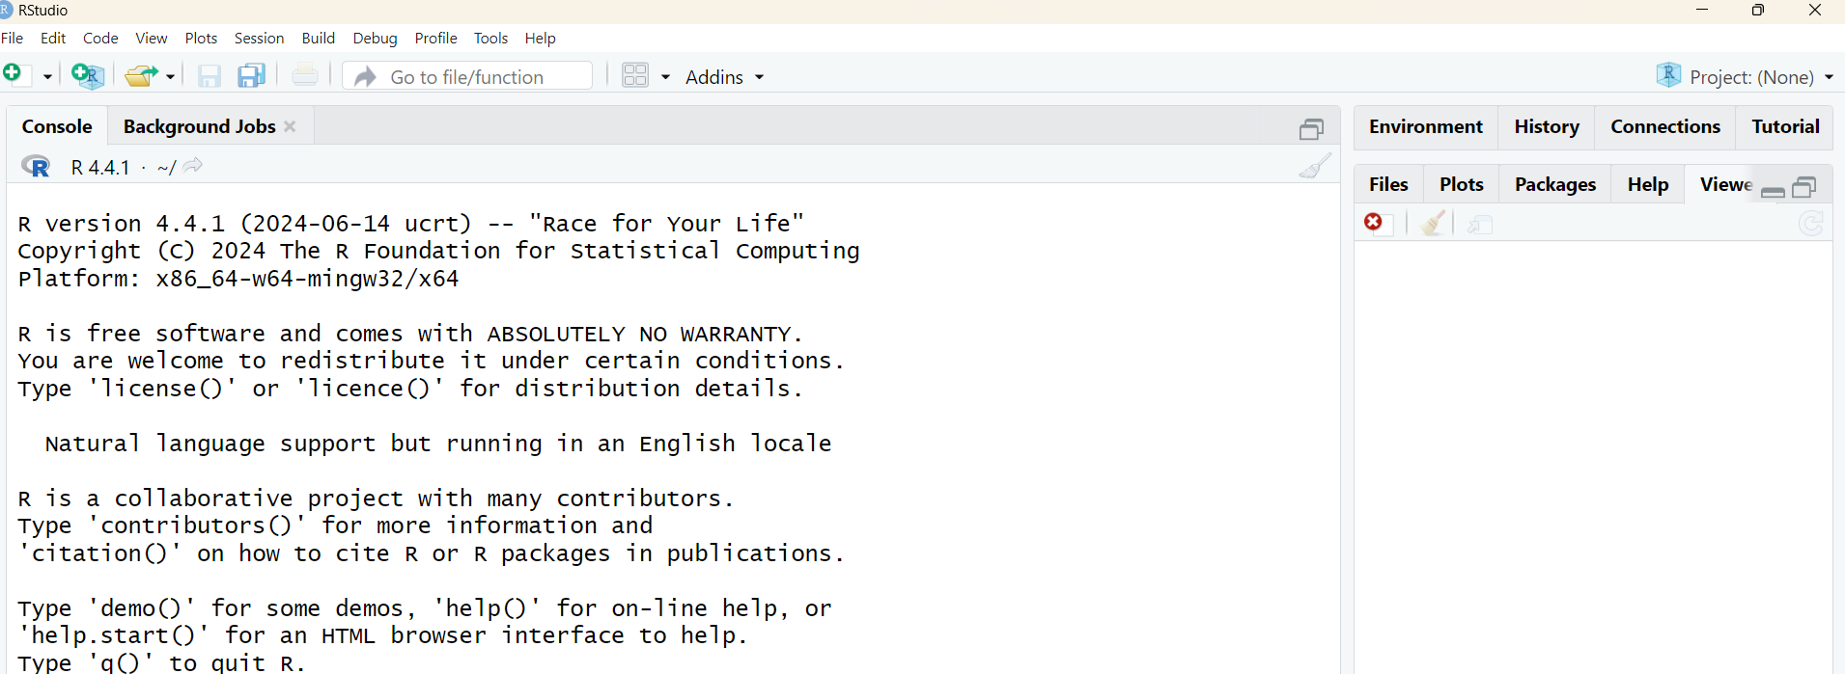
Open RStudio
You should have an RStudio shortcut on your desktop or start menu or somewhere on your computer
Open RStudio, you should see something like this:

Slide 6
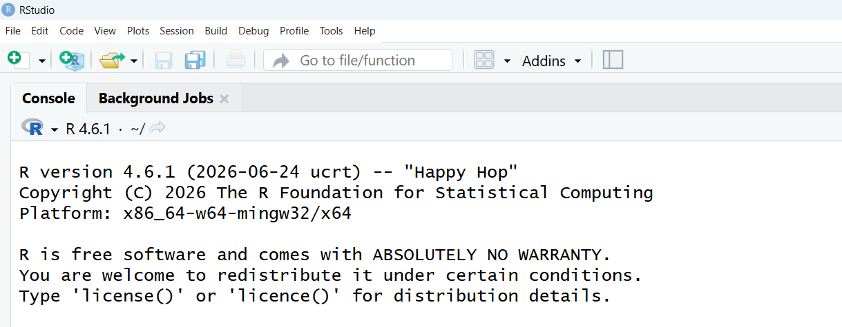
Updating version
If the R version isn’t current (4.6.1 as of July 28, 2026)
You may need to select the new version in the pulldown menu
Tools >> Global options >> R Session: >> R version.
Set to 4.6.1 (or later) and restart R. You should now see the correct version

Slide 7
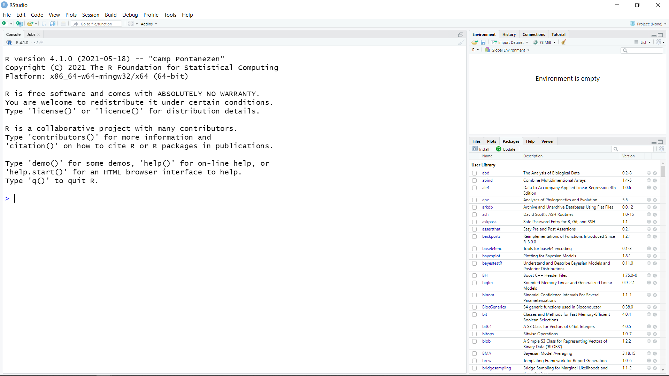
Installing libraries
In the lower right corner of the RStudio user interface, select: packages > install > and then type in the name of the libraries to install (ggplot2, tidyverse)
Answer any questions that come up

Slide 8
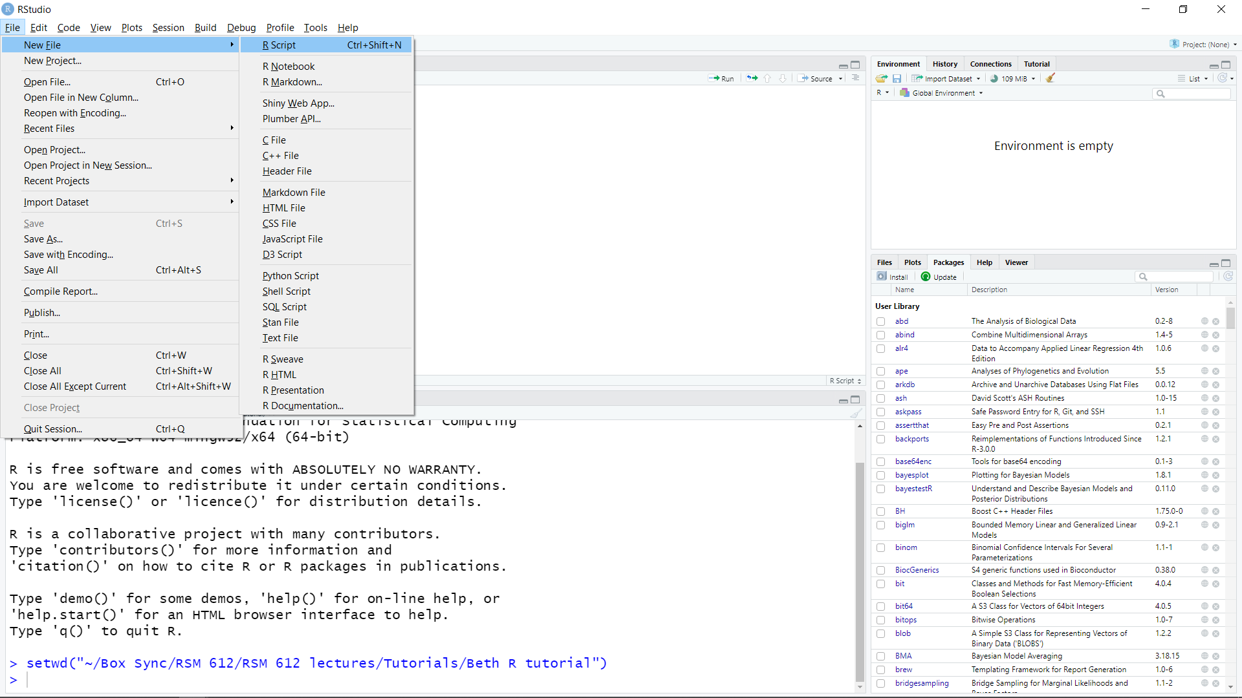
Make a new R script
You will save the code that you run in an R script (.r file) so that you can edit and re-use it
In RStudio, select New File>R Script and the new file will appear in the top right panel.

Slide 9
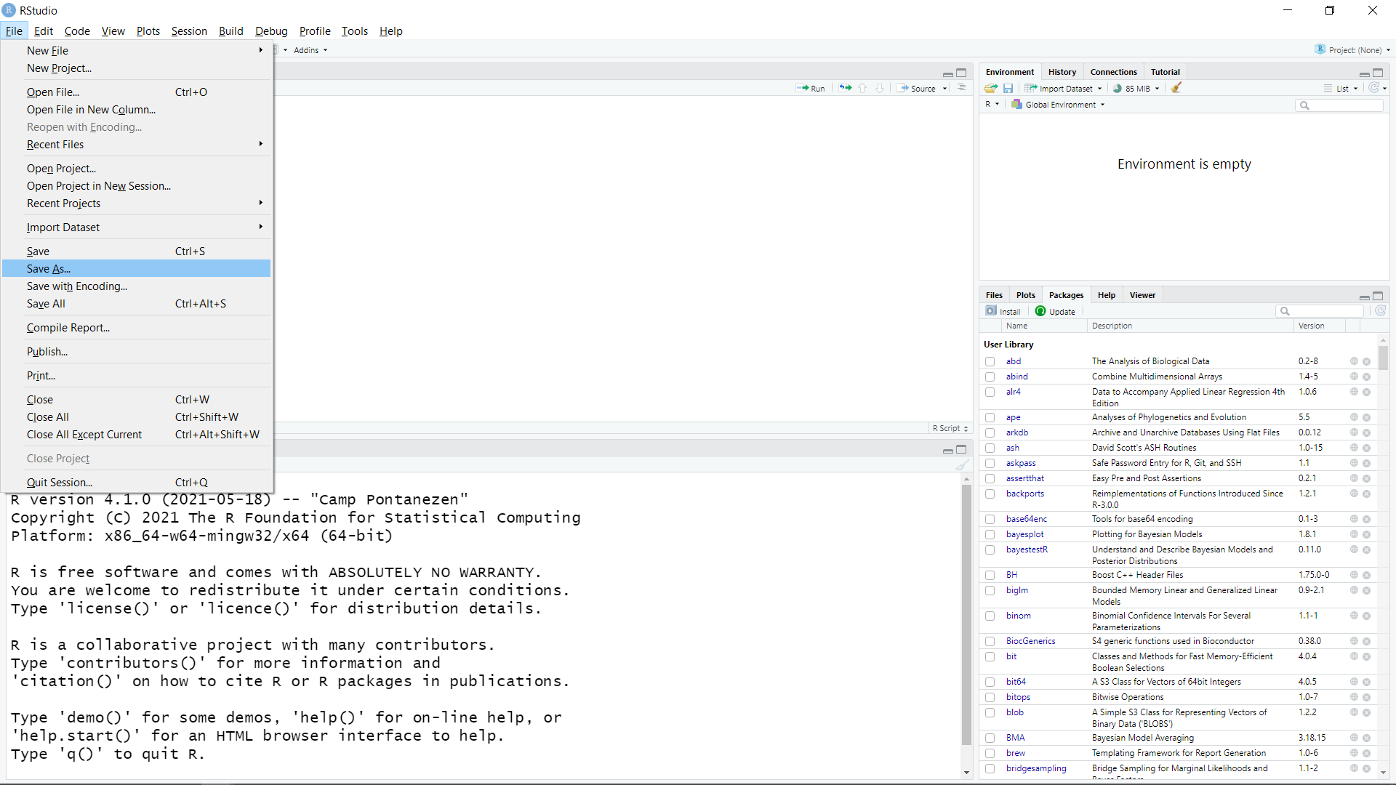
Saving the R script
Select File>Save as, and save the file into the folder where you are keeping your files for this class
Be sure to save regularly so you don’t lose your work

Slide 10
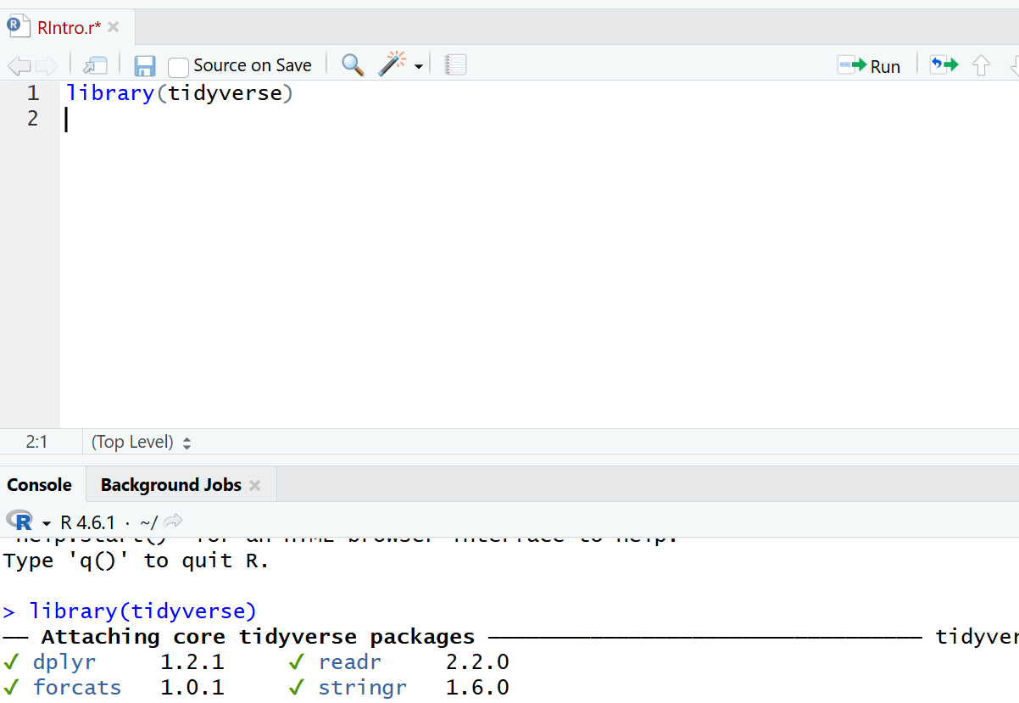
Using libraries
In the R Script, type
library(tidyverse)
And then click the green arrow that says run. In the console on the lower left you will see that the code ran and loaded the library
Ctrl-Enter also runs the code

Slide 11
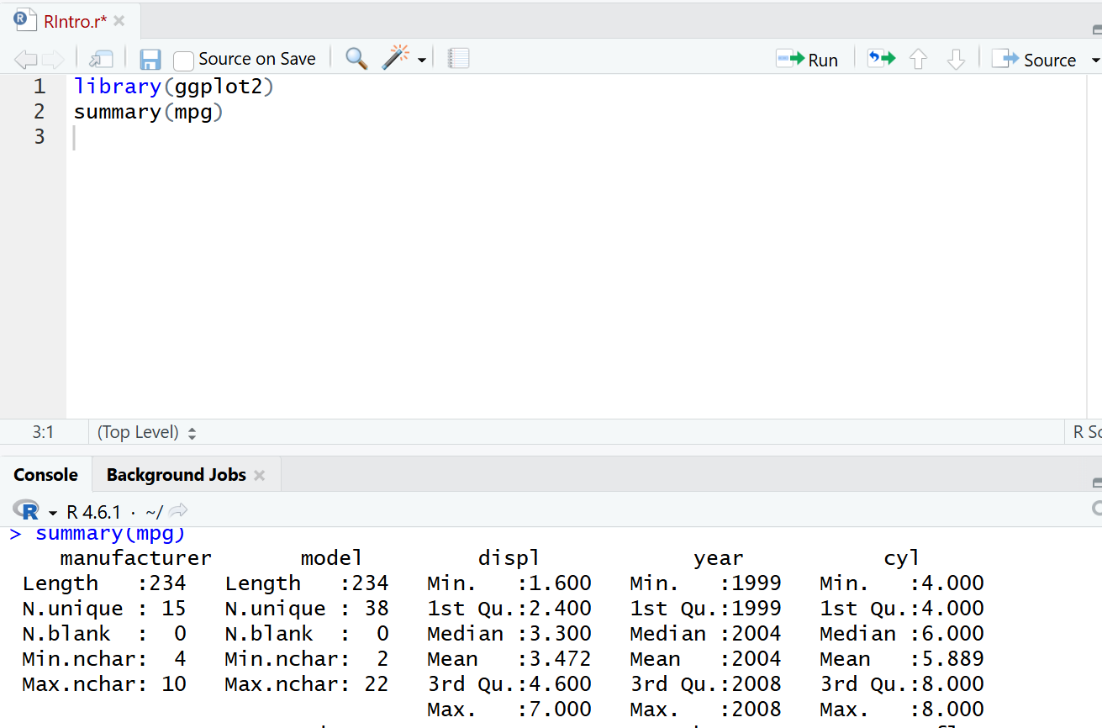
Using the library
Try typing this, and hitting run
library(ggplot2)
summary(mpg)
You should see in the console a summary of a dataset about car fuel efficiency, that loaded with ggplot2

Slide 12
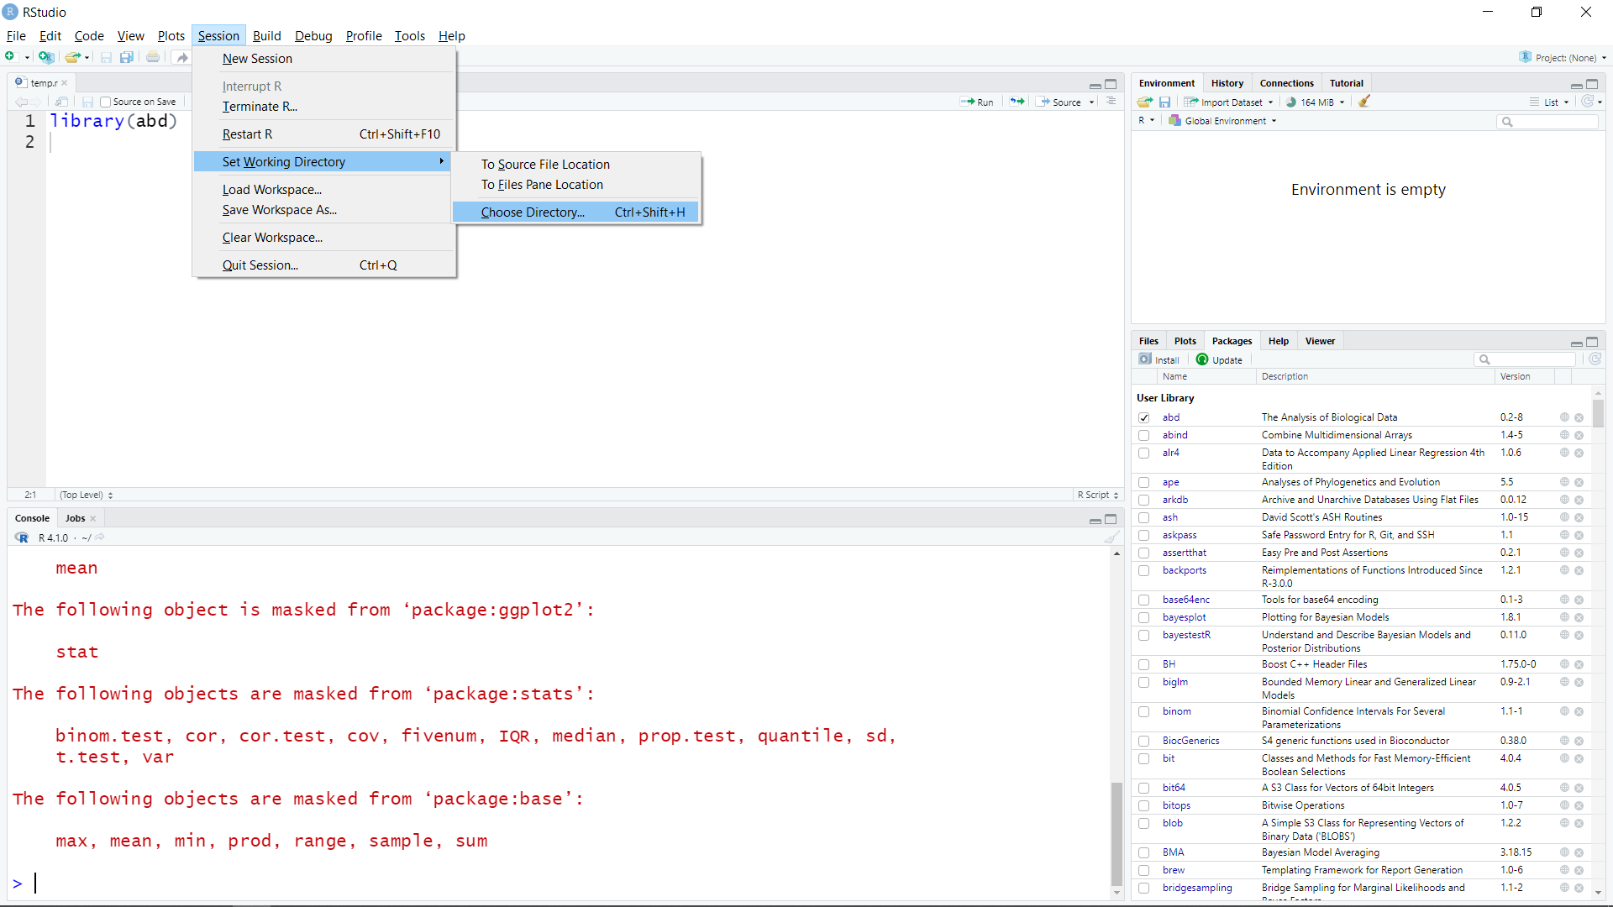
Changing the working directory
In RStudio select: Session>Set working directory> choose directory
And select the directory where you put the R script

Slide 13
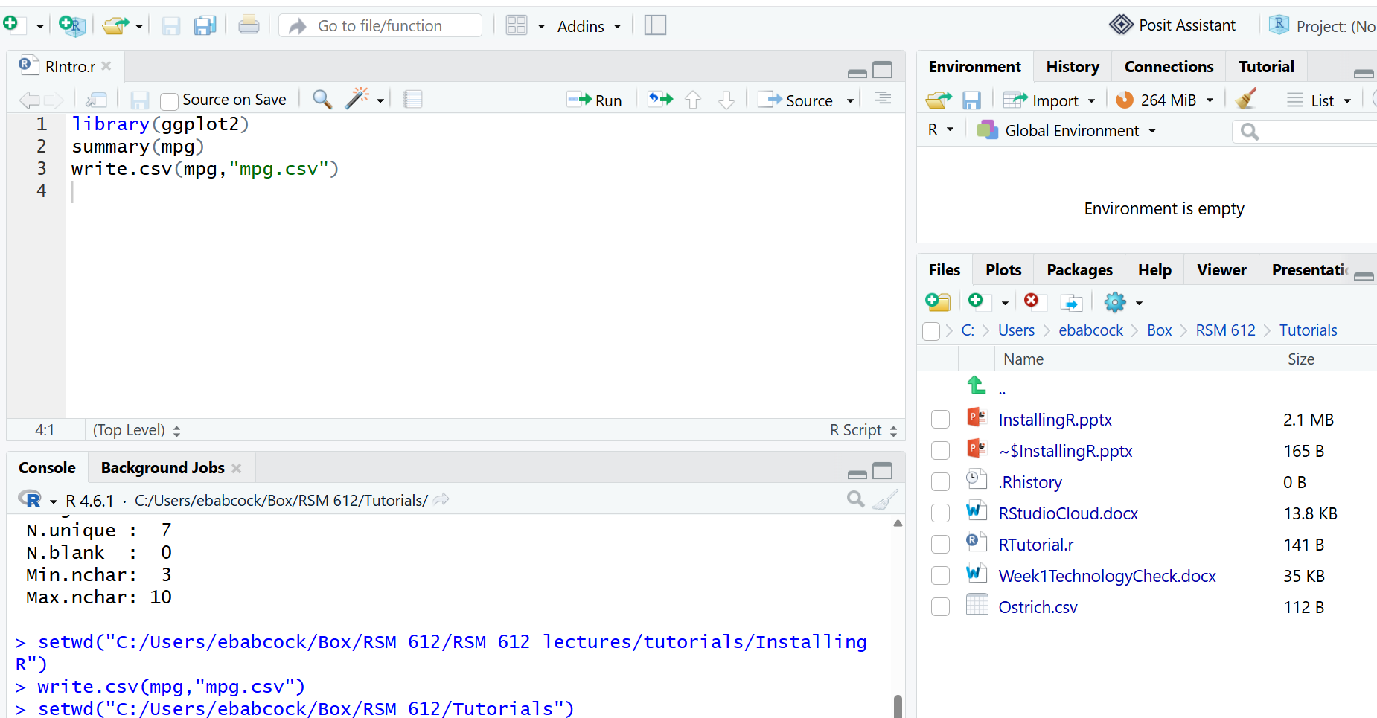
Check that you have the right directory
Run the function getwd()
Files tab also shows the files

Slide 14
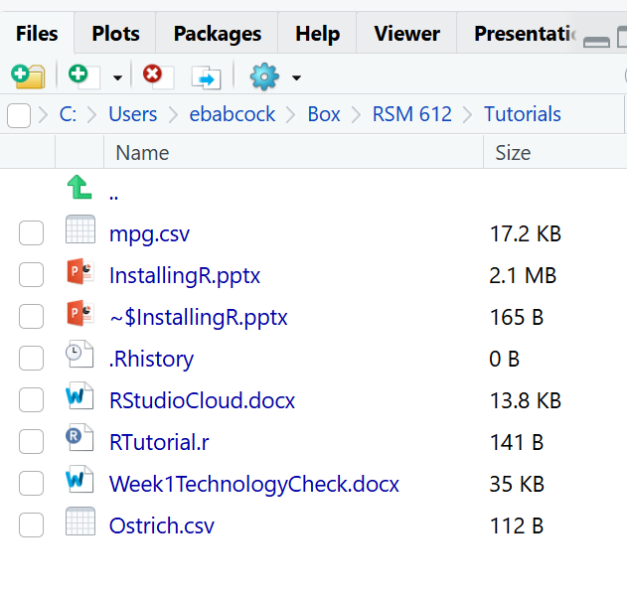
Saving data to a file
To save this data to a file, run this
write.csv(mpg,”mpg.csv”)
You should have printed a file with mpg data in your directory, called mpg.csv

Slide 15
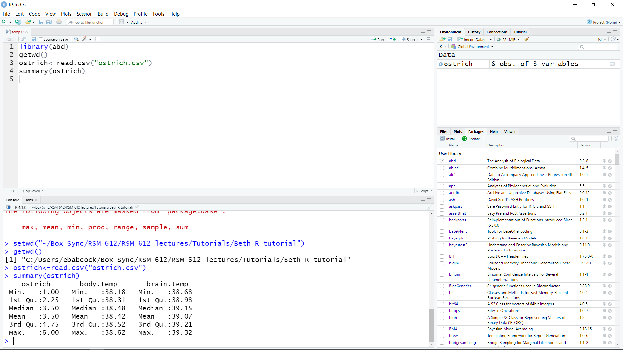
Read the data from the file into R
Run this code
mpg2<-read.csv(”mpg.csv”)
summary(mpg2)
If you see a summary of the mpg data, the data loaded correctly
mpg.csv must be in the working directory

Slide 16
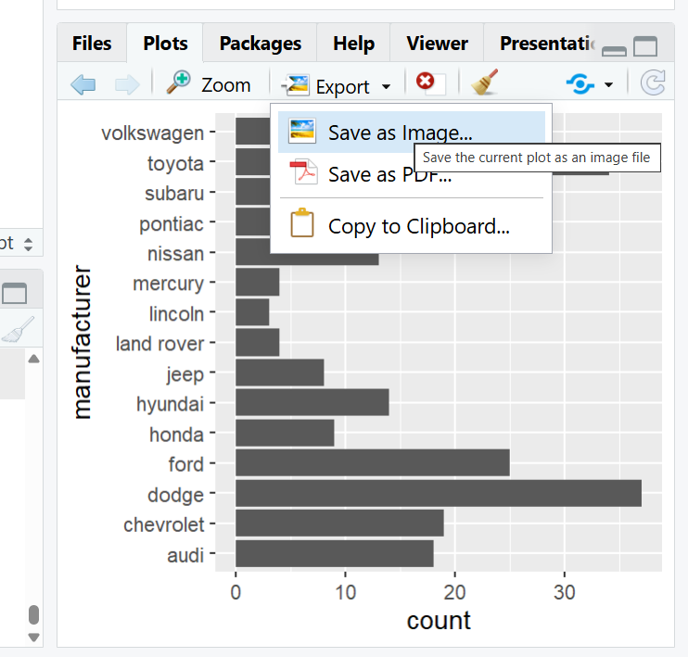
Make a plot and save it
Run this code to make a plot
ggplot(mpg,aes(y=manufacturer))+ geom_bar()
To save the plot, click “export”, “save as image”, and the image will be saved in your working directory.

Slide 17
GitHub
GitHub is the most commonly used method for sharing code https://github.com/
Does automatic version control, so you don’t have multiple versions with multiple authors
Everyone should use GitHub for their own code, especially for published papers
Can be used from R, from the website, with an interface called GitHub Desktop https://desktop.github.com/download/ or through RStudio with Git https://git-scm.com/install/windows

Slide 18
Installing and using GitHub
GitHub can be used in many ways
If you already use GitHub, keep doing whatever you are used to.
I’ll show you how to set up a Git project in RStudio.

Slide 19
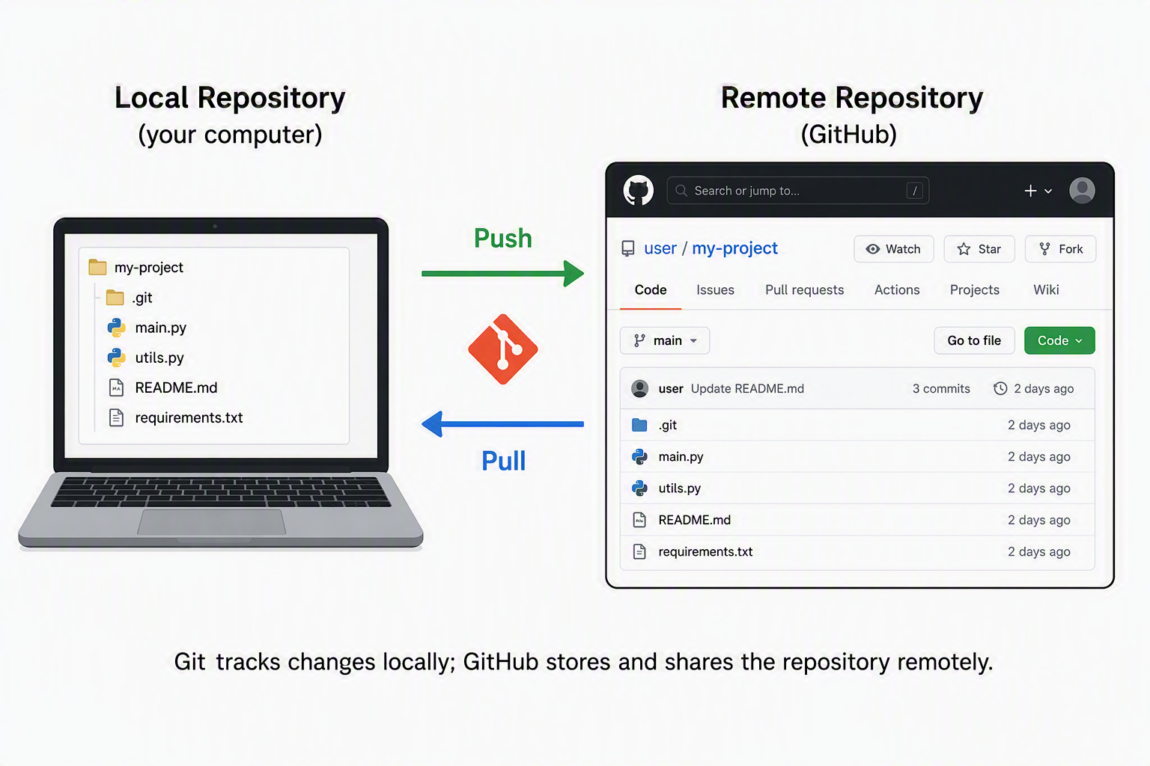
GitHub process

Slide 20
Vocabulary
Project is a group of files and folders that contain all the data, code, settings, etc. for one project you are working on (e.g. this class, a thesis chapter). It is defined in RStudio as a project.
A repository is the folder containing the project, and its changes. It is copied on both your local computer and GitHub
Repositories can be edited in GitHub or in any location they are cloned to, then synced via the GitHub repository
Clone means copy a repository to a new location
Branch means a parallel version of the repository (e.g. for testing) which may be merged with the main branch

Slide 21
GitHub syncing process
Make a change in your file on your computer in R
Commit the change on your computer
Push the committed changes to the GitHub cloud
Fetch committed changes from the GitHub cloud
Pull commits to update files on your computer

Slide 22
Organizing GitHub files
Set up a folder on your computer called “GitHub” with all your GitHub repositories in
Document/GitHub

Slide 23
To clone a repository
In RStudio, go to File → New Project → Version Control → Git
Paste the repository URL: https://github.com/ebabcock/MBE713Population-Dynamics
Choose where to save it on your computer (browse to documents/GitHub) click Create Project
Look in the directory and you will see a .proj file

Slide 24
For class on Thursday, August 20
Try to open R, save an R script, change your directory and read in data for Thursday,
If you can’t, please attend office hours or email for help.
There is an assignment on Canvas, called Week 1 Technology Check,
due Thursday during class, to make sure you have R and GitHub working and can upload your results to Canvas.

