Slide 1

MBE 713: Marine Population Dynamics Lecture 3:likelihood
Elizabeth A. Babcock

Slide 2

What is likelihood?
Most commonly used method for fitting a model to data
The likelihood of a particular parameter value is the probability of observing the data we actually collected, if that parameter value was the actual value in the population.

Slide 3
Maximum likelihood estime
maximum likelihood estimate (MLE): the value of a parameter that makes the observed data most probable.

Slide 4
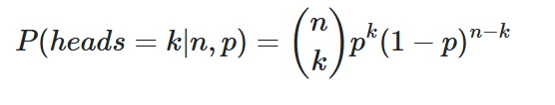
Example: estimating a proportion
We flip a coin 20 times and get 13 heads. What is the probability of heads (p)
Bernoulli distribution
Data: k=13, n=20,
Estimated parameter: p=?
In R: dbinom(x = heads, size = n, prob = 0.5)
is the probability of x successes out of n trials with probability prob

Slide 5
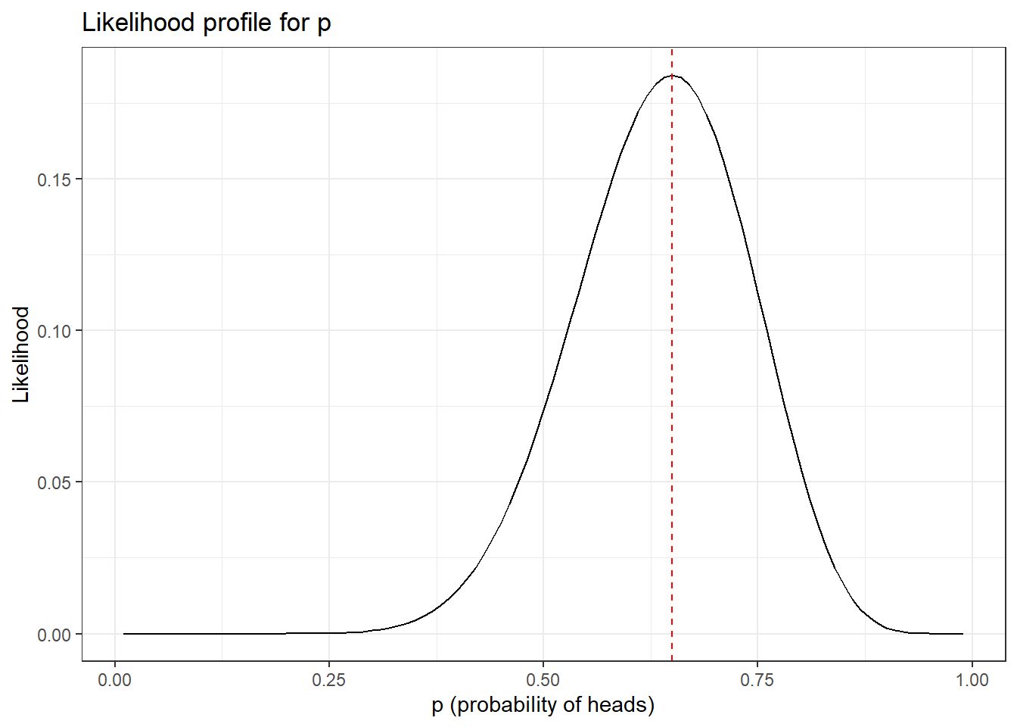
Likelihood profile
MLE value of p is 0.65 (=13/20)

Slide 6
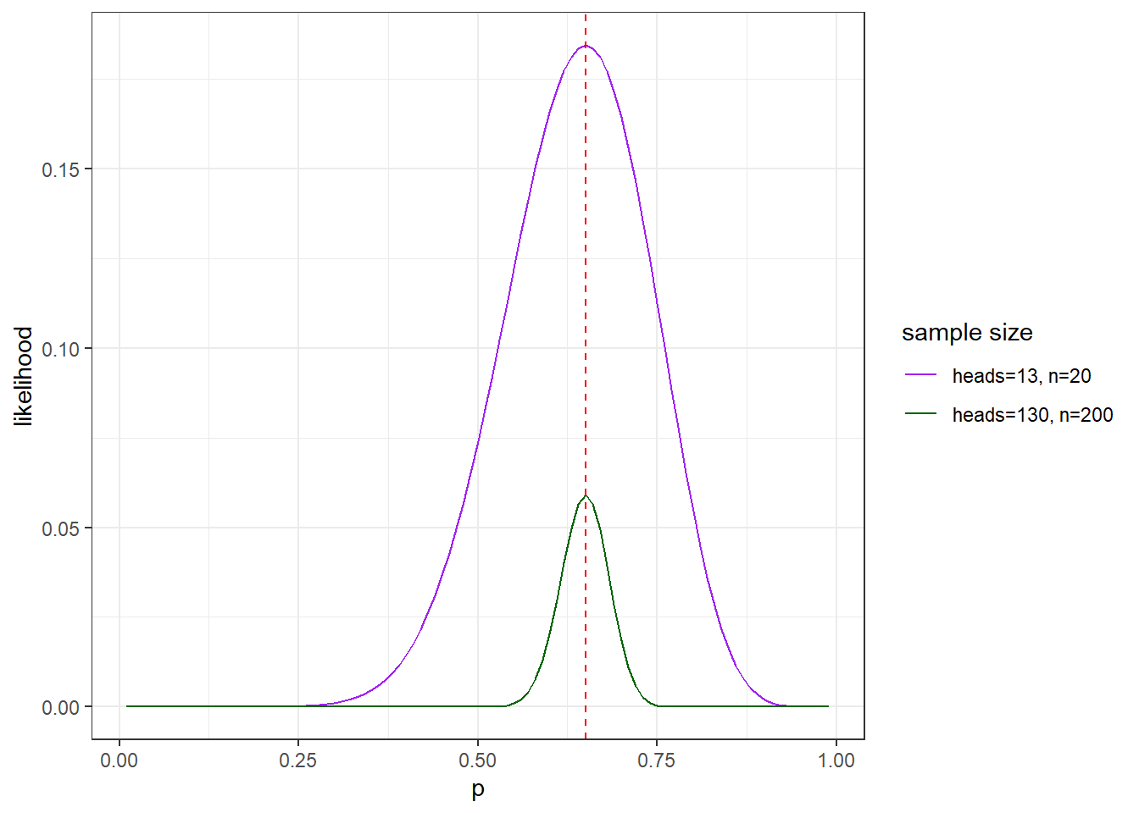
Uncertainty
Width of likelihood profile tells us how precisely the parameter is estimated

Slide 7
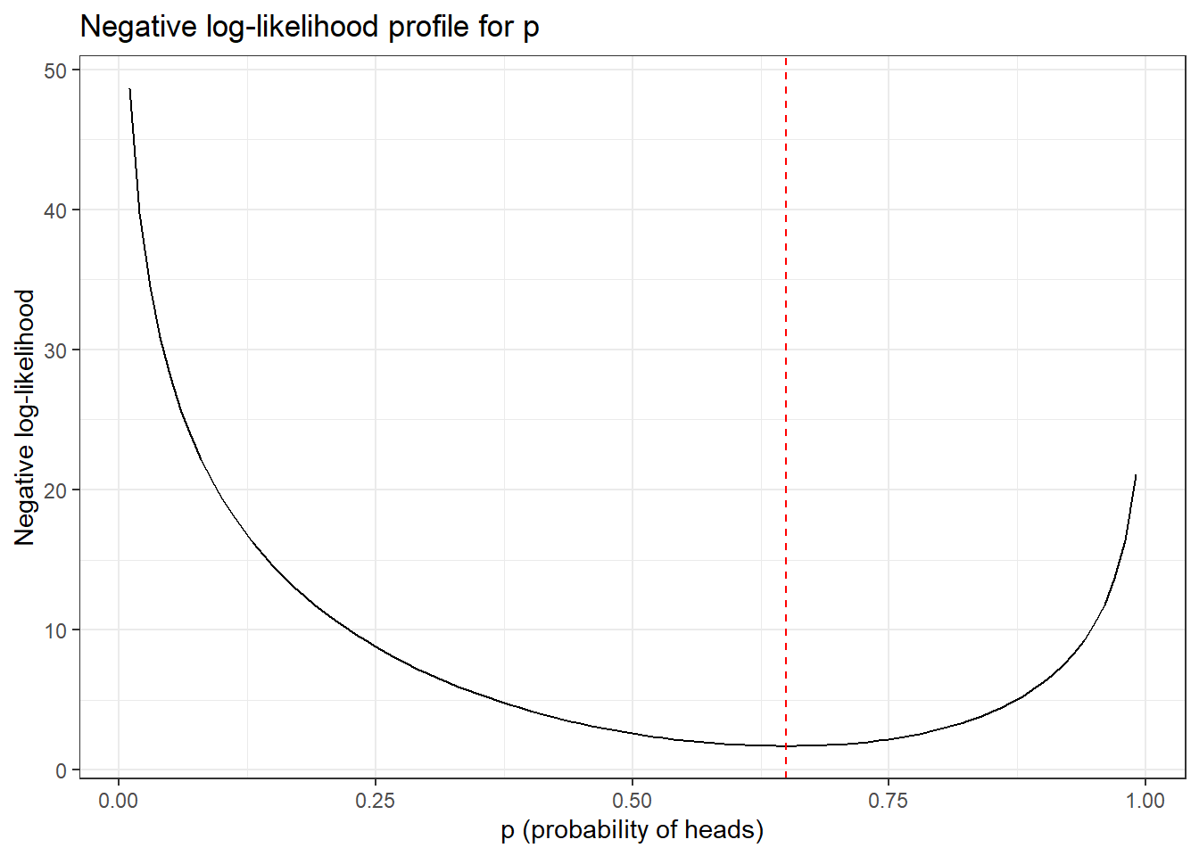
Negative log(likelihood)
Usually estimate negative log likelihood, because it is easier to minimize

Slide 8
MLE estimation algorithm
Make a function that takes the parameter(s) as an input and outputs the negative log likelihood
Use a minimizing function to find the value of the parameter that minimizes negative log likelihood

Slide 9
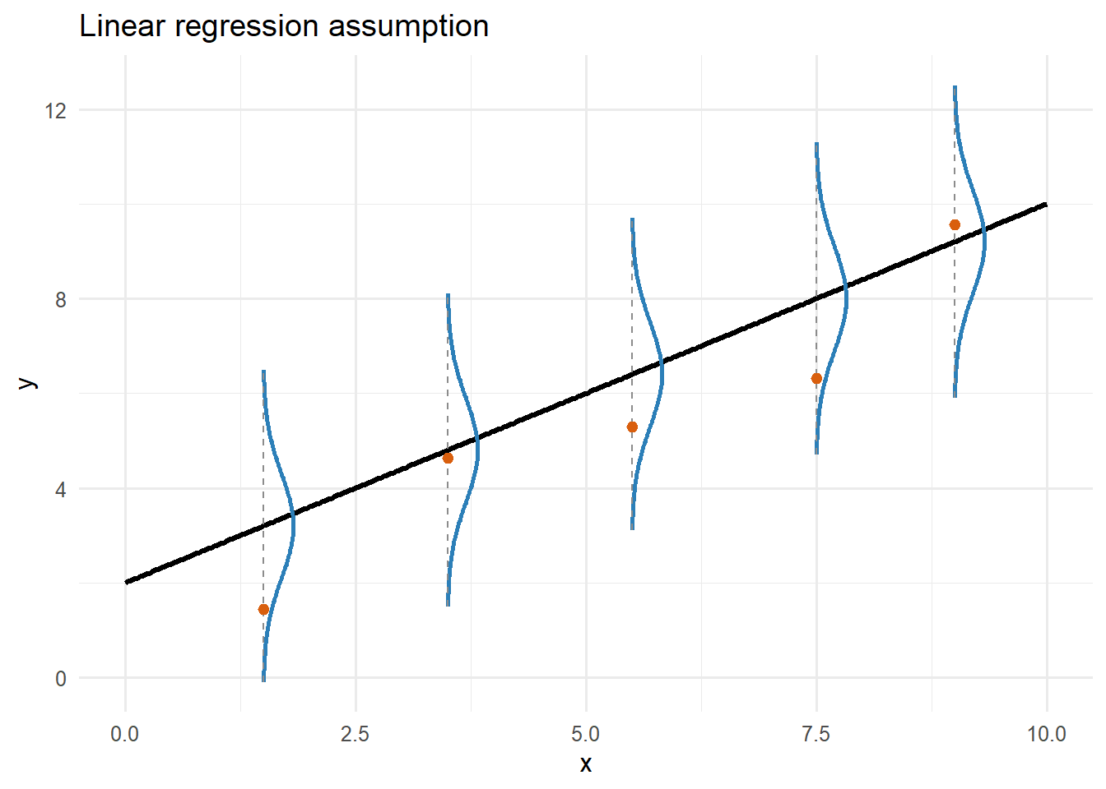
Linear regression

Slide 10
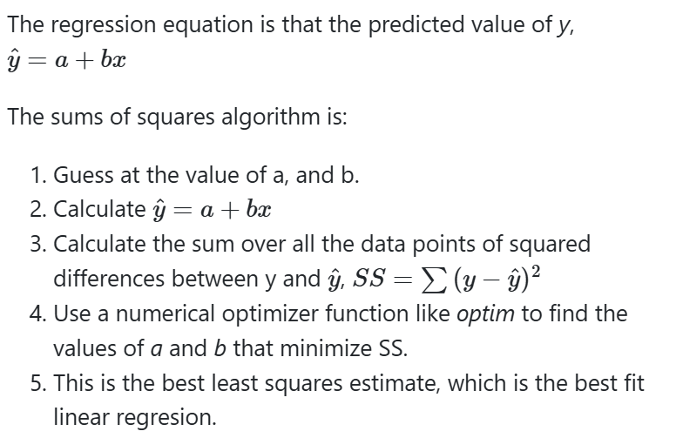
Sums of squares

Slide 11
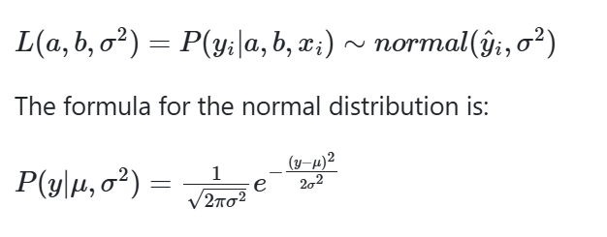
MLE uses normal distribution

Slide 12
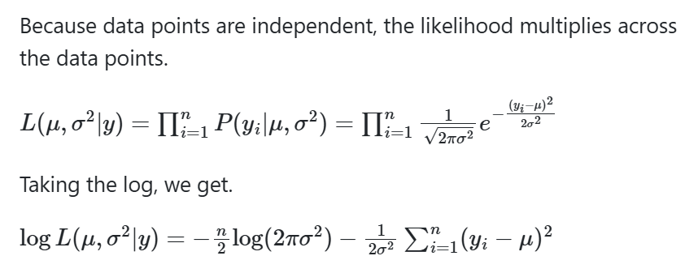
MLE

Slide 13
MLE algorithm
Make a function that calculates the negative log likelihood.
Minimize the function

