Slide 1
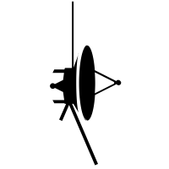


z
y
Planet direction
Satellite
x
$${\vec{F}}_{s}$$
$${\vec{δF}}_{P}$$

